Slide 1
Welfare Transition
Understanding Automation Codes Part 2
Notes:
Welcome to the Florida Department of Commerce’s (FloridaCommerce’s) Welfare Transition (WT) program’s Understanding Automation Codes, Part 2.

Slide 2
Code Cheat Sheet
Notes:
We have provided a copy of the Code Cheat sheet in Part 2 for quick reference. In Part 1, we learned what codes 499, 498, 497 and 495 are, what they mean, when they are activated and where they appear.
The goal of this presentation is to familiarize you with codes associated with WT Automation. We will share with you each code, their meaning, what must be done before they are activated in the system and where they appear once activated During this presentation, we will cover codes 494, 493, 492, 491, 489 and 488.

Slide 3
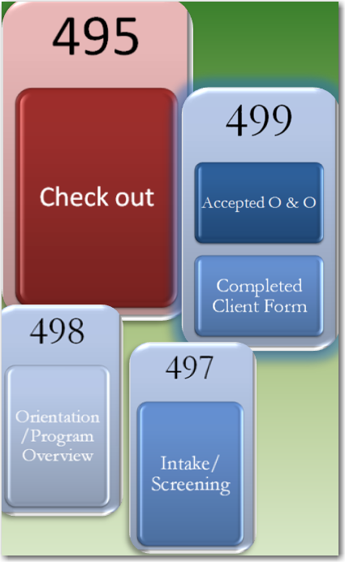
Understanding Automation Codes
Notes:
Code 494 will display if the region chooses the State’s default requirements as sufficient for Work Registration for its area and the customer completes all online requirements. Selecting the State’s default requirements will mean that the region will only require the applicant to do the following:
Accept the O & O and Complete the Client Form ( code 499)
Review the state-created or a locally-created Program Orientation/Overview (code 498)
Complete the Intake/Screening (code 497)
Check out after completing the online requirements (code 495)

Slide 4
Understanding Automation Codes (cont’d)
Notes:
If the region chooses the State’s default requirements as sufficient for Work Registration for its area and the customer completes all online requirements, code 494 will appear on the Skill Development Screen in the Skill Development section on OSST. If the region chooses this option and the customer completes the requirements, all associated codes will be closed with an outcome of Complete. We will show this in larger scale on the next slide.

Slide 5
Understanding Automation Codes (cont’d)

Slide 6
Understanding Automation Codes (cont’d)
Notes:
Code 493 will display if the region decides that the State’s online requirements are not sufficient for Work Registration in its area. The customer will still be required to complete the following
Accept the O & O and Complete the Client Form ( code 499)
Review the state-created or a locally-created Program Orientation/Overview (code 498)
Complete the Intake/Screening (code 497)
Check out after completing the online requirements (code 495)

Slide 7
Understanding Automation Codes (cont’d)
Notes:
Code 493 will display if the region decides that the State’s online requirements are not sufficient for Work Registration in its area. The customer will still be required to complete the following
Accept the O & O and Complete the Client Form ( code 499)
Review the state-created or a locally-created Program Orientation/Overview (code 498)
Complete the Intake/Screening (code 497)
Check out after completing the online requirements (code 495)
Code 494 WILL NOT display in the option. A case manager will be required to END code 493 to notify the system that the customer has satisfied additional local requirements outside of the online requirements.
Once the case manager ends code 493, all associated codes will be ended with an outcome of “complete”. These codes will appear on the Skill Development Screen in the Skill Development section on OSST case.

Slide 9
Understanding Automation Codes
Notes:
Similar to code 493, codes 489 and 488 require case manager action. Code 489 is a documentation submission code that will automatically generate if a work registrant indicates in their Needs Screening that they are “Caring for a Disabled Family Member”.
Code 488 is different from the rest of the automation codes. The rest of the codes, with exception of code 493, depend on interface and customer actions. Code 488 is entered by program staff and does not automatically occur with any interface or customer action. Staff can use code 488 to allow a customer access into the online Work Registration process. Program staff will enter code 488 in OSST on the Skill Development Screen in the Skill Development section. Once the case manager enters code 488, this gives allows the customer to access the system to start the online requirements or log back in to complete any remaining online requirements not completed within the 10-day time frame. We will provide more information about code 488 later in the presentation.

Slide 10
Understanding Automation Codes (cont’d)
Notes:
Code 489 will generate when the work registrant indicates that they are “Caring for a Disabled Family Member” by selecting the “Yes” radio button during their Needs Screening.

Slide 11
Understanding Automation Codes (cont’d)
Notes:
Code 489 – Document Submission Caring for a Disabled Family Member will appear on the Skill Development Screen in the Skill Development section in OSST. If the customer indicates they are Caring for a Disabled Family Member, they will be able to submit the document to you and advised to share the form with DCF. Code 489 will appear on the Skill Development Screen in the Skill Development section. If the customer turns in the documentation, close code 489 with completed and notification code EX will be reported to DCF to look for exemption documentation on the applicant. If the customer does not submit documentation and/or the case manager does not end code, the system will close out code 489 with Incomplete on day 11 after the customer has exhausted the 10 work registration days. We will show the example in larger scale on the next slide. Remember, if the customer has satisfied the online requirements and local requirements, where applicable, FloridaCommerce will report Work Registration completed to DCF even if the customer does not turn in the documentation to be exempted.

Slide 12
489 – Documentation Submission
Notes:
Example of code 489 that was not ended on time. Status = incomplete on day 11.

Slide 13
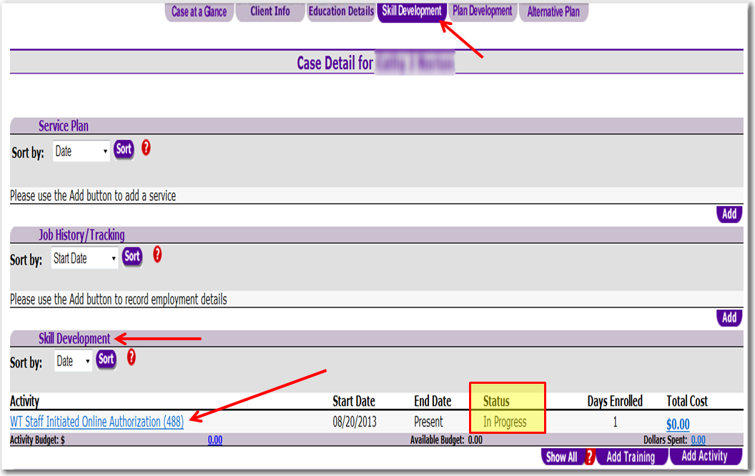
Understanding Automation Codes
Notes:
Code 488 will not generate as part of any automated service or customer action. Code 488 can only be created by case manager action. The case manager will enter code 488 on the customer’s OSST case on the Skill Development Screen in the Skill Development section of the system. We will demonstrate in upcoming slides.

Slide 14
Notes:
To start, the case manager will click on the “Add Activity” button on the Skill Development Screen under the Skill Development section.

Slide 15
Notes:
Next, you will enter your local provider name for the activity and select search.

Slide 16
Notes:
The provider listings will display based on the criteria entered. Select the desired providing by clicking on the paper icon next to the provider. Once selected, the system will display the screen illustrated in the right panel on the presentation slide. The screen will include the provider’s information as well as activity details. You will choose the activity code from this section.

Slide 17
Notes:
Under the Activity Details section, you will select the Activity Category dropdown. Then select WT Staff Initiated Online Authorization (488).

Slide 18
Notes:
Next, enter the number of “Scheduled Hours”. We entered 2 in our example. Next, enter the “Actual Start Date”. The actual start date is the date you are authorizing access. Select “Save” to save the changes.

Slide 19
Staff Authorized Access
Notes:
The activity will display on the Skill Development Screen in the Skill Development section with a status of “In Progress”.

Slide 20
488 – Staff Authorized System Access
May enter code 488
May not enter code 488
Initial 10-day automation period has expired
Customer has a TCA pending referral
There are no other active automated codes on the case
If the customer is an applicant and must complete Work Registration
Initial 10-day automation period has not expired
Customer does not have a pending TCA referral
There are other active automated codes on the case
Customer is a mandatory program participant
Customer is not required to complete Work Registration
Notes:
There are some restrictions with Code 488. Program staff will not be able to enter a code 488 on the case if the customer
Is still in the initial 10-day automation period that allows them access to complete online requirements;
If the customer is not pending for cash assistance
If there are active automation codes on the customer’s case
Staff will be able to enter a code 488 if:
The initial 10-day automation period for customer system access has expired
The customer has a pending TCA referral
There are no active automated codes on the case.

Slide 21
Understanding Automation Codes
New Case
End Applicant
Reopen
Notes:
The next two automated codes are activated once an applicant becomes mandatory for program participation or if an previously exempt customer becomes mandatory and referred to the program for participation.
If the case is opening as a mandatory participant, the system will automatically mail an Invitation Letter (code 492) to the customer. The invitation letter informs the participant to log onto OSST to complete the Initial
Assessment (491). The Initial Assessment is a federally-required program component and assesses the participant’s skills, work history and employability. The invitation letter informs the participant that they have seven
days to log into OSST, complete the initial assessment and follow through with any other requirements as instructed by the region in the invitation letter. The seven-day time standard starts the day after the invitation letter
is mailed.

Slide 22
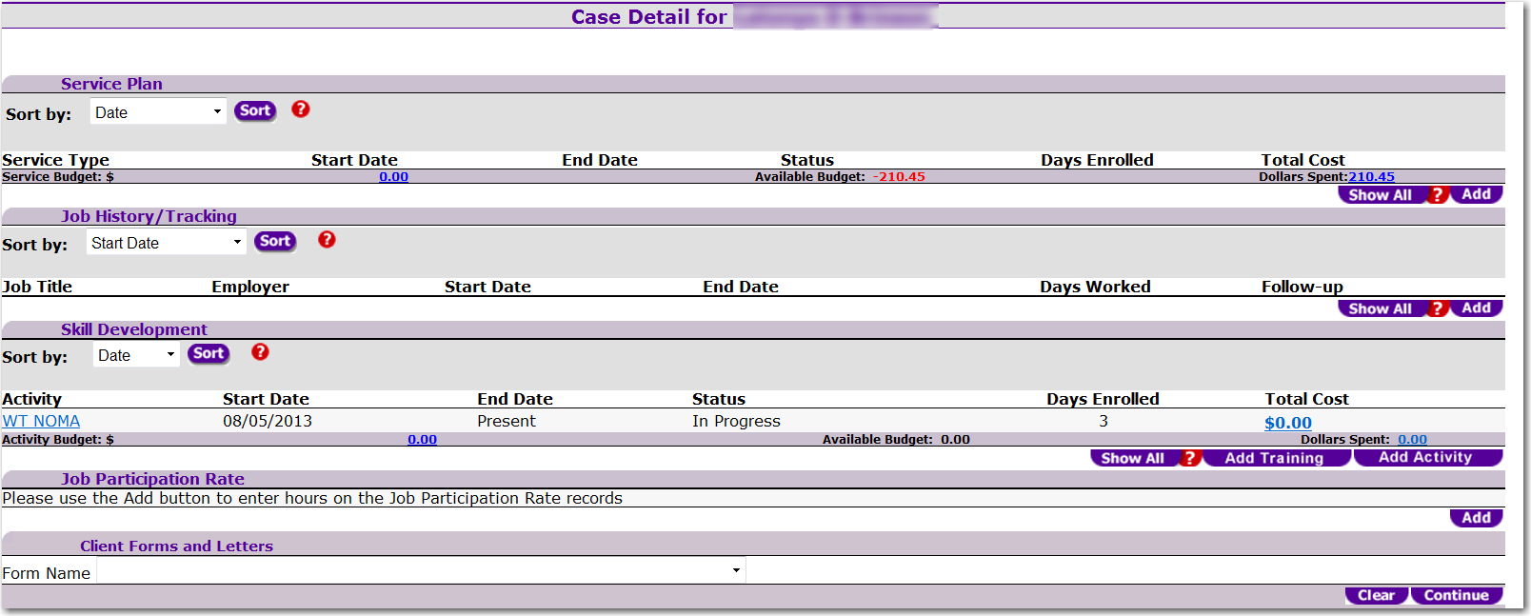
Understanding Automation Codes - 492
New Case
End Applicant
Reopen
Notes:
Code 492, which is the Notice of Mandatory Activity or NOMA will appear on the Skill Development Screen in the Skill Development Section

Slide 23
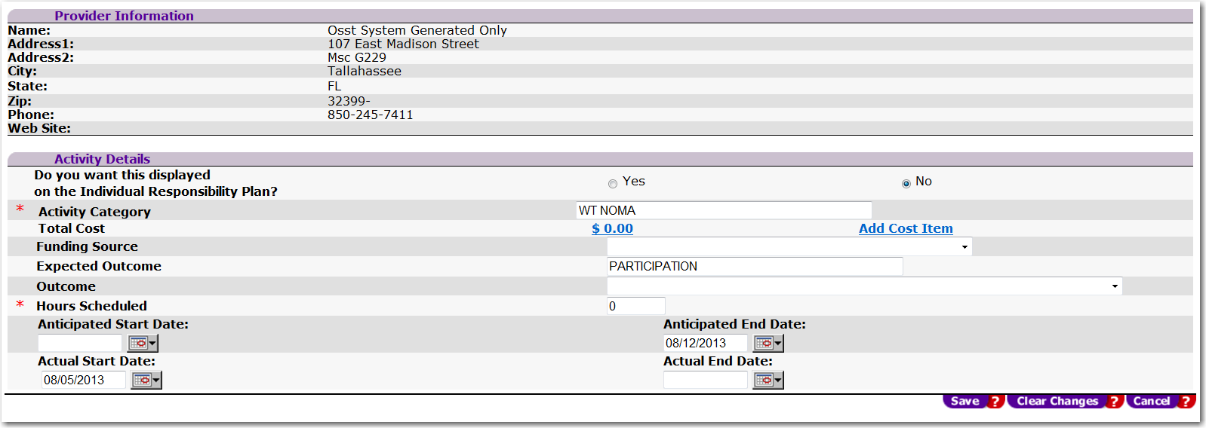
Notes:
If you click on the hyperlink WT NOMA, details about the activity appear. You will see that the system generated the activity, the actual start date is the date the NOMA was mailed. The customer has 7 days to log back into OSST and complete the requirements communicated in the NOMA. In this example, the letter was mailed on August 5, 2013 and the last date the participant can go in and complete the online requirements and supplemental requirements is August 12, 2013. On August 13, 2013 if a case manager has not ended code 492, the system will move forward with the pre-penalty process and mail the Notice of Failure to Participate.
In order to end the NOMA, the case manager will enter an “Actual End Date” and select Save. We will demonstrate this later in the presentation.

Slide 24
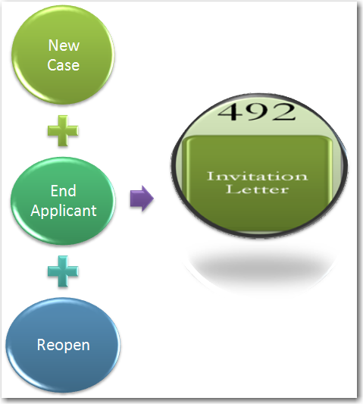
Understanding Automation Codes
Notes:
Code 491 will only be initiated once the engagement letter is mailed. Once the customer has completed the 491, the region has a few options on closing out the NOMA which is associated with code 491 (initial assessment). We will walk through the steps of closing the NOMA in upcoming slides.

Slide 25
Notes:
To close the NOMA you will click on the hyperlink NOMA from the Skill Development Screen as demonstrated earlier in the presentation. This will bring you to the details page. You will see that the system generated the activity and the actual start date. The customer has 7 days to log back into OSST and complete the online requirements communicated in the NOMA.
In order to end the NOMA, the case manager will enter an “Actual End Date” and select Save. The actual end date should be the date you are closing the activity.

Slide 26
Notes:
Select the appropriate outcome from the dropdown, enter the actual end date (the date you are closing the activity) and select save.

Slide 27
Closing NOMA
Notes:
The status will be updated with “Completed” and will display the date the customer satisfied the requirement.

Slide 28
End of Part 2
Notes:
This concludes Part 2 of our Understanding Automation Codes presentation. If you have any questions about this presentation or other program requirements, please contact the FloridaCommerce Team at WTProgram@commerce.fl.gov.

