Slide 1
Workforce Innovation and Opportunity Act (WIOA)
Youth Eligibility Overview
Division of Workforce Services
Bureau of One-Stop and Program Support

Slide 2
Objectives
Describe youth eligibility criteria and requirement(s)
In-School Youth (ISY)
Out-of-School Youth (OSY)
Discuss eligibility and the following barriers
High-Poverty Area
Individuals with Disabilities
Low-Income Status
Low-Income Exception
Requires Additional Assistance Limitation
Notes:
As a result of attending this training, participants will be able to (Refer to slide):

Slide 3
General Youth Eligibility Criteria
To be eligible to participate in the WIOA Youth Program, an individual must:
Be an ISY and OSY
Be a citizen or non-citizen authorized to work in the United States
Meet Military Selective Service registration requirements (males only)
Notes:
WIOA Section 129(a)(1) establishes the eligibility criteria that an individual must meet to participate in the WIOA Youth Program. Every individual receiving services under the WIOA Youth Program must meet either the In-School Youth or Out-of-School Youth eligibility criteria. All youth must be a United States (U.S.) citizen or have the right to work in the U.S. and males must comply with selective service registration requirements.

Slide 4
In-School Youth Eligibility
An ISY individual must:
Be between the ages of 14 to 21;
Attending school;
Low-income; and
Meet one or more of the following:
Basic skills deficient
English language learner
An offender
Homeless
Pregnant or parenting
An individual with a disability
Persons who require additional assistance to complete an educational program or to secure or hold employment
Notes:
In-school youth meet eligibility if the youth is (Refer to slide) 20 CFR 681.220
The term “Attending school” refers to secondary and postsecondary.
Requires additional assistance is an “exception”; not a rule. Staff should read their local plans for details…

Slide 5
Out-of-School Youth Eligibility
An OSY individual must:
Not be attending school;
Be between the ages of 16 to 24; and
Meet one or more of the following:
A school dropout
A youth who is within the age of compulsory school attendance, but has not attended school for the most recent complete school year
A recipient of a secondary school diploma or recognized equivalent and is a low-income individual and is
Basic skills deficient or
An English language learner
Notes:
Out-of-School youth meet eligibility if the youth is (Refer to slide) (20 CFR 681.210):
The term “school” refers to both secondary and postsecondary school.
Providers of adult education (YouthBuild, Job Corps), high school equivalency programs, or dropout re-engagement programs ARE NOT CONSIDERED to be schools. (20 CFR 681.230)
School dropout is an individual who no longer attends any school and who has not received a secondary school diploma or its State-recognized equivalent. (20 CFR 688.120; WIOA Section 3(54))
Youth programs verify dropout status based on school status timing, which is based on status at time of enrollment (i.e. time of eligibility determination). School status DOES NOT change during the program. Example: an individual who is out of school at the time of enrollment, and subsequently placed in any school, is an OSY. (20 CFR 681.240; TEGL 21-16)
Compulsory school attendance refers to all children who are either six years of age, will be six years old by February 1 of any school year, or are older than six years of age, but who have not attained the age of 16 years, must attend school regularly during the entire school term. A student who attains the age of 16 years during the school year is not subject to compulsory attendance beyond the date the student attains that age if he/she files a formal declaration of intent to terminate school enrollment with the school district. (F.S. 1003.21; WIOA Sec. 129(a)(5))
Basic skills deficient refers to:
A youth who has English reading, writing, or computing skills at or below the 8th grade level on a generally accepted standardized test; or
A youth who is unable to compute or solve problems, or read, write, or speak English, at a level necessary to function on the job, in the individual’s family, or in society.
English language learner must have:
Limited abilities in reading, writing, speaking or comprehending the English language, and:
Native language other than English; or
Lives in a family or community environment where a language other than English is the dominant language.

Slide 6
Out-of-School Youth Eligibility (cont’d)
An offender
A homeless individual, a runaway, in foster care or has aged out of the foster care system, or in an out-of-home placement
Pregnant or parenting
An individual with a disability
An individual who requires additional assistance to enter or complete an educational program or to secure or hold employment
Notes:
OSY barriers continued… (Refer to slide) 20 CFR 681.210, Administrative Policy 95
WIOA Sec. 129 (B)(iii) …A recipient of a secondary school diploma or recognized equivalent who is a low-income individual and is—
The term “Offender” refers to an individual who is subject to the juvenile or adult justice system.

Slide 7
Low-Income: Collecting Information
Income Determination:
Collection of participant information
Calculation of collected information
Lower Living Standard Income Level (LLSIL)
To meet the eligibility criteria, all ISY must be “low-income” except those that fall under the low-income exception
Notes:
Income is determined by collecting information from the family for the complete six-month period prior to the application for WIOA services. After verification of family size and the total reported six-month income is collected, this figure is then doubled (annualized) and compared to the Lower Living Standard Income Level (LLSIL)/Calculation of collected information. WIOA Section 3(36)
All ISY must be low-income to meet the ISY eligibility criteria, except those that fall under the low-income exception (Described in future slide).
The following low-income criteria must exist for OSY:
Youth who are the recipient of a secondary school diploma or its recognized equivalent
Youth who are either basic skills deficient or an English language learner, and
Youth who require additional assistance to enter or complete an educational program or to secure or hold employment.
All other OSY who meet OSY eligibility are not required to be low-income. 20 CFR 681.250; 20 CFR 681.210(c )(9)- requires additional assistance

Slide 8
Low-Income: Public Assistance Verification
Receives, or in the past six months has received, or is a member of a family that is receiving, or in the past six months has received, assistance through:
Supplemental Nutrition Assistance Program (SNAP)
Temporary Assistance for Needy Families (TANF)
Supplemental Security Income (SSI)
Other state or local income-based public assistance
Notes:
Low-income criteria for WIOA youth continued… (Refer to slide)
Administrative Policy 095; TEGL 8-15
To determine whether a youth must be low income, first consider whether the participant is OSY or ISY. As provided in 20 CFR §s 681.210 and 681.250, if the youth is OSY, the low-income requirement applies only to the following categories of youth – (1) the youth is a recipient of a secondary school diploma or its recognized equivalent who is either basic skills deficient or an English language learner; and (2) the youth is an individual who requires additional assistance to enter or complete an educational program or to secure or hold employment. All ISY must be low income unless they are served under the five percent exception.
There is one additional low-income category not included in WIOA Section 3(36). According to Section 129(a)(2) of WIOA, for both ISY and OSY, a youth qualifies as low income if the youth lives in a high-poverty area.

Slide 9
Low-Income: Poverty Status
Is in a family with total family income that does not exceed the higher of:
100 percent of the federal poverty level or
70 percent of the lower living standard income level
Resides in a high-poverty area
Homeless individual
Migratory children who qualify as homeless
Notes:
Low-income continued….(Refer to slide)
Examples: (Provide if necessary…)
A homeless individual is someone who:
Shares the housing of other persons due to loss of housing, economic hardship, or a similar reason; living in a motel, hotel, trailer park, or campground due to the lack of alternative adequate accommodations; living in an emergency or transitional shelter; abandoned in a hospital; or awaiting foster care placement.
Have a primary nighttime residence that is a public or private place not designed for or ordinarily used as a regular sleeping accommodation for human beings.
Administrative Policy-095
Speaker Note(s):
Homeless individual… An individual IS NOT considered Homeless if he/she reside in a “fixed” structure.
U.S. Department of Education, Part C — Education of Migratory Children, SEC. 1309. DEFINITIONS
(2) MIGRATORY CHILD- The term migratory child' means a child who is, or whose parent or spouse is, a migratory agricultural worker, including a migratory dairy worker, or a migratory fisher, and who, in the preceding 36 months, in order to obtain, or accompany such parent or spouse, in order to obtain, temporary or seasonal employment in agricultural or fishing work —
(A) has moved from one school district to another;
(B) in a State that is comprised of a single school district, has moved from one administrative area to another within such district; or
(C) resides in a school district of more than 15,000 square miles, and migrates a distance of 20 miles or more to a temporary residence to engage in a fishing activity.
https://www2.ed.gov/policy/elsec/leg/esea02/pg8.html

Slide 10
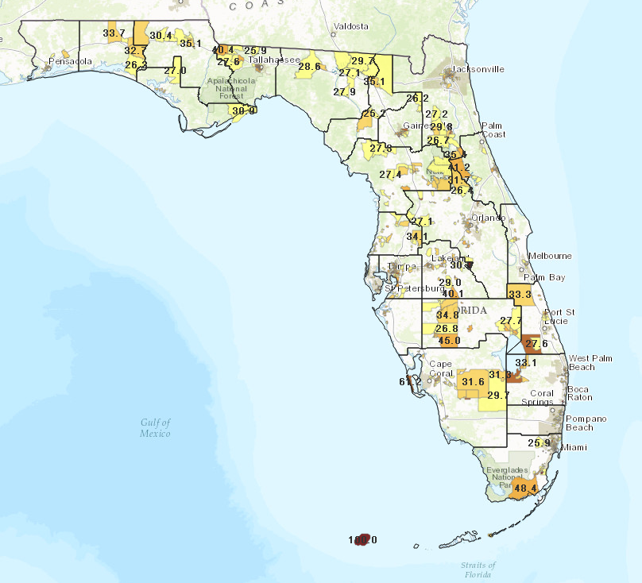
Youth Living in a High-Poverty Area
A youth who lives in a high-poverty area is automatically considered to be a low-income individual. Poverty Rate Map
Notes:
WIOA recognizes a youth who lives in a High Poverty Area as automatically low-income, for purpose of providing WIOA services. WIOA defines a High Poverty Area as a Census tract, a set of contiguous Census tracts, Indian Reservation, tribal land, or Native Alaskan Village or county that has a poverty rate of at least 25 percent as set every five years using the American Community Survey 5-Year data, pursuant to the final rule, 20 CFR 681.260.
The FloridaCommerce, Bureau of Workforce Statistics and Economic Research (WSER) created a Poverty Rate Map as a tool to assist staff in determining if an area meets the high poverty area criteria. The poverty map is located on the FloridaCommerce website under the WSER tab and may be accessed by this weblink: http://deolmsgis.maps.arcgis.com/apps/webappviewer/index.html?id=4e55cb961a5946b892bc94a0917e4978.

Slide 11
Low-Income: Other Documents
Receives or is eligible to receive a free or reduced-price lunch
Foster child
Notes:
Income determination includes (Refer to slide) Administrative Policy-095

Slide 12
Low-Income Exceptions
Local areas may apply the low-income exception to no more than five percent of its WIOA youth in a given program year. Youth included in the low- income exception do not have to be low income, but they must meet the other eligibility requirements.
200 Youth
100 OSY | Not required to be low-income
50 ISY | Required to be low-income
50 OSY | Required to be low-income
50 ISY + 50 OSY = Included in the low-income exception calculation 100 ISY/OSY 5% Exception = 5
Notes:
WIOA allows a low-income exception where five percent of in-school youth may be participants who meet the low-income eligibility criteria. However, local boards are allowed a 5% exception for youth who may not meet the low-income criteria. WIOA Sec. 129 (a)(3)(A)(ii); 20 CFR 681.250(c)
The 5% low-income exception applies to:
All ISY, who meet the low-income eligibility criteria; and
OSY who fall into one of the following three low-income eligibility categories:
Low-income, recipient of HS diploma or equivalency, and Basic Skills Deficient;
Low-income, recipient of HS diploma or equivalency, and English Language Learner; and/or
Low-income and needs additional assistance as defined by the LWDB.
For example, a LWDB enrolls 200 youth into its youth program. Of these, 200 youth fall into three types:
1. 100 are OSY (in categories that do not require the youth to be low-income);
2. 50 are OSY (in categories that ordinarily require the youth to be low-income); and
3. 50 are ISY (who are ordinarily always required to be low-income).
However, only the last two types of youth that ordinarily need to be low-income fall into the “5% low-income exception” group. This means only 5% of these 100 (50 +50) youth can be included in calculating the number of 5% low-income exception.
5% of 100 = 5
This means that five of these 100 youths are not required to be low-income if they are otherwise eligible youth participants.

Slide 13
Requires Additional Assistance Limitation
Factors to consider:
Low-income, unless granted low-income exception
Does not meet any of the other barriers
Defined in your local plan
Reasonable
Quantifiable
Evidence-based
For ISY, requires additional assistance to “complete” a program
For OSY, requires additional assistance to “enter or complete” a program
Notes:
The LWDB must establish a definition and eligibility documentation requirements for the “requires additional assistance” to complete an educational program, or to obtain or retain employment criterion of ISY and OSY eligibility. When establishing a definition for “requires additional assistance” and eligibility documentation, the following local plan and local operating procedures (LOP) must be included- (Refer to slide)
WIOA Section 129; TEGL 08-15; 20 CFR 681.300 - 681.310

Slide 14
Individuals with Disabilities
Other eligibility criteria to consider include:
Low-income is not a requirement of OSY
ISY must be low-income
Family of one disability verification can include the income of the youth
Notes:
WIOA has made youth with a disability a separate eligibility criteria. OSY with a disability are not required to be low income but ISY with a disability must be low-income.
20 CFR 681.280 states that for a youth with a disability, income for eligibility purposes is based on the youth’s own income rather than his or her family’s income. WIOA sec. 3(36)(A)(vi) states that an individual with a disability whose own income meets the low-income definition in clause (ii) (income that does not exceed the higher of the poverty line or 70 percent of the lower living standard income level), but who is a member of a family whose income exceeds this income requirement is eligible for youth services. Administrative Policy 095
Each LWDB is required to collect supporting eligibility documentation used to determine eligibility. Youth service providers must obtain and maintain documentation that supports the determination for eligibility and continuous participation. (i.e. verification documentation depends on the type of disability, but may include a doctor’s letter, SSI, IEP from school, etc.).

Slide 15
Basic Skills Deficient Definition
A youth who has English reading, writing, or computing skills at or below the eighth-grade level on a generally accepted standardized test
A youth who is unable to compute or solve problems, or read, write, or speak English, at a level necessary to function on the job, in the individual’s family, or in society
Notes:
A youth is “basic skills deficient” if he or she (Refer to slide): 20 CFR 681.210 (c )(3); 681.290(b) and (c)
LWDB must establish its policy in its local plan. In assessing basic skills, local programs must use assessment instruments that are valid and appropriate for the target population, and must provide reasonable accommodation in the assessment process, if necessary, for individuals with disabilities.

Slide 16
Deferred Action for Childhood Arrivals (DACA)
The DACA process is for individuals who came to the United States as children and:
Were under the age of 31 as of June 15, 2012
Came to the United States before reaching their 16th birthday
Have continuously resided in the United States since June 15, 2007, up to the present time
Were physically present in the United States on June 15, 2012, and at the time of making their request for consideration of deferred action with U.S. Citizenship and Immigration Services (USCIS)
Entered without inspection before June 15, 2012, or their lawful immigration status expired as of June 15, 2012
Notes:
WIOA section 188(a)(5) contains a specific nondiscrimination provision that provides that participation under the WIOA is available to citizens and nationals of the United States; lawfully admitted permanent resident aliens, refugees, asylees and parolees; and other immigrants authorized by the Attorney General to work in the United States.
Individuals with employment authorization qualify under this provision as “immigrants authorized by the Attorney General to work in the United States.” This includes “Deferred Action for Childhood Arrivals” (DACA) participants with employment authorization. Participants identified as DACA participants must meet the WIOA eligibility requirements to access any WIOA services for which they would otherwise qualify. LWDB staff must obtain appropriate documentation of employment authorization. The documentation must include self-attestation, at a minimum.
A.K.A. – The Dreamers

Slide 17
DACA Process (cont’d)
Are currently in school, have graduated or obtained a certificate of completion from high school, have obtained a general education development (GED) certificate or other equivalent State-authorized exam in the United States, or are an honorably discharged veteran of the Coast Guard or Armed Forces of the United States
Have not been convicted of a felony, significant misdemeanor, three or more other misdemeanors and do not otherwise pose a threat to national security or public safety
Notes:
The DACA process may result in a two-year period of “deferred action,” or relief from removal from the country or from entering into removal proceedings, subject to renewal, and issuance of employment authorization for the period of deferred action. A DACA participant whose case has been deferred is eligible to receive employment authorization for the period of deferred action, if he or she can demonstrate “an economic necessity for employment.’ Individuals who can demonstrate through verifiable documentation that they meet guidelines will be considered for deferred action. Determinations will be made on a case-by-case basis under the DACA guidelines.
U.S. Citizenship and Immigration Services (uscis.gov)

Slide 18
References
WIOA Public Law and Code of Federal Regulations: https://www.govinfo.gov/
WIOA Public Law, Section 129(a)
20 CFR 681.200-320
United Stated Department of Labor: https://wdr.doleta.gov/directives/
TEGL 8-15
TEGL 02-14
TEGL 21-16
TEGL 23-14
Florida Statutes
Sections 445.003, 445.004(5)(a) and 445.004(5)(b)(1)
Florida Department of Commerce: http://www.floridajobs.org
Administrative Policy 95
Notes:
References included in this PowerPoint were obtained from federal, state and local sources. The various references may be viewed via website from the following (Refer to slide)…

Slide 19
Questions & Answers

Slide 20
Contact Us
Thank You.
If you have questions or comments about this presentation, please contact us.
Florida Department of Commerce
Email: WIOA@commerce.fl.gov
Office: Division of Workforce Services
Bureau of One-Stop and Program Support

