Slide 1


Job Search and Job Readiness Assistance

Slide 2

Job Search and Job Readiness Assistance
What does Florida Work Verification Plan say about job search and job readiness assistance?
How is Job Search and Job Readiness is coded in OSST system?
Supervision of hours
Extension of job search weeks
Example of job search and job readiness program model(s)

Slide 3
Job Search and Job Readiness Assistance (cont’d)
Florida’s Work Verification Plan defines job search and job readiness as
  The act of seeking employment or learning how to seek employment
It is organized and includes such activities as
  Formal classes
  Workshops
  Individualized activities
  On-site job search
  Off-site job search
Notes:
Job search and job readiness assistance is actually an organized activity that uses services to help participant gain employment within a limited period of time. The goals of activity is to help individuals be prepared to look for work, apply for work, get the job and keep the job.
So what does the work verification plan say about job search and job readiness assistance…..

Slide 4
Job Search and Job Readiness Assistance (cont’d)
Formal classes can include
  Time management
  Teaching professional behaviors and etiquette
  Teaching basic job seeking skills
    Instruction in completing an application
    Interviewing skills
    Resume development
    Appropriate dress

Slide 5
Job Search and Job Readiness Assistance (cont’d)
Workshops may include
  Preparing for employment
    Orientation to the world of work
    Budgeting
    Life Skills
    Interpersonal skills
    Decision making skills

Slide 6
Job Search and Job Readiness Assistance (cont’d)
Individualized Activities may include
  Finding employment
    Completing applications
    Submitting resumes
    Interviews
    Orientations
  Job retention skills
    Teaching participants to keep their jobs

Slide 7
Job Search and Job Readiness Assistance (cont’d)
May include
  Substance Abuse and Mental Health (SAMH) services if the individual is
    Determined to be in need of services to get a job or keep a job
    Determined in need of services by a SAMH professional

Slide 8
Job Search and Job Readiness Assistance (cont’d)
May include
  SAMH services
    In-patient services
    Out-patient services
    Workshops
    Group and individual therapy
    Detoxification
    Rehabilitation services
    Other sessions determined “medically necessary”

Slide 9
Job Search and Job Readiness Assistance (cont’d)
Job Search does not include searching for
  Childcare
  Housing
  Other nonjob search and job readiness assistance related activities

Slide 10

Job Search and Job Readiness Assistance (cont’d)
Final Rule
  Allows travel time to and from interviews to count as actual time
  Cannot count time from home to first interview
  Cannot count from last interview to home

Slide 11

Job Search and Job Readiness Assistance (cont’d)
Entering Job Search and Job Readiness Assistance in OSST

Slide 12
Job Search and Job Readiness Assistance (cont’d)
Prior to entering a participant into job search, program staff should consider the following:
  Has the participant been assessed?
  Is the participant job ready?
  What does my region’s local operating procedure consider job ready?
  Was the participant previously engaged in job search and job readiness assistance?

Slide 13
Job Search and Job Readiness Assistance (cont’d)
Why is it important to know this information?
  Participants should be appropriate for the activity
    Would it be appropriate to assign someone who has exhibited the following work habits to job search?
      Excessive absenteeism
      Excessive tardiness
      Fighting with co-workers and supervisors
  Is it likely such a person will retain employment for long?

Slide 14
Job Search and Job Readiness Assistance (cont’d)
Why is it important to know this information?
  If the participant was previously engaged in job search and job readiness assistance, program staff should know
    If the individual completed four consecutive weeks within a rolling 12 months
    If the individual completed 360 hours in a rolling 12 months
  Since Florida is a Needy State, we can engage participants in job search for a maximum of 360 hours (the equivalent of 12 weeks) in job search

Slide 15
Job Search and Job Readiness Assistance (cont’d)
Program staff enter Job Search and Job Readiness Assistance in the One-Stop Service Tracking (OSST) system
  Skill Development section of the Skill Development screen
  Click the “Add Activity” tab
  Job Search and Job Readiness - Code 120

Slide 16
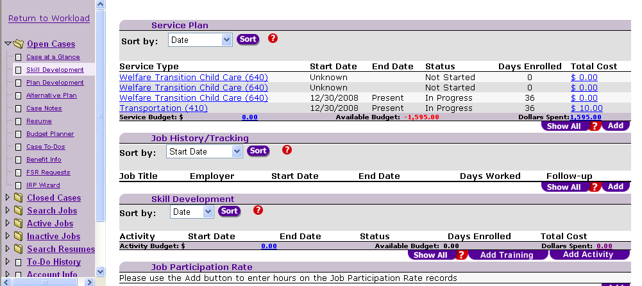
Select “Add Activity”

Slide 17
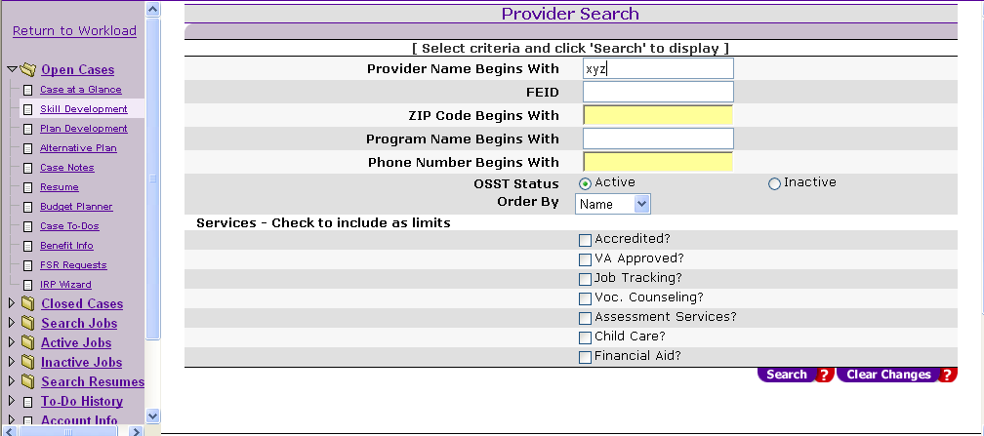
Enter Provider Information and Search

Slide 18
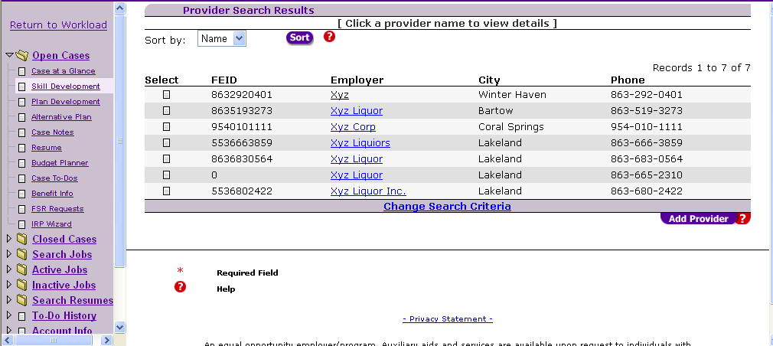
Select the preferred provider

Slide 19
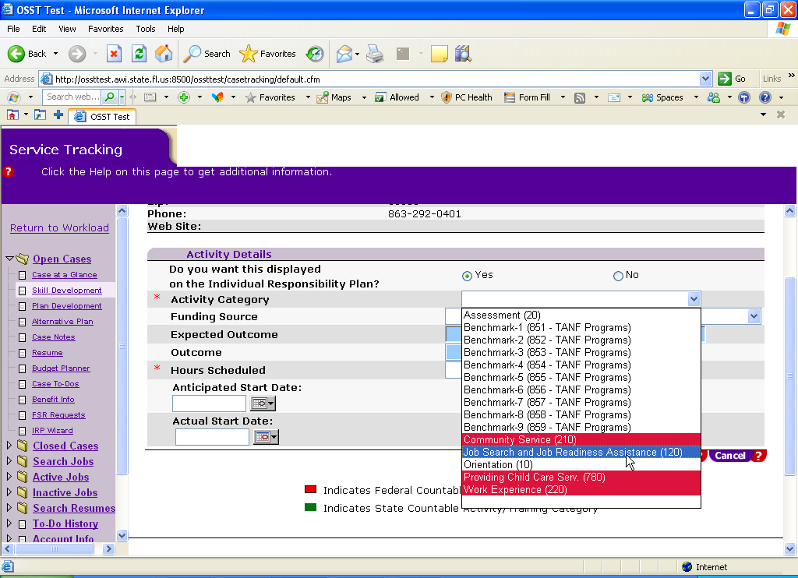
Under Activity Details, select Job Search and Job Readiness Assistance (120)

Slide 20
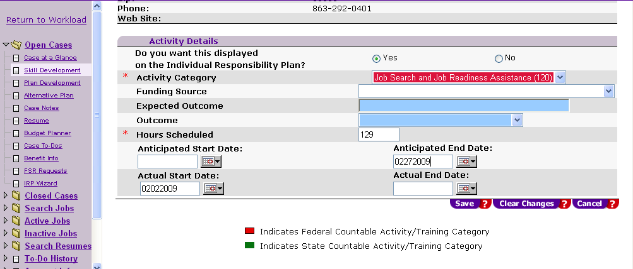
Next, enter the number of hours the participant is required to complete, the start date and anticipated end date for the activity.

Slide 21
Job Search and Job Readiness Assistance
Why did we enter 129 hours?
  129 is 30 x 4.3, the maximum hours to meet participation in the all-family rate
    86 of those hours must be in a core activity
    Job Search is a core activity, and participants can complete all required hours in this activity
  Can we use less job search hours?
    Yes. As long as the participant is assigned to 86 hours in a core activity and 129 total for the month

Slide 22
Job Search and Job Readiness Assistance (cont’d)
What if my region requires all participants to complete 35 or 40 hours per week?
  For regions that require 35 hours per week
    35 x 4.3 = 150.5 or 151 hours for the month
  For regions that require 40 hours per week
    40 x 4.3 = 172 hours for the month

Slide 23
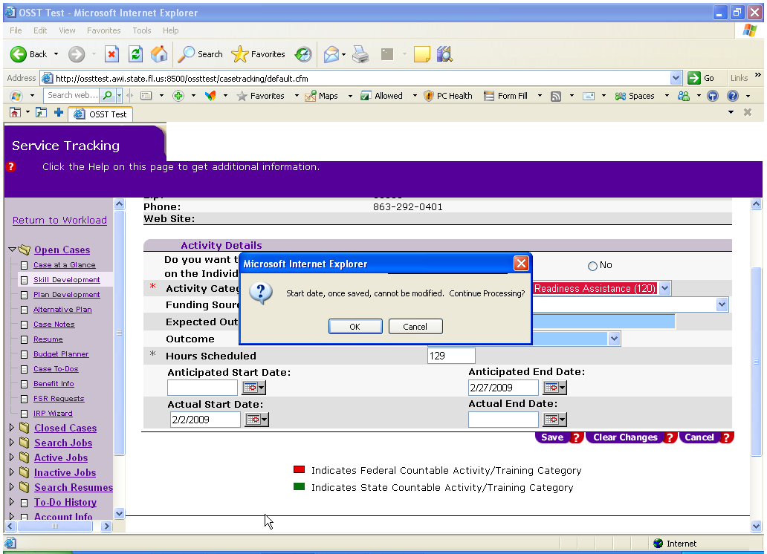
Remember, once you save this information, it cannot be changed.

Slide 24
Job Search and Job Readiness Assistance
Final rule states
  Participants may be included in the numerator of the participation rate for up to 4 consecutive weeks in a rolling 12-month period
  Participants may be included in the numerator of the participation rate for up to 6 total weeks or
    180 hours in a rolling 12-month period if the individual is a single parent with the youngest child six or older
    180 hours in a rolling 12-month period if the individual is a parent in a two-parent family

Slide 25

Job Search and Job Readiness Assistance (cont’d)
Final rule states
  120 hours if the parent is a single parent with the youngest child under the age of six

Slide 26

Job Search and Job Readiness Assistance (cont’d)
Needy State
  Florida is currently a needy State
  Now we can include families in the numerator of the participation rates if the individual has not been included in the numerator for participation in code 120 (in a rolling 12-month period)
    For more than 360 hours (the equivalent of 12 weeks) if the individual is a single parent with the youngest child over six
    For more than 360 hours if the individual is part of a two-parent family

Slide 27
Job Search and Job Readiness Assistance (cont’d)
Needy State
  Florida is currently a needy State
  We can include families in the numerator of the participation rates if the individual has not been included in the numerator for participation in code 120 (in a rolling 12-month period)
    For more than 12 weeks or 240 hours if the individual is a single parent family with the youngest child being under the age of six

Slide 28

Job Search and Job Readiness Assistance (cont’d)
What is a rolling 12-month period?
  In the last 12 months (including the report month in question), has the participant already used up the ability to be counted in the numerator for participating in the job search and job readiness activity?

Slide 29

Job Search and Job Readiness Assistance (cont’d)
Supervision
  Job search must be supervised by a responsible party
  All hours of participation must be documented
  Documentation must be secured by staff before entering any hours of participation on the Job Participation Rate (JPR) screen in OSST

Slide 30
Job Search and Job Readiness Assistance (cont’d)
Supervision
  Hours of in-house job search can be documented using
    Time sheets
    Job search report form
  Hours of on-site job search can be documented using
    Time sheets
    Job search report form

Slide 31
Job Search and Job Readiness Assistance (cont’d)
Supervision
  Program staff must conduct a random review of at least 10% of participant job search logs and timesheets to validate that the job entries are accurate and valid

Slide 32

Job Search and Job Readiness Assistance (cont’d)
Supervision
  Hours of participation in a SAMH treatment program can be documented on time sheets

Slide 33
Job Search and Job Readiness Assistance (cont’d)
Supervision
  Who is the authorized party that may verify hours or sign the documentation?
    In-house job search
      The party who is actually supervising the individual
      If the individual is in a job search program, like a Job Club, the instructor is the most appropriate person
      If the individual is job searching in the resource room, the resource room staff may verify all the hours completed
      If the individual is working with employment services staff, the staff may verify all hours completed

Slide 34
Job Search and Job Readiness Assistance (cont’d)
Supervision
  Who is the authorized party that may verify hours or sign the documentation?
    On-site job search
      If the individual is receiving referrals to an employer as a part of an “organized” program, the employer may be able to verify the hours or staff may be able to verify the hours as a part of the “organized” program
      If the individual is completing job searches outside of an organized program, each hour must be documented, and the employer must verify hours on-site

Slide 35
Job Search and Job Readiness Assistance (cont’d)
Supervision
  Who is the authorized party that may verify hours or sign the documentation?
    Hours in a SAMH treatment program must be documented by the appropriate party
      Counselor
      Doctor
      Therapy leader
      In-patient treatment coordinator

Slide 36
Job Search and Job Readiness Assistance (cont’d)
Supervision
  How does program staff know who can sign off on these hours?
    That is the responsibility of the Regional Workforce Board (RWB)
    This information should be outlined clearly in the Local Operating Procedure (LOP)
    Documentation should be checked against the approved supervising parties

Slide 37
Job Search and Job Readiness Assistance (cont’d)
What else may be appropriate for the LOP?
  Who are the SAMH providers in the area?
  Who can verify that SAMH treatment is really necessary?
  What is our job search readiness program?
    Can program staff assign participants job search any time?
    Are there criteria a participant must meet before assigning job search and job readiness as an activity?

Slide 38
Job Search and Job Readiness Assistance (cont’d)
What else may be appropriate for the LOP?
  What is our job search readiness program?
    Do participants job search on their own?
    Is there an instructor led program?
    Who helps participants find a job?
  What documents are completed to verify the hours?
  Do employers sign off on the form(s)

Slide 39
Job Search and Job Readiness Assistance (cont’d)
What else may be appropriate for the LOP?
  What is our job search readiness program?
    When are the off-site (with employers) hours verified?
      Applications filed, interviews, logs (10 percent review)
    Who verifies the off-site hours?

Slide 40
Questions & Answers

Slide 41
Contact Us
Thank You.
If you have questions or comments about this presentation, please contact us at 1-866-352-2345.
An equal opportunity employer/program. Auxiliary aids and services are available upon request to individuals with disabilities. All voice telephone numbers on this document may be reached by persons using TTY/TDD equipment via Florida Relay Service at 711.

