Slide 1
Co-Enrollment: Trade Adjustment Assistance (TAA) and Workforce Innovation and Opportunity Act (WIOA) Dislocated Worker Program Overview
Christina Omran, State Trade Program Coordinator
October 2021

Slide 2
OBJECTIVES
TAA and WIOA overview
Co-enrollment simplified
Co-enrollment guidance and details
Benefits
Myths
Expectations
Notes:
Today’s webinar will focus on co-enrollment between the Trade Adjustment Assistance (TAA) and Workforce Innovation and Opportunity Act (WIOA) Dislocated Worker (DW) programs. During this presentation, we will cover:
A brief overview of both TAA and WIOA DW.
Define co-enrollment.
Co-enrollment: where did it come from, and why now?
The benefits of co-enrollment.
Challenges and concerns with the co-enrollment process.

Slide 3
TRADE ADJUSTMENT ASSISTANCE OVERVIEW
TAA program offers a variety of benefits and services to eligible workers, including:
Trade Readjustment Allowance (TRA) for extended income support
Job Search and Relocation Allowance for commuting and travel support
Health Care Tax Credit (HCTC) for reimbursement
Reemployment Trade Adjustment Assistance (RTAA) (wage subsidy for workers 50 and older)
Training (lifetime education benefit including credentials and higher education degrees)
Authorized by the Trade Act of 1974, as amended.
Trade Adjustment Assistance Reauthorization Act of 2015 (TAARA 2015)
Notes:
The TAA program provides resources to help workers obtain new skills and find suitable employment when foreign trade or competition reduces the demand for the products they make or the services they provide. The Trade Act of 1974 established the Trade Adjustment Assistance Program to mitigate the effect of global trade and foreign competition on American workers. The Trade Adjustment Assistance Reauthorization Act of 2015 (TAARA 2015), reauthorized and reasserted changes to the act. TAARA 2015 revised reporting requirements to align performance accountability for the TAA program with that of other partner programs in the workforce system under the 2014 Workforce Innovation and Opportunity Act, (WIOA).
TRA – Income support that extends unemployment benefits past the initial Reemployment Assistance (RA) benefits while trade-affected workers are in training.
TAA – Provides funding for training, job search and relocation allowance.
HCTC – Health Coverage Tax Credit is an IRS tax credit to help with the costs of health insurance.
RTAA – A wage supplement established and available for trade-affected workers 50 and older who secure employment at a lesser wage (up to $50,000 per year).
For more information, check out our TAA Overview presentations at FloridaJobs.org → Training Materials.

Slide 4
WORKFORCE INNOVATION AND OPPORTUNITY ACT OVERVIEW
Workforce Innovation and Opportunity Act (WIOA) took effect on July 1, 2015.
Youth, Adult, and Dislocated Worker
WIOA Dislocated Worker programs provide the following specialized reemployment services:
Career development
Job placement services
Funding assistance for training
Notes:
The Workforce Innovation and Opportunity Act (WIOA) Dislocated Worker program provides participants with workforce preparation, career services, training services and job placement assistance needed to increase occupational skills attainment, obtain industry recognized credentials, and secure a good job that provides earnings that lead to self-sufficiency. The WIOA Dislocated Worker (DW) program serves eligible workers who are unemployed through no fault of their own or have received an official layoff notice, and this aligns perfectly with TAA.
A central tenant of WIOA is assisting dislocated workers with barriers to reentering the workforce, like the TAA program where trade-affected workers may need education and/or new skillsets, and this is extremely beneficial to our TAA customers for a couple obvious reasons: (1) because DW funds supportive services, and (2) DW funds post-employment follow up services. Those are not covered by TAA.
Previously, co-enrollment may occur with TAA and any WIOA Title I program (such as Adult). However, that has changed. Section 239 of the Trade Act, codified in 20 CFR 618 Section 325 starting at paragraph (A) (1), mandates, when eligible, co-enrollment between TAA and WIOA DW. Based on studies published by USDOL, there are similarities of both programs, providing ease of co-enrollment eligibility and long-term reemployment and career benefits to customers.
For more guidance regarding the integration of services, please see Section 618.310 paragraph (D). It further defines what it means to "make available" the employment and case management services described in this subpart. TEGL number 16-16, "One-Stop Operations Guidance for the American Job Center Network“.
Now that we understand how the two programs support each other; what exactly constitutes co-enrollment?

Slide 5
CO-ENROLLMENT SIMPLIFIED
As codified in 20 CFR 618.325, co-enrollment between the TAA and WIOA programs is to ensure the integrated, coordinated delivery of services that help participants return to work quickly.
Co-enrollment occurs when:
The participant is eligible for both programs.
The majority certified trade-affected workers are eligible for Dislocated Worker enrollment.
The partner program funds at least one service, such as a career assessment or Test for Basic Education. This service must be recorded in Employ Florida.
Notes:
Co-enrollment is defined as having occurred when a participant is enrolled in additional programs, such as WIOA, for which they are eligible, and that program (DW) has added value to the participant’s success through providing at least one recorded service.
Co-enrollment between TAA and WIOA ensures the participant receives the necessary services to address as broad a range as possible of a participant’s identified needs. Co-enrollment benefits the participant by streamlining processes across two or more programs. Effective co-enrollment requires communication between case managers and timely, accurate documentation in Employ Florida.
Co-enrollment requires that WIOA DW funds must contribute to at least one service, which could include case management, career assessment, or the administering of a specialized assessment such as the Test for Basic Education (TABE) or the Comprehensive Adult Student Assessment Systems (CASAS). Co-enrolled trade-affected workers can also receive supportive services that may help them complete TAA-approved training and then return to suitable employment. The TAA program may pay for all training and training related costs, unless the training began under DW and well before the trade-affected worker’s petition was certified. This instance is rare.
However, trade-affected workers often benefit from WIOA’s assessments, supportive services, case management services, and post-employment follow-up services. Supportive services and follow-up services cannot be funded through the TAA program. The TAA program includes eight required case management services. However, WIOA-funded programs provide a variety of job-readiness and career preparation services such as financial literacy, computer literacy, resume writing, cover letter writing, interview prep, and other group workshops that encourage, prepare, and benefit the customer during work search.

Slide 6
CO-ENROLLMENT GUIDANCE AND DETAILS
Training and Employment Guidance Letter (TEGL) No. 4-20:
Dislocated Worker services include career services, training, supportive services, and follow-up services.
Dislocated Worker funds allow the affected worker to start services earlier in the process while the Trade Act petition is being filed, reviewed, certified, etc. by the US Department of Labor (USDOL).
Co-enrollment aligns with the workforce goal of providing immediate and seamless workforce program integration.
TAA Data Integrity Report tracks TAA partipants who are co-enrolled in the WIOA DW program.
75% of new TAA participants must be co-enrolled.
Notes:
Now you know what co-enrollment is, but why is this mandatory? Early intervention, DW may start providing services immediately, whereas TAA requires a certified petition prior to serving participants. If a Trade Act petition is denied, the affected worker experiences no interruption in DW career and training services. As discussed, co-enrollment facilitates better outcomes for the customer because DW provides supportive services and follow-up services, whereas TAA does not. DW may provide assessments, job-readiness workshops, financial literacy, and other services to our participants.
As a result of the TAA reauthorization and enactment of WIOA, USDOL has made the seamless integration between these two programs a major focal point.
Additionally, sec. 221(a)(2)(A) of the Trade Act requires that Rapid Response and appropriate career services are delivered to all workers who are covered by a certified TAA petition. This requirement was previously met through co-enrollment with the partner program Wagner-Peyser. While Wagner-Peyser provides a suite of valuable job seeker and career services, it is not guaranteed to provide the individualized career services to participants that drive early intervention, including assessments. As such, it does not have the same impact on program delivery and performance outcomes.
Statewide co-enrollment outcomes are tracked by the Trade Adjustment Assistance Data Integrity (TAADI) report. What is the TAADI? The TAADI report brings a lot of program requirements together under one snapshot, performance report. The entire state of FL contributes to our TAADI results, it utilizes the records we enter into Employ Florida. The TAADI pulls together fiscal data, unemployment insurance data, and programmatic data. There’s four (4) main categories containing multiple measures:
Cross validation of fiscal data from the 9130 report against the Participant Individual Record Layout or PIRL,
Data accuracy and reporting issues (such as underreporting) for training completion and Rapid Response,
Validating standardized codes (like ONET and North American Industry Classification System), and
Flagging wage outliers and inaccurate wage records.
For the co-enrollment measure, the minimum passing score requires at least 75% of all new TAA participants be co-enrolled in WIOA DW. This is an increase from last year, when the minimum passing score was 50%.

Slide 7
BENEFITS
Benefits of co-enrollment in TAA and WIOA DW programs include:
No “soft cap” restriction on training costs
Broad range of training options
Trade program provides case management services
Reimbursement of Dislocated Worker costs if spent prior to known TAA program eligibility, and
Shared performance (credential attainment, training result, measurable skills gains).
Notes:
TEGL 19-16 states that enrollment in WIOA DW “improves the overall effectiveness of the TAA Program”, but what benefits are there for WIOA?
The training costs are paid for by TAA funding which does not have a “soft cap” restriction on the cost of program.
The TAA program provides assistance for all training needs (e.g., remedial education, prerequisite education, post-secondary education, and vocational training).
Additionally, the TAA program provides funding for full-time case managers, ensuring minimum burden on WIOA staff.
Lastly, the shared performance outcomes are improved. Performance, such as measurable skills gains and credential attainment (now training result), may be claimed across both programs, even if the training is funded in full by TAA. These credentials and skills are reported upon common program exit.

Slide 8
BENEFITS
Co-enrollment also makes additional money available for On-the-Job Training (OJT).
WIOA allows up to 75% reimbursement to employers for OJT.
For a TAA participant co-enrolled in WIOA:
TAA may reimburse employers up to 50%
WIOA may reimburse an additional 25% to bring the total reimbursement to employers up to 75%
Notes:
An additional benefit for WIOA is shared costs for OJT funding.
WIOA Title I allows up to 75 percent reimbursement to employers for OJT in certain circumstances, while the TAA program allows reimbursement up to 50 percent.
For OJT training for a co-enrolled TAA participant, the TAA Program may reimburse employers up to 50 percent, and WIOA may reimburse employers up to an additional 25 percent, bringing the total reimbursement to employers up to 75 percent to align TAA program benefits with WIOA Title I program benefits with a reduced cost to WIOA.

Slide 9
MYTH #1: ELIGIBILITY
“The WIOA Dislocated Worker program offers employment and training programs for eligible workers who are unemployed through no fault of their own or have received an official layoff notice.”
“The TAA program is a federal program that assists U.S. workers who have lost or may lose their jobs as a result of foreign trade.”
Notes:
Let’s begin by looking at the concerns surrounding eligibility between the two programs.
You may have noticed from the overviews of TAA and WIOA given earlier, these two programs appear to be closely aligned in their mission and scope.
(Read Slide)
TAA eligible workers are unemployed or may be unemployed through no fault of their own. Therefore, most TAA eligible workers will also be eligible for WIOA DW.
This congruent eligibility requirement between WIOA DW and TAA further adds to the need for co-enrollment to avoid duplicative processes. The purpose of co-enrollment is to create a seamless delivery system, without sensitivity to programs, which provides comprehensive services to each customer in order return them to employment.

Slide 10
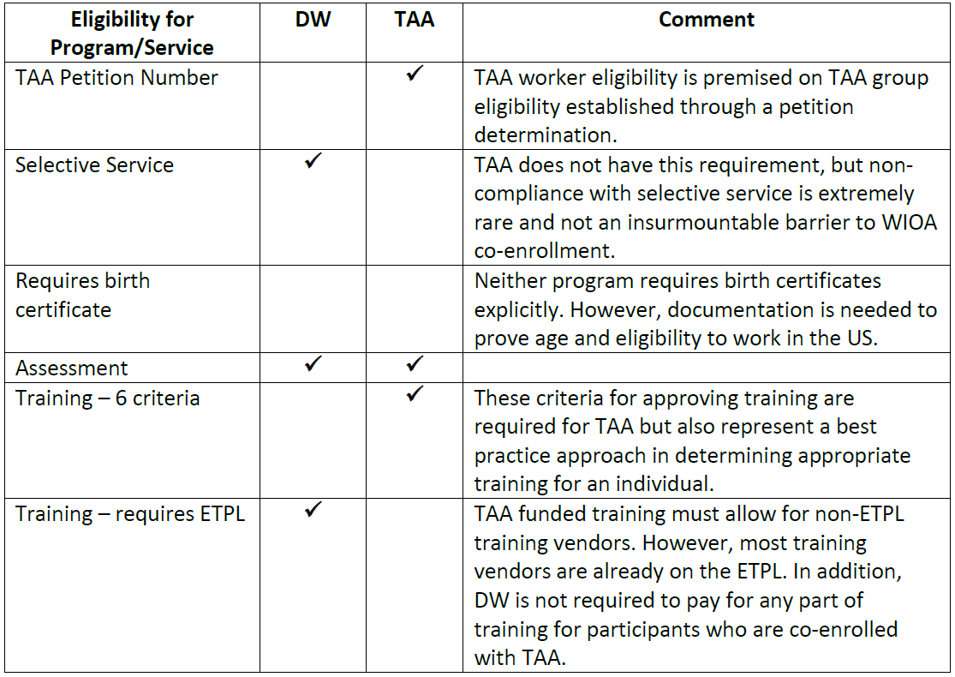
MYTH #1: ELIGIBILITY, CONTINUED
WIOA
Dislocated Worker
TAA-funded training must allow for non-Eligible Training Provider List (ETPL) training vendors. However, most training vendors are already on the ETPL. In addition, WIOA Dislocated Workers program is not required to pay for any part of training for participants wo are co-enrolled with TAA.
Notes:
There are very few barriers to eligibility for WIOA DW and almost all trade affected workers will be found eligible. TAA participants who only receive Basic Career Services through WIOA may self-attest to these eligibility criteria, making it even easier to enroll into the WIOA Title I program.
The table here shows the eligibility criteria for both WIOA Dislocated Worker (DW) and TAA. One difference shown is that WIOA does require that all males over the age of 18 be registered for Selective Service. This is not required for TAA eligibility. The Trade Act went into effect in 1974, six years prior to the Selective Service Act and was never amended to include the selective service requirement.
Only in rare circumstances, such as this, should a TAA eligible participant not qualify for WIOA Title I services. If the participant is not eligible for WIOA (e.g., not registered with selective service) a case note should be entered in Employ Florida documenting that the participant was referred but found not eligible for co-enrollment with WIOA.

Slide 11
MYTH #2: FUNDING
No requirement to spend WIOA dollars.
Only a single WIOA service is required for co-enrollment.
Utilize minimal cost WIOA programs, including resume writing workshops, financial literacy, etc.
Notes:
There is a concern that DW has limited funds, therefore, TAA participants should be limited to TAA funds.
There is no requirement that WIOA funds be used to pay for any portion of approved TAA training costs for TAA participants to be co-enrolled. There are many ways to coordinate co-enrollment that are a minimal cost burden for WIOA programs, including resume writing workshops, financial literacy, etc.

Slide 12
MYTH #2: FUNDING, CONTINUED
WIOA and TAA program funds must be managed in a coordinated manner.
TAA funds are primary.
WIOA funding may be used to “bridge the gap”
WIOA funds are supplemental and not required to fund training for TAA participants.
TAA funding may be used to develop case management tools which aid co-enrollment.
Notes:
(Read Slide)
WIOA and TAA program funds must be managed in a coordinated manner. Duplication of training cost payments is not permitted. The TAA program must be the primary source of assistance to TAA program participants. If a TAA program participant requires assistance or services not authorized under the TAA program or TAA program funds are unavailable or insufficient, assistance must be made available through WIOA.
Under limited circumstances, TAA program participants may receive WIOA-funded training that would otherwise be provided under the TAA program. The most common circumstance is when a trade petition has been filed by or on behalf of a group of workers, but a determination of group eligibility is pending. In this case, WIOA funds should be used for training in the short-term, until the TAA program determines the worker’s individual eligibility and approves the training. (In the event a negative decision is rendered, and the petition is denied, the worker may continue as a WIOA participant.)
Coordination between partner programs to develop a common framework or tools for customers may have a positive impact. Products or tools may be developed or procured using TAA case management and employment funds. LWDBs should consult with the DEO Bureau of Financial Management for guidance on additional allowable activities that can be supported with TAA funding.

Slide 13
MYTH #3: DUPLICATION OF EFFORTS
WIOA and TAA program staff are encouraged to:
Communicate frequently and share records;
Familiarize themselves with partner programs;
Coordinate services the TAA participant is receiving to maximize all resources available within the career center; and
Eliminate barriers to service delivery.
Notes:
Co-enrollment necessitates a high level of communication and coordination among WIOA and TAA personnel to maximize effectiveness and avoid duplication of services.
LWDBs are encouraged to establish local policies that support the needs of all dislocated workers, including those impacted by trade, and to promote a seamless service delivery system. The TAA and WIOA program staff are encouraged to:
Communicate frequently – to include sharing required documentation (e.g., measurable skills gains, credential attainment / training result, case management updates);
Coordinate services to maximize all resources available for the TAA participant; and,
As required by the regulations, eliminate barriers to service delivery.
Through training, job aids, job shadowing, and other methods, LWDBs should ensure that WIOA staff possess a basic understanding of the TAA program (and vice versa), including similarities and differences between the two programs.
The best practice to reduce barriers to service delivery may involve conducting a WIOA orientation overview of services during the initial one-on-one appointment with the Local TAA Coordinator. This overview could either be presented by a WIOA case manager or, if they were not available, by the Local TAA Coordinator. The WIOA case manager and Local TAA Coordinator should participate in informational sessions together, and when trade-impacts are suspected or identified, should participate in Rapid Response sessions together. Essentially, the best practice is teamwork, open communication, and coordination.
Additionally, the TAA coordinator must have a checklist of documents required for enrollment in WIOA and collect them during the one-on-one meeting and upload them into the Employ Florida documents folder. These documents could be shared with WIOA staff to ease the enrollment process and eliminate the need for multiple customer appointments.

Slide 14
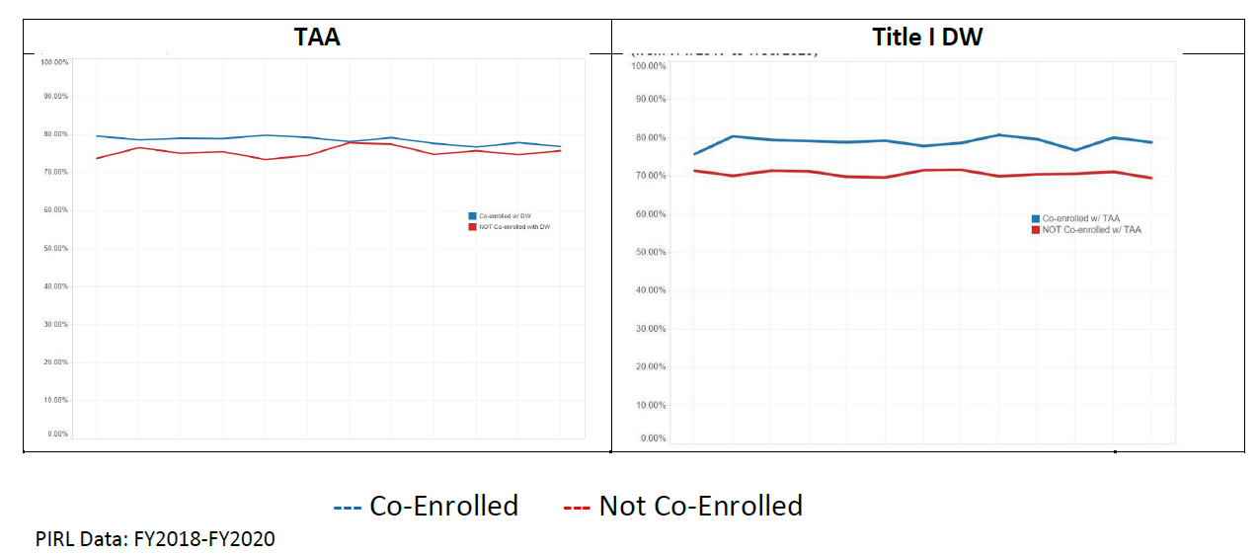
MYTH #4: PERFORMANCE
The blue line (co-enrollment) is higher on both graphs.
Notes:
Performance improves when TAA participants are co-enrolled with Title I DW (left view). The same is true for DW participants co-enrolled with the TAA program (right view). See these trends on Employment Rate (ER) 2nd Quarter After Exit:
Average participation in TAA is longer than in DW (459 days to 148 days). There is the perception that this longer time will hurt outcomes. Although TAA participants are often engaged in long-term training, this point should not be a disincentive to co-enrollment. In fact, it is an asset. The Measurable Skill Gains performance indicator under WIOA measures the progress of participants engaged in training; thus, positive outcomes can be reflected even during long term training.
Additionally, most WIOA performance indicators are calculated after exit. Therefore, length of participation and participants who have a longer period of participation should have no impact on outcomes. Lastly, Florida has a common exit policy, meaning only once no benefits or services are provided for 90 days and no future benefits or services are scheduled, will the participant exit.
Aside from these facts, the nationwide data collected on co-enrollment shows that performance outcomes are improved when TAA and WIOA DW participants are co-enrolled. The US Department of Labor tracked data from the Participant Integrated Reporting Layout (PIRL) for TAA and the Workforce Integrated Performance System (WIPS) for WIOA to monitor the performance implications of co-enrollment between TAA and WIOA DW.
Both reports reflected increased entered employment rates when comparing those participants who were co-enrolled (blue) compared to those who were not (red).

Slide 15
MYTH #4: PERFORMANCE, CONTINUED
Participant Individual Record Layout (PIRL)
Co-enrolled participants are more likely to successfully complete training and obtain credentials.
Notes:
There are other high-performance results for TAA Participants Co-Enrolled with DW. The chart shown here highlights the improved outcomes for training competition and credential attainment for those participants who were co-enrolled between TAA and WIOA during 2020. Individuals may be enrolled in WIOA while TAA group eligibility is still being determined. Therefore, co-enrollment provides access to early intervention services which lead to better outcomes.

Slide 16
MYTH #5: PROVIDERS
WIOA requires the use of the Eligible Training Provider List (ETPL). TAA does not require the use of the ETPL.
WIOA is not required to pay for any training for TAA certified participants.
The ETPL must be used if the participant is awaiting certification and begins training in WIOA.
ETPL is recommended but not required for TAA.
FloridaJobs.org ETPL Webpage:
https://floridajobs.org/office-directory/division-of-workforce-services/workforce-programs/eligible-training-provider-list
Notes:
Participants enrolled into the WIOA program prior to the certification of a TAA petition are required to use their LWDB’s Eligible Training Provider List (ETPL) for selection of training providers and programs. If the eligibility status for TAA is known at the time of enrollment into both programs, the use of the ETPL is exempt.
It is recommended, but not required, that providers be on the Eligible Training Provider List (ETPL) for the approval of TAA funded training. Training providers not on the ETPL may be utilized if it can be confirmed that the training institution is accredited and that there is a reasonable expectation of employment following the successful completion of such training.

Slide 17
EXPECTATIONS
When eligible, identify and co-enroll your trade-affected workers.
TAA must have a local process including regular referrals of all participants who wish to enroll in TAA to be enrolled in and served by WIOA DW first.
WIOA DW will be able to serve the participant immediately.
Do not wait for the certified petition.
WIOA case managers must be educated on the TAA program. Case managers must screen new customers for the influence of foreign trade or competition by the former employer.
Case managers will communicate with the Local TAA Coordinator. By working together, and making referrals, co-enrollment will become regular practice.
WIOA may provide assessments, résumé workshops, supportive services and payments or any other service which enables, delivers, and records co-enrollment.
Notes:
As of Program Year 2019, co-enrollment is required. The takeaway message from this slide is: Work together, make referrals and introductions, and do what is best for the participant.
Meaning, trade-certified dislocated workers who want to enroll in TAA funded training to first enroll in WIOA DW. How this works at the local level is left up to each individual LWDB. It is recommended that shared procedures or policies be developed to ensure that undue burden is not placed on the trade-affected dislocated worker.
Again, co-enrollment is as easy as having the WIOA staff conduct TABE or CASAS testing or using WIOA for supportive services.

Slide 18
CONTACT INFORMATION
Thank You!
If you have questions about this presentation, please contact the State Trade Program office.
Christina Omran, State Trade & Rapid Response Program Coordinator
E-mail: TAA@deo.myflorida.com
Notes:
Thank you for your time and great questions. Here is my contact information as I’m always happy to help! Thank you.

