Slide 1
Complaint-Resolution system
A Guide to Processing Complaints: Wagner-Peyser Related
Notes:
Welcome to the Wagner-Peyser complaint resolution system’s guide to completing complaints. This presentation is designed to provide step by step instructions on how to properly process Wagner-Peyser related complaints. For background information on the complaint resolution system, please visit www.floridajobs.org and review the complaint system overview presentation.

Slide 2
Wagner-Peyser Related
Involves one of the following:
Employer related
Agency /One-Stop related
Occurred within the last 12 months
Complainant was referred by the One-Stop
Violation of employment related laws
Discrimination
Violation of WP regulations by One-Stop through action or omission
Violation of terms and conditions of a job order
Employer in another state or another state agency
Multiple One-Stop Career Centers
Notes:
Wagner-Peyser related complaints must be employer or agency related and have occurred within the last 12 months. These types of complaints involve a complainant who was referred to a job by the One-Stop, and they are filing a complaint about that particular job, or the complaint is about the One-Stop services.
Wagner-Peyser related complaints must also meet at least one of the following criteria:
A violation of employment related laws, to include alleged cases of discrimination;
A violation of WP regulations by the One-Stop, which may be through action or omission;
A violation of the terms and conditions of a job order;
A complaint involving a violation by an employer in another state or another state agency; or,
A complaint about multiple one-stop centers within the state.

Slide 3
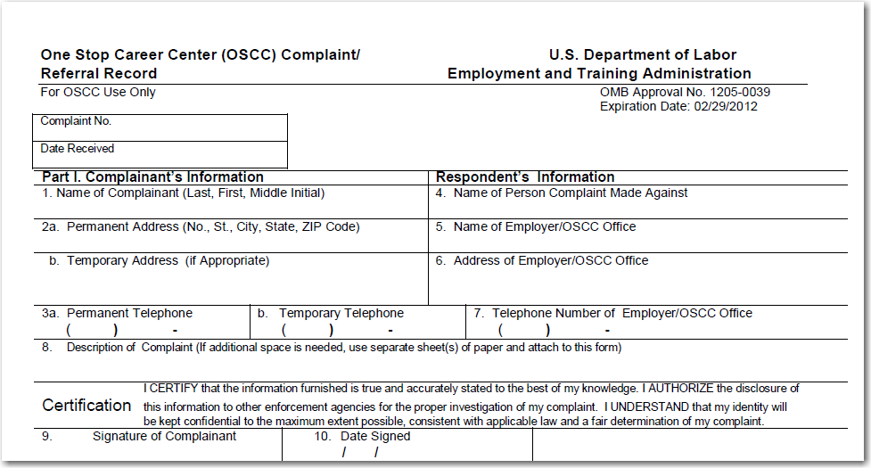
One-Stop Career Center (OSCC) Complaint Referral Record ETA 8429
Notes:
Shown here is part one of the One-Stop Career Center Complaint/Referral Record, commonly referred to as the ETA 8429, which is used to document and process complaints filed at the One-Stops. Any time a complaint is initiated by a customer, it is imperative that staff complete this form in its entirety before attempting any informal or formal resolutions.
Part one of this form documents the complainant’s and respondent’s information and a description of the complaint. Complainants should list their permanent and temporary address and telephone number where they may be reached during the investigation. If the complainant is an MSFW, list any temporary addresses and telephone numbers to include the name of a grower or directions to the site. If this information is not available, ask for a friend or family member’s contact information where the complainant may be reached or given a message.
The description of the complaint must be written in the first person and should describe the incident as accurately and completely as possible. The description should include information such as the specific wrong-doing, the complainant’s proposed or expected corrective action, amounts of wages due, number of hours worked, dates and times, and any additional details that will aid in the investigation. If additional space is required, do not write on the back of the ETA 8429. Use additional sheets of paper to list the additional information and ensure the complainant’s name and the complaint number is listed on the extra sheets. It is also suggested to have the complainant sign the additional sheets to certify the information listed. On the extra pages, draw a diagonal line from the last word of the statement to the end of the page to ensure additional comments are not made to the original statement.
Review part one with the complainant and collect their signature and date.
It is pertinent that each of these fields are completed with as much information as possible as this sections aids in the initiation of the complaint.

Slide 4
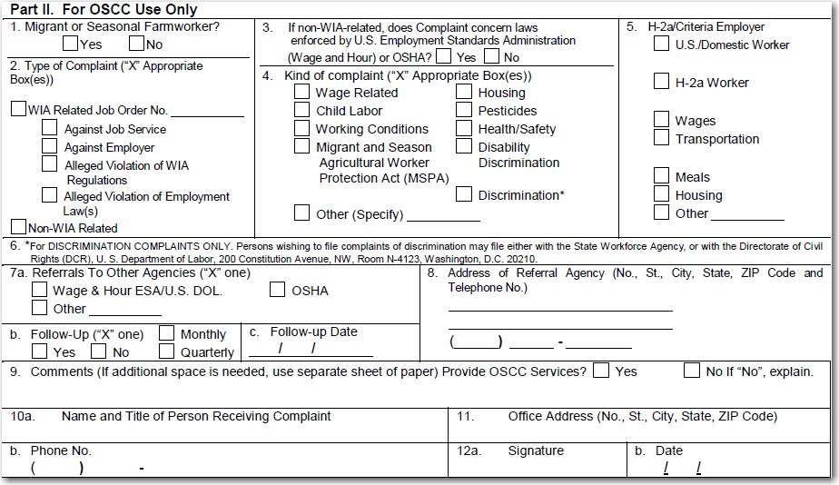
One-Stop Career Center (OSCC) Complaint Referral Record ETA 8429
Notes:
Shown here is part two of the ETA 8429 which must only be completed by the One-Stop Career Center Staff. This section collects additional details that aid in processing the complaint form.
Section one requests information about a complainant’s migrant or seasonal farm worker status. This section is important as it helps to identify the type of follow-up that may be necessary in the future. Section two is used to indicate whether the complaint is WP related or non-WP related. You may notice that block two lists the types of complaints as WIA related and non-WIA related. These terms are synonymous with Wagner-Peyser related and non-Wagner-Peyser related complaints, meaning that if a complaint is WP related, staff would mark WIA related and if it is non-WP related, non-WIA related would be selected.
Section three requests information about types of non-WP related complaints and should only be completed if the complaint is not WP related.
Section four goes on to further define the kind of complaint that is being filed. More than one box may be appropriate for selection in this section.
Section five should be completed if the complaint involves an H-2A job order.
Section six provides information for discrimination complaints only. These complaints should be sent to the local Equal Employment Opportunity Commission or the Florida Commission on Human Relations.
Section 7a requires the selection of the appropriate referral agency who will handle the complaint. If a complaint involves multiple agencies, the One-Stop must complete a new ETA 8429 form and list each referral agency’s address separately.
Section 7b must indicate if follow-up will be required for the complaint. If marked ‘yes’, indicate whether monthly or quarterly follow-up is necessary. It is important to keep in mind that all WP related complaints must have follow-up indicated on the ETA 8429 regardless if local resolution is attained.
Section 7c must be completed to list the appropriate follow-up date.
Section eight must list the referral agency to whom the complaint is being referred for follow-up. If the complaint is referred to multiple agencies, staff must send a separate ETA 8429 to each individual agency. Staff should not list multiple addresses on one form.
Section nine must be marked to indicate whether one-stop center services were provided. If marked “no”, staff must explain why no other one-stop services were provided. Remember, all complainants should be offered and provided with one-stop services regardless of the nature of the complaint. It is up to the complainant to accept or deny the additional services.
Sections 10a – 12b must be completed to document the information of the staff responsible for taking the complaint.
Part two of the ETA 8429 must be completed in its entirety, depending on the type of complaint, to ensure accurate reporting and timely processing.

Slide 5
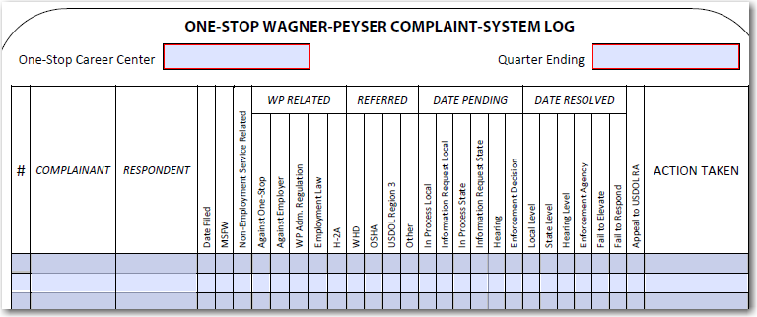
Notes:
All complaints must be documented on the complaint log, shown here. This log must be used to document the complaint, regardless of the type, until the complaint is resolved. Complaint logs are monitored during the annual quality assurance monitoring and submitted to the Senior Monitor Advocate quarterly.

Slide 6
Wagner-Peyser related
Processing Complaints through Resolution
Notes:
The next portion of this presentation will review examples of Wagner-Peyser related complaints, demonstrate how to complete the ETA 8429 and discuss the steps to process the complaint through resolution.
The following examples have been developed only for the purpose of displaying properly completed Complaint Referral forms. Some complaints may be referred to different agencies depending on the type of complaint. Please consult the Complaint System Handbook for referral agency addresses.

Slide 7
WP Related Complaint – Violation of Employment Related Law
Scenario:
Jim Bainbridge was referred to job order 965874 on July 23, 2010. On February 1, 2011 he enters the One-Stop Career Center to file a complaint against the employer, Moore Construction, for not paying him overtime wages. Jim states that Mr. Bradley Moore owes him for 23 hours of overtime worked during the week of January 16-23, 2011. Jim is not an MSFW.
Notes:
Jim Bainbridge was referred to job order 965874 on July 23, 2010. He enters the One-Stop Career Center on February 1, 2011 to file a complaint against his employer, Moore Construction, for not paying him for overtime worked. Jim states that Mr. Bradley Moore owes him for 23 hours of overtime worked during the week of January 16-23, 2011. Jim is not an MSFW.

Slide 8
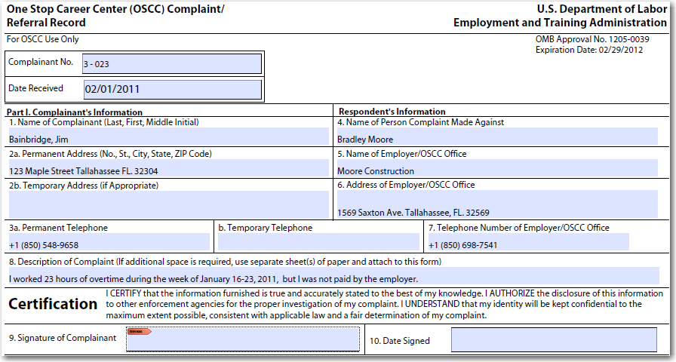
Jim Bainbridge
2/1/2011
Notes:
The first step of the complaint process would be to provide the complainant with an overview of how the complaint system operates to include the data collection process, reassurance of confidentiality to the extent possible and an explanation about how the customer will be informed of the progress and resolution of the issue.
Next, complete the ETA 8429 form. The One-Stop Career Center staff should fill in the complaint number and the date the complaint is received. Remember, the complaint number should list the quarter the complaint is filed followed by the consecutive number of the complaint based on the fiscal year, starting July 1st. As shown here, this complaint has been filed in the third quarter and is the 23rd complaint of the year.
Part one of the form should be completed by the complainant unless they ask for assistance from the One-Stop staff. Each field must be completed where appropriate.
Staff should ensure that the description of the complaint is listed in the first person. As shown here, Mr. Bainbridge has listed “I worked 23 hours of overtime during the week of January 16-23, 2011, but was not paid by the employer”. It would be incorrect for the description to state “The complainant worked 23 hours of overtime and was not paid”, as this is referencing the complainant in the third person.
Lastly, have the complainant sign and date the form.

Slide 9
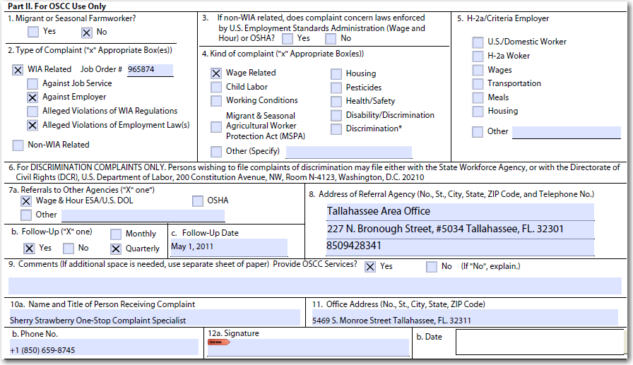
Rm 4120
Sherry Strawberry
2/1/11
Sherry Strawberry
2/1/2011
Notes:
Part two of the ETA 8429 must be completed by the One-Stop Career Center staff only. This portion of the form helps determine what type of complaint is being filed and which enforcement agency must receive the referral.
The scenario indicates that Mr. Bainbridge was not an MSFW, so the first block should be marked no. Section two asks if this is a Wagner-Peyser related or non-Wagner-Peyser related complaint. Since the scenario mentions that he was referred to a job order, this is an indication that this complaint is a Wagner-Peyser related complaint, and the job order number should be listed. Any time there is a Wagner-Peyser related complaint, staff must indicate who the complaint is against and what the alleged violation concerns. In this case, this complaint is against the employer and concerns violations of employment related laws.
Section three only refers to non-WP related complaints and would not be applicable to this scenario.
Section four requires information about the nature of the complaint. Mr. Bainbridge has not been paid overtime wages, thus making the ‘wage related’ box the correct selection.
Section five does not apply to this complaint because it is not an H-2A related complaint.
Section seven ‘a’ should be marked for the appropriate enforcement agency that will handle the complaint. In this case, the complaint should go to the Wage and Hour division.
Section seven ‘b’ should be marked ‘yes’ for follow-up because this complaint is Wagner-Peyser related and these types of complaints are always followed up on until resolution. The follow-up schedule would be performed quarterly since this is a non-MSFW complaint.
Section eight lists the referral agency’s information.
Section nine has been marked yes to indicate the provision of other one-stop services.
And lastly, sections 10a-12b have been completed by the one-stop staff who was responsible for taking this complaint.

Slide 10
Log complaint
Draft a referral letter for Wage and Hour (WHD)
Provide complainant a copy of the referral letter and ETA 8429
Send the referral letter and complaint to WHD
Follow up on the complaint quarterly until resolution
Indicate follow up information on the fact sheets
Log the complaint’s resolution
Notes:
Shown here are the next steps staff must complete to properly process this complaint. Upon completion of the ETA 8429:
Log the complaint information on the complaint log.
Draft a referral letter that will be sent with the complaint form to the Wage and Hour Division.
Provide a copy of the completed form and referral to the complainant for their records. Collect any evidence of the nonpayment of wages from the customer to include paystubs, timesheets and additional proof of nonpayment that may be forwarded with the referral letter and complaint.
Follow up with the referral agency on a quarterly basis until the complaint has been resolved. Provide follow-up to the complainant as well.
Additional follow-up information must be listed on a fact sheet. This additional information would include items such as the date and time the one-stop followed up on the complaint, the current status of the investigation, whether contact has been made with the complainant and the details of those conversations or correspondence.
Staff must continue this follow-up process until the complaint has been resolved and indicate resolution on the complaint log.

Slide 11
WP Related Complaint – Violation of WP Regulations
Scenario:
Roberto Ruiz is interested in applying for four non-agricultural suppressed job orders in EFM. He goes to the One-Stop to get pre-screened for the positions. Roberto meets all of the minimum qualifications for each position but is refused the referrals by the One-Stop Representative. Roberto is an MSFW.
Notes:
In this scenario, Roberto Ruiz is interested in applying for four non-agricultural suppressed job orders. He enters the one-stop to get pre-screened for the referrals. Roberto meets all of the minimum qualifications for each position but is refused the referrals by the one-stop representative. Roberto is an MSFW.

Slide 12
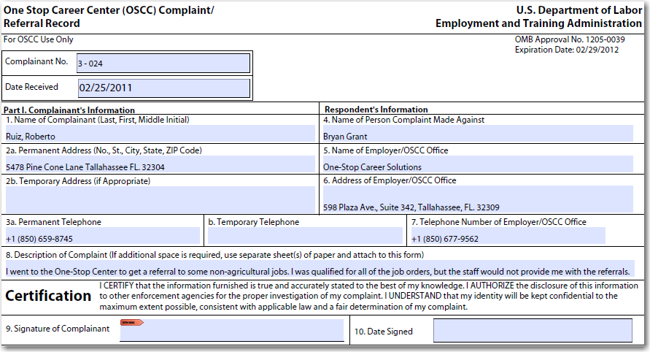
Roberto Ruiz
2/25/2011
Notes:
The complainant or Complaint Specialist must complete part one of the ETA 8429 and sign and date. Section eight must be written in the first person with sufficient information to initiate the investigation.

Slide 13
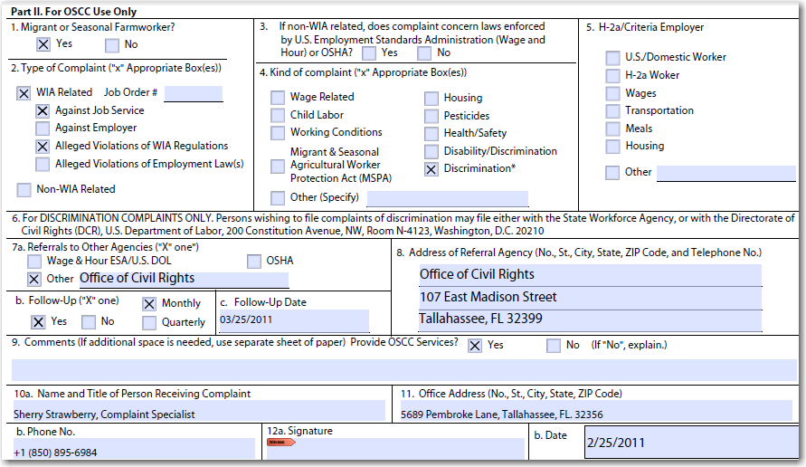
(Only if there is no local resolution)
(Only if there is no local resolution)
Sherry Strawberry
Notes:
According to this scenario, the complainant is an MSFW; thus mark section one ‘yes’.
The scenario mentions that one-stop center staff refused to provide Mr. Ruiz with referrals to several job orders for which he was qualified. This would be a violation of Wagner-Peyser regulations, which provide universal access to labor exchange services, and may be an indicator that because he is an MSFW who wanted non-agricultural referrals, he may have been denied these referrals based on his ethnicity. Therefore, section two must indicate this complaint as a WIA or WP-related complaint against the One-Stop for alleged violations of WIA regulations.
Section three would not apply.
Section four would indicate the kind of complaint as a ‘discrimination’ complaint.
Section five would not apply.
Since this is a discrimination complaint against the one-stop staff, section 7a should be left blank while informal resolution is attempted by the Regional Workforce Board’s Equal Opportunity officer.
Follow-up is performed for all WIA related complaints, so section 7b must be marked ‘yes’ and ‘monthly’ because the customer is an MSFW.
Section 7c must indicate when the next follow-up would occur; in this scenario, staff would indicate the monthly follow-up date, which for this scenario would be March 25, 2011.
Section eight must be left blank while informal resolution is attempted. Regional staff must attempt local resolution of the complaint within five working days; however, if the complainant is not satisfied with the local attempt at resolution, the one-stop must escalate the complaint to the state workforce agency’s Office of Civil Rights.
Section nine would be marked ‘yes’, and the appropriate one-stop services should be provided. The recommended service would be referral to the initial job orders the complainant wanted if they are still open or performing a staff assisted job search.
Sections 10a-12b must be completed by the person taking the complaint.

Slide 14
Log the complaint
Provide complainant a copy of the ETA 8429
Investigate complaint and attempt informal resolution within 5 days
If not resolved within 5 days, draft referral letter and send with complaint to OCR
Follow up on the complaint monthly until resolution
Indicate follow up information on the fact sheets
Log the complaint's resolution
Notes:
Shown here are the next steps staff must complete to properly process this complaint. Upon completion of the ETA 8429:
Log the complaint information on the complaint log.
Provide a copy of the completed form to the complainant for their records.
Investigate the complaint and attempt an informal resolution within five working days.
If informal resolution cannot be obtained within five working days or complainant is not satisfied with the outcome, draft a referral letter that will be sent with the complaint form to the Office of Civil Rights.
Follow up with the referral agency on a monthly basis until the complaint has been resolved. Provide follow-up to the complainant as well.
Additional follow-up information must be listed on a fact sheet.
Staff must continue this follow-up process until the complaint has been resolved and indicate resolution on the complaint log.

Slide 15
WP Related Complaint – Violation of Terms of a Job Order
Scenario:
Sue -Ellen Wells was provided a referral to job order 976233 on March 23, 2011. The terms of the job order stated that the applicant would be paid bi-weekly at $10.75/hr. Sue -Ellen was hired, but she soon found the conditions of the job order to be much different than those originally listed when she was referred. Instead of paying $10.75/hr, she was paid $9.25/hr. Sue is not an MSFW and files her complaint on April 12, 2011.
Notes:
Sue-Ellen Wells was provided a job referral on March 23, 2011. The terms of the order stated that the applicant would be paid bi-weekly at $10.75 an hour. Sue-Ellen was hired for the position, but she soon found the conditions of the job offer to be different than those originally listed on the job order. Instead of getting paid $10.75 an hour, Sue-Ellen was only paid $9.25 an hour. Sue-Ellen is not an MSFW and files her complaint on April 12, 2011.

Slide 16
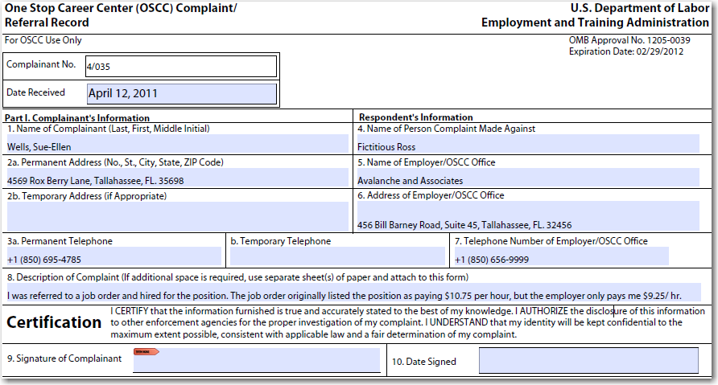
Sue Ellen Wells
4/12/2011
Notes:
The One-Stop Complaint Specialist should complete the section with the complaint number and date received. Sue-Ellen filed her complaint on April 12th which is the fourth quarter of the fiscal year, thus the complaint number should list the fourth quarter and the number of the complaint that has been filed that program year.
The complainant should complete each field in part one unless they request the assistance of the one-stop staff.

Slide 17
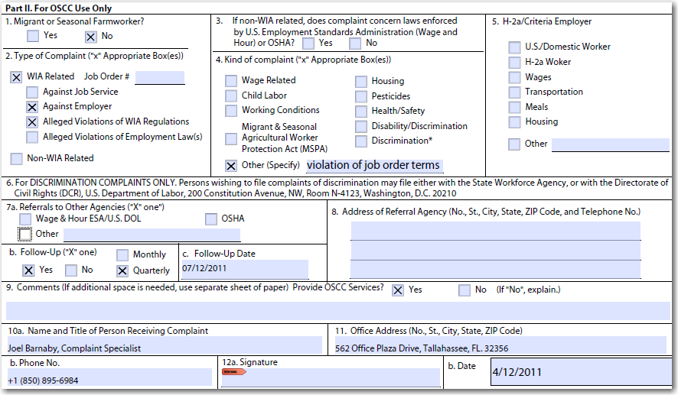
976233
Joel Barnaby
Notes:
According to the scenario, Sue Ellen is not an MSFW, so section one must be marked ‘no’.
This would be a WIA related complaint, because she was referred to the job by the One-Stop. Staff must list the job order number. This complaint is against the employer because Sue Ellen was not paid the salary that was initially listed in the order, and it is a violation of WIA regulations.
Section three does not apply.
In Section four, staff should mark ‘other’ and specify “violation of job order terms” on the blank provided.
Section five does not apply.
Since the violation of the terms of the job order did not lower the wage below minimum wage, which would have made this a federal offense, the Wage and Hour Division would not be the appropriate referral agency. Instead, the referral information should be left blank, and the region should attempt local resolution with the employer. If the employer refuses to pay the wage listed on the job order, the region should initiate the discontinuation of services process with the employer.
Follow-up would be checked ‘yes’ and ‘quarterly’ with the next follow-up date listed.
One-Stop Career Center services should be offered and indicated by ‘yes’ in section nine. If services are not offered, ‘no’ should be marked, and a reason must be listed to explain why services were not provided.
Sections 10a – 12b must be completed by the staff who received the complaint.

Slide 18
Log the complaint
Provide complainant a copy of the ETA 8429
Attempt local resolution within 15 days of the complaint filing date
If not resolved within 15 days, initiate the discontinuation of services procedures
Conduct quarterly follow up until resolution
Indicate follow up information on the fact sheets
Log complaint resolution
Notes:
Shown here are the next steps staff must complete to properly process this complaint. Upon completion of the ETA 8429:
Log the complaint information on the complaint log.
Provide a copy of the completed form to the complainant for their records.
Contact the employer to discuss the complaint and attempt to resolve the problem at the local level. If staff are unable to resolve the issue within 15 working days of the complaint filing date, begin the discontinuation of services procedures.
Follow up with the complainant on a quarterly basis until the complaint has been resolved.
Additional follow up information must be listed on a fact sheet.
Staff must continue this follow up process until the complaint has been resolved and indicate resolution on the complaint log.

Slide 19
WP Related Complaint - Discrimination
Scenario:
Jackie Bell was referred by the One-Stop to Jake’s Auto Body, job order 965874, on November 5, 2010. Jackie comes to the One-Stop on November 12, 2010 to file a complaint. She states that the employer, Mr. Jake Beaver, told her that she was not masculine enough to fulfill the requirements of the position which is suited for a man. Jackie is not an MSFW.
Notes:
Jackie Bell was referred by the One-Stop to Jake’s Auto Body. She wants to file a complaint because the employer told her that she was not masculine enough to fulfill a man’s position. Jackie is not an MSFW.

Slide 20
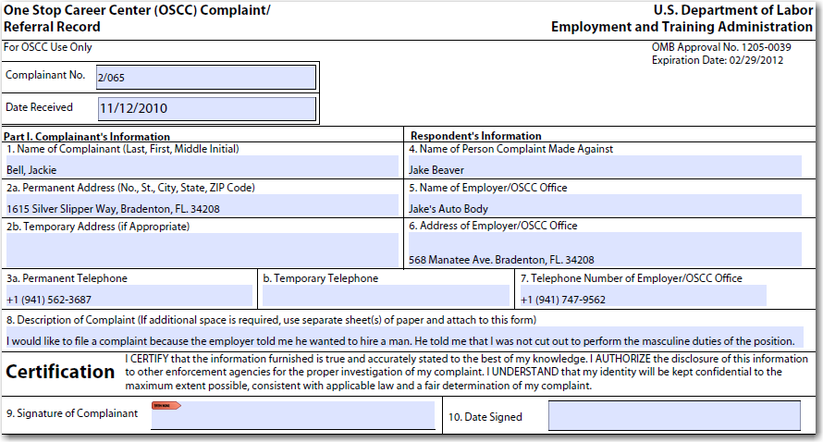
Jackie Bell
11/12/2010
Notes:
The One-Stop staff must complete the complaint number and date.
The complainant must complete part one and sign and date the section.

Slide 21
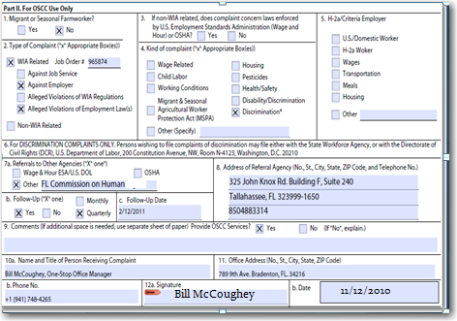
Relations
2009 Apalachee Pkwy, Ste. 100
Tallahassee, FL. 32301
(850)4888-7082
Notes:
Jackie is not an MSFW, so section one would be marked ‘no’.
She was referred to the job by the One-Stop, which makes this a WIA related complaint accompanied by the job order number. Jackie’s complaint is against the employer and involves a violation of employment laws.
Section three does not apply.
This is an “alleged discrimination” complaint.
Section five does not apply.
Discrimination complaints would be referred to the Florida Commission on Human Relations and/or the Equal Employment Opportunity Commission. The Florida Commission on Human Relations may be able to process the complaint more rapidly, but the complaint may be sent to either or both agencies.
For section 7b-c, follow-up is required to be completed quarterly because it is a WIA related complaint and Jackie is not an MSFW.
Section eight should list the referral agency’s address.
One-Stop Career Center Services should be offered and provided, therefore checking ‘yes’. If the services are refused check ‘no’ and explain.
Sections 10a-12b must be completed by the staff taking the complaint.

Slide 22
Document the complaint on the complaint log
Draft a referral letter for the appropriate agency
Provide a copy of the referral letter and ETA 8429 to the complainant
Send the referral letter and complaint form to the Equal Employment Opportunity Commission (EEOC) and/or Commission on Human Relations
Follow up on the complaint quarterly until resolution
Indicate follow up information on the fact sheets
Log resolution on the complaint log
Notes:
After completing the ETA 8429:
Document the complaint on the complaint log
Draft a letter to provide to the referral agency
Provide a copy of the referral letter and complaint form to the complainant for their records
Send the referral letter and complaint form to the EEOC and/or Commission on Human Relations
Follow up with the referral agency quarterly and list any follow-up information on the fact sheet. Provide follow-up to the complainant as well.
Staff must continue this follow-up process until the complaint has been resolved and logged on the complaint log.

Slide 23
WP Related Complaint – Employer in a Different State
Scenario:
Lisa Prawley moved to Florida from Alabama. Lisa enters the One-Stop Center to file a complaint against her previous employer in Alabama. She states that her previous employer owes her for one week of pay and ten hours of overtime. She was referred to this employer by a One-Stop in Alabama. Lisa is not an MSFW and filed her complaint on January 13, 2011.
Notes:
Lisa Prawley moved to Florida from Alabama. She files a complaint on January 13, 2011 at the One-Stop about her previous employer in Alabama stating that she is owed for one week of regular pay and ten hours of overtime. Lisa was referred to the employer by a One-Stop in Alabama. She is not an MSFW.

Slide 24
3/066
Lisa Prawley
Lisa Prawley
1/13/2011
1/13/11
Notes:
One-Stop Center staff must complete the complaint number and date received. The customer should complete part one and sign and date the section.

Slide 25
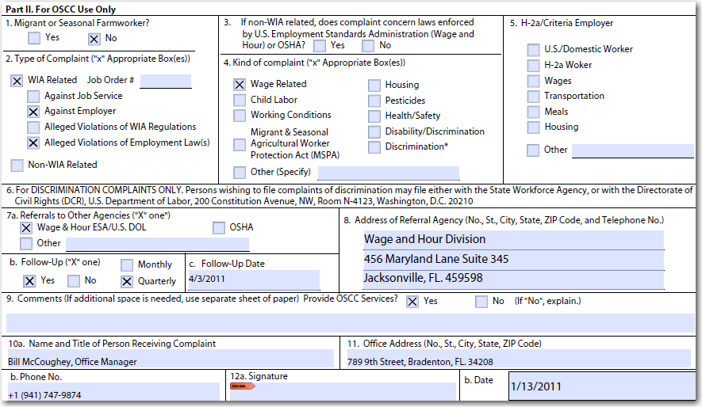
4/13/2011
Bill McCoughey
Notes:
Lisa is not an MSFW, therefore question one must be marked ‘no’.
Although Lisa is filing a complaint about an employer in another state, the complaint does involve the labor exchange system and is considered a WIA/WP related complaint. This complaint is against an employer and alleges violations of employment laws.
Question three does not apply.
Section four must be marked as ‘wage related’ as Lisa is complaining that she has not been paid for hours worked and overtime pay.
Question five does not apply.
As this complaint involves an employer in another state, a copy of the complaint and supporting documents would be sent to the state workforce agency, attention Senior Monitor Advocate.
Section 7b must indicate the required follow-up, which would be ‘yes’ and ‘quarterly’ since Lisa is not an MSFW.
7c must indicate the next quarterly follow-up date.
Section eight should be left blank.
Staff must offer and provide one-stop services. If they are declined, complete section nine as appropriate.
Section 10a-12b must be completed by the staff who receives the complaint.

Slide 26
Draft a referral memo
Provide a copy of the ETA 8429 and referral to the complainant
Send copy of complaint file to the Senior Monitor Advocate
Do not send originals, only copies
Follow up on the complaint quarterly until resolution
Indicate follow up information on the facts sheets
Log the complaint’s resolution
Document the complaint on the complaint log
Notes:
After completing the ETA 8429:
Document the complaint on the complaint log.
Draft a referral memo to send with the complaint form.
Provide a copy of the completed form to the complainant for their records.
Send a copy of the file, which includes a referral memo, the ETA 8429 and supporting documentation, to the Senior Monitor Advocate. Do not send the original documentation, only copies.
Follow up with the Senior Monitor Advocate on a quarterly basis until the complaint has been resolved. Provide follow-up to the complainant as well.
Additional follow-up information must be listed on a fact sheet.
Staff must continue this follow-up process until the complaint has been resolved.

Slide 27
WP Related Complaint – Multiple One-Stop Career Centers in Florida
Scenario:
Anna Ruiz files a complaint on May 5, 2011 against three different One-Stops in Florida for refusing to provide her with services. Anna is an MSFW.
Notes:
Anna Ruiz files a complaint on May 5, 2011 stating that three different one-stops in Florida refused to provide her with services. Anna is an MSFW.

Slide 28
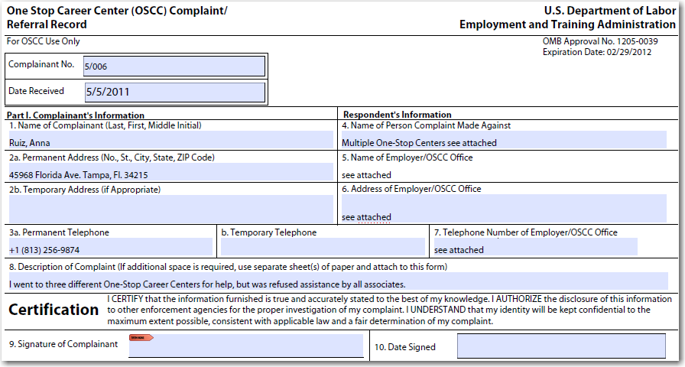
4/006
Anna Ruiz
May 5, 2011
Notes:
The one-stop Complaint Specialist must complete the complaint number, including the quarter and date received.
Part one must be completed by the complainant unless they request assistance.

Slide 29
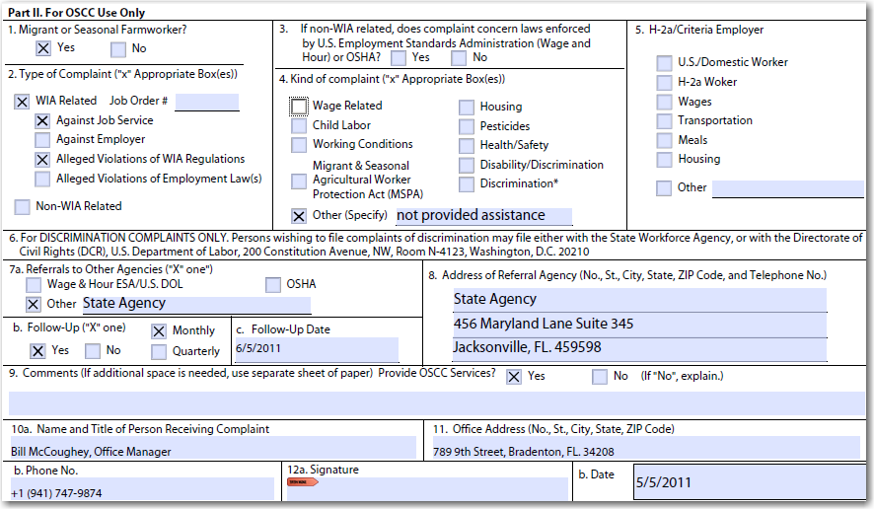
State Agency
cc/: Senior Monitor Advocate
107 E. Madison Street
Tallahassee, FL. 32399
Bill McCoughey
Notes:
Part two must be completed by the staff receiving the complaint.
Anna is an MSFW, and question one must be checked ‘yes’.
The scenario states that Anna was refused services by one-stop center staff. The one-stop centers are required to offer universal services to all customers, and refusal of such violates the law. This scenario makes this complaint WIA related against the One Stop for alleged violations of WIA regulations.
Section three does not apply.
Section four must be marked ‘other’ with the specific reason listed.
Section five does not apply.
Complaints which involve multiple one-stops in different regions within the state must be immediately referred to the Senior Monitor Advocate. Section 7a must be marked other with the specific referral agency listed.
Section 7b must indicate the appropriate follow-up. As Anna is an MSFW, this complaint would require monthly follow-up.
7c must indicate the next follow-up date, which would be one month from the date the complaint is filed.
Section eight must list the referral agency’s address.
Question nine must be marked ‘yes’ and one-stop services provided (unless they have been declined).
Sections 10a-12b must be completed by the person receiving the complaint.

Slide 30
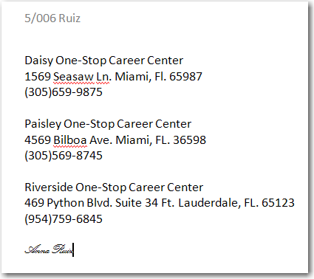
Additional Information Page
4/006
Notes:
Shown here is a supplemental page listing each one-stop center’s address who denied Anna services. As mentioned earlier, supplemental pages should be used if there is an overflow of information. The complaint quarter and number should be listed at the top of each subsequent page. It is recommended that the complainant sign each page indicating affirmation of the information listed.

Slide 31
Log the complaint
Draft a referral memo to the Senior Monitor Advocate
Provide the complainant a copy of the referral memo and ETA 8429
Send a copy of complaint file to the Senior Monitor Advocate
Follow up on the complaint monthly until resolution
Indicate follow up information on the fact sheets
Log the complaint resolution
Notes:
After completing the ETA 8429:
Document the complaint on the complaint log.
Draft a referral memo to send with the complaint form.
Provide a copy of the completed form to the complainant for their records.
Submit the referral memo and complaint form to the state workforce agency’s Senior Monitor Advocate for processing and resolution.
Follow up with the state workforce agency monthly until the complaint has been resolved.
Additional follow-up information must be listed on a fact sheet.
Staff must continue this follow-up process until the complaint has been resolved.

Slide 32
Complete ETA 8429
Log complaint in the complaint log
Draft referral memo for referral agency, as appropriate
Indicate follow up information on the fact sheets
Document the complaint’s resolution on the complaint log
Conduct follow up accordingly
Send referral memo and complaint form to appropriate agency, or attempt informal resolution, as appropriate
Provide complainant a copy of referral memo and ETA 8429
Only if WP related or Non-WP related, MSFW
Monthly for MSFW or quarterly for all other customers
Notes:
Shown here is the complaint process at a glance. Each complaint the One-Stop Career Center processes will be different. However, by following these steps in the order listed, each complaint will be processed and resolved in a timely manner.

Slide 33
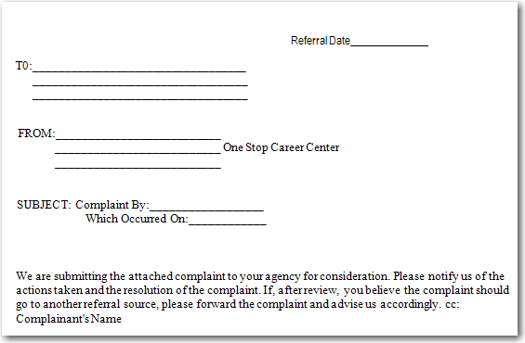
Referral Agency Cover Letter
Notes:
Shown here is a cover letter template that may be used when referring a complaint to another agency. A cover letter should accompany all complaints that are elevated to an agency or department other than the One-Stop Career Center. The cover letter may be printed on the One-Stop Career Center’s letterhead.

Slide 34
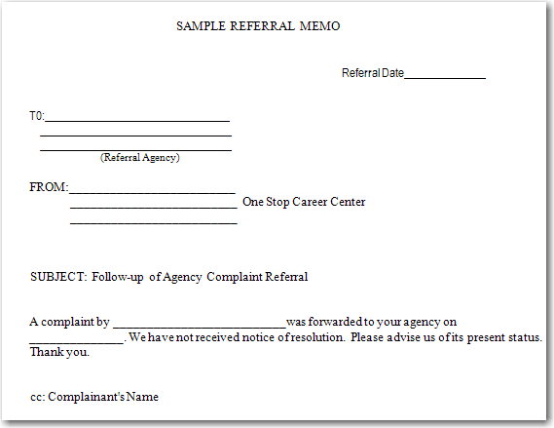
Follow-Up Referral Memo
Notes:
Shown here is a follow-up referral memo that may be used when conducting follow-up on a complaint that was elevated to another agency.

Slide 35
Quiz
Test Your Knowledge
Notes:
Thank you for viewing the Wagner-Peyser related complaint instructions. Please take a moment to complete the following quiz questions.

Slide 36
Quiz
Wagner-Peyser related complaints may involve which of the following:
Violations of employment related laws
Violations of Wagner-Peyser regulations
Discrimination
All of the above
A and B
Notes:
Answer: D

Slide 37
Quiz
Wagner-Peyser related complaints may only be accepted if they are filed within the past ___ months.
6
10
12
24
Notes:
answer: C

Slide 38
Quiz
Follow up must be conducted ___ for Migrant Seasonal Farm Worker complaints?
Daily
Weekly
Monthly
Quarterly
Notes:
Answer: C

Slide 39
Quiz
True or False.
The complainant’s description of the complaint must be written in third person.
Notes:
Answer: False. A complainant’s description of a complaint must be written in first person.

Slide 40
Quiz
Local resolution must be attempted on which type of complaint(s)?
Wage related
Discrimination
Job order violations
None of the above
Notes:
Answer: C

Slide 41
Quiz
Discrimination complaints may be referred to which agency?
Office of Civil Rights
Wage and Hour Division
Equal Employment Opportunity Commission
A and C
Notes:
Answer: D

Slide 42
Quiz
True or False.
All original forms must be sent to a referral agency.
Notes:
Answer: False. Only copies of documentation should be sent to a referral agency.

Slide 43
Quiz
All complaints must be logged on which of the following?
Log of Apparent Violations
Complaint Log
Monthly Complaint Report
None of the above
Notes:
Answer: B

Slide 44
Quiz
True or False.
One-Stop Career Centers are not required to process complaints filed about an employer in another state.
Notes:
Answer: False. If the complainant was referred to the employer through a job service center, the One-Stop Career Centers must process the complaint as a Wagner-Peyser complaint using the formal complaint-resolution system.

Slide 45
Quiz
Non-MSFW complaints must be followed up ___
Monthly
Quarterly
Annually
No follow up is required
Notes:
Answer: B

Slide 46
Additional Information
Danielle McNeil
Phone: (850)245-7498
E-mail: Danielle.McNeil@deo.myflorida.com
Tammellia Bacon
Phone: (850)921-3868
E-mail: Tammellia.Bacon@deo.myflorida.com
Marisela Ruiz
Phone: (850)921-3207
E-mail: Marisela.Ruiz@deo.myflorida.com
Notes:
Thank you for viewing the Wagner-Peyser related complaint processing instructional guide. If you have additional questions or require assistance processing a complaint, please contact one of the representatives listed on this slide.

