Slide 1
Welfare Transition Automation
One-Stop Service Tracking (OSST) Client Login and Client Screens – Part 2
Notes:
Welcome to the Department of Economic Opportunity’s (DEO’s) Welfare Transition (WT) program presentation. This presentation focuses on Client Login and Client Screens for WT applicants in the One Stop Service Tracking (OSST) system who must complete the Work Registration process.

Slide 2
Objective
Understand the “My Status” Screens
Familiarize you with the Client’s Online Instructions
Familiarize you with Client Result pages
Notes:
In Part 1 of the Client Login and Client Screens, we discussed the Login steps and completing Client Information. In Part 2, we will discuss the Client’s Status screens, instructions provided on the status screens Client Result pages.

Slide 3
Notes:
The “My Status” Screen is designed to help the work registrant navigate their work registration requirements and serves as a guide to show them where they are, what they have completed and what they have left to do. Once the customer has successfully logged in as described in Part 1 of the Client Login and Client Screens modules, they will see a Welcome message as well as their first step, which is the Orientation or Program Overview. Clicking the hyperlink to access the Orientation will display either the State’s default or the region’s customized presentation.
The customer will also be required to complete some acknowledgements before being allowed to move on to their next step. The system will not allow them to move forward if the boxes are not selected. The customer will acknowledge and attest that:
They understand that their social security number may be used to administer the program and in the provision of program services, including their eligibility to receive services, communicate program participation, and reporting purposes;
They understand that the RWB may share participation related information with appropriate agencies in the administration of the program for determining continued eligibility for services as well as reporting suspected instances of fraud;
They understand that failure to meet program requirements could result in a loss of program benefits and services
They understand their right to a supervisory review, how to file a grievance with the RWB, file a grievance with the RWB if they disagree with a RWB decision and follow the local grievance process if they feel their issue has not been resolved satisfactorily
They have a right to request a fair hearing with DCF if their benefits are terminated or reduced
They have a right to file a complaint with the Office of Civil rights if they feel their civil rights have been violated based on age, gender, ethnicity, disability or race.

Slide 4
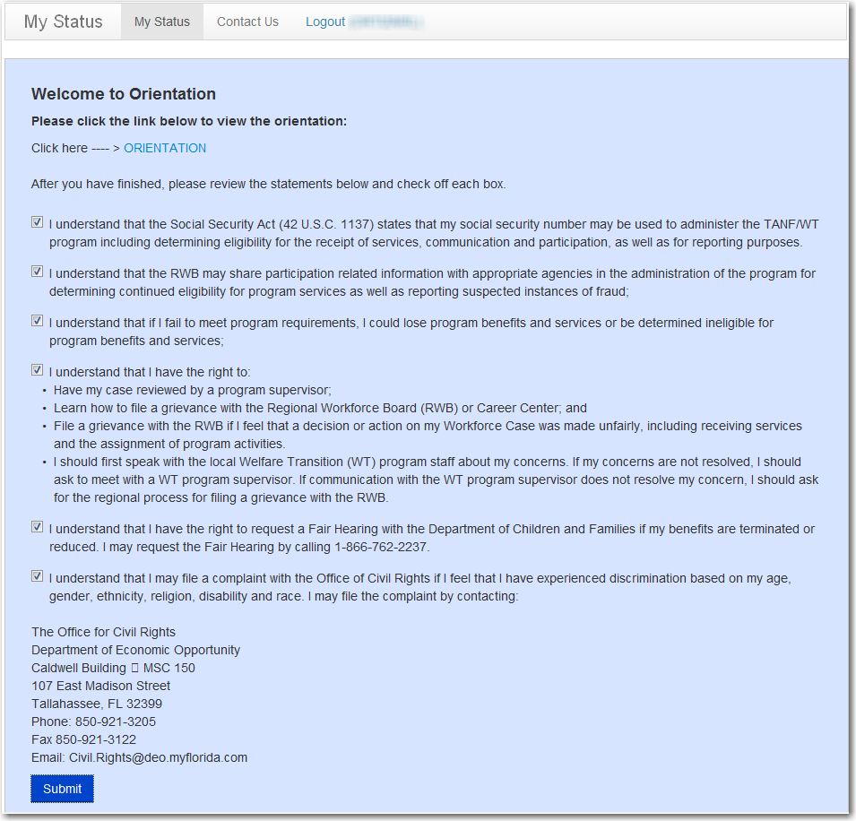
Notes:
After selecting the acknowledgements and clicking Submit, the customer will be automatically directed back to their Status screens.

Slide 5
Notes:
After clicking on the acknowledgements, the work registrant will see the next steps to complete the Work Registration process. Next, the customer will be asked to complete the Intake/Screening which will ask them questions about their needs. These questions will be designed to find out information that will assist the case manager with providing services if the customer becomes mandatory, assist with getting the customer exempted from program participation, and identifying areas of need that may require immediate assistance.
The system also tells them what they have completed, what they have left to complete, and the date it must be completed by. In this example, the customer completed his orientation on 8/22/13. As you can see now the system allows access to the customer to start his intake/screening.

Slide 6
Result Pages
Region’s WR Settings
Needs Screening Answers
Client Result Pages
Requesting immediate assistance
Notes:
The Result Pages shares information with the customer based on two main factors.
How they answer certain questions during the Intake/Screening
If the region requires additional work registration requirements

Slide 7
Caring for a Disabled Family Member
Notes:
If during the Needs Screening the client indicates they are “Caring for a Disabled Family Member” in the home, their result page will give them the opportunity to access the “Need for Care” form and have it completed by the family member’s physician. They are instructed to take the form to the Career Center as soon as possible. If the customer turns in the document within the designated work registration time frame (10 days), the case manager will end code 489 (document submission – Caring for a Disabled Family Member). Once this is ended, OSST will report an “EX” code to DCF. This will alert DCF that they need to secure documentation to exempt the customer from participating in the program. We suggest that once you receive a copy, that you also send a copy to DCF to help facilitate the exemption which will prevent the customer from being referred as a mandatory participant.

Slide 8
What if the work registrant doesn’t turn in the Need for Care Form?
If the customer does not turn in the need for care form within the designated time frame
OSST will automatically close code 489 (day 11)
Report to DCF that the customer satisfied the Work Registration requirement
**the system will not report the code to notify DCF that they should be looking for documentation to exempt the customer
Notes:
If the customer does not turn in the Need for Care form in order be considered for exemption from the program, it will not interfere with their Work Registration requirements. The result pages display after the customer has completed the online process. OSST will report to DCF that the customer has completed the work registration requirements and DCF will process the TCA application.

Slide 9
Permanent Medical – SSI/SSDI Application
Notes:
If during the Needs Screening the client indicates that they have a permanent medical condition and have applied for SSI/SSDI, they will see the result language illustrated in the presentation slide. It gives them the opportunity to access the medical form to have completed by their doctor and instructs them to hold on to the information until their appointment. It also informs them that they should provide proof of their SSI/SSDI application.

Slide 10
Permanent Medical – No SSI/SSDI Application
Notes:
If the customer indicates that they have a permanent medical condition , has not applied for SSI/SSDI, but would like assistance applying for SSI/SSDI the result page will display the language illustrated in the presentation slide. It gives them the option to click the hyperlink to download the medical form, print it and have it completed by their physician. They are instructed to hold on to the form until a determination on their cash assistance case is made and if approved, they should present the career manager with the medical documentation at the time of the first appointment.

Slide 11
Temporary Medical Limitation
Notes:
If the customer indicates that they have a medical condition that will temporarily limit their ability to participate in the program, they will see the result language displayed in the presentation slide.

Slide 12
Temporary Medical – Frequent Appointments
Notes:
If the customer indicates that they have a medical condition that will temporarily limit their ability to participate in the program but they are required to attend frequent medical appointments, they will see the result language illustrated in the presentation slide.

Slide 13
Emergency Question – Potential Up Front Diversion
Notes:
If during the Needs Screening the applicant indicates that they have an emergency situation that lead them to apply for cash and they can provide proof of the emergency and can show proof of ongoing income, they will see the result message illustrated in the presentation slide.

Slide 14
What if the work registrant doesn’t come in to be considered?
If the customer does not come in to be considered for the UFD
OSST will automatically close code UFD code 842 (day 11)
Report to DCF that the customer satisfied the Work Registration requirement
**the system will not report the code to notify DCF that they should be looking for documentation for an UFD decision
Notes:
If the customer doesn’t come in to be considered for Up Front Diversion during the time frame, on day 11 OSST will automatically report up work registration completed if all other requirements have been satisfied. It will not notify DCF to look for an Up Front Diversion decision.

Slide 15
What if the work registrant shows but we deny the request for UFD?
If the customer is denied for UFD
OSST will
Report to DCF that the customer satisfied the Work Registration requirement
**the system will not report the code to notify DCF that they should be looking for documentation for an UFD decision
Notes:
If the customer shows but is denied for Up Front Diversion, OSST will report that the customer has satisfied the work registration requirement and will not report the code to notify DCF to look for an UFD decision.

Slide 16
Confidential Questions – Would like assistance
Notes:
If a Work Registrant answers “Yes” to one of the confidential questions, their result screen will display as shown in the presentation slide. However, there may be variations in language depending on how they answer the follow up questions to the confidential questions. For example, if a customer indicates that they are afraid of someone in their home and indicates that they would like to receive counseling for their domestic situation, the language will display as illustrated. If the customer clicks the link, they will be directed to a map of the state of Florida with a list of available Domestic Violence and Substance Abuse/Mental Health Counseling Resources.

Slide 17
Resource Map
Notes:
When the customer clicks on their county, they will see a list of counseling resources in their area. We are finalizing the resource list and will also provide it on the DEO website as a tool for you to use as well.

Slide 18
Confidential Question – Does not want assistance
Notes:
If the customer answers one of the confidential questions but indicates they do not want assistance with the issue, they are still given the option to click on the map if they change their mind.

Slide 19
What types of confidential questions are asked?
I often feel very sad and I don’t know why
My anger gets so bad at times I can’t control myself
I am easily agitated and I don’t know why
Notes:
We asked questions related to mental health, substance abuse and domestic violence. Examples of such questions may include:
I often feel very sad and I don’t know why
My anger gets so bad at times, I can’t control myself
I am easily agitated and I don’t know why
It also includes questions such as:
I feel unsafe in my home
I often feel that people are out to get me

Slide 20
Homeless
Notes:
If the customer indicates that they are homeless, they are instructed to engage their Career Center for a list of potential resources and referrals.

Slide 21
Need Transportation Assistance
Notes:
If the customer indicates they need transportation assistance, the result page will inform them that if they are approved for cash assistance, they may request this service at the first appointment with a career manager.

Slide 22
Need Childcare Assistance
Notes:
If the applicant indicates they need childcare assistance, they will be informed that if they are approved for cash assistance, they can request the service at their first appointment with a case manager.

Slide 23
Questions?
Email us your questions at WT_SNAPProgramInfo@deo.myflorida.com
Notes:
This concludes part 2 of Client Login and Client Screens. If you have questions about this presentation or other WT program questions, please email us at WT_SNAPProgramInfo@deo.myflorida.com

