Slide 1
Welfare Transition
Automated Pre-penalties and Sanctions
Notes:
Welcome to the Department of Economic Opportunity’s (DEO’s) Welfare Transition (WT) program’s presentation on Automated Pre-Penalties and Sanctions.

Slide 2
Objectives
Understand Automated Pre-penalties and Sanctions
When they start and how does the client know
What must the Career Manager do
Automated Sanctions and the Forgiveness Policy
Notes:
The goal of this presentation is to familiarize you with the automated Pre-penalty and Sanction process. You will learn:
What happens when an automated pre-penalty starts and how the participant is notified
What you must do as part of the automated process
Information about automated sanctions and the forgiveness policy.

Slide 3
Initial Engagement Activity Codes
492
491
Initial Assessment
Engagement Letter
Notes:
Once a individual becomes a mandatory participant in the Welfare Transition (WT) program, they will receive an engagement letter. The engagement letter informs them that they need to log into OSST to complete their Initial Assessment and meet with a career consultant as part of their Initial Engagement Requirement. If you recall from the Initial Engagement presentation, codes 492 and 491 will automatically populate as a part of the automated process when the participant becomes mandatory. If the participant completes the Initial Assessment as required and meets with the career consultant by the due date on their letter, the customer will be removed from the automated process by the case manager.
If the customer fails to complete the Initial Engagement requirement, the system will automatically start the pre-penalty process

Slide 4
When does the pre-penalty start?
The participant has 7 days from the date the Engagement Letter is mailed to
Complete the Initial Assessment
Meet with a career manager to be removed from the automated process
Notes:
The participant has 7 calendar days from the date the Engagement Letter is mailed to:
Complete the Initial Assessment; and
Meet with a Career Manager to be removed from the automated process.

Slide 5
How does the system know when to start?
Notes:
During the auto process, the system will look at the Notice Of Mandatory Appointment (NOMA) start date and will check 7 days after that date to see if the code 492 has been ended by a career manager. If the code has not been ended by a career manager, the system will start the pre-penalty process by mailing out a Notice of Failure to Participate, DEO WTP 2290, to the participant. The system will also generate a case note of the automated events.
The case note provides information about when the NOMA was generated and when the letter was mailed. The 7 days start from the mail date. In this example, you can see that the case note states the letter was generated on August 26, but wasn’t mailed until August 27, 2013. It also includes the date for which the participant must complete his/her Initial Engagement requirements, which is September 03, 2013 in this example.

Slide 6
How do the 7 days work?
Customers will have 7 days to complete the NOMA requirements
Some participants may get more than 7 days if
The end date of the NOMA requirement is on a weekend
The end date of the NOMA requirement is on a holiday
Notes:
The customer will have 7 days to complete the NOMA requirements. However, there may be instances where the participant may have more than 7 days to complete the NOMA before the auto pre-penalty process starts.
If the NOMA requirement end date is on a weekend, the participant will have until the next business day to complete the requirement.
If the NOMA requirement end date is on a holiday, the participant will have until the next business day to complete the requirement.
We will provide examples in the upcoming slides.

Slide 7
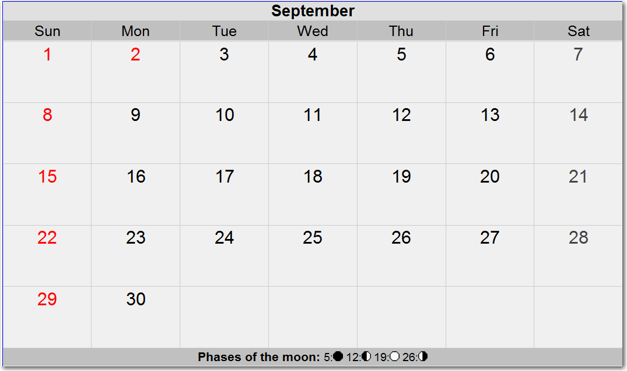
Mail Date
Day 7
NOMA Requirements due date
Notes:
Looking at the month of August in the top panel of the presentation slide, we received the referral on the highlighted date, which is August 26th, the system will confirm the referral, generate the NOMA and mail it on August 27th. The customer’s 7 days will start on August 27th. Although, September 2nd is technically the 7th day from the NOMA mail date, the customer will have until September 3rd to complete the requirements because September 2nd is a Holiday. In this example, the participant will technically have 8 days to complete the requirement.

Slide 8
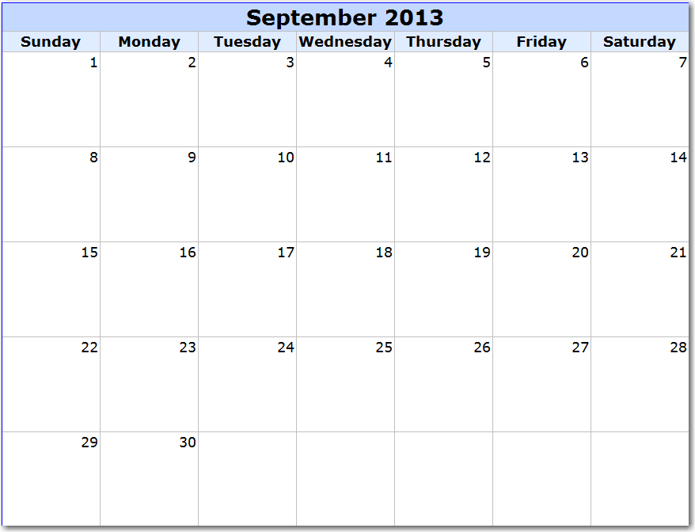
Referral Date
NOMA Mail Date
NOMA Requirements due date
Notes:
Using the same calendar months as in the first example, if the referral comes in on Friday August 30, 2013, the customer will not be mailed a NOMA the next day because the following day is a weekend day. Furthermore, the following Monday, September 2, 2013, is a Holiday so the NOMA would not be mailed that date either. Although the letter will be generated on August 30, 2013, the NOMA will not be mailed until Tuesday, September 3, 2013. This will be the customer’s NOMA start date. The NOMA requirements due date will be September 9, 2013.

Slide 9
Client Screens – Initial Engagement
Notes:
Once the customer receives their NOMA, they are instructed to log back into OSST and complete the steps outlined in their NOMA. When the client logs in to complete the Initial Engagement, they will get steps they must complete in order to be compliant with the Initial Engagement requirements.
Step 1 – reminds them when their NOMA was mailed and gives them an opportunity to view the printed letter.
Step 2 – Informs them that they must complete the instructions on their NOMA, which is 7 days from the NOMA mail date.
Step 3 – reminds them that they are not done until they actually meet with a case manager and failure to meet with the case manager may result in a loss of their benefits.

Slide 10
What happens if the participant fails?
OSST
Generates DEO-WTP form 2290
Mails 2290
Case Manager
Makes oral attempt
Enter case note
Sends an alert to case manager
Provide pre-penalty counseling, if attempt is successful
Notes:
During the auto process, the system will look at the NOMA start date and will check 7 days after that date to see if code 492 has been ended by a career manager or program staff. If the code has not been ended by a career manager, the system will start the pre-penalty process by generating a Notice of Failure to Participate, DEO WTP 2290, and mails the 2290 to the participant. The system will also send an alert to the career manager informing that the pre-penalty process has started and that he or she must make an oral attempt to contact and counsel the participant for the failure. The case manager must enter a case note of the events of the oral attempt. If the oral attempt is unsuccessful, the case manager would indicate that in the case notes. If the oral attempt is successful, the case manager will inform the customer what needs to take place to avoid a penalty on the case and provide pre-penalty counseling.

Slide 11
Case Manager Oral Attempt/Counseling Alert
Notes:
In the last slide we indicated that the case manager would receive an alert to make an oral attempt when the system starts the pre-penalty process on someone who is noncompliant with the Initial Engagement requirements or the NOMA requirements.
When you go to the customer’s to-do’s or alerts, you will see the To-Do or alert type is an “Auto TODO”. The post date will be the date that the pre-penalty was started. The start date will also be the date the Pre-penalty was started. The end date of the TODO will be the 10th day in the 2290 or pre-penalty duration. Remember, if this date is a weekend or a holiday, the penalty will be requested on the next business day. If you click on the customer’s hyperlinked name (which has been purposely obscured), you will see detailed information about the alert. We will show this detail on the next slide.

Slide 12
Pre-penalty Counseling To-Do
Notes:
After clicking on the customer’s hyperlinked name, you will be able to see the details of the alert. The alert notifies the case manager that the WT NOF or the Welfare Transition Notice of Failure has been sent. It further instructs you to call/counsel the participant.

Slide 13
What does the Pre-penalty letter say?
Notes:
The automated pre-penalty letter reminds the customer that an initial letter was mailed and asked them to complete a set of instructions. The goes on to tell the customer that they did not complete the steps outlined in the letter. It informs them that they must log onto the system and complete the initial assessment and meet with a career manager at their local service center before 5pm prior to the last day in the 10-day pre-penalty process. It also reminds them of the steps and tells them about possible good cause reasons for failing to complete the steps. Lastly, the letter provides instructions for them to contact a career manager if they cannot complete the steps by the end of the 10-day pre-penalty process.

Slide 14
What happens if the oral attempt IS NOT successful
System generates 2290
System mails 2290
Case Manager’s oral attempt – unsuccessful and no contact from customer
System requests sanction (Auto sanction) on day 11
Notes:
If the oral attempt is not successful and participant does not respond to the 2290 within 10 days, OSST will automatically request a penalty on the case on the 11th day.

Slide 15
What happens after an automated sanction has been requested?
Notes:
If the oral attempt isn’t successful and the customer doesn’t respond to the 2290, the system requests a sanction on the case. Once the system requests a sanction on the case, this will update the customer’s OSST Client account. IF the customer logs in after the sanction has been requested, the system will notify them that a penalty was requested on their case. The system will also inform them of which sanction level has been requested and notifies them to contact the career center for more information about the sanction request. They will also have the ability to click on a hyperlink to see a copy of the failure letter that was mailed.

Slide 16
What must the customer do if the oral attempt is successful?
Log in to OSST and Complete the Initial Assessment
Counsel the participant and set an appointment date/time to meet with you
Notes:
Now we will discuss what happens if the oral attempt is successful. If the oral attempt is successful, instruct the participant to log on to their OSST account and complete the Initial Assessment and give them a date and time to meet with you. Give them a set date that is before the pre-penalty expires. They must complete both to avoid a penalty.

Slide 17
What happens if the oral attempt is successful and…
The client logs in, completes the Initial Assessment
The client attends the appointment
End code 492 – Skill Development Screen
End pre-penalty with complied – Alternative Plan Screen
Notes:
If the participant logs in and completes the Initial Assessment and attends the case management appointment, you will end Code 492 with an outcome of “Completed” which lets the system know that the customer has satisfied the Initial Engagement requirements. You would also update the pre-penalty with complied. You will end the pre-penalty with the date the customer agreed to comply during your pre-penalty counseling, once the customer has actually complied.

Slide 18
What happens if…
Client logs in and completes the Initial Assessment
DOES NOT attend the appointment
Case manager notates the failure in case notes
Manual Sanction Request if no good cause
This is a 2nd failure – set alert for 3 days
End Code 492 with “Not Completed”
Notes:
If the participant logs in and completes the Initial Assessment, but does not attend the appointment in order to be removed from the Automated process, this is a 2nd Failure. Set an alert from 3 days from the 2nd failure to allow the participant to report good cause for the failure. You will enter a case note that the customer failed to attend the appointment. You will need to include the date and time of the appointment in the case note. You would end code 492 with “Not Completed”. If good cause does not exist, request the appropriate level sanction on the case and mail a Notice of Failure to Demonstrate Satisfactory Compliance, DEO-WTP Form 2292.

Slide 19
Automated Sanctions and the Sanction Forgiveness Policy
OSST
Clearly less than six months
Clearly more than six months
Case Manager
Reviews the sanction history
Borderline
Requests the appropriate level sanction
System alerts case manager to review
Determines the level
Requests the appropriate level
Notes:
There will be instances when the system will not be able to request a sanction because it cannot determine which sanction level to request due to the Sanction Forgiveness Policy. The system will be able to track compliance based on a number of factors, including the time an activity was open and active, a deferral was open and active, or a job was open and active while the case was in Mandatory status since the last time a sanction was ended with compliance. If the system cannot clearly identify that a participant exceeded the six month forgiveness threshold or clearly identify that the case was under the six month threshold, it will send an alert to the case manager to review the sanction history, cash assistance receipt and request the appropriate sanction level.
OSST will look at the elements previously mentioned, look at the last time a sanction was ended with an outcome of “Complied” and calculate the number of months the participant had an open and active activity, training, job, or deferral. The system will not look for JPRs and makes the assumption that if any of these were open and active in a mandatory case status, it will count the time as a compliant month to make the sanction level assessment.
However, there will be instances where the system may assess that the participant was compliant for 5.8 months or 6.2 months. These assessments will be considered borderline, especially in instances where two activities overlapped during that time frame. In borderline situations, the system will alert the case manager to review the sanction history and request the appropriate level.

Slide 20
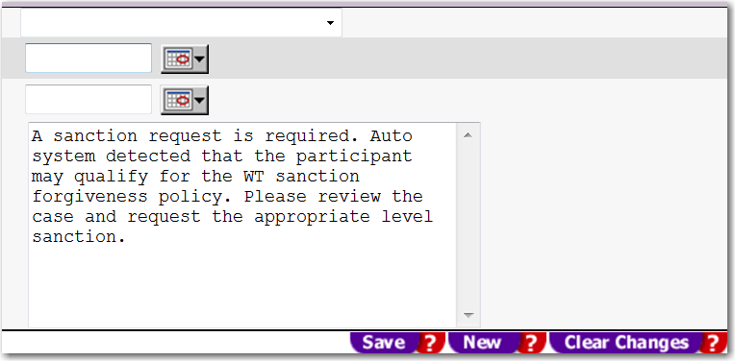
Sanction Forgiveness – Alert and Case Note
Alert
Case Note
Notes:
The Sanction Forgiveness alert and case note will generally contain the same language. It is up to the case manager to review the case and request the appropriate level sanction.

Slide 21
End of Automated Pre-penalties and Sanctions
To learn more about non-automated Pre-Penalties and Sanction, please visit our website and access the three part “Pre-penalties and Sanctions” series. Click on the hyperlink to visit the program training page
Program Training
WT_SNAPProgramInfo@deo.myflorida.com
Notes:
This concludes our presentation on Automated Pre-penalties and sanctions. If you have questions about non-automation pre-penalties and sanctions, please visit our website and access the three part “Pre-penalty and Sanction” series. You may use the hyperlink to access the program training page. If you have questions about this presentation or other WT related program questions, please email the WT Team at WT_SNAPProgramInfo@deo.myflorida.com.

