Slide 1
Tier One Report
2013
Notes:
Welcome to the Tier One Report webinar. During this webinar, we will discuss a report that was built to help manage staff members’ time and efforts in completing the Tier One training program.

Slide 2
First page documents
which Regional Workforce Board (RWB) the data is related to
the date the report was executed
Notes:
The first page of the Tier One Monthly Curriculum Report provides information about when the report was compiled. As you can see on this screen, this report was compiled on February 13, 2013 at 4:22 PM. Any action completed by trainees after 4:22 PM on February 13, 2013 will not be reflected in this report.

Slide 3
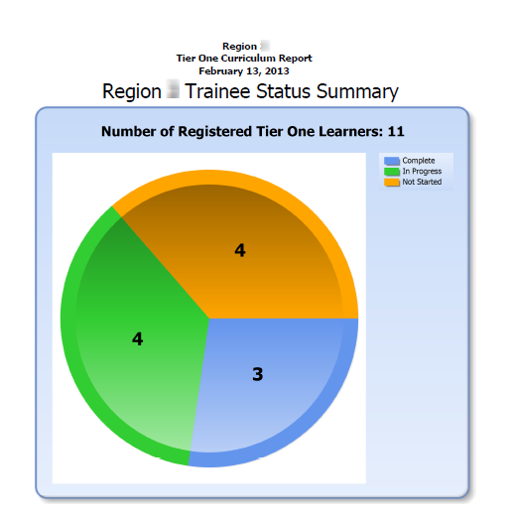
The first section is a high level overview of the number of individuals registered in the Tier One curriculum
Completers
Not started
In progress
Notes:
The first section of the report shows the number of trainees registered in the Tier One training for the RWB. This is very high level report. This page breaks down in a graph the number of Tier One curriculum completers, as well as the number of staff who are enrolled but have not started the courses, and the number of staff who are enrolled and have started completing the related lessons in the system.

Slide 4
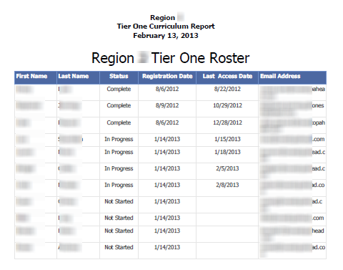
The second section is focused on providing the
Date each person was registered in Tier One
Last date each person accessed the Tier One program
Status in completing the Tier One program
Notes:
The second section of the report is focused on providing more detailed information to the Training Coordinator and his or her team. This information can be used to help monitor trainees’ progress in the Tier One training program. In this section, the data is further broken down by each trainee. We offer the date each person was registered in the Tier One training program, as well as the last date the trainee accessed the training materials and his or her status in completing the Tier One program. So why is this information important?
In this example, the trainee listed in the first line was given access on August 6, 2012. The staff member worked on the training materials for several weeks: and, he/she has not gone into the materials since August 22, 2012. If the staff member were to try to take the exam, the staff member may not pass because he or she may not remember the materials. The Training Coordinator might want to meet with the staff member and implement a training plan for the staff member to complete the materials and prepare for the exam.

Slide 5
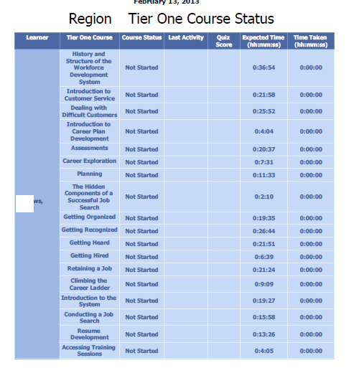
This section provides a lot more detail and was designed for coordinators
Let’s look in more detail
Notes:
The third section of the report offers the Training Coordinators a lot more detail about staff engagement in the training system.

Slide 6
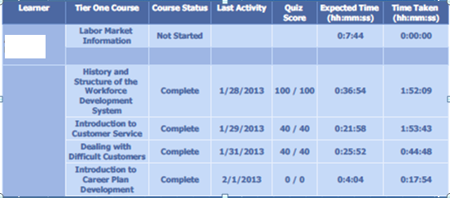
First column – name
Second column – course name
Third column – course status
Fourth column – last activity
Fifth column – quiz score
Sixth column – expected time
Seventh column – time taken
Notes:
In this example, the name of each Tier One course is given, and the status of the course is provided. The course status is listed as “Not started”, “Complete” or “In progress”. The report also lists the date the staff member last accessed the particular course. This is important because the last section of the report tells the coordinator the date the study guide is printed. If the staff member prints the guide after the lesson is accessed, then the trainee did not use the study guide to complete the course. The date also provides the Training Coordinator an approximate idea of when the staff member last reviewed the materials online. The second to last column tells the Training Coordinator the amount of time it takes a staff member to complete the course if he or she does not press pause or advance a slide. The last column indicates how long it actually took the staff member to watch the training.

Slide 7
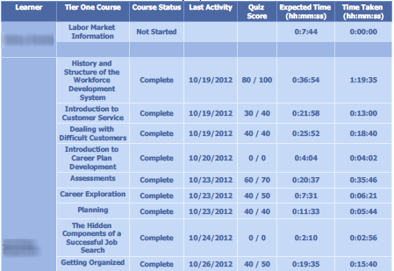
What Does This Tell You?
Notes:
Let’s take a look at this example. The lesson titled Introduction to Customer Service should take a trainee around 22 minutes to complete the training materials if he or she advances at the end of each slide and does not skip any materials. However, this staff member completed the lesson in only 13 minutes. In this example, the staff member completed the web-based lesson in almost half of the expected time. As a Training Coordinator, you may ask yourself, “did the trainee watch the entire session or skip materials?” Instead of waiting until the end of the slide to advance, he or she may have skipped ahead during the webinar. If he or she skipped materials, he or she may not pass the test.

Slide 8
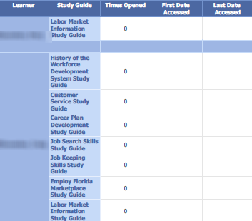
The final section is related to the access of the study guides
What if we print/copy these for our staff?
What if our staff do not access these documents through Adobe Connect?
Notes:
Finally, this last section will indicate if the trainee printed the study guide from the Adobe Connect system. If the staff member selected the study guide button associated with the module, the system will record that the lesson or the workbook was opened. Whether the learner selected the button from the front of the lesson or on the menu in Adobe Connect, the fact that the staff member opened the study guide is recorded in the system and reported here. Please keep in mind: if the Training Coordinator is printing the workbooks or study guides in bulk, this information will not be recorded in Adobe Connect.

