Slide 1
Welfare Transition Automation
Initial Engagement
Notes:
Welcome to the Florida Department of Commerce’s (FloridaCommerce’s) Welfare Transition (WT) program presentation. This presentation focuses on engaging a Welfare Transition (WT) program participant once they have become mandatory and have completed the automated engagement requirement.

Slide 2
What will I learn?
What’s included in the Automated Engagement Process
How to remove customers from the automated process
Steps to take during the initial appointment
Notes:
In this presentation, you will learn what’s included in the Initial Engagement process, how to remove customers from the automated process once they have been referred over as a mandatory participant by the Department of Children and Families (DCF), and steps you will need to take during the initial appointment.

Slide 3
How is the customer notified of mandatory participation?
DCF
Mandatory Referral to OSST
OSST
Creates mail file for Pitney Bowes
Pitney-Bowes
Prints and mails engagement letter to the mandatory participant
Notes:
Once an applicant for Temporary Cash Assistance (TCA) is determined eligible for cash by DCF, they will be referred as a mandatory participant to the WT program. When the One Stop Service Tracking (OSST) system receives the referral via the OSST/FLORIDA interface, the system will start the process of Initial Engagement for the customer.
OSST will generate a mail file for Pitney Bowes to mail out Engagement Letters to the customers referred by DCF in the batch interface. The letters are printed and mailed by Pitney Bowes.

Slide 4
What’s in the letter?
Notes:
The Engagement Letter contains information that instructs the customer to log into OSST, complete their Initial Assessment, and meet with a career manager or career advisor. The shell letter only provides information about completing the initial assessment but does not provide when and where to go to meet with a career advisor. This information will have to be completed by the region to inform the customer where to go and what days to meet the career advisor for their first appointment. In upcoming slides, we provide examples of ways the first appointment can be communicated.

Slide 5
How do the instructions get in the letter?
Notes:
Once the region decides on the instructions, the Regional Security Officer (RSO) or someone with RSO privileges will go into the OSST Security Folder and enter the instructions in the Unit Details. Under “Unit Auto Letter Information” there are primary and Supplemental Instructions. Because the Engagement Letter already contains specific instructions about logging in and completing the initial assessment, the Primary instructions will not be available for you to enter information. The language in the Engagement Letter already serves as the primary instructions. What you will communicate with the user must be entered in the Supplemental Instructions. There is limited space in this section. You may enter up to 400 characters or 8 lines.

Slide 6
Notes:
The information in the parenthesis will not be included in the shell letter. This section has been designated as the area for the region to communicate when the customer should to come to the career center. In this example, it instructs the participant to call a specific number after they complete their initial assessment to schedule the appointment an appointment.

Slide 7
Notes:
In this example, the region has provided the ability to come during the week between established times based on the day.

Slide 8
Notes:
In this example, the customer is informed they will receive a letter from their case manager once they have completed the initial assessment.

Slide 9
Meeting with the Customer for the First Time
The customer completed the Initial Assessment, what do I do next?
Notes:
The customer completed the online assessment and they are in the office with me, what do I do next? What you do next will depend on what you instructed the customer to do. For example, if you instructed the customer to call and schedule an appointment once they have completed their Initial Assessment and they call, you would schedule the appointment and end code 492.
If you informed the customer that they would receive an appointment letter once they complete their initial assessment and they complete it, you would end the code 492 and mail them an appointment letter.

Slide 10
End the Automated Code 492
Notes:
Whatever you required the customer to do in the supplemental instructions, it is important that you verify that the customer completed those instructions and then end code 492. To do this, you must be logged into OSST and must navigate to the customer’s case. Ending this code will tell the system that the customer has satisfied the steps in the Engagement Letter, which are to complete the Initial Assessment and meet with a career manager. To end this code, click on the hyperlinked WT NOMA (492).

Slide 11
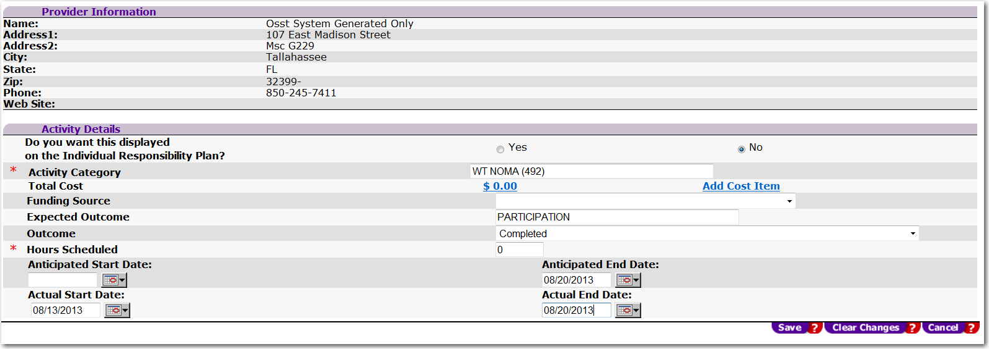
Notes:
In the Activity Details section, select the outcome of “Completed” from the dropdown, enter the Actual End Date and click “save”. The actual end date is the date the customer is meeting with you as a part of the Initial Engagement process or the date they satisfied what you told them to complete in their NOMA instructions. Once you have saved the record, you have successfully removed the customer from the automated process.

Slide 12
Review the Assessment Responses
Notes:
Next, because the customer will have already completed an Intake/Screening as well as an Initial Assessment, you will need to review their responses. To do this, you must be in their OSST case. Click on the “Assessments” hyperlink on the left-hand side navigation menu. The system will refresh and take you to the Assessment Detail for the participant. Under the section titled “WT Auto Assessment and Participation” is a hyperlinked date. By clicking on this date, you will be able to view the participant’s responses.

Slide 13
Notes:
We’ve provided an example of the questions and responses for reference

Slide 14
Notes:
Also on the Assessment Detail Screen you will be able to see barriers created as a result of the participant’s responses to their Intake/Screening questions. This is a way to quickly identify areas of need that could be resolved easily or help you identify whether or not you should ask if they have documentation they need to share with you. In the example, a barrier of “Medical Limitation Not Permanent” appears on the Needs and Barriers section. This could prompt you to ask the participant if they had medical documentation completed by their physician and gives them the opportunity to provide it to you.

Slide 15
Hidden Disabilities Screening
LNST Communiqué
Learning Needs Screening Tool Communique-2010
LNST Guidance
Learning Needs Screening Tool Guidance
LNST Attachment
Learning Needs Screening Tool Attachment
Notes:
After reviewing the responses, it is important to engage the customer in conversation that will help build an Individual Responsibility Plan (IRP). However, before doing that, the customer should be screened for potential Hidden Disabilities, such as learning limitations, hearing and/or vision impairments that may impact their ability obtain or retain employment. To do this, you should use the local screening for hidden disabilities. Many regions use the Learning Needs Screening Tool, which is a 13 question screening that must be read to the participant. To learn more about the Learning Needs Screening Tool, use the links in the presentation slide to access resources and guidance provided to regions in 2010. To learn more about the local tool used to screen for potential hidden disabilities, speak with your program manager or supervisor.

Slide 16
Creating an Individual Responsibility Plan
Notes:
After you have reviewed the assessment results and completed a Hidden Disabilities screening, it’s time to develop the IRP WITH the participant. Keep in mind the responses from the assessment. You will determine what type of plan to create with the participant based on the assessment results, the customer’s goals, and where the customer currently is in their skills and abilities. At this meeting you will determine if the participant needs a:
Skill Focused plan – in a skill focused plan, the participant may have the educational knowledge of a particular job or field, but may lack the skills in the field. The Skill Focused plan is designed to provide the participant an opportunity to gain the skills needed to move into a job or career.
An Education/Skill Focused Plan – in an Education/Skill focused plan, the participant may have expressed a desire to enter into a certain career field but lacks the education and skills to secure employment. The Education/Skill Focused plan is designed to give them the opportunity to gain the education and skills needed to secure a job in their field of choice
An Ability Focused or Alternative Plan – in an Ability Focused plan, the participant may have a temporary or permanent limitation that’s hindering them from getting a job or going to work at the moment. Ability focused plan is designed to help the customer work through current limitation that is hindering them from moving forward. An Ability focused plan is developed when the customer has domestic issues, medical concerns or some other barrier that prohibits participation in the program at the moment.

Slide 17
Notes:
Just to recap, a Skills Focused Plan is developed when the customer has identified a Career Goal/Field, has some education in the field but lacks skills or has education and limited skills in the field.

Slide 18
Notes:
Education/Skill focused plans are developed when the customer has identified a career field, but lacks education and skills to enter the career field.

Slide 19
Notes:
Established if the participant has a temporary of permanent limitation that may hinder work participation or finding a job. This could include medical issues, substance abuse or mental health issues, and domestic violence.

Slide 20
Activity
Assign an activity
Use assessment results
Customer’s goal
Local process
Document assignment
Give clear instructions
Who, what, when , where
Deferral
Does the participant have their medical form?
Are there treatment recommendations for medical, SAMH, DV?
Give clear instructions
Who, what, when, where
Notes:
Once you have determined what type of plan that will be created, you will need to assign the participant to an activity. Use the assessment results and customer’s goal to assign an appropriate activity. Keep in mind your local process for assigning particular activities. Document what the customer has been asked to do. Give the participant clear instruction and expectations (who, what, when, where)
If the customer will be deferred, does the customer have medical documentation at the time of the appointment? If not, you may need to provide another form. Set a clear and reasonable due date. If the customer has a medical form, did the physician recommend a treatment plan or treatment recommendations? Does the customer have a SAMH issue? Is there a treatment plan or recommendation? Does the customer have a DV issue? Is there a treatment plan or recommendation? Give clear instructions (who, what, when, where)

Slide 21
Questions & Answers

Slide 22
Contact Us
Thank You.
If you have questions or comments about this presentation, please contact us.
Welfare Transition Program
Email: WTProgram@commerce.fl.gov
Notes:
This concludes the Initial Engagement session. If you have questions about this presentation or other WT program questions, please email us at WTProgram@commerce.fl.gov.

