Slide 1
Jobs for Veterans’ State Grant (JVSG)
Case Management Framework
State Veterans’ Program Team
Division of Workforce Services, Bureau of One-Stop and Program Support (OSPS)

Slide 2
Introduction
Case Management Framework Framework
The structure for which Disabled Veterans Outreach Program (DVOP) specialists and Consolidated Positions (CP) evaluate and assist a participant's individual needs, by conducting an objective assessment (OA), establishing an employment plan, delivering services, and providing consistent contact.

Slide 3
Objectives
Individual Employment Plan (IEP)
Attaining Commitment
Developing a S.M.A.R.T. IEP and IEP Examples
Employ Florida Reporting and Case Closure
Case Management Framework
Objective Assessment and Building Rapport
IEP Follow-ups and Consistent Contact

Slide 4
Case Management Framework
Objective Assessment
Individual Employment Plan (IEP)
Consistent Contact
Identify Skills and Barriers
Course of Action
Accountability

Slide 5
Objective Assessment
An objective assessment serves as the foundation for all services provided and is conducted to:
Identity services
Guide in the development of each participant’s Individual Employment Plan (IEP)
Identify barriers
Identify employment goals

Slide 6
V01 - Objective Assessment
An objective assessment is a comprehensive evaluation of:
Work history (Civilian and Military)
Work Readiness
Employment Barriers and Goals
Needs and Expectations
Education
Certificates
NOTE: All SBEs must be stated on the overall notes of the objective assessment summary.

Slide 7
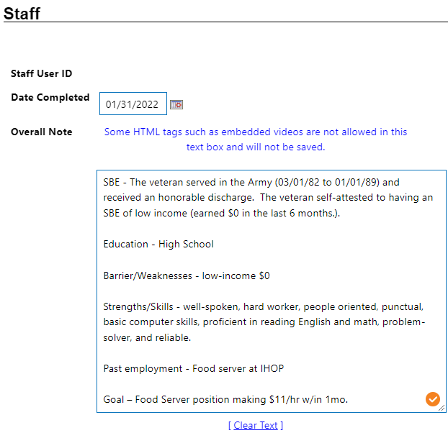
Objective Assessment Summary
All elements of the objective assessment must be completed using the Employ Florida Objective Assessment Summary.
Staff must also include an overall note (located on the OA Summary General tab) that includes the following:
The SBE or Special Population affirming the participants eligibility for DVOP services; and
A summary of the assessment’s findings, to include the participant’s barriers to employment, occupational skills, and education.

Slide 8
Building Rapport
Before you conduct your objective assessment start by building rapport
Building rapport establishes trust between you and the veteran. They can trust that you will help them find employment and you can trust them to listen to your ideas and advice.
The more you get to know the veteran, and the more they get to know you, the easier the process.
Notes:
While building the rapport, it is important for the Veteran to feel they can trust you for more than just helping them find employment. This is important because a Veteran who isn’t homeless today may be homeless next month, but they may feel embarrassed to speak to you about it. This is just as important if they are having a mental health breakdown and they do not feel comfortable speaking to a DVOP who can guide them to the VA and/or other community partners.

Slide 9
Building Rapport and Identifying Basic Needs
The counseling a DVOP specialist provides may include discussing delicate or sensitive information, such as:
personal hygiene,
In order to explore these needs, you must take the time to get to know the veteran so that you can speak directly to their needs and assist them in overcoming their perceived challenges.
health conditions,
living situation,
substance abuse problems, etc.

Slide 10
Maslow’s Hierarchy of Needs
Self Actualization
Love and Belonging
Safety and Security
Physiological Needs
Self-fulfillment needs
Psychological needs
Continuous self-discovery and growth
Self-Esteem
Pride and accomplishment
Psychological needs
Relationships with friends and family
Basic needs
Security and Safety
Basic Needs
Food, water, clothing, and sleep
Employment, shelter, and health

Slide 11
Building Rapport and Identifying Basic Needs
Ways to Build Rapport and Identify Needs
Ensure confidentiality and safety
Be an active listener
Be sympathetic or empathetic
Ask permission before giving advice
Share stories - relate
Ask open-ended questions
Be open-minded
Empower, support, & motivate
Make no assumptions
Take detailed notes
Notes:
When sharing stories, take into consideration the Veterans mental state, therefore, add steps on how they can overcome like you did. This will allow the Veteran to feel part of the story.
This is not the time to be on the computer; but rather develop a summary of topics to cover on a paper pad and simply take notes while having a direct and earnest conversation with the veteran.

Slide 12
What is an Individual Employment Plan (IEP)
The IEP is a negotiated agreement between the veteran and the DVOP specialist detailing what the veteran will do for their development, and what the DVOP specialist will do to assist them in that effort.

Slide 13
What is an Individual Employment Plan (IEP)
The IEP must include:
A clear employment goal.
Barriers that may prohibit the veteran from achieving the goal.
Supportive services and steps necessary to overcome the barriers.

Slide 14
Purpose of an Individual Employment Plan (IEP)
Why develop an IEP?
An IEP is visual roadmap to success.
Provides a plan and guide for attaining goals.
Sets expectations and accountability between the veteran and DVOP specialist.
Builds confidence, motivation, and self-esteem.
Guides the DVOP specialist on how to assist and collaborate.
Increases engagement and the likelihood of finding employment.

Slide 15
Attaining Commitment (The Buy-In)
What is the buy-in?
The buy-in is the veteran's acceptance of and willingness to actively participate in the program.
It encourages collaboration, increases the veteran's satisfaction with the process, and results in a better outcomes.
Why is it important?

Slide 16
Attaining Commitment (The Buy-In)
Ways to Attain Commitment
Allow them to express their goals, challenges, and areas of opportunity.
Let them identify how they plan on achieving their goals and establish a timeline.
Be Transparent
Tell them exactly what is expected of them and what they can expect from you.
Get them Involved
Ask them what their expectations are of you and clarify any misconceptions.
Coach and Motivate
The veteran is responsible for choosing and implementing their own change(s), while the DVOP supports, encourages, and facilitates the changes.
Notes:
For best practice use a team approach, such as explaining to the Veteran what “we” are going to do, and “We are going to complete a resume; we are going to conduct mock interviews and we are going to find suitable employment (but you will receive the paycheck).” This allows the Veteran to feel part of a team and not just a plan they are required to fulfill on their own.

Slide 17
Attaining Commitment (The Buy-In)
Where is the veteran now?
Meet them where they are not where you think they should be.
Where does the veteran want to go?
Allow the veteran to define their desired results and type of career they are seeking.
How will they get there?
Recommend services, tools, strategies, and training to achieve goals.
Are they open to change?
Point them in the right direction.
Ask open-ended questions to understand their current situation, skill sets, work experience, strengths and weaknesses.

Slide 18
Developing a S.M.A.R.T. IEP
Once you have a clear empathic understanding of their goals and have identified their challenges or areas of opportunity, its time to start developing a S.M.A.R.T. IEP.

Slide 19
S.M.A.R.T. Goals and Objectives
S
Specific: Goals should be as specific and well-defined as possible.
M
Measurable: Goals should include dates, amounts, and other measurements that will help verify progress.
A
Achievable: Goals should account for the abilities of achievement and any initial steps needed to succeed.
R
T
Realistic: Goals should be realistic and within reach.
Timely: Goals should be time-bound for completion. Do not allow time to procrastinate.

Slide 20
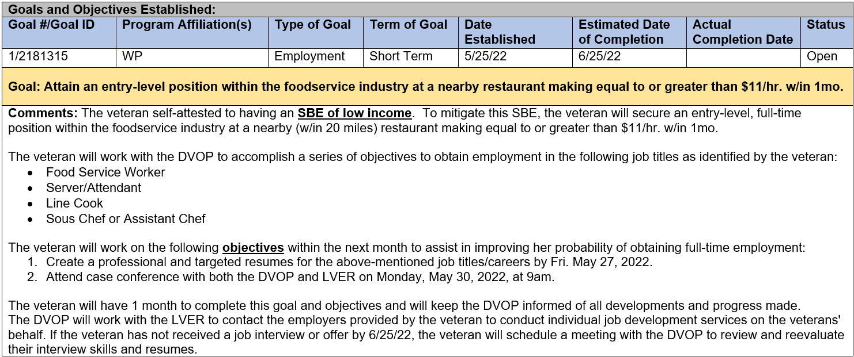
IEP Example – Employment Goal

Slide 21
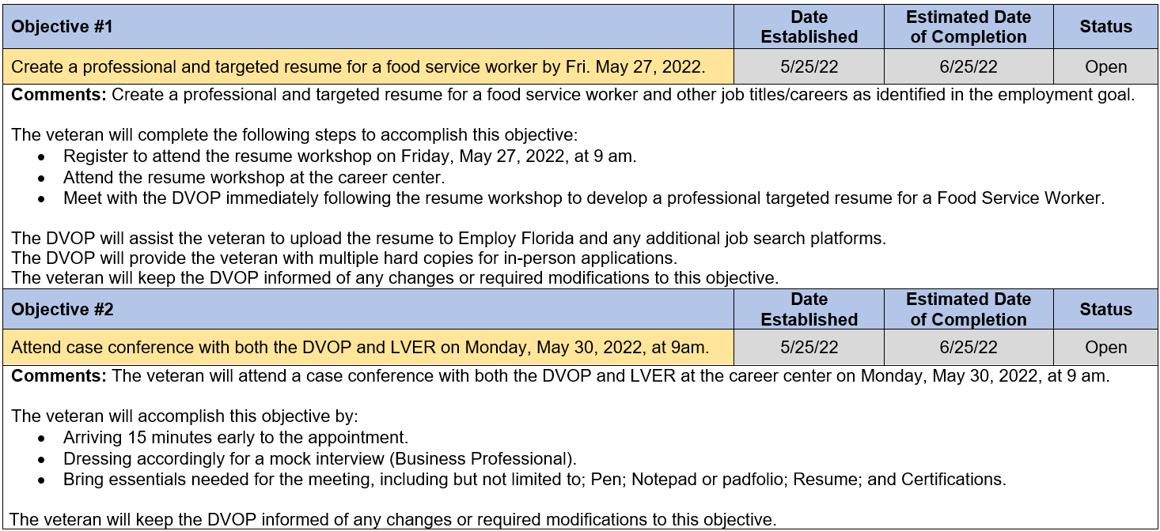
IEP Example – Objectives

Slide 22
Consistent Contact
Consistent contact is regular contact between the DVOP and the participant. It is the foundation of quality case management.
Consistent contact is based on the participant’s individual needs and situation per the written plan and case notes.
Contact may be conducted remotely or in person; however, no pre-employment contacts should be made without reference to the IEP.

Slide 23
Consistent Contact
An effective IEP process requires extensive follow ups to make sure things are progressing as planned.
The DVOP must keep track of important dates and follow up prior to deadlines to ensure the veteran is on track.
There can be no follow-up without a clearly outlined IEP. Both DVOP and the veteran must know what is expected.

Slide 24
Consistent Contact
Why is consistent contact important?
Maintains accountability
Helps the veteran stay on track
Reveals roadblocks and prevents mishaps
Allows for intervention
Increases positive outcomes

Slide 25
Employ Florida Reporting
V04 – JVSG IEP Update
At a minimum, the IEP must be reviewed with the participant every 30 days to ensure progress in completing objectives.
Code is recorded when the participant’s IEP is amended, in coordination with the participant.
IEP Amendments/Updates may include:
A successful closure of an objective or goal.
A new goal or objective that was established jointly with the participant.
An unsuccessful objective or goal that no longer aligns with the participant’s employment goal or have exceeded the anticipated completion dates.
A case note in the summary section of the respective objective indicating the reason for change or unsuccessful completion (e.g., unexpected emergency, relocation, change in career path, etc.) is required.
A case note describing the update (e.g., objective added/completed, additions to goal/objective description, etc.) is required.

Slide 26
Employ Florida Reporting
V09 – JVSG Pre-Employment Consistent Contact
Pre-Employment Consistent Contact Reporting
A case note attached to the service code is required and must include the method of contact, reason for contact, and outcome of the interaction.
The purpose of pre-employment consistent contact is to ensure all parties are accountable for achieving the objectives and goal of the jointly developed IEP.
Reported when a DVOP specialist conducts ongoing pre-employment contact with the participant regarding the veteran’s individual needs and IEP.

Slide 27
Employ Florida Reporting
V13 - JVSG Post Employment Consistent Contact
The DVOP specialist must provide post-employment consistent contact for 90 days to ensure sustained employment.
A case note attached to the service code is required and must include the method of contact, reason for contact, and outcome of the interaction.
Post-employment consistent contact must be biweekly the first month following employment and monthly thereafter.
Case Closure
A case closure is required prior to recording and conducting a V-13 - JVSG Post Employment Consistent Contact.
Case closure is a case management tool to signal the customer is ready to stop receiving services and exit the program.
If the participant is being closed due to employment, the DVOP specialist must ensure that the employment information is entered prior to closure.

Slide 28
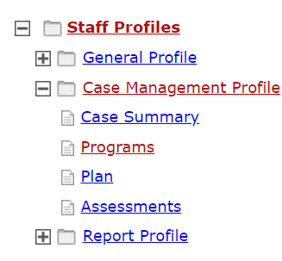
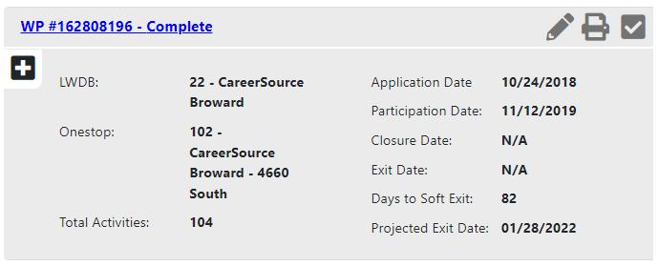
Case Closure
1. Click on programs tab
2. Click and open the case information of last Wagner-Peyser application

Slide 29
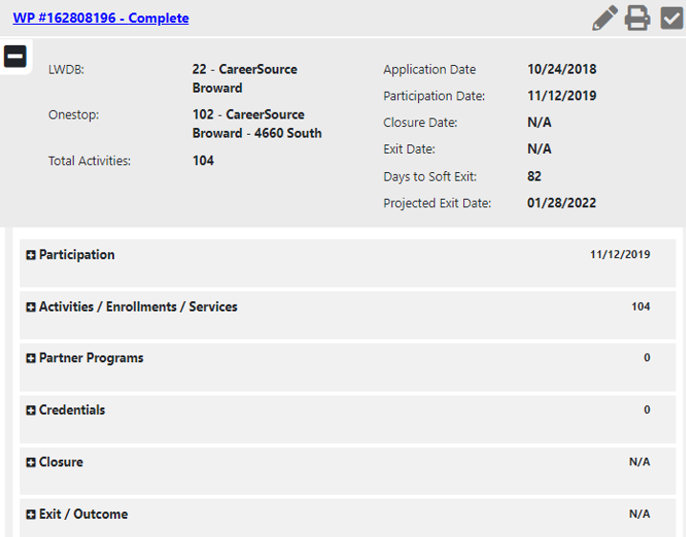
Case Closure
3. Click on closure and select create closure

Slide 30
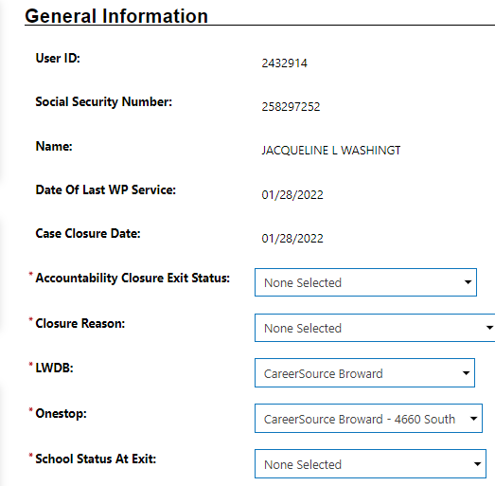
Case Closure
4. Click and select appropriate option from drop down for each section

Slide 31
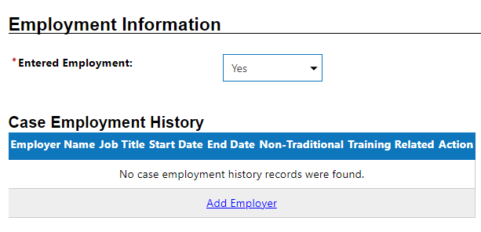
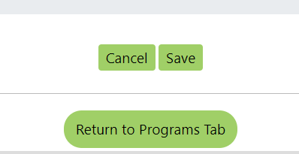
Case Closure
5. Select yes for entered employment
6. Add employer information
7. Save and return to program tab

Slide 32
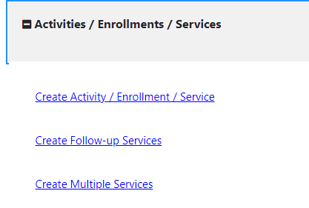
Reporting a V13
1. Return to Program Tab
2. Click on Activities/Enrollments/Services then select: Create Follow-up Services

Slide 33
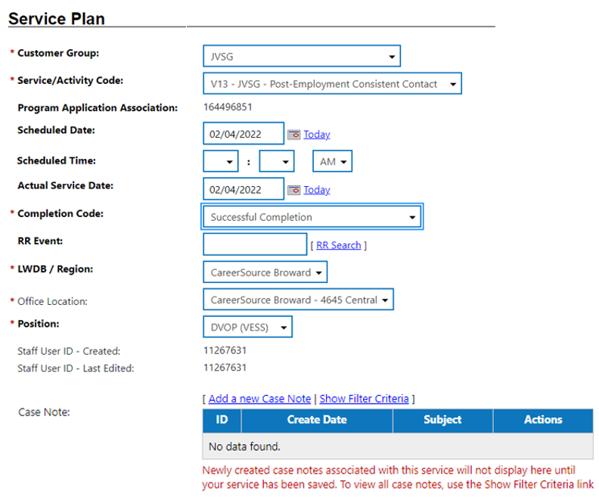
Reporting a V13
3. Select customer group: JVSG
4. Select service code V13 – JVSG – Post Employment Consistent Contact
5. Select appropriate option for each section and add a new case note.
*Case note must include the date, time, method of contact, and outcome of the interaction).

Slide 34
Questions & Answers

