Slide 1
Welfare Transition
Understanding Automation Codes Part 1
Notes:
Welcome to the Florida Department of Commerce’s (FloridaCommerce’s) Welfare Transition (WT) program’s Understanding Automation Codes presentation.

Slide 2
Objectives
Learn and understand WT Automation Codes
What they are
What they mean
How they are activated
Where they appear
Notes:
The goal of this presentation is to familiarize you with codes associated with WT Automation. We will share with you each code, their meaning, what must be done before they are activated in the system and where they appear once activated.

Slide 3
Understanding the Codes
499
498
Orientation/Program Overview
497
Intake/ Screening
Completed Client Form
Accepted O & O
Notes:
The first set of codes are 499, 498 and 497.
499 – indicates that the customer has logged in, accepted the opportunities and obligations and completed the client informational form
498 – indicates that the customer completed the Orientation or Program Overview
497 – indicates that the customer has initiated and/or completed the Intake/Screening (Needs Assessment)

Slide 4
Understanding the Codes (cont’d)
495
Check out
494
Work Registration Complete – Automated
493
Work Registration Complete - Manual
Notes:
The next set of codes are 495, 494, and 493
495 – indicates that the customer has completed all of the required online processes and clicked submit
494 – indicates that the region chose the State Default as its local work registration completion requirement and the customer is considered fully work registered once they check-out (code 495)
493 – indicates that the region requires additional tasks outside of the online processes in order for the customer to be considered work registered. Code 493 must be ended by a case manager in order before work registration can be reported as completed to DCF.
We will provide more detail about codes 494 and 493 in Part 2 of Understanding Automation Codes.

Slide 5
Understanding Automation Codes
492
491
Initial Assessment
Invitation Letter
Notes:
The next set of codes are 492, 491, and 488
492 – is the invitation letter that goes out to a newly referred Mandatory program participant after DCF has determined the participant eligible for cash assistance.
491 – is the initial engagement activity (Initial Assessment) that the customer will be required to complete upon mandatory referral to the WT program for participation.
We will cover these codes in Part 2 of Understanding Automation Codes

Slide 6
Understanding Automation Codes (cont’d)
488
Case Manager Authorized System Access
489
Document Submission – Caring for Disabled Family member
Notes:
The next set of codes are 489 and 488
489 – will automatically populate if the customer indicates in their Needs Screening that they are Caring for a Disabled Family Member. If the customer turns in a Need for Care form, the case manager will end this code to report up to DCF that the customer could meet an exemption
488 – is the code entered by case managers that will allow a customer access to the online system to complete the online work registration process.
We will provide more information about these codes in Part 2 of the Understanding Automation Codes.

Slide 7
Code Cheat Sheet
Code | Action
499 | Logged into OSST, accepted O&O, completed client information page
498 | Completed Orientation/Program Overview
497 | Started Intake/Screening
495 | Check-out (completed online requirements)
494 | Work Registration Complete - Automated
493 | Work Registration Complete – Manual
492 | Invitation Letter – Mandatory Participant
491 | Initial Assessment – Mandatory Participant
489 | Document Submission - Caring for Disabled Family Member
488 | Case Manager Authorized System Access
Notes:
We have provided a code cheat sheet as a quick reference guide to help you identify WT Automation Codes. In the upcoming slides we will detail about when each code occurs.

Slide 8
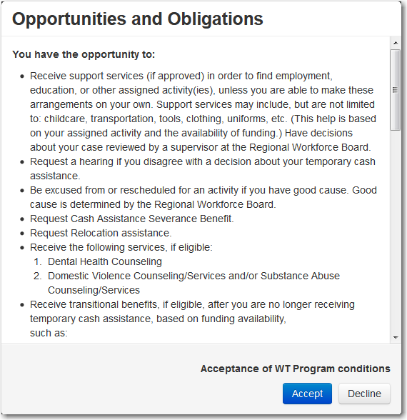
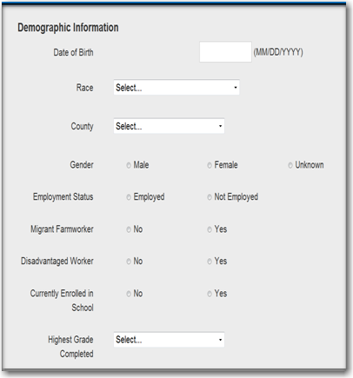
Automation Codes Explained
Notes:
The 499 is activated when an applicant for Temporary Cash Assistance (TCA), logs into the One Stop Service Tracking (OSST) system, accepts the Opportunities and Obligations program conditions, and completes the Client informational Form. Code 499 will close once the customer has accepted the O & O and completes the Client Form

Slide 9
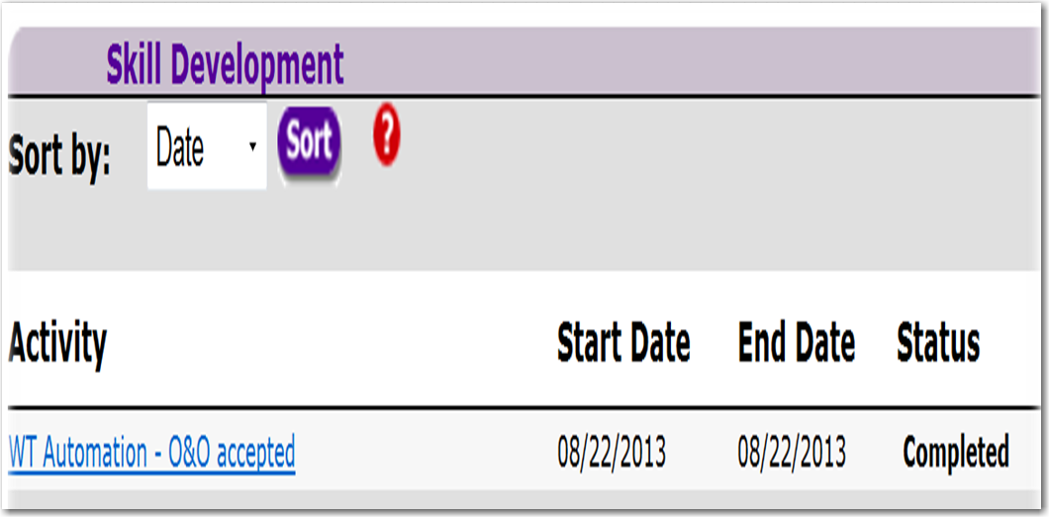
Automation Codes Explained (cont’d)
Notes:
Once the applicant completes the required actions, code 499 will appear on the applicant’s case on the Skill Development Screen in OSST. It will display under the Skill Development section as an automated activity.

Slide 10
Question?
Will we be required to have a signed copy of the O & O in the case file for an applicant who completes the online process?
No – the customer will digitally sign that they understand and accept the O & O.
Notes:
Will we be required to have a signed copy of the O & O in a case file for an applicant who completes the online process? No. The applicant will digitally sign that they accept and understand the O & O. A signed paper copy is not necessary for an applicant who completes work registration online.

Slide 11
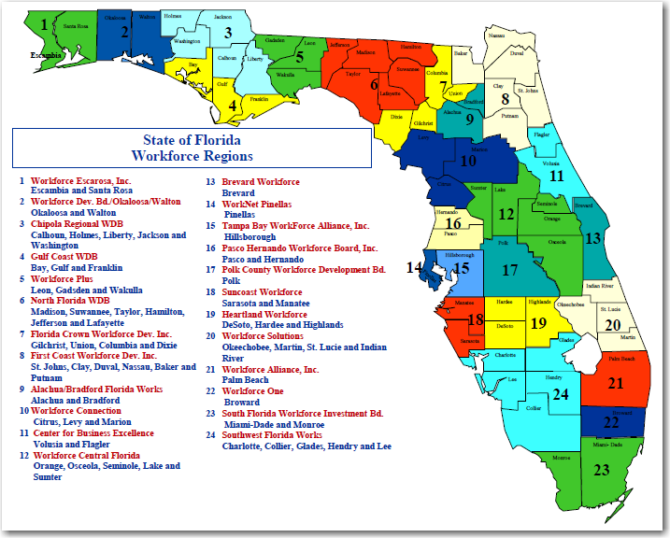
Automation Codes Explained
Notes:
Code 498 is activated once the applicant completes the online Orientation/Program Overview. The program overview may be the one created by FloridaCommerce or one created locally by the Regional Workforce Board. Code 498 will appear as completed when the applicant starts the Intake/Screening (497).

Slide 12
Automation Codes Explained (cont’d)
Notes:
Code 498 is activated once the applicant completes the online Orientation/Program Overview. The program overview may be the one developed by FloridaCommerce or one developed locally by the Regional Workforce Board. Code 498 will appear as completed when the applicant starts the Intake/Screening (497) and will appear on the Skill Development Screen under the Skill Development Section as an activity. Notice, directly above the highlighted WT Orientation, the WT (APPL) – Needs Assessment or the WT Applicant Needs Assessment appears as “In Progress”. The completed 498 – WT Orientation will only display once the 497 or Needs Screening is started. We will show the screen in larger scale on the next slide.

Slide 14
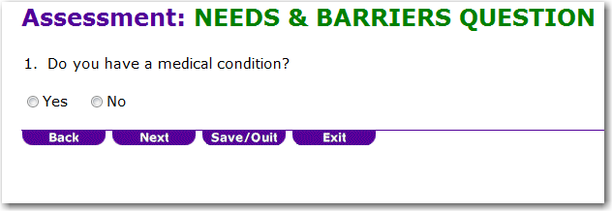
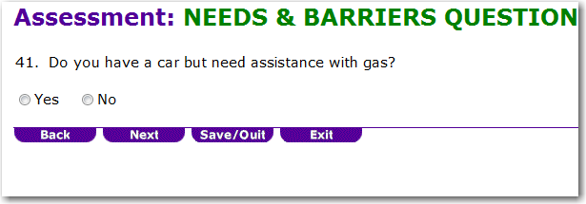
Automation Codes Explained
Notes:
Code 497 is activated once the applicant starts the Intake/Screening. The applicant will be asked a series of Needs related questions which will be saved and stored for review. The 497 will be automatically ended once the customer responds to every question and clicks I Am Done.

Slide 15
Automation Codes Explained (cont’d)
Notes:
Code 497 is activated once the applicant starts the Intake/Screening. The applicant will be asked a series of Needs related questions which will be saved and stored for review. The 497 will be automatically ended once the customer responds to every question and clicks I Am Done or Check out and will Display on the Skill Development Screen in the Skill Development section as an activity in OSST.

Slide 16
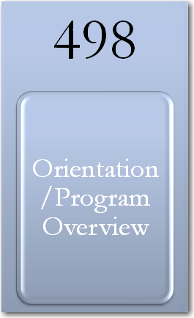
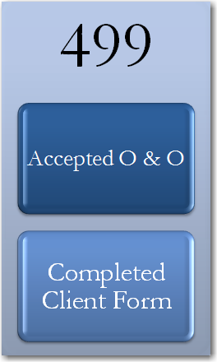
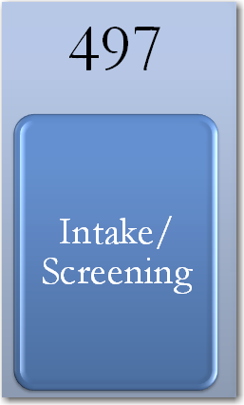
Automation Codes Explained (cont’d)
Notes:
Code 495 will display once the customer has activated code 499 (accepting O & O, completing client form) and has completed codes 498 (program overview) and 497 (intake/screening).

Slide 17
Automation Codes Explained (cont’d)
Notes:
Code 495 will appear on the Skill Development Screen in the Skill Development section as an activity in OSST.

Slide 18
Codes Displayed in Skill Development
Notes:
Here is how the codes will display in Skill Development. They will not appear twice. We used several test cases over and over again to make sure that the information was properly crossing over from the Client Application to the case management application. The activity and code should only appear once as the applicant completes the online process.

Slide 19
End of Part 1
Notes:
This concludes Part 1 of our Understanding Automation Codes presentation. Please proceed to Part 2 of this presentation.

