Slide 1
Trade Adjustment Assistance (TAA)
Introduction to Performance Reporting
Yolanda Triplett, State Trade Program Coordinator

Slide 2
Objectives
Trade Adjustment Act (TAA) program overview
Florida’s service delivery structure
Reporting expenditures
Trade Adjustment Assistance Data Integrity (TAADI) measures
TAA reporting examples in Employ Florida
Monthly data reconciliation
Questions
Notes:
During this presentation we will cover:
Trade Adjustment Assistance (TAA) program overview
Florida’s service delivery structure
Reporting expenditures
Trade Adjustment Assistance Data Integrity measures
Employ Florida reporting examples
Monthly data reconciliations between Employ Florida information and financial information

Slide 3
TAA Overview
Trade Adjustment Act is a federal program that assists workers who have lost or will lose their jobs due to foreign trade or competition.
TAA offers training, income support, employment and case management services, job search and relocation allowances.
TAA participants are covered by United States Department of Labor (USDOL) certified Trade Act petitions
Notes:
For those unfamiliar with the TAA program, we will begin with a brief overview of the program to include a summary of some of the benefits and services which are available to participants.
TAA is a federally funded program established by the Trade Act of 1974 (Trade Act) to assist workers adversely affected by foreign trade who have lost their jobs because of a decline in production, sales, or outsourcing of jobs to foreign countries. The program was most recently reauthorized by the Trade Adjustment Assistance Reauthorization Act (TAARA) of 2015.
The TAA program offers extended income support, training, employment and case management services, and other benefits to displaced workers who are certified as eligible to receive TAA benefits and services. To be eligible for TAA, a group of three or more trade-affected workers, or an agent on their behalf, must petition the U.S. Department of Labor (USDOL) and become certified. Eligible trade-affected workers covered by the certification can apply for benefits and services at a local career center.

Slide 4
Florida’s Service Delivery Structure
Employment Services
Employment and Case Management Services
Training
Job Search Allowance
Relocation Allowance
Benefits
Trade Readjustment Allowance (TRA)
Reemployment Trade Adjustment Assistance (RTAA)/ Alternative Trade Adjustment Allowance (ATAA)
*Health Coverage Tax Credit (HCTC)
*Administered by the Internal Revenue Service (IRS)
Notes:
The Florida Department of Commerce shares in the delivery of services with Florida’s 24 Local Workforce Development Boards (LWDBs) through the CareerSource Florida network. Services and benefits available to trade-affected workers include the following:
Employment services, such as the provision labor market information and résumé assistance, are provided to assist workers in preparing for and obtaining new employment. Workers may also receive case management services from a Local TAA Coordinator to eliminate any barriers to obtaining suitable employment (work of a substantially equal or higher skill level than the trade-affected worker’s past trade-affected employment, with wages no less than 80 percent of the trade-affected worker’s average weekly wage from the trade-affected employment). When suitable employment is unavailable, training funds are offered to support trade-affected workers in obtaining credentials to enhance their marketability. In some cases, workers who pursue employment outside their local commuting area may be eligible for job search or relocation allowances.
Trade Readjustment Allowance (TRA) is a weekly income support payment for TAA-certified workers who have exhausted their reemployment assistance (RA) benefits and who are enrolled in an eligible training program, or have received a waiver of the training requirement. Weekly TRA payments are equal to the worker’s final weekly RA benefit amount. Workers may collect RA and TRA for a combined maximum of 130 weeks, the final 13 of which are only available if necessary for the worker to complete a qualified training program.
Reemployment Trade Adjustment Assistance (RTAA), formerly known as Alternative Trade Adjustment Allowance (ATAA), is a wage insurance program available to certified workers age 50 and over who obtain reemployment at a wage lower than their trade-affected employment. The wage insurance program provides a cash payment equal to 50% of the difference between the worker’s new wage and previous wage, up to a two-year maximum of $10,000.
The Health Coverage Tax Credit (HCTC) is a tax credit equal to 72.5% of the trade-affected worker’s qualified health insurance premiums. Unlike other TAA benefits, HCTC is administered through the Internal Revenue Service (IRS).
That’s a brief overview of what the TAA program offers and how we work together to provide the benefits and services. Now, how does this relate to reporting expenditures and who does the reporting?

Slide 5
Reporting Expenditures
Trade Adjustment Assistance Data Integrity (TAADI) measures:
Cross validation of financial data
Participant Individual Record Layout (PIRL) vs. Employment and Training Administration (ETA) Form 9130
Employ Florida vs. Subrecipient Enterprise Resource Application (SERA)
USDOL allows a maximum 15% variance or difference in performance measures between the two reports mentioned above: the PIRL and ETA’s Form 9130.
Notes:
Similar to other workforce programs, the TAA program has performance measures that seek to ensure data accuracy and gauge the program’s effectiveness. Quarterly, each state workforce agency receives a report card from USDOL referred to as the Trade Adjustment Assistance Data Integrity (TAADI) report. The TAADI is a standardized review of high-quality data that is essential to evaluating the program’s effectiveness and monitoring service delivery.
Several measures of the TAADI report involve the cross validation of fiscal data. Participant data for TAA is reported quarterly through the Participant Individual Record Layout (PIRL).
These measures seek to ensure expenditure data recorded in the Participant Individual Record Layout (PIRL), as reported within Employ Florida, is aligned with corresponding data on the state’s TAA financial report, Employment and Training Administration (ETA) Form 9130.
Financial reports for the TAA grant are submitted quarterly to USDOL on the ETA-9130 Financial Report. The PIRL report extracts financial data reported by Local TAA Coordinators within Employ Florida and the ETA 9130 report is comprised of financial data from the Subrecipient Enterprise Resource Application (SERA).
The TAADI allows reported expenditures on the PIRL and the financial reports to be within a 15% difference of one another.
FY21 changes: Rapid Response is target increasing to 65%, the Credential measure (now renamed as Training Result) is increasing to 80%, and Co-enrollment target is increasing to 75%. Florida has consistently failed to meet the federal co-enrollment target for the past reported quarters. The takeaway message is reporting matters.

Slide 6
Reporting Expenditures (cont’d)
Employ Florida reporting requirements:
All performance reporting data elements follow accrual reporting
Report costs as soon as they are accrued (owed)
Local TAA Coordinators must enter service codes and case notes into Employ Florida.
Requirement applies to co-enrolled trade-affected workers
TAA Coordinator must communicate with the Workforce Innovation and Opportunity Act Dislocated Worker (DW) case manager
Notes:
Okay, so that’s the TAADI but why is it so important we are having a standalone webinar to cover it and my reporting responsibilities?
The TAA program requires expenditures funded by TAA be reported in the PIRL. These costs must be reported in Employ Florida by the Local TAA Coordinator as they are accrued as opposed to when billing, payments, or disbursements take place. This methodology is specifically modeled to mirror USDOL reporting. The expenses reported in Employ Florida comprise the PIRL expenditure data required to validate federal financial reports for the TAADI.
Training expenses are considered to be accrued when the participant is obligated to pay for the expenses, such as receiving an invoice, as determined by the training provider. With tuition, for example, this training expense is typically considered accrued after the deadline date for dropping classes has passed. This situation means that as soon as the participant can no longer drop the class, and they have to pay for it, that is the time when it would be considered accrued. At this point, the training provider expects payment although the payment deadline and/or billing may occur at a future date.

Slide 7
TAA Data Integrity Measures
Performance Measures to gauge Data Integrity
Training Expenditures
TRA Expenditures
RTAA Expenditures
Job Search and Relocation Expenditures
Rapid Response
Petition Number
Individual Employment Plan (IEP)
Co-enrollment
Employment and Case Management Services
Training Case Management
Training Completion
Training Result (Credential)
Service in Quarter
Wages
Notes:
The TAADI has several performance measures which monitor service delivery to ensure participants are served effectively.

Slide 8
Employ Florida Reporting – Individual Employment Plan
Ensure an IEP has been completed prior to the trade-affected worker being enrolled in approved training.
Notes:
An individual employment plan (IEP) is required for Trade Adjustment Assistance (TAA) participants who do not possess the skills to secure suitable employment in the existing labor market and will be entering TAA-approved training. The IEP must precede the approval of any training, or waiver of training requirement, as outlined in FloridaCommerce Memorandum: Trade Adjustment Assistance Individual Employment Plan Reporting dated December 6, 2018.
While conducting the comprehensive assessment, the Local TAA Coordinator must explore any relevant barriers that may hinder the participant’s ability to successfully complete training. These barriers must be converted into goal statements, and along with the necessary steps (objectives) to complete training, be included in the TAA participant’s IEP. Labor Market Information must be used by Local TAA Coordinators when assisting TAA participants in selecting appropriate occupational skills training and/or developing an IEP. These objectives serve as the actions necessary to achieve the overarching goal of obtaining suitable employment and must be monitored and reviewed with the TAA participant on a consistent basis to ensure success.
The IEP must be documented in the participant’s Employ Florida TAA program application by recording the service code T05. The IEP must be signed by the TAA participant and available in the participant’s Employ Florida case file. For more information on TAA Training Services, please review Administrative Policy 107. For more information on the TAA training approval criteria, process, and reporting, please review Administrative Policy 108.
Make sure an IEP/ISP has been completed prior to the trade-affected worker entering into training.
It is allowable for the IEP/ISP to be completed under a partner program application such as Wagner-Peyser or WIOA as long as the date the IEP was completed is prior to the date the participant entered into training. The completed IEP ensures there is a plan in place for the participant to accomplish their short and/or long-term educational and occupational goals, and that the approved training aligns with them. The initial development of an IEP is important from a performance standpoint, but it is also critical in ensuring we are providing the case management framework necessary to ensure successful outcomes for Florida’s TAA participants.

Slide 9
Employ Florida Reporting – Individual Employment Plan (cont’d)
Example:
How to document the IEP and when to use Service Code T05.
It is allowable for the IEP to be completed under a partner program application such as Wagner-Peyser or WIOA as long as the date the IEP was completed is prior to the date the participant entered into training.
Notes:
As stated previously, it is critical to ensure the IEP is documented in Employ Florida and that is easy to do if you create the IEP in Employ Florida. This step can be accomplished through manually entering the Employ Florida service code T05 (Individual Employment Plan), along with an accompanying case note which outlines the goals and tasks required to accomplish those goals. To clarify, the case note would include the same information (e.g., goals and tasks) recorded in the Goals Section of the IEP. Meaning, the case note should not require any additional steps, new text, or meetings with your participant. You are also able to enter service code 205 under the Wagner-Peyser program application. It is allowable for the IEP to be completed under a partner program application such as Wagner-Peyser or WIOA as long as the date the IEP was completed is prior to the date the participant entered into training.
Key takeaway messages:
If the IEP is completed even the day after training commences, then the IEP will not be considered complete, and it will not be counted in the performance measure accurately.
Always create the IEP after completing your assessments and well before the participant enters training.
Question: When we enter a T05 IEP service, is the projected end date the same as the projected end date of service code 334 (TAA Approved Occupational Skills Training)? Should both services have the same closure dates?
Answer: Employ Florida service codes that are not training or work experience services, like writing an IEP, must not be future dated to extend participation (see Administrative Policy 115: Common Exit for more detail). The T05 activity represents the action of preparing or creating an Individual Employment Plan. Once the plan is created, the service is successfully reported same day. There is no requirement or reason to assign a projected end date to the T05 activity. If the plan is updated or modified, the user may report another T05 to reflect the update and ensure the EF case file accurately reflects the IEP update.

Slide 10
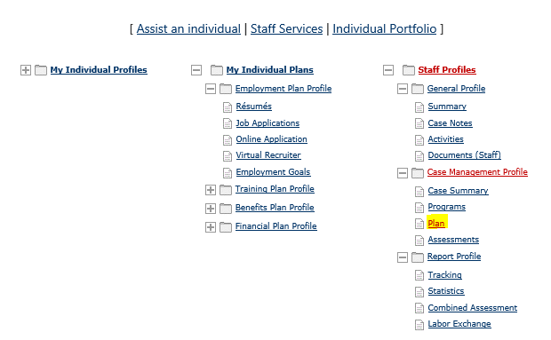
Employ Florida Reporting – Step 1
Steps on where to key service codes into the Employ Florida system.
1) Click “Plan.”
Notes:
Local boards are encouraged to utilize the Virtual One Stop (VOS) plan in Employ Florida, as this use ensures the IEP service code (205) is automatically entered in the participant’s Activity History/Service Plan when the plan is completed. The following screen shots will walk you through the process of creating an IEP using the VOS Plan feature in Employ Florida.
The first step is to select “Assist an individual” from the home screen then, when on the customer’s initial landing page, select the “Plan” hyperlink under the Case Management Profile.

Slide 11
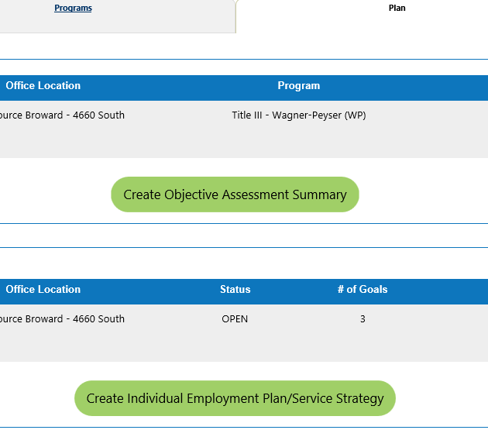
Employ Florida Reporting – Step 2
2) Click “Create Individual Employment Plan/Service Strategy.”
Notes:
Step two is to select “Create Individual Employment Plan/Service Strategy” under the Plan tab and complete each prompted field. A detailed IEP should include:
Goals (suitable employment),
Objectives (short-term and long-term),
Deadlines,
Identifies the responsible party for each objective and the associated deadline, and
Details the services that we will provide to meet each objective and the goal.
One of the benefits of utilizing the Employ Florida VOS Plan is that it prevents staff from missing key components of an IEP because they are required to be entered prior to proceeding to the next step of the plan.

Slide 12
Employ Florida Reporting – Reminders
Create a detailed and SMART plan. The goals and objectives must be:
Specific
Measurable
Attainable
Relevant
Timely
The final copy of the negotiated IEP should be reviewed and signed by both the participant and staff member.
Notes:
The IEP is a jointly developed, SMART plan. The SMART Principles are: Specific, Measurable, Attainable, Relevant, and Timely. The jointly developed plan should answer and address:
Who is involved?
What needs to be accomplished?
Identify the location or locations (campus, remote/home, work-based training, etc.).
Establish a time-frame for completing the short and long-term goals (setting milestones to achieve and associated dates).
Identify requirements and constraints or barriers (as well as how to address barriers).
Specific value, skill, ability, etc. added from accomplishing this goal.
The actual writing of the IEP should be done by the Local TAA Coordinator. This is because the Local TAA Coordinator has been trained in how to properly structure and write effective IEPs. This does not mean the Local TAA Coordinator should simply write the IEP and then give it to the participant to sign.
The IEP is a negotiated agreement between the TAA participant and the TAA program detailing what the TAA participant will do to return to suitable employment and what the TAA program will do to support his/her efforts.
The final copy of the negotiated IEP should be reviewed and signed by both the participant and staff member, and then a copy should be provided to the participant.

Slide 13
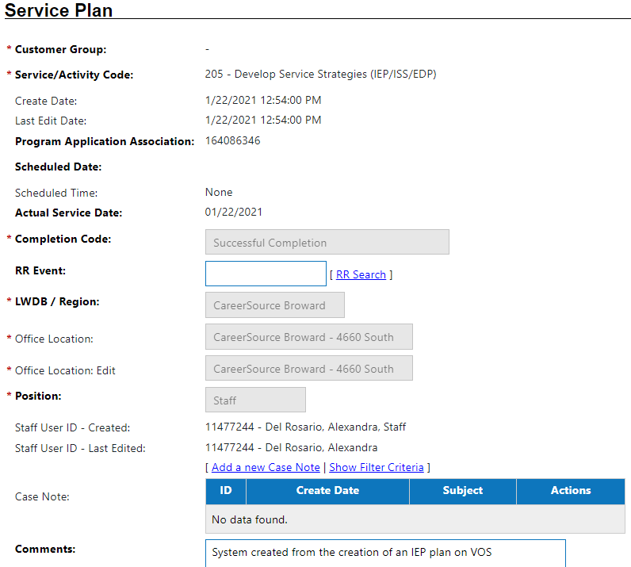
Employ Florida Reporting – Step 3
3) The system generates automatically the service code 205 upon completion of the IEP. Important: Without this 205 code, you will not receive credit for providing this service.
Notes:
The system will generate an automated 205 service code upon completion of the IEP, and it does not automatically generate the T05 which must be entered under the TAA program application. T05 is specific to the TAA program, where 205 is not. T05 should be entered after the IEP is completed, usually same-day. The service codes indicate a completed Individual Employment Plan on the TAADI. Without these codes, your region will not receive credit for providing the service. If you create the IEP within the VOS system (using the Wizard), then the 205 code will not require a case note as the details of the plan are already housed within the Employ Florida system. This saves you time and it is the recommended reporting practice.

Slide 14
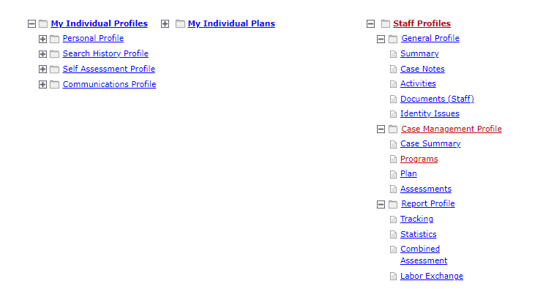
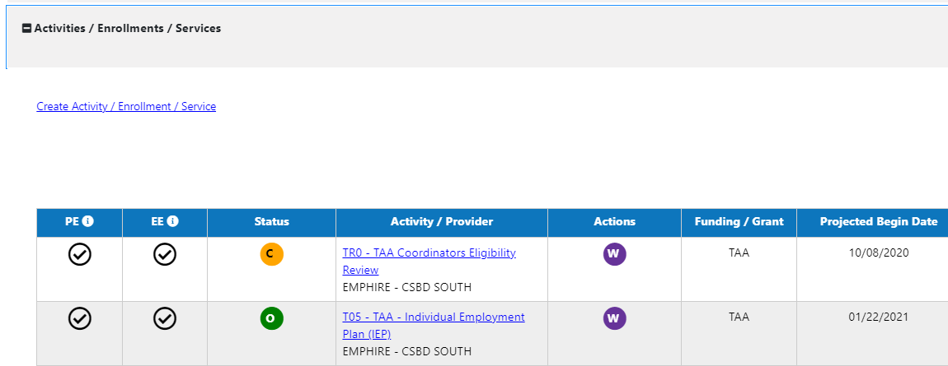
Employ Florida Reporting – Service Code
Notes:
Under the TAA program application, report the T05 service code.

Slide 15
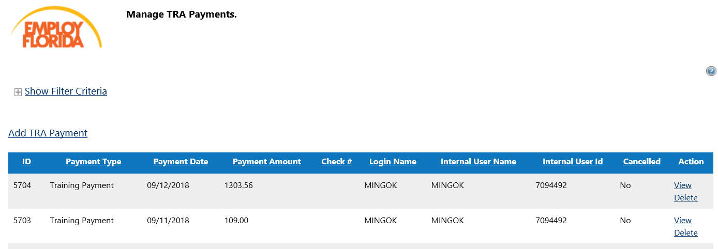
TAA Expenditures Reporting – 7 Steps
Next, report all accrued TAA expenditures under the TAA/TRA payment section of the TAA application.
Notes:
Local TAA coordinators are required to report all accrued TAA expenditures in Employ Florida under the Manage TAA/TRA Program Benefit Payments section of the participant’s TAA application. Despite the link’s title, it is not to report TRA claim information. CONNECT contains the claimant’s TRA-related information and CONNECT is the statewide benefits system.
To ensure everyone understands what is required, we are going to provide a brief walkthrough.

Slide 16
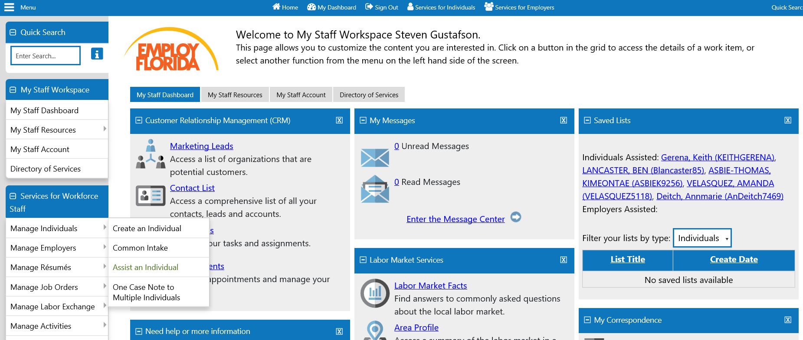
TAA Expenditures Reporting – Step 1
1) Click ‘Assist an Individual’
Notes:
[Read Slide]

Slide 17
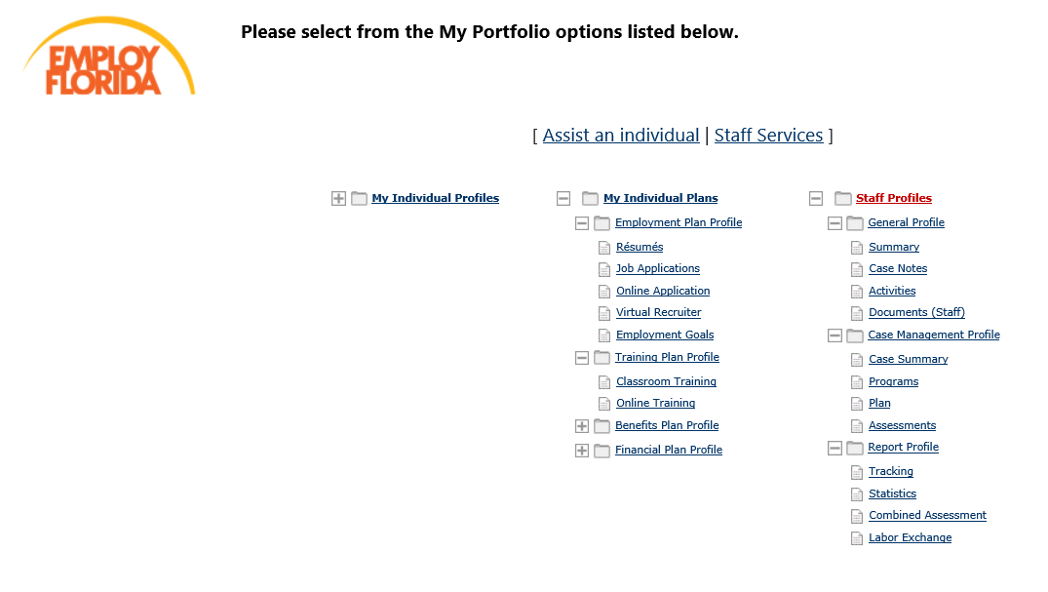
TAA Expenditures Reporting – Step 2
2) Open ‘Staff Profiles’ tab, click Programs
Notes:
After selecting an individual to assist, open the “Staff Profiles” tab and select Programs (under the case management profile).

Slide 18
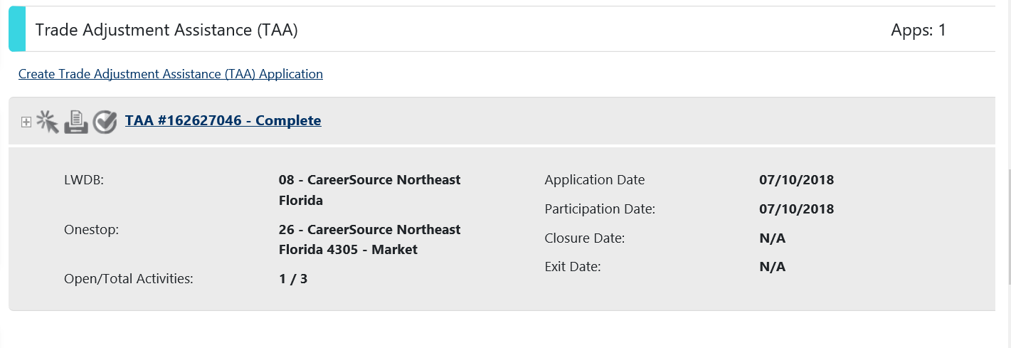
TAA Expenditures Reporting – Step 3
3) Expand TAA application (see plus sign below)
Notes:
Next, you will want to scroll down to the participant’s TAA Application and click the plus sign to expand the TAA application.

Slide 19
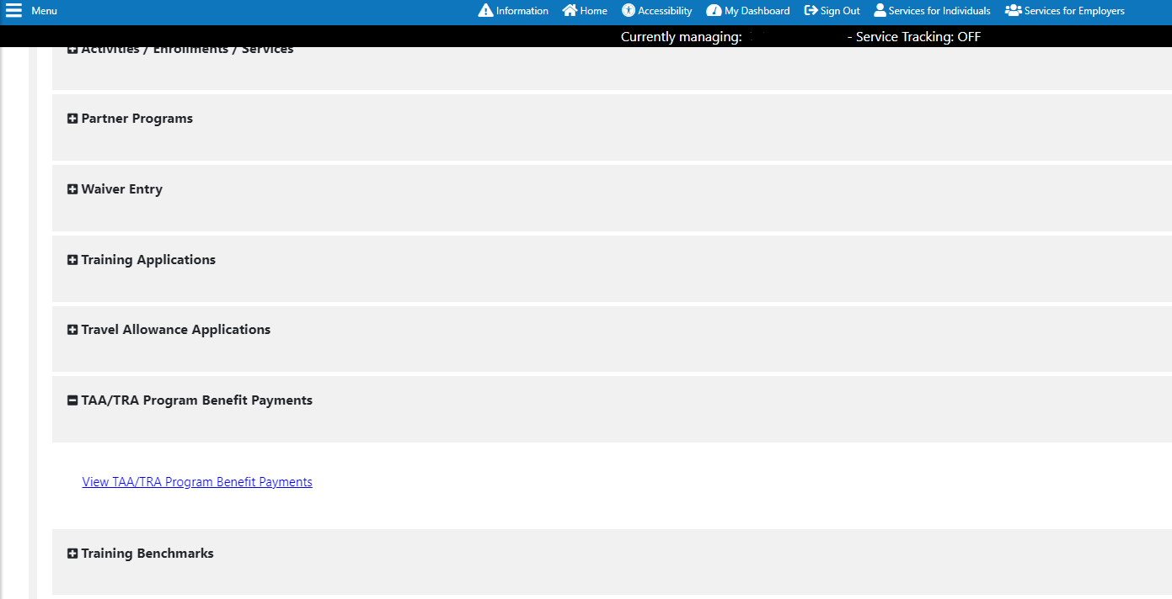
TAA Expenditures Reporting – Step 4
4) Click the plus sign at TAA/TRA Payments screen
Notes:
Once the TAA Application has been expanded, you will click the plus sign next to TAA/TRA Program Benefits Payments and click the View TAA/TRA Program Benefits Payments hyperlink.

Slide 20
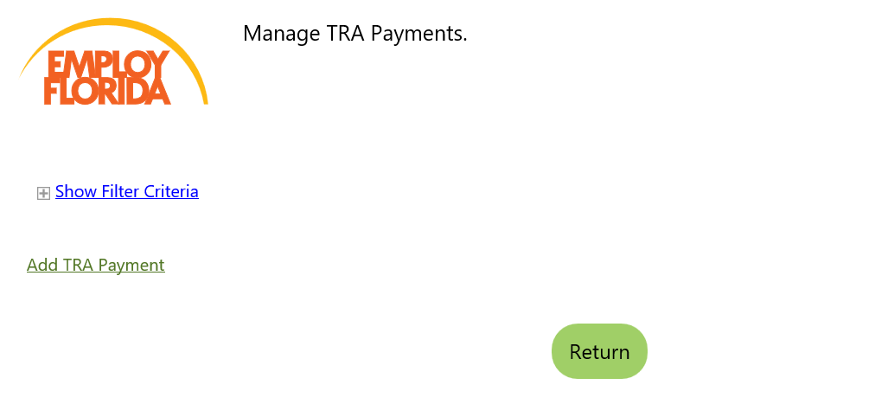
TAA Expenditures Reporting – Step 5
5) Click ‘Add TAA/TRA Payment’
Notes:
Next, you will be brought to the Manage TRA Payments screen. Here you will click the Add TAA/TRA Program Benefit Payment hyperlink.

Slide 21
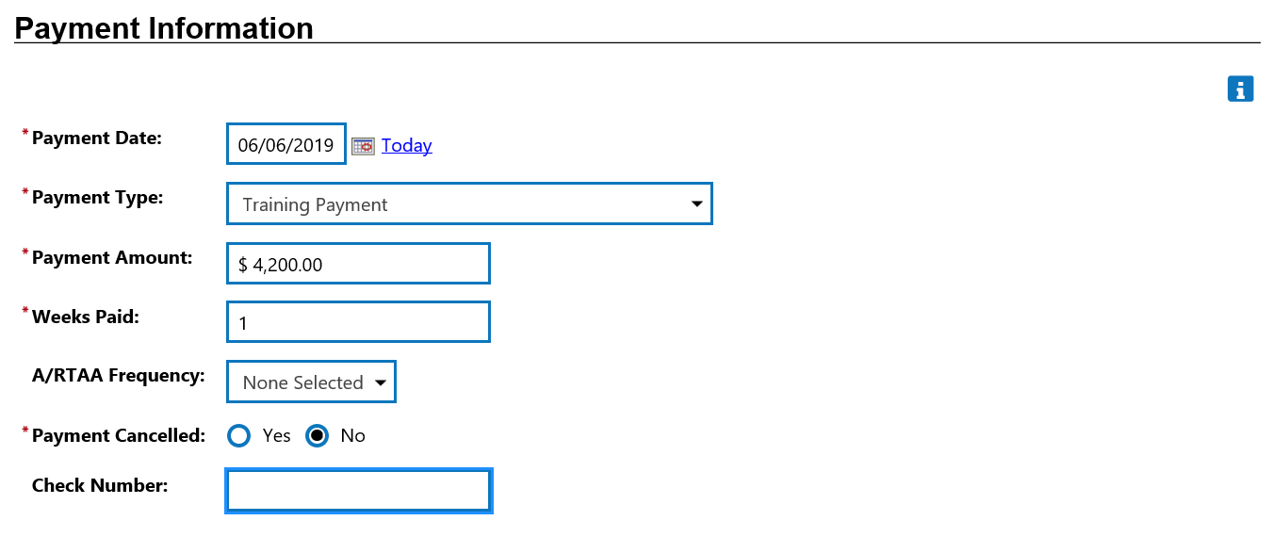
TAA Expenditures Reporting – Step 6
6) Complete the payment information.
Remember to report owed or accrued costs here, not the actual payments made.
Notes:
Complete the required fields of the Payment Information section, to include:
Payment Date – The date the payment became accrued or owed.
Payment Type – Select ‘Training Payment’ from the drop-down menu.
Payment Amount – Enter the accrued or owed training cost.
Weeks Paid – Leave this field as 1; it is not applicable.
A/RTAA Frequency – Select ‘None Selected’ from the drop down menu.
Payment Canceled – Select No.
Check Number – Not required; leave blank.
Although this section of Employ Florida is titled Payment Information, it is important to remember that you are reporting owed or accrued costs and not payments which have been made. To reiterate, payment dates have no correlation to the reporting of TAA training costs. These costs are reported as soon as they become owed or accrued.

Slide 22
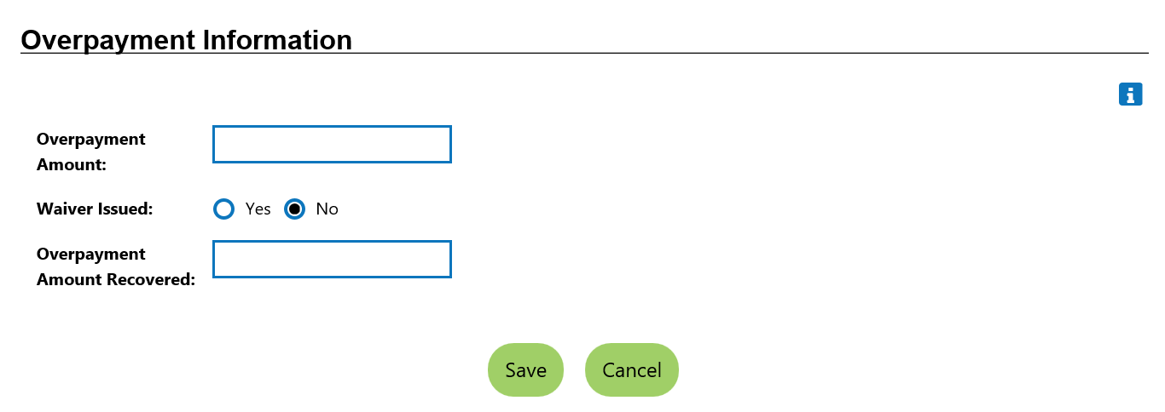
TAA Expenditures Reporting – Step 7
7) Skip the ‘Overpayment’ section and click Save.
Notes:
Next, bypass the Overpayment Information section and click the Save button.

Slide 23
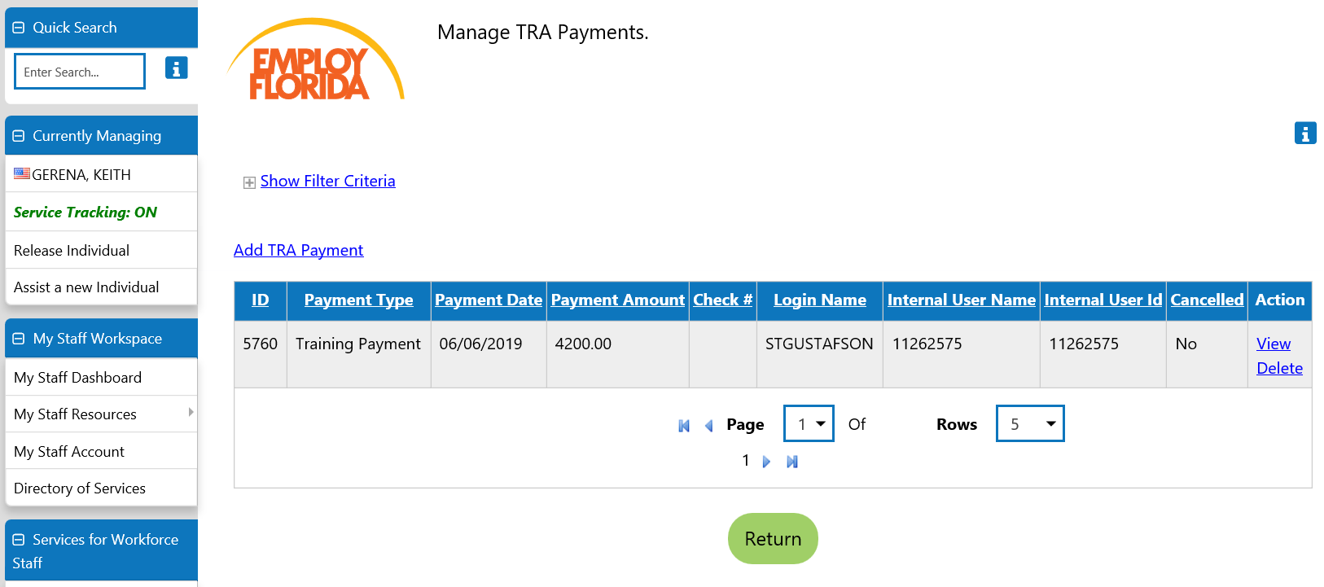
TAA Expenditures Reporting – Review
Confirm you now see the expenditure in ‘Manage TRA Payments’
Manage TAA/TRA Program Benefit Payments
Notes:
The training expenditure has successfully been reported. You should now see the expenditure on the Manage TAA/TRA Program Benefit Payments screen.

Slide 24
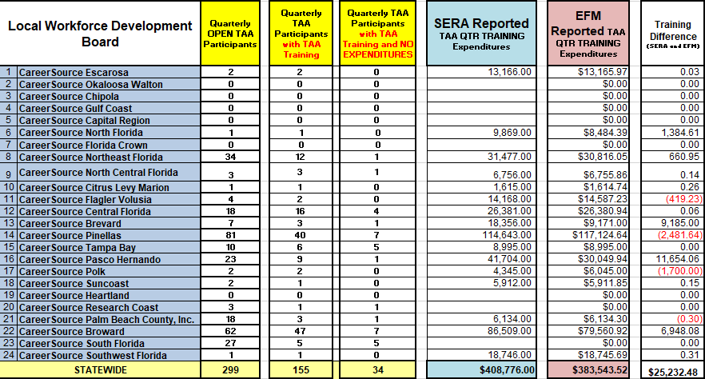
Monthly Data Reconciliation
Notes:
As stated earlier, the Trade Adjustment Assistance Data Integrity report requires that the reported TAA expenditures on the Participant Individual Record Layout (PIRL) and the state’s TAA financial report, Employment and Training Administration (ETA) Form 9130 align. The PIRL report extracts financial data reported by Local TAA Coordinators within Employ Florida and the 9130 report is comprised of financial data from the Subrecipient Enterprise Resource Application (SERA).
The TAADI allows reported expenditures on the PIRL and the financial reports to be within a 15% difference of one another because of the differences that may occur based on when the two reports are submitted. When FloridaCommerce notices anomalies between the two reports, LWDBs will be contacted individually in order to address any reporting discrepancies including execute updates in Employ Florida. The US Department of Labor collects and reviews TAADI quarterly.

Slide 25
Questions & Answers
Notes:
This brings us to the conclusion of the TAA funding overview training presentation. Today’s presentation gave you a better understanding of:
The Trade Adjustment Assistance program
Florida’s service delivery structure
Reporting expenditures, with examples
Our Trade Adjustment Assistance Data Integrity measures
Monthly data reconciliations between Employ Florida’s participant information and local financial information
Do we have any questions?

Slide 26
Contact Us
Thank You.
If you have questions or comments about this presentation, please contact us.
Yolanda Triplett, State Trade Program Coordinator
Email: TAA@commerce.fl.gov
Main Line: 850-245-7477
Notes:
Thank you for your time and great questions. Here is my contact information, as well as two key contacts for federal performance reporting and financial management (below). We’re always happy to help! Thank you.
Kathy Keeton (Performance Reporting)
kathy.keeton@commerce.fl.gov and
Caroline Womack, Chief, Bureau of Financial Management
Main Line: 850-245-7126
Email: Caroline.Womack@commerce.fl.gov

