Slide 1
Reaching the Business Community: Getting Ready for Recovery
Candace Moody
WorkSource
Kimberly Sullivan
WORKFORCE CENTRAL FLORIDA

Slide 2
Models that Work
Commission Based Sales
Team EWT $ Amount
Team Dashboard Measures & Community Points
Individual Goals (EWT & Plans)
External Partners
RFP process
50% cost/50% performance
Decentralized Relationship Managers

Slide 3
Models that Work
Territory Assignments
Industry Assignments
Targeted Industries get more attention
Facilitates cooperation with ED organizations
Economic Development Partnerships
Business Advisory Council

Slide 4
Tools for Business Relevancy
State of the Workforce Survey
Workforce Summit
Paid Internships Year Round

Slide 5
Tools for Business Relevancy
Mobile Unit Training
Employed Worker Training
WORKFORCE CENTRAL FLORIDA UNIVERSITY
Virtual Job Fairs
Lending Library

Slide 6
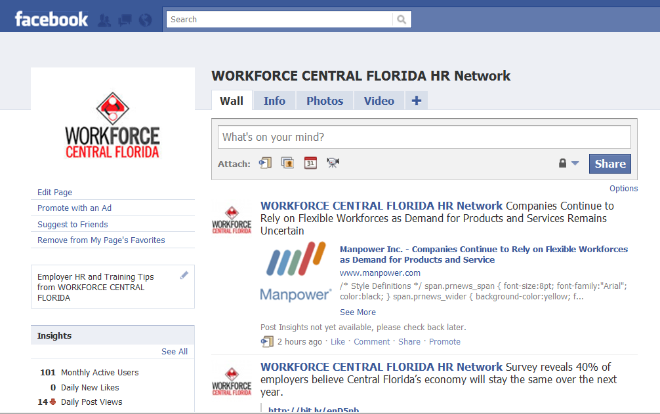
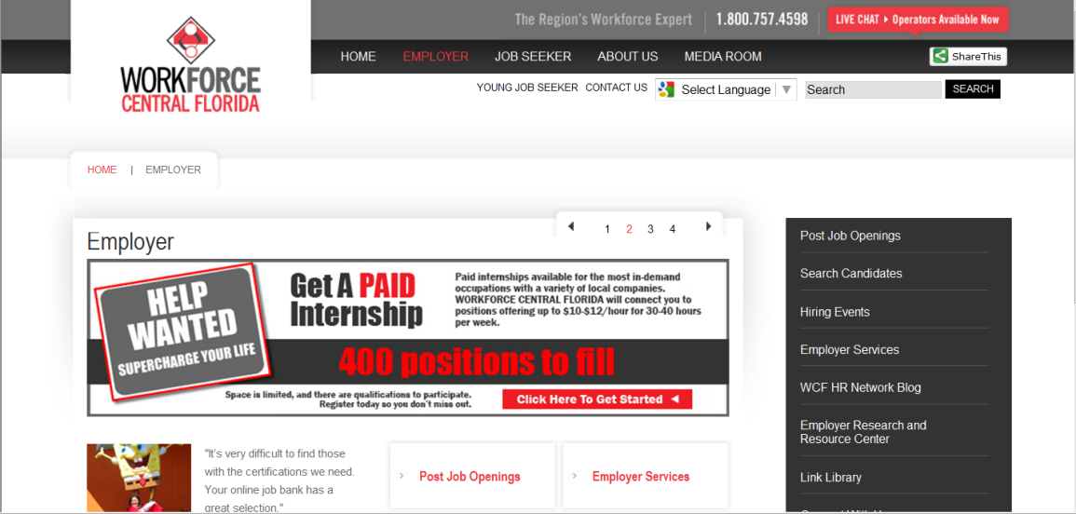
Tools for Business Relevancy
E-newsletter
Social Media
Web site

Slide 7
Tools for Business Relevancy
Connecting with Entrepreneurship programs
Small Business Centers
Incubators
Virtual Job Fair
Florida Ready to Work
Employed Worker Training

Slide 8
Preparing for Recovery
Watching HWOL and Employ Florida Trends
New Employer Registrations (by County)
New Employer Registrations (By NAICS)
Job Orders and Openings by Industry
Job Orders (by Occupation)
Services Provided to Employers
Referrals
Ready To Work
Rapid Response

Slide 9
Help Wanted Online

Slide 10
Help Wanted Online

Slide 11
Preparing for Recovery
Monitoring targeted industries
Connect with ED organizations; ask for data
Turnover, churn, and contracting in the workplace
Harder to measure – BLS does not have good tools for this
Connect with industry organizations; professional jobseekers; temporary staffing companies

Slide 12
Questions to Ask Business
Even in this economy, some jobs are very hard to fill. Which jobs are those in your company/industry?
How has the recession made it easier or harder to recruit? How can we help?
How has the recession changed your standards for recruiting? (Credit ratings, i.e.)
Which positions are showing high turnover right now?

Slide 13
Preparing for Recovery
Build products, services & relationships now; so when hiring needs return employers know where to go
Employer Workforce Plans
Contact info
Challenges
Action Plan & Goals
Indentify External Resources
Coordinate Activities & Timeline
Comments
Survey Employers to assess need

Slide 14
State of Workforce Survey 2010
Primary Reasons employers are located in Central Florida
Greatest challenges employers are facing
How economic turndown has impacted employers
What employers see as new and emerging industries; how they affect their businesses

Slide 15
State of Workforce Survey 2010
Most important soft skills expected
To what extent hiring qualified workers is a challenge
Primary concerns when hiring new employees
Plans on expanding/reducing for next year

Slide 16
Q & A

