Slide 1
Optional Service Delivery Strategies
Kimberly Sullivan
WORKFORCE CENTRAL FLORIDA
Cheryl Taylor
Worksource

Slide 2
Three Best Practices @ WCF
Web-based Services
JobVantage Offices
ZuCan

Slide 3
Web-based Services
Philosophy
Goals
550,000 actions a year
Online applications, virtual job fairs, reservations, online learning, webinars, optimal resumes, job posting, view videos, newsletter sign ups, …
End of October at 163% of goal to date

Slide 4
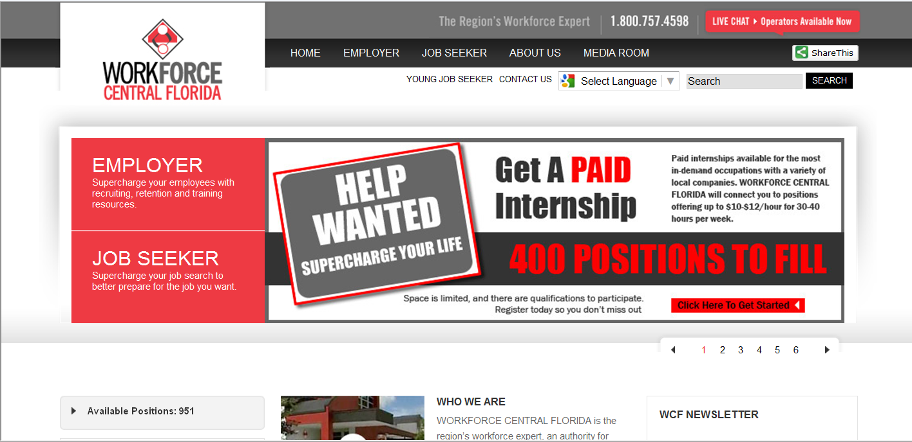
Web-based Services
Redesigned web site & launched end of October

Slide 5
Web-based Services
Allowed us to free classroom and conference room space; staff time
Allowed us to create accessible activities available 24/7 for welfare and WIA
Speeds up process; no waiting for a scheduled class
Information in consistent and always available

Slide 6
Web-based Services
Videos & Webinars for Job Seekers
Services and program orientations (WIA, ZuCan, etc)
ZuCan Professional Standards Webinar
FAQ Webinar
Resume Writing & Interviewing Webinars
Pathways for Employment for the Ex Offender
Using Twitter for Your Job Search
Intro & Registering in EFM
Re-Evaluating your Life
Understanding & Managing your Credit Score

Slide 7
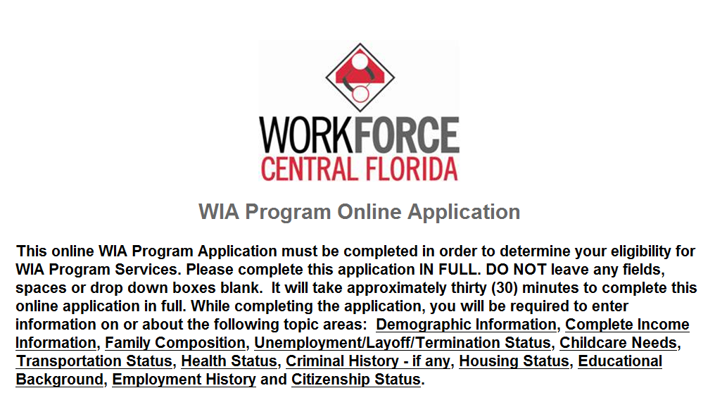
Web-based Services
Online Applications
WIA Online Application
CAREER TRACK
Application
Internship Programs (employer & job seeker apps) Application
Employed Worker Training Application

Slide 8
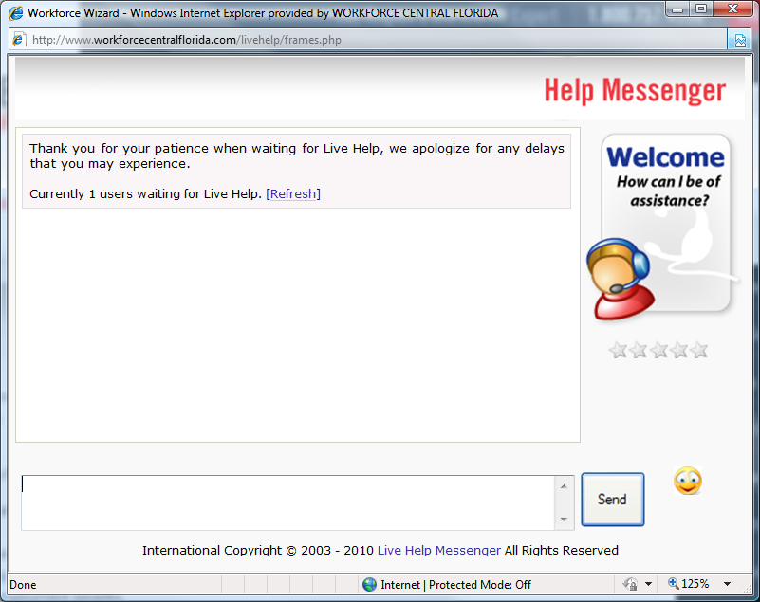
Web-based Services
Ask an Expert: Workforce Wizard

Slide 9
Web-based Services
InfoSource
Virtual Job Fairs
Sign up for E-Newsletters
On-line Annual Reports
Translation in 50 languages
Share This Option

Slide 10
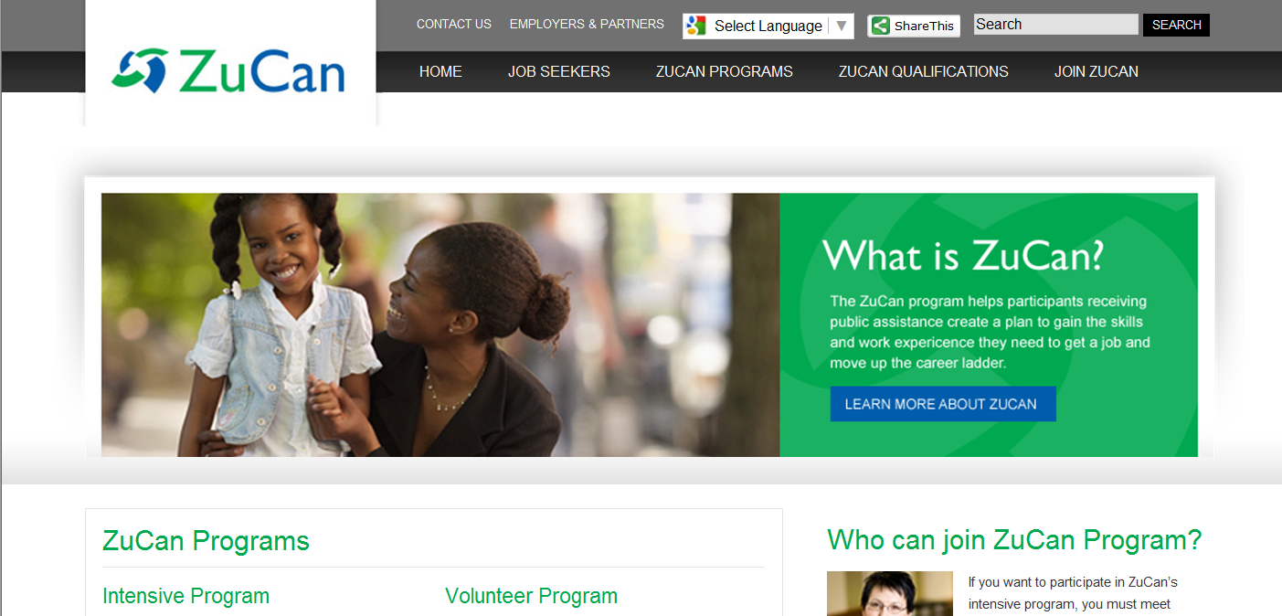
ZuCan
Philosophy
Brand

Slide 11
ZuCan
Goals & Progress
Program is a choice to participate
Participants make a commitment to ‘join’ the program
Materials redesigned to sell program & benefits of joining
Professional standards agreement
Work with career coaches

Slide 12
JobVantage
Philosophy
New Brand
Focus on Employment & Placement Services
Smaller Footprints; closer to customer
Staff Travel; Hotel cubicle space;
Different Hours
Offer Placement Services to Professional job seeker

Slide 13
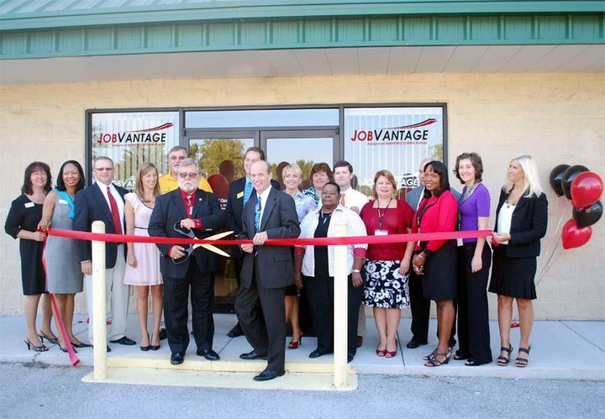
JobVantage
Three Locations

Slide 14
Mobile Access Points

Slide 15
What are Access Points?
Faith based organizations
Community sites on public transportation routes
Government sites such as libraries
Can be scheduled occasionally or regularly
Have identified assets that they contribute
Staff
Computer resources and internet access
Volunteers

Slide 16
Why do we need Access Points?
To increase our reach into communities that need us
To raise awareness of our services
To provide a flexible way to serve more people
To deploy resources more effectively

Slide 17
What do we look like?
3 person team
3 Managers/Site Developers
25 computers
Mobile Resources (printer, copier, etc.)

Slide 18
Services We Provide
Employ Florida Marketplace – job search
WorkSource Career Services
Orientation to training
Workshops- provided by staff and a pool of qualified trainers
Schedule may be regular, periodic, or one-time

Slide 19
Sites & Partnerships
Current Sites
Jacksonville Urban League
Goodwill
Sulzbacher Center
Branch Libraries
Department of Children and Families (Family support sites)
Public Housing
Faith Based Centers
Community Centers
Future Sites
Military Base
Veteran Centers

Slide 20
Customer Profile
Average age 40-55
Educational Level- High School – College Degree
Average length of Unemployment 6-12 months
20% Veterans

Slide 21
Mission Match
What’s In It for Me???
Benefits for the community
Identifying Resources
Setting goals and Level of Service
Logistics
Setting up training and site visits

Slide 22
Benefits & Challenges for the Sites
Benefits
Extended reach and impact in community
Mission expansion / capacity building
Partnership with workforce and economic development
Additional resources
Challenges
Recruiting and training volunteers
Staff commitment / overextension
Technology capacity
Facility space – can they accommodate the increase in traffic?

Slide 23
Measuring Success
Number of customers receiving services and gaining employment
Number of customers who are first timers to this Access Point
Number of first time customers who have not previously been to WorkSource

Slide 24
Sustaining Success
Site Developers
Ongoing training and support
Marketing and outreach

Slide 25
Lessons Learned
Site Developers
Ongoing training and support
Marketing and outreach

