Slide 1
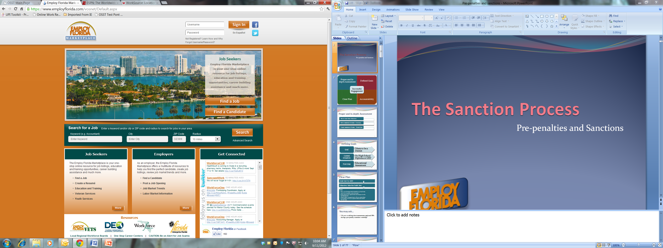
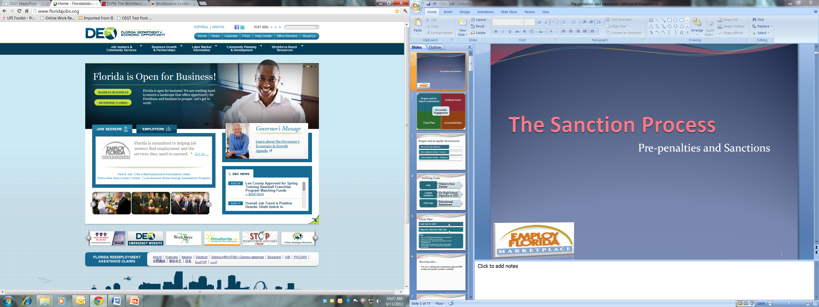
Accountability and the sanction process
Part III
Notes:
Welcome to the Welfare Transition (WT) program’s training on Accountability and the Sanction Process: Part 3 offered by the Florida Department of Economic Opportunity. This training will highlight the sanction levels and the forgiveness policy mandates.

Slide 2
Customer agrees to comply and shows for activity
MONDAY | TUESDAY | WEDNESDAY | THURSDAY | FRIDAY | SATURDAY | SUNDAY
 |  |  | 1 Failure Occurs | 2 Notice of Failure (2290) mailed/oral attempt successful (customer agrees to comply on the 5th) | 3 | 4
5 Shows for activity | 6 | 7 | 8 | 9 | 10 | 11
12 | 13 | 14 | 15 | 16 | 17 | 18
19 | 20 | 21 | 22 | 23 | 24 | 25
26 | 27 | 28 | 29 | 30 | 31
Notes:
In this example, the participant contacted the case manager regarding the failure but did not have good cause. The customer has been counseled and would like to continue engagement in the program. You have given the customer a compliance activity for the 5th of the month. The customer shows for his/her compliance activity. What do you do in the system?

Slide 3
Shows for activity after agreeing to comply
The customer shows to the compliance activity on the compliance date, what do I do?
  End the pre-penalty in OSST with “complied”
  Use the date the customer agreed to comply as the compliance date
Case note the events
Notes:
If the customer attends the compliance activity, you would end the pre-penalty started in OSST with “complied”. It is important to note that the date to be used will be the date the customer agreed to comply as the compliance date, not necessarily the date they attended the compliance activity. The reason we use this date is because the customer made a verbal agreement, and attending the compliance activity is the result of that agreement. Once they have attended the activity, they have “complied” with the agreement of re-engagement. Case note the events in OSST as well.

Slide 4
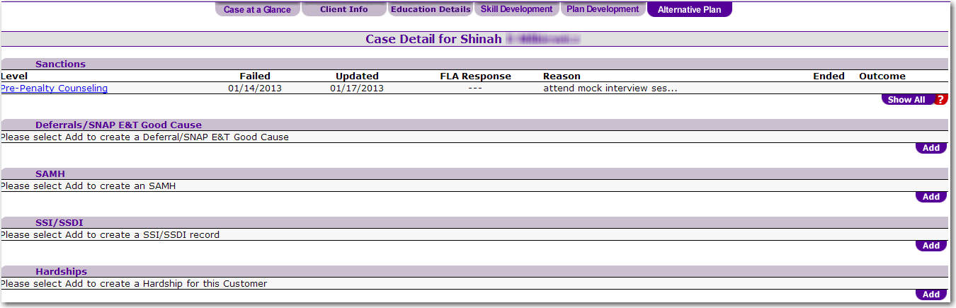
Notes:
After the customer has satisfied the compliance activity, you will select the pre-penalty counseling hyperlink.

Slide 5
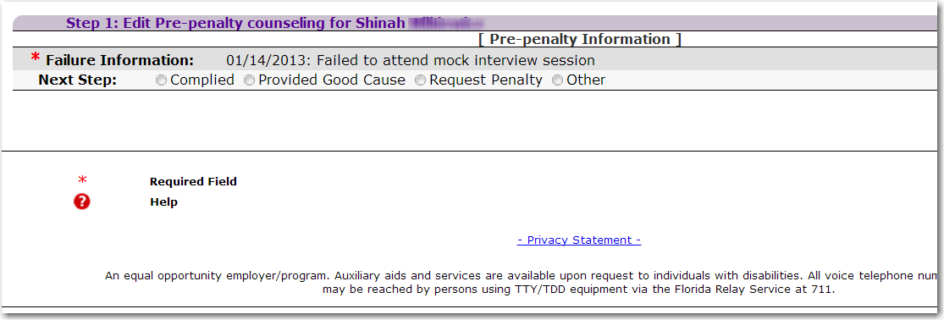
Notes:
Once you have selected the pre-penalty hyperlink, you will be asked to record the next step. In this example, you will select the “Complied” radio button to end the pre-penalty.

Slide 6
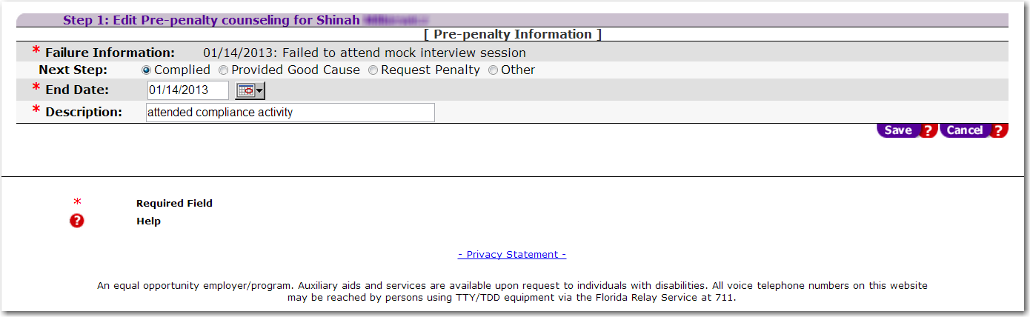
Enter the pre-penalty end date and a brief description of the compliance.
Notes:
Once you select the “Complied” radio button, the next step would be to enter the end date and a description of why the failure was satisfied due to the attendance of the compliance activity. The failure date and the end date should be the same. After all appropriate data is entered, select the “Save” button. Remember to case note the event(s).

Slide 7
Shows for activity and fails again
MONDAY | TUESDAY | WEDNESDAY | THURSDAY | FRIDAY | SATURDAY | SUNDAY
 |  |  | 1 Failure Occurs | 2 Notice of Failure (2290) mailed/oral attempt successful (customer agrees to comply on July 5th) | 3 | 4
5 Shows for activity | 6 | 7 | 8 | 9 Does not show for activity | 10 | 11
12 | 13 | 14 | 15 | 16 | 17 | 18
19 | 20 | 21 | 22 | 23 | 24 | 25
26 | 27 | 28 | 29 | 30 | 31
Notes:
In this example, the customer shows for her compliance activity scheduled for the fifth but fails to show for the next activity scheduled for the 9th day of the month, what should we do?

Slide 8
Shows for activity and fails again
The customer shows to the compliance activity on the compliance date, but fails again within 30 days of the first failure, what do I do?
  Set an alert for three days from the 2nd failure
Case note the events
Notes:
Because this is the 2nd failure, you should set an alert for three days from the 2nd failure date to allow the participant to report good cause. The 3 days are in place to give the customer an opportunity to report to the case manager good cause for missing the activity. Unlike the first failure, the case manager is not obligated to contact the customer to inquire about missing the activity. We have previously counseled the customer on what is acceptable in the program after the first failure, so it is the customer’s responsibility to report good cause within 3 days of the 2nd failure.

Slide 9
Shows for activity and fails again
MONDAY | TUESDAY | WEDNESDAY | THURSDAY | FRIDAY | SATURDAY | SUNDAY
 |  |  | 1 Failure Occurs | 2 Notice of Failure (2290) mailed/oral attempt successful (customer agrees to comply on July 5th) | 3 | 4
5 Shows for activity | 6 | 7 | 8 | 9 Does not show for activity | 10 | 11
12 | 13 | 14 | 15 Request Penalty | 16 | 17 | 18
19 | 20 | 21 | 22 | 23 | 24 | 25
26 | 27 | 28 | 29 | 30 | 31
1
2
3
Notes:
In this example, the customer shows for her compliance activity. She fails to show for her next activity scheduled for the 9th day of the month, what should we do in the system? You would set an alert for three business days from the second failure. Using the 9th day of the month as the second failure date, you would set your alert on your calendar to request a penalty on the 15th day of the month if the customer has not contacted you with good cause. In this example, it is important to realize that requesting this penalty timely can have an impact on your local and the State’s participation rate. Recognizing and acting on program failures is a part of your accountability to the customer as well as the program.

Slide 10
Shows for activity and fails again
MONDAY | TUESDAY | WEDNESDAY | THURSDAY | FRIDAY | SATURDAY | SUNDAY
 |  |  | 1 Failure Occurs | 2 Notice of Failure (2290) mailed/oral attempt successful (customer agrees to comply on July 5th) | 3 | 4
5 Shows for activity | 6 | 7 | 8 | 9 | 10 | 11
12 | 13 | 14 | 15 | 16 | 17 | 18
19 | 20 | 21 | 22 | 23 | 24 | 25
26 | 27 | 28 | 29 | 30 Fails again | 31
Notes:
In this example, the participant complied on the 5th day of the month and continued to comply until the 30th day of the month. What do we do?

Slide 11
Complies, then fails again within 30 days
The customer shows to the compliance activity on the compliance date, but fails again within 30 days of the first failure, what do I do?
  Set an alert for three days from the 2nd failure
  Provide three days for the participant to report good cause
Issue: the three days will take us beyond 30 days of the first failure
What do I do?
Notes:
In the calendar example, the 2nd failure occurred on the 30th day of the month and is considered within 30 days of the initial failure. As long as the 2nd failure occurs within 30 days of the first, you can request a penalty on the case.

Slide 12
MONDAY | TUESDAY | WEDNESDAY | THURSDAY | FRIDAY | SATURDAY | SUNDAY
 |  |  | 1 Failure Occurs | 2 Notice of Failure (2290) mailed/oral attempt successful (customer agrees to comply on July 5th) | 3 | 4
5 Shows for activity | 6 | 7 | 8 | 9 | 10 | 11
12 | 13 | 14 | 15 | 16 | 17 | 18
19 | 20 | 21 | 22 | 23 | 24 | 25
26 | 27 | 28 | 29 | 30 Fails again | 31
  Count three days from the date of the 2nd failure and request a penalty on the appropriate day of the following month if the customer does not contact with good cause
Notes:
Despite the 2nd failure occurring on the 30th day, you would still count three days from the date of the 2nd failure and request a penalty on the appropriate day of the following month if the customer does not contact you with good cause. As long as both dates of a penalty request are within 30 days of each other, the system will allow for a sanction to be requested for the participant.

Slide 13
Frequently Asked Question…
What if the participant has good cause for the second failure, what do I do?
Notes:
One of the most common questions we receive is: What do I do if the participant has good cause for the second failure?

Slide 14
Frequently Asked Question…
DO NOT end the pre-penalty with good cause
  Enter a case note that the customer has good cause for the 2nd failure
  Good cause only relates to the second failure
  Leave the pre-penalty in place until it is no longer valid
Notes:
If the customer has good cause for the second failure, you would enter a case note stating that the customer has good cause for the second failure. You would not end the pre-penalty with good cause because the good cause only pertains to the second failure. There was not any good cause for the first failure so you would leave the pre-penalty in place until it is no longer valid in the OSST system. The system will automatically dismiss the pre-penalty once the time limit of the pre-penalty expires and the link disappears.

Slide 15
Sanction Levels
Level 1
Cash is terminated for 10 days or until the participant complies
Level 2
Cash is terminated for one month or until the participant complies, whichever is later
Level 3
Cash is terminated for three months or until the participant complies, whichever is later
Notes:
There are currently 3 sanction levels. The penalty for a Level 1 sanction terminates cash assistance for 10 days or until the participant complies (whichever is later). If the participant reaches a level 2 sanction, cash assistance is terminated for one month or until the participant complies (whichever is later). The final penalty is a level 3 sanction which terminates cash assistance for 3 months or until the participant complies (whichever is later).

Slide 16
Frequently Asked Question…
How do I know which sanction level to request?
Notes:
Now that we know the sanction level penalties and time limits, how do we know which sanction level to request?

Slide 17
Sanction Levels—Level 1
Level 1 Sanction
Never been sanctioned or first time being sanctioned
Previous level 1 sanction was ended due to good cause
Meets sanction forgiveness criteria
Notes:
If this is the person’s first sanction ever, then a level 1 sanction is appropriate.
If the customer previously had a level 1 sanction that was ended due to good cause and you need to request a sanction for noncompliance, then a level 1 sanction also would be appropriate.
If the customer had any level sanction that was previously ended with complied and they meet sanction forgiveness criteria, a level 1 sanction is appropriate.

Slide 18
Sanction Levels—Level 2
Level 2 Sanction
Previous sanction was a level 1 and was not ended due to good cause
Previous level 1 was requested, but was not imposed by DCF
Previous sanction was a level 1, but the customer does not meet forgiveness criteria
Notes:
If the customer’s last sanction was a level 1 and was not ended with good cause and the customer needs to be sanctioned again, a level 2 sanction is appropriate.
If a level 1 sanction was previously requested by DEO, but not imposed by DCF for some reason and now the customer needs to be sanctioned again, then a level 2 sanction is appropriate.
If the previous sanction level was a level 1 and the customer does not meet forgiveness criteria, then a level 2 sanction is appropriate.

Slide 19
Sanction Levels—Level 3
Level 3 Sanction
Previous sanction was a level 2 and was not ended due to good cause
Previous sanction was a level 2, but was not imposed by DCF
Previous sanction was a level 2, but the customer does not meet forgiveness criteria
Notes:
If the customer’s last sanction was a level 2 and was not ended with good cause and needs to be sanctioned again, a level 3 sanction is appropriate.
If a level 2 sanction was previously requested by DEO, but not imposed by DCF for some reason and now the customer needs to be sanctioned again, then a level 3 sanction is appropriate.
If the previous sanction level was a level 2 and the customer does not meet forgiveness criteria, then a level 3 sanction is appropriate.

Slide 20

Forgiveness Policy
If a program participant has been compliant in the program 6 months since his or her last sanction was ended with “complied”, then all prior sanctions can be forgiven
Notes:
The forgiveness policy states: If a program participant has been compliant in the program 6 months since his or her last sanction was ended with “complied”, all prior sanctions can be forgiven.

Slide 21
Frequently Asked Question…
Does the participant have to be compliant in the WT program for six consecutive months in order to meet the forgiveness policy criteria?
Notes:
Based on the forgiveness policy definition, would the 6 months have to be consecutive?

Slide 22
Answer
No
  The months do not have to be consecutive
    The months cannot include months the participant was transitional
    The months cannot include any month where the customer did not receive cash assistance
Notes:
The answer is no, the 6 months do not have to be consecutive; however, the months can not include any of the months the participant was transitional nor any of the months the customer did not receive cash assistance.

Slide 23
Quick Review
Accountability starts well before we even get to the pre-penalty process
We should establish clear goals to eliminate the number of sanction occurrences
We sanction because it’s a requirement
Notes:
It is our job to actively engage and help all of our participants in this program. We have to understand that both career managers and participants are held accountable for our responsibilities. As a career manager, accountability starts well before the pre-penalty process. Proper in-depth assessments, clearly defined goals, and open communication of expectations and availability of services are a few things that are in place to ensure that the participant has the best chance at being successfully engaged in our program. It is important to keep in mind that we do not sanction because we want to, but because it is a requirement.

Slide 24
Questions?
Please Contact the
Welfare Transition Team
@1-866-352-2345
An equal opportunity employer/program. Auxiliary aids and services are available upon request to individuals with disabilities. All voice telephone numbers on this document may be reached by persons using TTY/TDD equipment via Florida Relay Service at 711.
Notes:
For any additional questions, please contact the Welfare Transitional team at 1-866-352-2345

