Slide 1
Job Orders
Part One: Job Order Overview
Notes:
Welcome to the Wagner-Peyser presentation on processing job orders in the Employ Florida Marketplace (EFM) system. This presentation provides an overview of some job order basics and describes various types of job orders. For more specific job order guidelines, please refer to part two of the job orders presentation series.

Slide 2
Employ Florida Marketplace
Florida’s management information system and job bank
Employers post vacant positions and recruit qualified applicants
Job seekers view and apply for vacancies
Terms of use policy governs conduct on the site
Staff should use this policy as guidance when accepting or revoking job orders
Notes:
The Employ Florida Marketplace is the state’s management information system and job bank that brings employers and job seekers together to facilitate labor exchange activities. Employers are able to post job orders, recruit job seekers, and seek out training opportunities. Job seekers can post resumes for employers to view, search for vacant positions, and utilize other workforce related resources. Prior to registering in the system, all users must review and accept the terms of use policy which governs the conduct of users of the site. It is imperative that staff are familiar with the terms of use as it will guide the decision-making process when posting or revoking job orders, as well as reporting any behaviors prohibited under the terms of use policy.

Slide 3
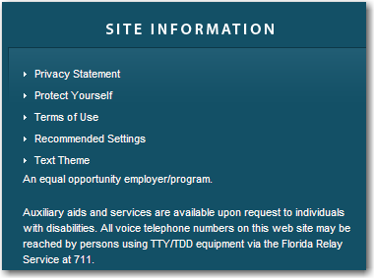
Terms and Conditions of Use
Notes:
The terms and conditions of use were established to provide guidelines regarding acceptable conduct by jobseekers and employers while using EFM. Employers and job seekers review and agree to the terms and conditions of use for access to EFM upon registration. These terms advise employers of acceptable and unacceptable behaviors when posting jobs or recruiting applicants on EFM. This also serves as a protection barrier for job seekers against any potential scams or inequalities. Staff who manage job orders or provide referrals to job seekers should be knowledgeable of the terms of use.

Slide 4
Job Order Definitions
Job order – structured record of an employer’s requirement for filling vacant positions with qualified workers
Job opening – single job opportunity which the local office has a request on file to select and refer applicants
Notes:
A job order is a structured record of an employer’s requirement for filling vacant positions with qualified workers. Before a job order can be constructed, there must be a job opening available. A job opening means a single job opportunity for which the local office has a request on file to select and refer applicants. It is inconsistent with the purpose of the One-Stop Career Center to refer job seekers to an employer who only wishes to build applicant files for possible future openings. However, it is permissible to refer an applicant for an interview with an employer who may be able to create an opening that will be available on a definite future date.

Slide 5
Job Order Entry
Can be self-entered by employers
An alert is sent to staff for review once an employer enters a job order in the system
Staff have 48-hours to review employer entered orders
All job orders must comply with federal and state laws, as well as the terms of use policy
Requests received by staff must be reviewed for compliance prior to entry into EFM
Notes:
Job orders are the vehicle which drive the recruitment and application process for employers and job seekers. Job orders can be self – entered by employers, or entered by the One-Stop Career Center staff. If an employer enters their own job order, an alert will be sent through EFM to notify staff of the pending order so that they may be reviewed for compliance and accuracy.

Slide 6
Job Order Requirements
Qualifications of a worker
Specific hiring requirements
Information about the job
Applicant referral instructions
Notes:
Before posting a job order, employers must have a job opening available. Information about the vacancy will go into constructing the job order along with other requirements. At a minimum, job orders must state the qualifications a worker must have to perform the duties of the position such as education or employment experience; list specific hiring requirements and information related to the job such as the pay, hours of work, etc.; and, there must be applicant referral instructions that provide staff and job seekers with the proper application method.

Slide 7
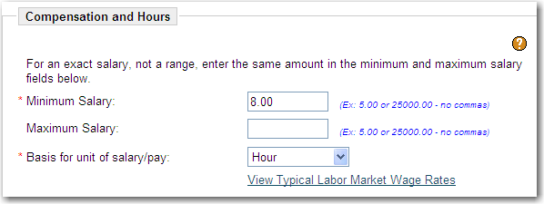
Job Order Form
Fields marked by an asterisk must be completed
Employers are not required to list salary information
An actual wage or wage range should be listed as expressed by the employer
Notes:
All fields on the job order form that are marked by an asterisk must be completed. There are supplemental fields that, if completed, will assist with providing more information about the advertised position; however, these fields are not required. An example of this is the wage data. Employers are not required to list pay information if they choose not to, but some numerical value must populate this field. For those employers wishing to list pay data, the actual wage or wage range should be listed on the job order.

Slide 8
Hiring Requirements
Notes:
The job order form provides a field for employers to list any hiring requirements that may be associated with a position. To be a legitimate requirement the company policy must require all job seekers meet this criteria regardless of the referral source. These requirements may include drug testing, physical examinations, background or credit checks to name a few.

Slide 9
Orders in Violation of the Law
Job orders that don’t comply with laws and policies should not be displayed to the public
Staff should contact the employer to discuss the perceived violations
Failure to change the illegal specifications should result in a voided order
Restricting specifications must be bona fide occupational qualifications
Notes:
Job orders that don’t comply with federal and state laws or other terms, should not be enabled to display to the public. Staff should contact the employer for clarification of any inconsistencies with the order. If the employer refuses to change the violations with the job, the order should be closed. Restricting criteria must be justified as a bona fide occupational qualification or the order should be voided.

Slide 10
Staff Review Process
Review job orders for compliance with federal and state laws
Ensure job orders follow the terms and conditions of use
If job orders do not comply, contact employer for modifications
If employer does not correct deficiencies, revoke the job order
Timely entry into Wagner-Peyser (WP) reporting system
Notes:
Once job orders have been received by the one-stop center, staff play a crucial role in the review and entry of those orders in EFM. Staff should review job orders for compliance with federal and state laws, and should also ensure that all job orders follow the terms and conditions of use displayed on the EFM homepage. Employers fund the labor exchange system through the Federal Unemployment Tax Act (FUTA), therefore all employers should be entered into the WP reporting system in a timely manner. EFM allows employers to enter their own job orders, however, One-Stop staff should review the job orders for accuracy prior to the 48-hour auto-enable process.

Slide 11
Staff Review Process (cont’d)
Job orders auto-enable after 48 hours
Employer entered job orders will automatically display to the public
May expose job seekers to compromising information such as
Violations of the law
Scams
Insufficient information
Notes:
Auto-enabling means the system will automatically display an employer’s job order to the public even if staff have not reviewed the information. Job orders allowed to auto-enable could allow compromising or incorrect information to be displayed to viewers. This may include violations of Equal Employment Opportunity, job scams, and job orders that don’t provide sufficient information for job seekers. Staff review and follow-up of job order information is pertinent to the integrity of the EFM system.

Slide 12
Types of Job Orders
Notes:
There are several types of job orders that may be entered into the Employ Florida Marketplace. Some of these orders must follow specific procedures as set forth by federal laws and state policy. The next few slides will review each type of job order and any associated criteria that must be listed.

Slide 13
Job Development Job Order
The process of securing a job interview with a public or private employer for a specific applicant for whom the local office has no suitable opening on file
20 C.F.R. 651.10
Notes:
A job development job order is the process of securing a job interview with a public or private employer for a specific applicant for whom the local office has no suitable opening on file.

Slide 14
Job Development Process
Interview customer to determine needs
Refer to other services or begin job development (JD) attempts or contacts
Record code 123 and case note the name of the employer/company
Regardless of the result of the contact/attempt
Upon hire, write a job order and take a placement credit
Notes:
Job developments (JD) provide good customer service to individuals who are having difficulty in finding suitable jobs in EFM or through other means. Individuals that are not “job-ready” should be referred to other services, such as resume preparation or interviewing skills workshops, before beginning job development attempts or contacts. The proper method of a job development contact is when staff communicate with an individual at a company with hiring authority to discuss a specific job seeker. Staff must record an activity code 123 on the service plan for job development attempts or contacts, and record the name of the employer or company on the notes screen. The quality assurance review will monitor job development services and case notes for proper procedure. During follow-up or notification of a hire as a result of a JD contact, create a job development job order and take a placement credit.

Slide 15
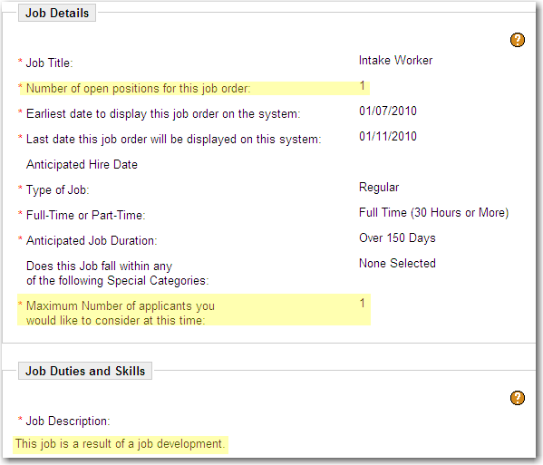
Notes:
A JD job order follows standard procedures regarding the occupation, location and contact information; however, in the Job Details there are two fields that are specifically customized for the JD job order definition. The number of open positions for this job order must always be a one-to-one match with the maximum number of applicants to consider for the job. Although, the number one (1) is the most common number for JD job orders, it is not the only number that can be used. If staff has contacted an employer regarding the same position for several job seekers, a JD job order can also be written as long as there is a number-to-number match in both fields, i.e., three (3) open positions to three (3) maximum numbers of applicants. The job description field is required to indicate ‘job development’ instead of a lengthy description. A region’s local policy may require an actual job description; however, at minimum the phrase ‘job development’ must be included. Job developments should be marked as an option three (3) to prevent public viewing of the position and potential contact with the employer.

Slide 16
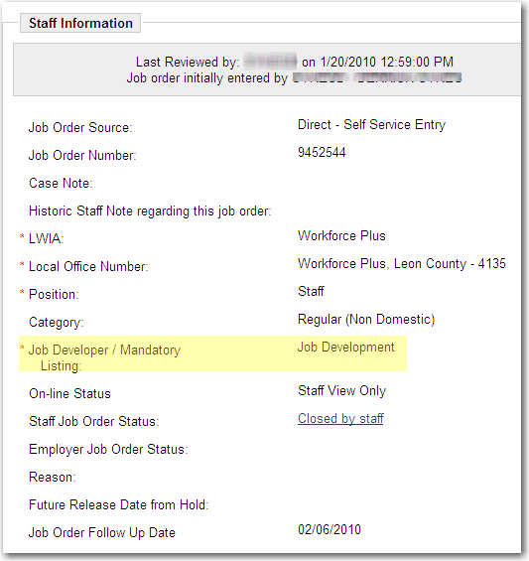
Job Development Job Order
Notes:
Lastly, the staff information section must be completed to indicate this as a job development job order and record verification information. Select job development from the job developer/mandatory listing field. Verification of the placement should be entered in the case note field and indicate the applicant’s start date, the name and title of the source of verification, and wage information. It is also important to update the status of the job order to show that the position has been placed.

Slide 17
Agricultural Job Orders
Notes:
Federal regulations require exact information be displayed in agricultural job orders so that applicants can make an informed decision about referral to agricultural jobs.

Slide 18
Agricultural Job Order Criteria
Job title to match O*NET code
Describe job specifically
What worker does specifically
How does worker do it/degree of skill required
Specific days and hours (i.e. M-F 6a.m.-4p.m.)
Specific number of days/months listed if job duration 4-150 days (i.e. July-November depending on weather, crop, etc.)
Notes:
One-Stop staff must ensure all required information be entered into the system on agricultural job orders falling under the North American Industry Classification System (NAICS) farm work industry codes 111-crop production, 112-animal production, and 115- support activities of agriculture and forestry. These job orders must contain:
A job title’s O*NET code which matches the job’s duties as closely as possible. If no match can be found, staff may use the title the employer provided.
The job order summary should describe the job’s duties specifically; identifying what the worker does, how the worker will do the job, and what degree of skill will be involved.
The job order must state the specific days and hours to be worked. For example Monday through Friday 6 a.m. to 4 p.m. Phrases such as to be announced (TBA) are not acceptable.
If a jobs duration is selected to last between four (4) and 150 days, the specific number of days and hours is required to be listed in the job description field.

Slide 19
Agricultural Job Order
Specific Wage Rate
If paid by piece rate include: unit of payment, unit of measurement, concise description of size/capacity
Depending on experience (DOE) is not acceptable
Covered by Fair Labor Standards Act (FLSA) or minimum wage guaranteed
Crew leaders must include the federal and/or state registration number
Job site address must be included if different from address on job order
Notes:
Agriculture job orders require a specific wage rate. If the worker is to be paid by piece rate, the job summary should include the amount to be paid and a concise description of unit of measurement. For example, $.055 per 3/5 bushel. The phrase depending on experience is not acceptable to describe the wage rate. A statement as to whether or not the employer is covered by the Fair Labor Standards Act (FLSA) or that the employer guarantees minimum wage must be included.
An employer who is a crew leader is required to have their federal and/or state registration number listed on the job order as well.
Many times the job site location is different than the employer’s address that is listed on the job order. If this is the case, the specific directions to the job site should be placed on the notes screen.

Slide 20
Agricultural Job Order
Statement “Referrals Within Commuting Distance Only”
Notes:
The statement “referrals within commuting distance only” should be placed on agricultural job orders that are not to go into the agricultural clearance system. The agricultural clearance system allows for recruitment locally, within the state (intrastate), and in other states (interstate). In order to keep referrals local, this statement is imperative. Shown here is an example of the job description of an agricultural job order that contains all of the required criteria.

Slide 21
Immigration Reform and Control Act (IRCA) Job Orders
Job description states “IRCA Order I-9 Required”
I-9 must be completed prior to referral
I-9 kept on file for five (5) years
Issue 516INS to employer
Do not send with applicant
To be signed in the presence of the employer
Maintain a copy with the original I-9
Notes:
The Immigration Reform and Control Act of 1986 established a system of verifying documents that allow employers to hire individuals who are legally authorized to work in the United States. Employers requesting an I-9 to be completed by job seekers must have ‘IRCA Order, I-9 required’ posted in the job description section of the job order.
Staff must complete the I-9 prior to the referral and verify the legitimacy of the documentation. Under no circumstance should falsified information be accepted or recorded on the I-9.
All original I-9s must be kept on file at the One-Stop Center for five years.
Staff must also complete a FloridaCommerce form 516 INS which is a certificate to the employer that the applicant is authorized to work in the U.S. This form should be sent directly from the One-Stop Center to the employer. The applicant is not to sign or date this form until they are in the presence of the employer. Also, a copy must be kept on file at the One-Stop Center with the original I-9.

Slide 22
Foreign Labor Certification
H-2A Certification for Temporary Agricultural Workers
Hiring of foreign workers to perform agricultural labor
Temporary or seasonal work
State Workforce Agency (SWA) processes applications and posts job orders
Staff should provide referrals and update placement information
Notes:
There are times when employers anticipate a shortage of domestic workers and request to bring non-immigrant foreign workers to the U.S. to fill the shortage. Under the Immigration and Nationality Act of 1952, employers are permitted to recruit and hire foreign workers to work on a temporary or seasonal basis. These types of job orders are referred to as H-2A or H-2B. The H-2A certification for temporary visa program allows the employer to recruit and hire non-immigrant foreign workers to perform agricultural labor of a temporary or seasonal nature. As of March 15, 2010, applications for H-2A jobs are processed by the Florida Department of Commerce, Alien Labor Certification department. FloridaCommerce also reviews and posts all H-2A job orders in EFM. Regional staff are responsible for referring job seekers to these positions and recording placement information to the job order as appropriate. If at any time the number of referrals or positions for the jobs change, staff should increase the number of referrals by one until the need is met.

Slide 23
Foreign Labor Certification
H-2B Certification for Temporary Non-Agricultural Workers
Employers hire foreign workers to perform non-agricultural labor
Hire on a one-time, seasonal, peak load, or intermittent basis
Applications are processed by United States Department of Labor
Employer can enter job order or request entry by the SWA
Alien Labor Certification Program
Notes:
The H-2B certification for temporary visas allows an employer to hire foreign workers to perform non-agricultural labor on a one-time, seasonal, peak load, or intermittent basis. FloridaCommerce no longer receives or processes applications for the H-2B program. These applications are processed through the United States Department of Labor. Upon application approval, employers are able to enter their own job orders in EFM or they can contact the SWA for entry. If an employer posts their own job order, they must notify the SWA because there are certain guidelines that must be followed. You can find more specific guidelines by following the link on this slide.

Slide 24
Referral to Private and Temporary Staffing Agencies
Job orders entered by staffing agencies are permitted
Job seekers must be advised of the referral to a temporary agency and there is no fee
All job summaries should begin with the phrase “Position offered by a no fee agency”
Notes:
Wagner-Peyser law states that there is nothing in the Act which prohibits the referral of any job seeker to private agencies, as long as the job seeker is not charged a fee. Posting job orders by a temporary staffing agency requires the phrase “position offered by a no fee agency” be listed as the first line in the job order’s job description.

Slide 25
Independent Contractors
Employers recruiting independent contractors may submit job orders to EFM
The terms of employment must be indicated in the job description
Job summary: This is an independent contractor/business opportunity and does not establish an employee/employer relationship. Will receive IRS 1099 form and will be responsible for own withholding taxes
Staff should advise job seekers about the conditions of these jobs prior to making a referral
Notes:
Independent contractor positions are those jobs in which an employer-employee relationship does not exist. These positions provide a job opportunity for a job seeker without a guarantee of wages. Independent contractor job orders are permitted to be posted in EFM as long as the terms of employment are listed in the job description. Staff should advise job seekers about the conditions of these positions prior to making a referral.

Slide 26
Referral During Labor Disputes
Regional Workforce Boards (RWBs) shall notify FloridaCommerce of the existence of a dispute
Referrals should not be made to fill a position that is vacant due to an issue resulting from the labor dispute
Written notification shall be provided to job seekers referred to jobs not involved with the labor dispute
Notes:
If a company is involved in a labor dispute, the regional workforce boards shall notify FloridaCommerce of the existence of the labor dispute. Referrals should not be made to job seekers that will aid directly or indirectly to filling a position that is vacant due to the former occupant being on strike or locked out as a result of the dispute; or any other issue in the dispute involving a work stoppage. Written notification shall be provided to job seekers referred to a position not at issue in the labor dispute if the employing unit is involved in a labor dispute.

Slide 27
Referral During Labor Disputes
Job orders received from an employer involved in a labor dispute involving a work stoppage:
Must have the dispute verified by the RWB
Determine the significance to the vacancies in the order(s); and
Notify all potentially affected staff about the dispute
Notes:
Job orders received from an employer involved in a labor dispute involving a work stoppage shall be verified by the regional workforce board. Staff should determine the disputes impact to each vacancy submitted in the job order. All potentially affected associates should be notified concerning the status of the labor dispute.

Slide 28
Referral During Labor Disputes
One-stop centers shall resume full referral services upon verification of a labor disputes termination
Notify the federal regional office in writing if a labor dispute:
Results in a work stoppage at an establishment involving a significant number of workers; or
Involves multi-establishment employers with other establishments outside of the reporting state
Notes:
One-stop centers shall resume full referral services upon verification that a labor dispute has been terminated. The regional office should be notified about the dispute in writing if a labor dispute results in a work stoppage at an establishment involving a significant number of workers or involves multi-establishment employers with other establishments outside of the reporting state.

Slide 29
Federal Contractors
Contracts for services for $100, 000 or more must post job orders in the state’s job bank
Government contractors are required to take affirmative action to employ qualified veterans
Job orders must be posted in the local area where the position will reside
The job order(s) must indicate the position as a federal contract
Notes:
Federal regulations require government contractors receiving $100, 000 or more for contracted services to post job orders in the state’s job bank. Contractors are required to take affirmative action to employ qualified veterans; a process completed by performing a veteran file search by the One-Stop Centers. Job orders must be posted in the local area where the position will reside and be tagged as a job under federal contract on the job order form.

Slide 30
Affirmative Action Job Orders
Seeks qualified job seekers, particularly members of a protected group
Result from government acts or court orders
Employer should disclose this information to staff
Order must be identified as such on the job order form
Job description should begin with the phrase “Affirmative action, females/minorities encouraged to apply”
Notes:
Affirmative action job orders seek qualified job seekers, particularly those individuals who are members of a protected group, to fill positions. Protected groups are those individuals that for reasons of past custom, historical practice, or other non-occupationally valid purposes have been discouraged from entering certain occupation fields. These job orders typically result from government acts or court orders. Employers should disclose this information to One-Stop staff verbally or by indicating it on the job order form if self-entered or noted on a hard copy job order request.

Slide 31
Mass Recruitments
Job orders for mass recruitments should be taken and reviewed for compliance
One-Stop Centers should not participate in a recruitment without first entering the job order in EFM
Participation in a recruitment prior to entering a job order may forfeit placement credit
Notes:
Job orders for a mass recruitment event should be taken as soon as possible and reviewed for compliance. To avoid a potential violation of the federal placement definition, One-Stop Center participation in a mass recruitment should not occur without first entering a job order into the Wagner-Peyser reporting system.

Slide 32
Test your knowledge.

Slide 33
True or False
The Terms and Conditions of Use policy does not apply to all job order postings in EFM.
True
False
Notes:
Correct answer: False

Slide 34
Multiple Choice
Job orders must be reviewed and verified prior to the ____ hour auto-enable process?
24
36
48
72
Notes:
Correct answer: 48

Slide 35
Multiple Choice
All job orders must be reviewed for compliance with which of the following:
Federal and State Laws
State Policy and Guidance
EFM Terms and Conditions of Use
All of the Above
Notes:
Correct answer: D

Slide 36
True or False
Job orders may be entered into EFM without a current vacancy and no definite start date.
True
False
Notes:
Correct Answer: B

Slide 37
True or False
Staff must complete an I-9 on all H-2A job order referrals.
True
False
Notes:
Correct answer: B. March 15, 2010 rule eliminated the requirement for One-Stop Career Centers to complete the employment eligibility or I-9 for H-2A referrals.

Slide 38
Multiple Choice
Employers may list special hiring requirements on a job order if:
The One-Stop will agree to pay the cost
The jobseeker signs a liability release form
They require the test to be performed for all applicants regardless of the referral source
Minimum requirements for the position are met
Notes:
Correct answer: C

Slide 39
Multiple Choice
Job orders paying less than minimum wage may be posted in EFM if:
The employer is exempt from the FLSA
The employer will compensate the wage with other benefits
Job orders may not be posted if they fall below minimum wage
None of the above
Notes:
Correct answer: A

Slide 40
Multiple Choice
Job development job orders are created
Before the candidate finds a job
When an employer expresses interest in a particular jobseeker
After staff have been notified about the placement that resulted from a previous JD service
None of the above
Notes:
Correct Answer: C

Slide 41
Multiple Choice
Agricultural job orders falling under NAICS codes 111, 112 and 115 must have the following listed on the job order:
The specific days and hours
Specific months if the job lasts between 4-150 days
A specific job description
All of the above
Notes:
Correct Answer: D

Slide 42
Questions & Answers

Slide 43
Contact Us
Thank You.
If you have questions or comments about this presentation, please contact us.
Danielle McNeil
Email: Danielle.McNeil@commerce.fl.gov
Phone: 850-245-7498
Tammellia Bacon
Email: Tammellia.Bacon@commerce.fl.gov
Phone: 850-921-3868
Notes:
Thank you for viewing the job order overview. For more information or additional questions, please contact the Wagner Peyser team at the information shown.

