Slide 1
10,000
Job Openings
Which one will be yours?
^{Register today on}
863-508-1100 | PolkWorks.org

Slide 2
What is it?
A County-wide Jobs Initiative with the goal of placing 10,000 job seekers into jobs between
January 1, 2013 and June 30, 2013
That’s just 6 months!

Slide 3
Who’s Doing It?
E⁴
Employers
Listing Job Openings in Employ Florida
Education
Getting their students registered in EFM and posting quality resumes
Economic Development
Helping local businesses expand and new businesses relocate.
Everybody Else
Jobseekers being better prepared to meet business talent needs.

Slide 4
WHY ARE WE DOING IT?
Because our Unemployment Rate in Polk at 8.6% is TOO HIGH!
Because Polk has 23,553 out of work and actively seeking employment!
Because we had over 5265 advertised job openings in January!
So…
WE need to do a better job helping YOU as EMPLOYERS connect with quality talent – JOBSEEKERS!

Slide 5
What Do We Need from YOU?
Become a RACE to PLACE Partner TODAY!
Join the Race by committing to help our entire community put 10,000 people in jobs in
By June 30, 2013!

Slide 6
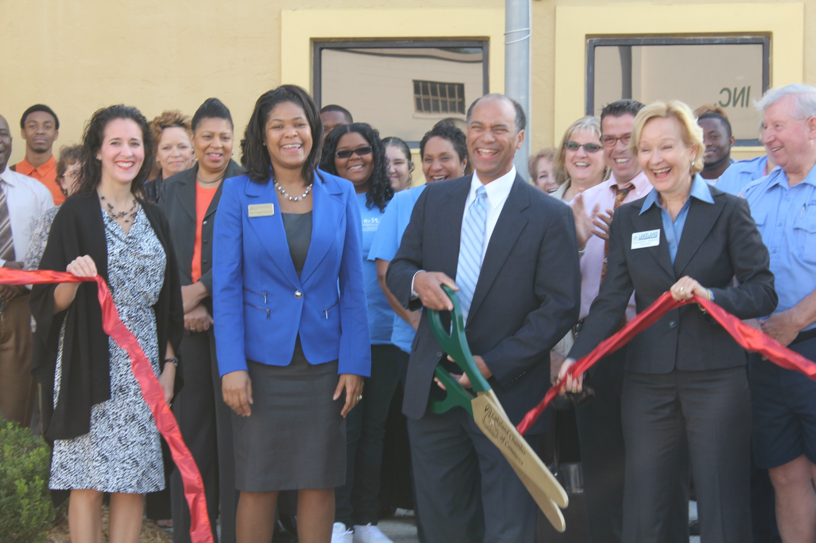

Slide 7
It’s the Middle of February…
What’s been done so far?
Secured over 200 Committed Partners
Preliminary numbers show that we have placed 1506 job seekers into jobs for January
Hosted 3 Ribbon Cuttings & Job Seeker Open houses (serving 1100 job seekers in one day)
Hosted 25 Recruiting Events in a month
Placed Race to Place Posters throughout Polk

Slide 8
What Else?
Awarded 2 Runner’s Club Awards for the month of January
Hosted our largest Race to Place Job Fair with over 100 hiring employers.
Hosted What IF? Expo with over 200 Youth participants

Slide 9
What’s NEXT?
MARCH MADNESS
High Touch Jobseeker Prep Sessions in One-Stop Career Centers
Friday – March 1
Friday – March 8
Friday - March 15
Friday - March 22
Young Leaders Open Houses – SPRING BREAK
March 25 – 29th

Slide 10
SAVE THE DATE
2013 RACE to PLACE
CELEBRATION
Thursday, August 22nd
7:30a -9:00a
The Lakeland Center

