Slide 1
Optimum Bench Strength through Local Credentialing
Jody A. Toner,
Vice President of Universal Services
WORKFORCE CENTRAL FLORIDA
Region 12
December 7-9, 2011

Slide 2
What is credentialing?
Objective evaluation process
Competency & qualifications of staff
Effectiveness of training
Retention and application of required knowledge skills and abilities to successful perform essential job functions

Slide 3
Why is Credentialing important?
Establishes a depth of bench standard within the organization
Internal WD industry standard
Ensures common understanding of the local operating policies and procedures, federal and state compliance
Impacts organizational effectiveness and performance

Slide 4
Methodology
Staff training is a crucial element to the success of an organization. How good is staff training if the information is not processed and retained properly?
By implementing a local credentialing system, you can validate and measure staff’s depth of knowledge and ensure the consistency and quality of information being disseminated to customers.

Slide 5
Competency Model History
Competency Certification originated during PY 05-06 for the WIA Program
Competency exams were developed from existing training materials, practices and LOP’s.
Extensive input was obtained from management and frontline staff
Centralized staff training materials and LOP’s

Slide 6
Competency Model History
1 hour duration for competency exam testing
# of questions range from 105-120
Equal weighted value on each question
Established internal performance standard pass rate of 90%
Staff are given one opportunity to retest
High levels of staff anxiety

Slide 7
Competency Model History
Reminder email with testing tips was distributed to staff:
Review all training materials the day before actual exam
Read each question and review all possible responses prior to making a determination of the answer
Prior to submitting exam review all questions
Don’t rush through testing process

Slide 8
Staff Training Resources
Investment in ongoing extensive staff development training
WCF University
Mandatory programmatic training w/SME’s
Annual performance goals are established for all staff
Lending library materials are also available to staff
WCF Online Learning
Captivate

Slide 9
Exam Training Preparation
Training manuals are issued to staff each PY containing all forms, LOP’s, PPT’s etc.
As additional training occurs during the PY, staff receive printouts of all materials and manuals are updated
Staff are required to bring manuals to all training events
Pop quizzes, games, and pre-tests occur during the training
Make-up sessions are available

Slide 10
Competency Exam
Competency certification is mandatory for all staff
Level 1 exams are currently developed for each position in WIA program, Re-Employment Connection program and Universal Services department
Exams are customized based on the position/scope of work

Slide 11
Level 1 Competency Exam
Level 1 Competency exams are straight forward, knowledge checks.
Staff are assessed on their understanding of eligibility requirements, definitions, programs, policies and procedures.

Slide 12
Current Level 1 Exams
Special Projects Department:
WIA (Adult and DW)
Summer Job Connection
Re-Employment Connection

Slide 13
Current Level 1 Exams
Universal Services Department:
Front Desk CSR
Resource Room Technician
Universal Placement Specialist
Reemployment Specialist
REA Specialist
Veteran Representative
Backroom Operations Team

Slide 14
Level 1 Competency Exam
Includes a mixture of questions are created from the programmatic training, LOP’s and state and federal law.
True/False questions
Multiple choice questions
Open-ended questions
Essay

Slide 15
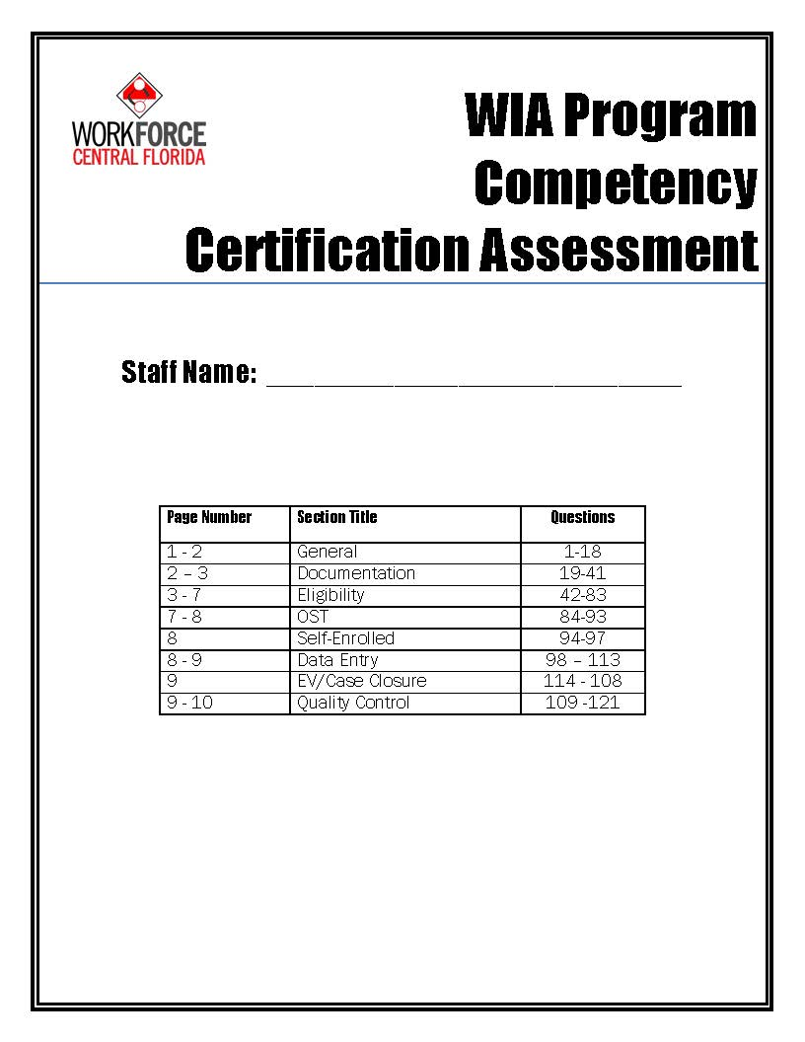
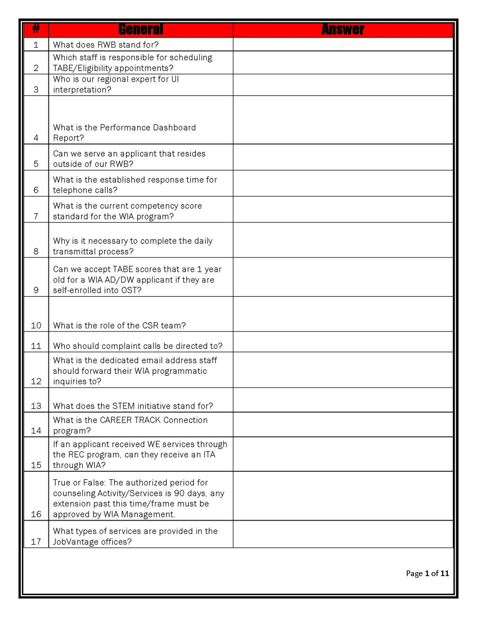
WIA Level 1 Competency Exam
121 Total questions

Slide 16
Sample WIA Level 1 Questions
General
What types of services are provided in the JobVantage offices?
Documentation
List at least three forms of acceptable documentation to verify citizenship?
Eligibility
What is the WIA definition of a family?
Data Entry
How frequently are case notes updated/entered in EFM?

Slide 17
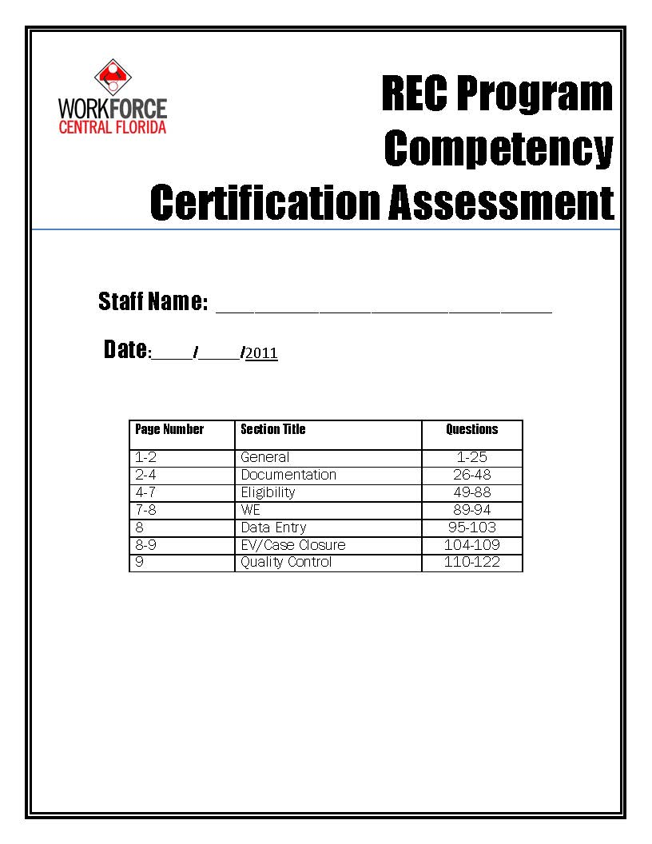
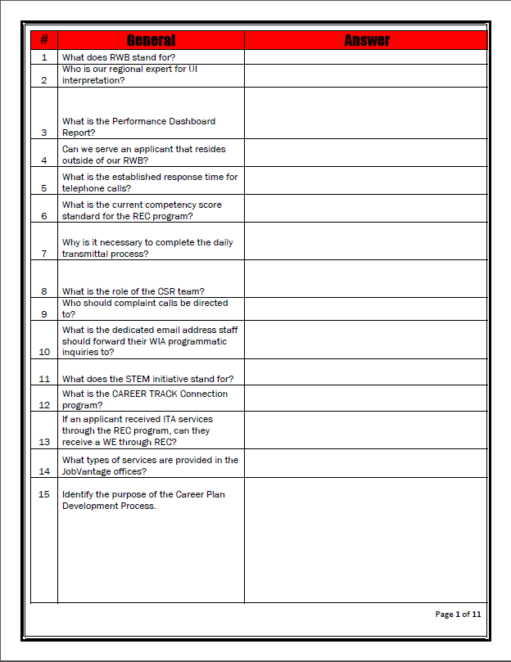
REC Level 1 Competency Exam
122 Total questions

Slide 18
Sample REC Level 1 Questions
General
Who completes the REC Eligibility Screening Assessment?
Documentation
What is acceptable documentation for Veteran status?
Eligibility
Define substantial disability.
Quality Control
What is the purpose of the annual DEO monitoring process?

Slide 19
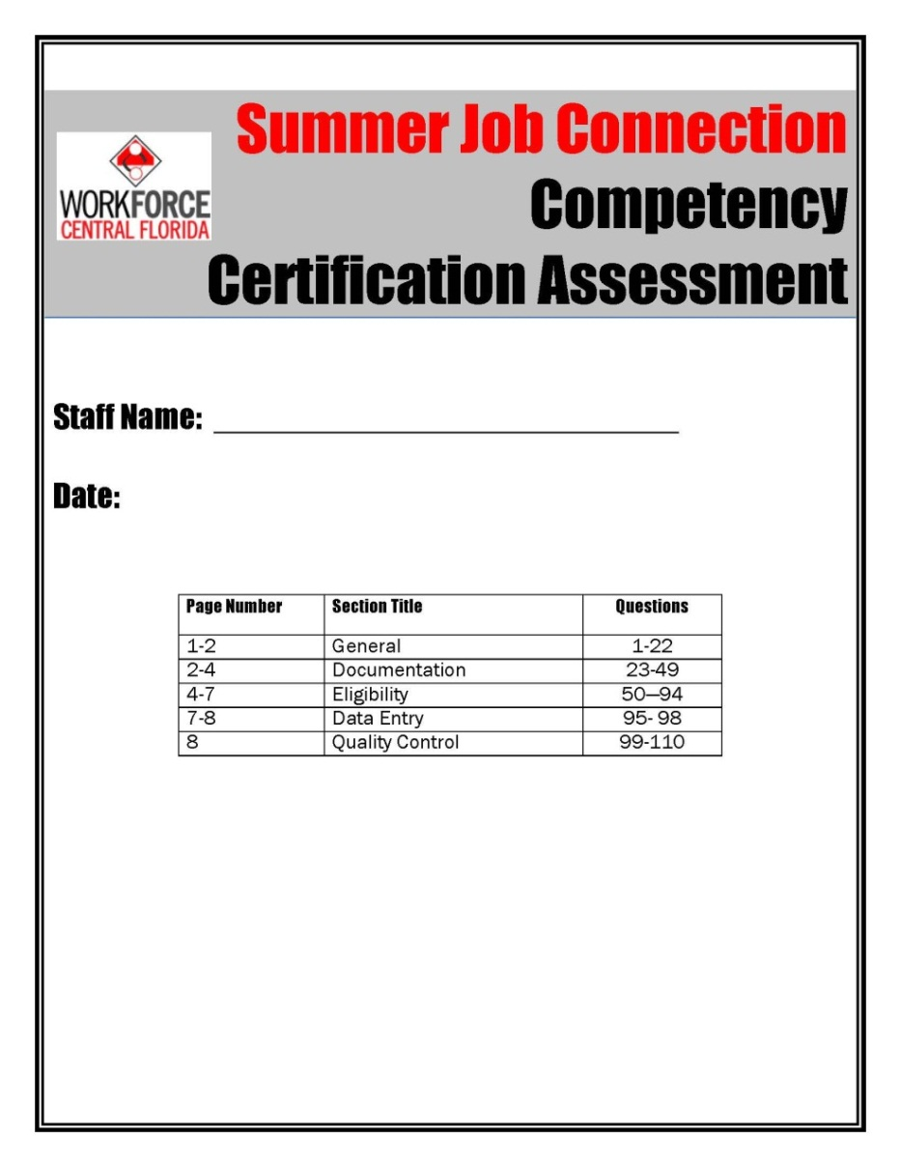
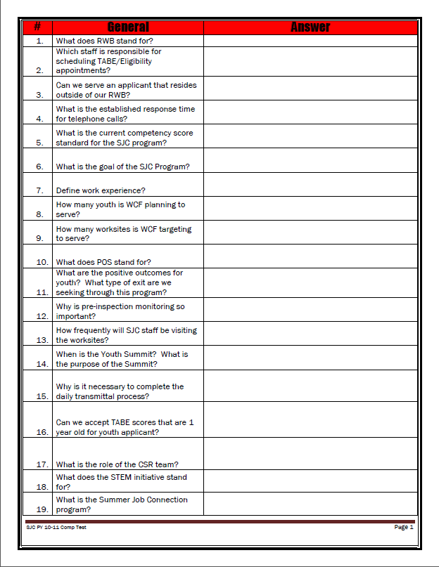
SJC Level 1 Competency Exam
110 Total questions

Slide 20
Sample SJC Level 1 Questions
General
Define Work Experience.
Documentation
List three acceptable forms of documentation to verify Social Security number.
Eligibility
Define WIA low income- cash welfare.
Quality Control
What are the ramifications of a staff having a disallowed cost (new registrations)?

Slide 21
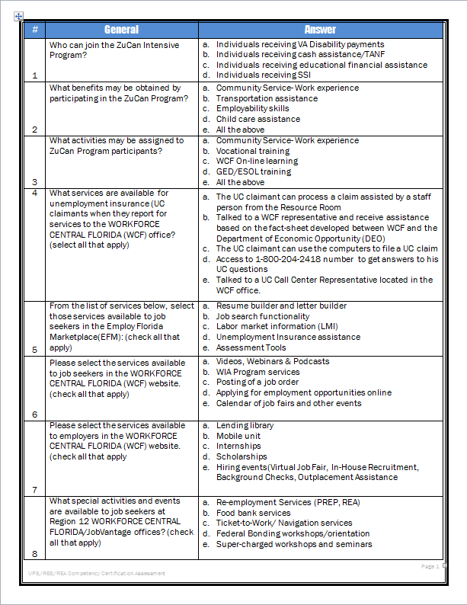
Sample USD General Level 1 Questions
What does Veteran Priority of Service mean?
What is the unemployment rate for Metropolitan Orlando?
Identify two partner agencies operating in the WCF offices.
What are the general eligibility requirements for an adult to enter the WIA program?

Slide 22
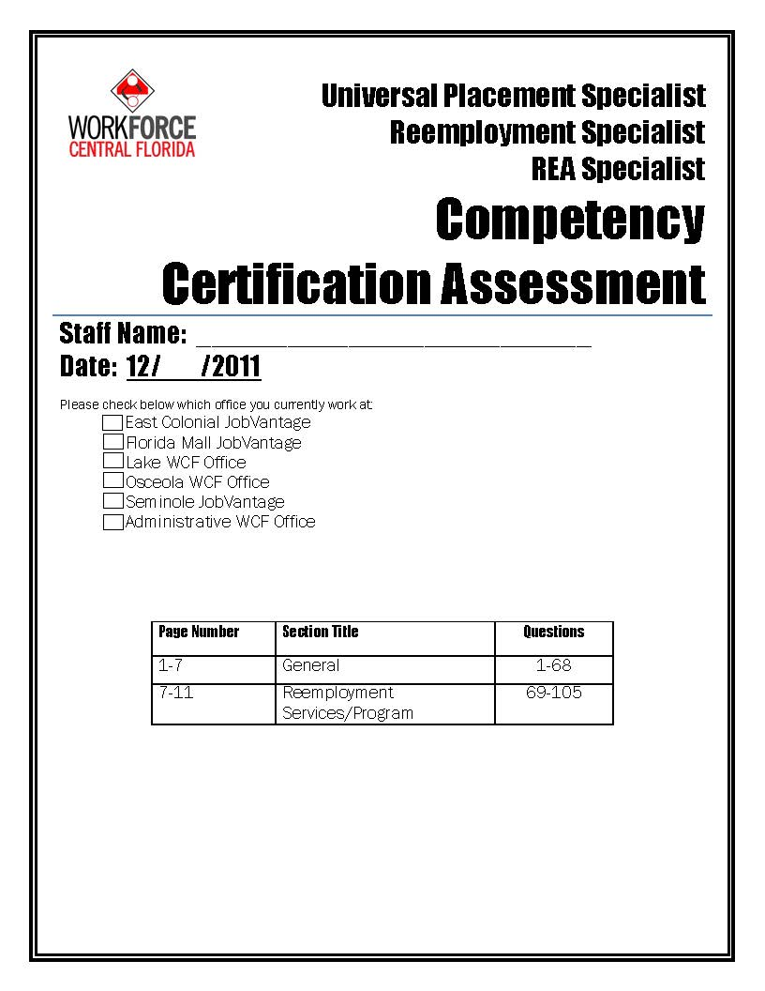
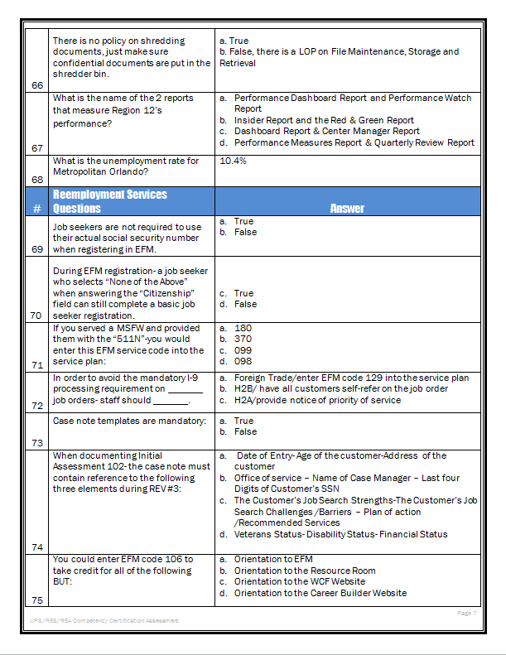
Sample UPS/RES/REA Level 1 Competency Exam
105 Total questions

Slide 23
Sample UPS/RES/REA Level 1 Questions
UPS/RES/REA
What are the reemployment services that a RES Specialist provides during visit #1?
What EFM service code would you use to document referral to ABE/GED/Literacy programs?
If you served a MSFW and provided them with the “511N” you would enter this EFM code into the service plan.
How many resumes can a job seeker store in EFM?

Slide 24
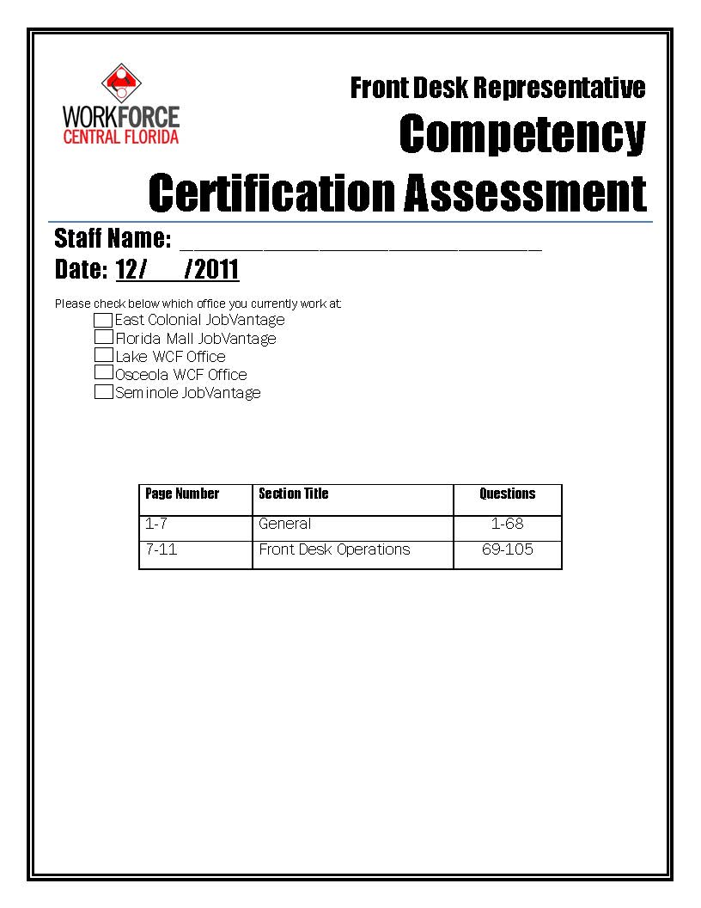
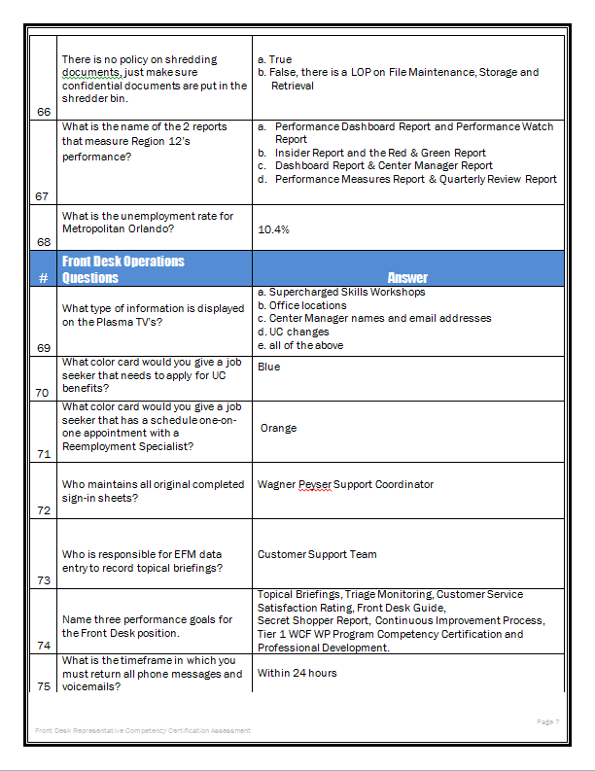
Sample Front Desk Level 1 Competency Exam
105 Total questions

Slide 25
Sample Front Desk Level 1 Questions
What are the Front Desk responsibilities under the UC Services LOP?
What is the purpose of Secret Shopper Monitoring?
What two programs would you suggest to a job seeker looking for employment?
What is the phone number to call for questions regarding Unemployment Compensation?

Slide 26
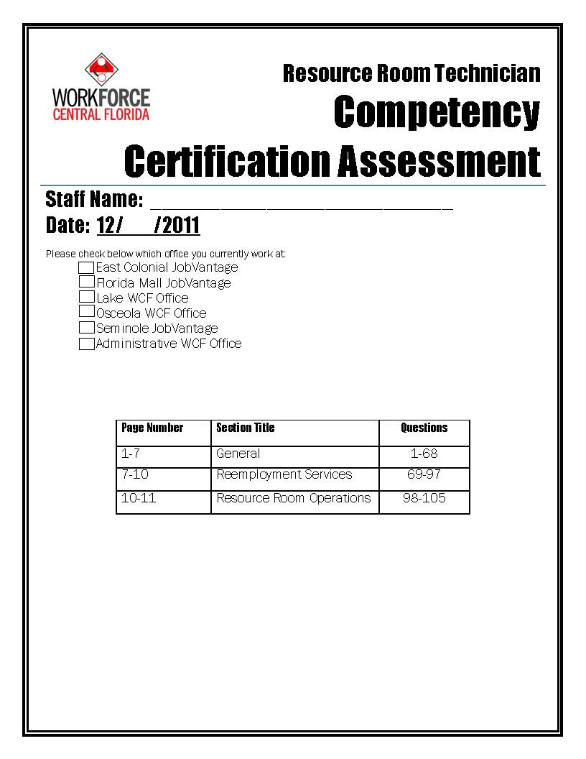
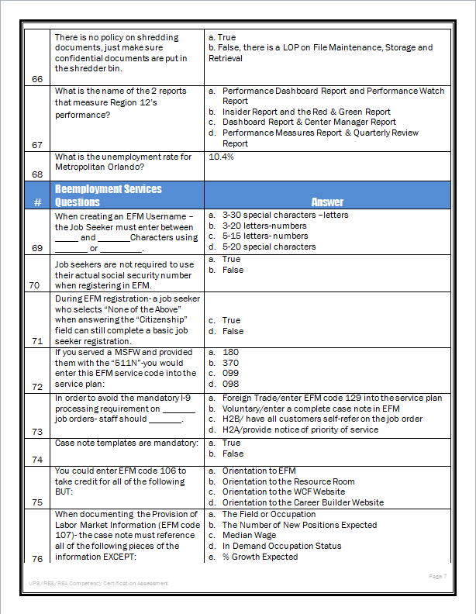
Sample Resource Room Level 1 Competency Exam
105 Total questions

Slide 27
Sample Resource Room Level 1 Questions
Where would you direct a job seeker to click to learn more about internet, job search and employment scams?
This test measures the individual’s possession of, interest in, or ability to acquire job skills and knowledge. EFM service code 201 is entered in EFM to take credit for:
Which of the following is not a “Security Question” option in EFM?

Slide 28
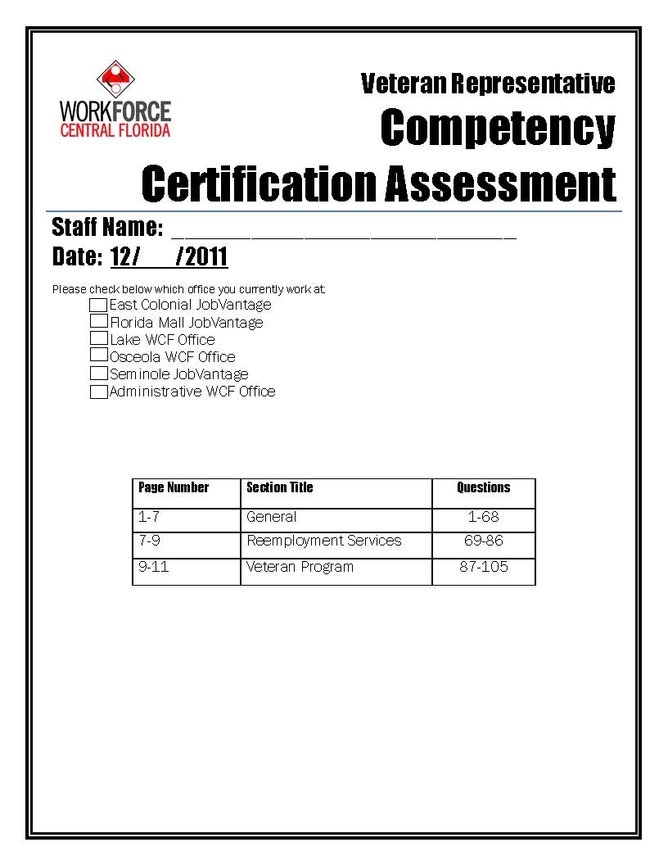
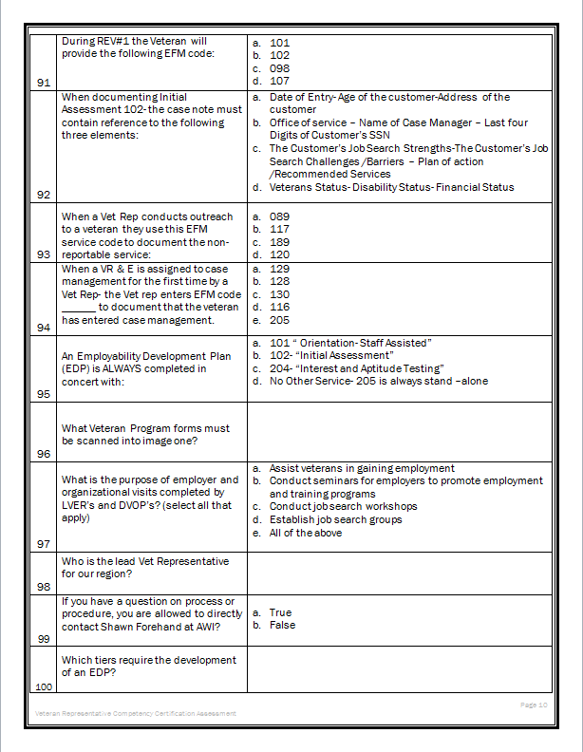
Sample Veteran Level 1 Competency Exam
105 Total questions

Slide 29
Sample Veteran Level 1 Questions
When a Vet Rep conducts outreach to a veteran they use this EFM service code to document the non-reportable service.
An Employability Development Plan – EDP- is always completed in concert with?
Are assessments mandatory for initial visits? Y/N

Slide 30
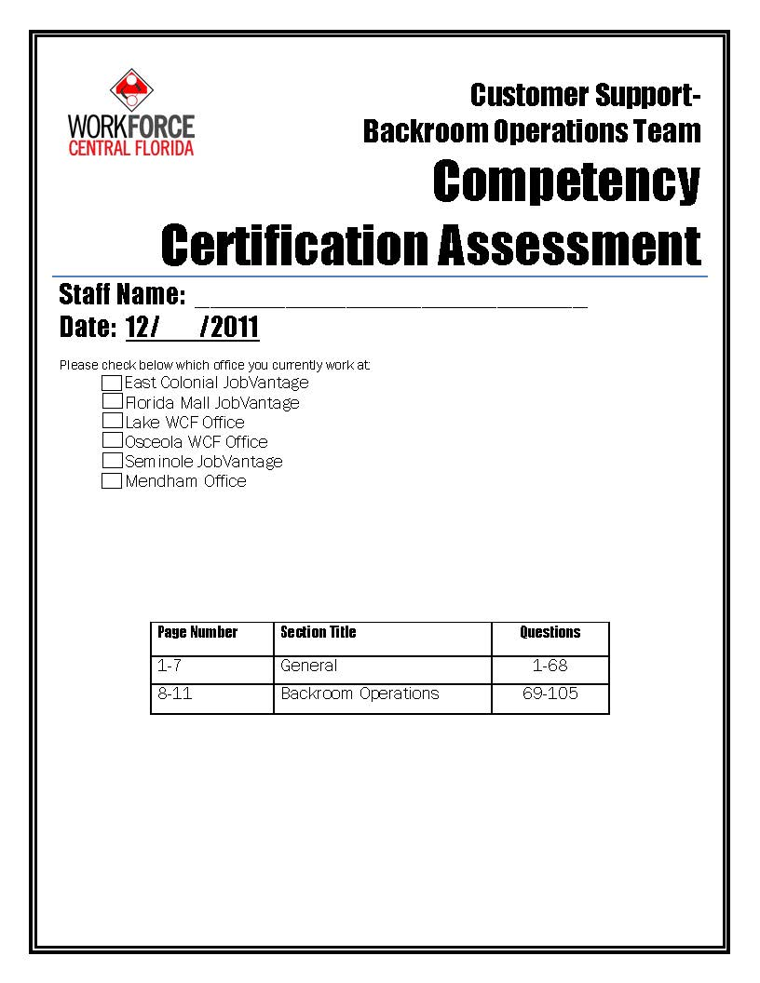
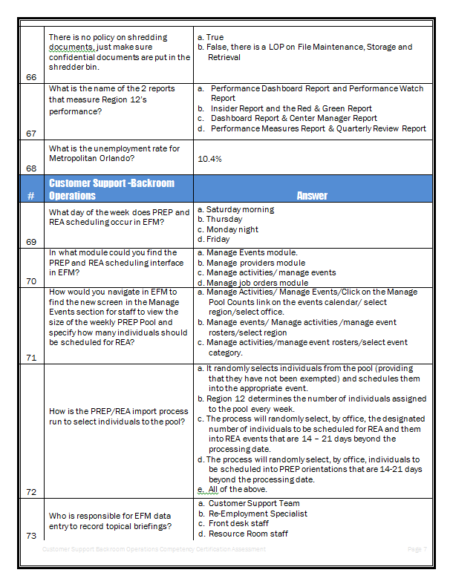
Sample Backroom Operations Level 1 Competency Exam
105 Total questions

Slide 31
Sample Backroom Operations Level 1 Questions
In what module could you find the PREP and REA scheduling interface in EFM?
How is the PREP/REA import process run to select individuals to the pool?
Who is responsible for EFM data entry to record topical briefings?
What are the EFM services codes that staff must update once the UC claimant completes PREP online?

Slide 32
WIA Level 2 Competency Exam
PY11-12 WIA Level 2 was implemented
Scenario-based exams
Detailed case study scenarios are presented covering all aspects of pre-screening, program eligibility, suitability, LOP’s, required documentation and forms.
Each case study is designed to encourage problem-solving and critical thinking skills

Slide 33
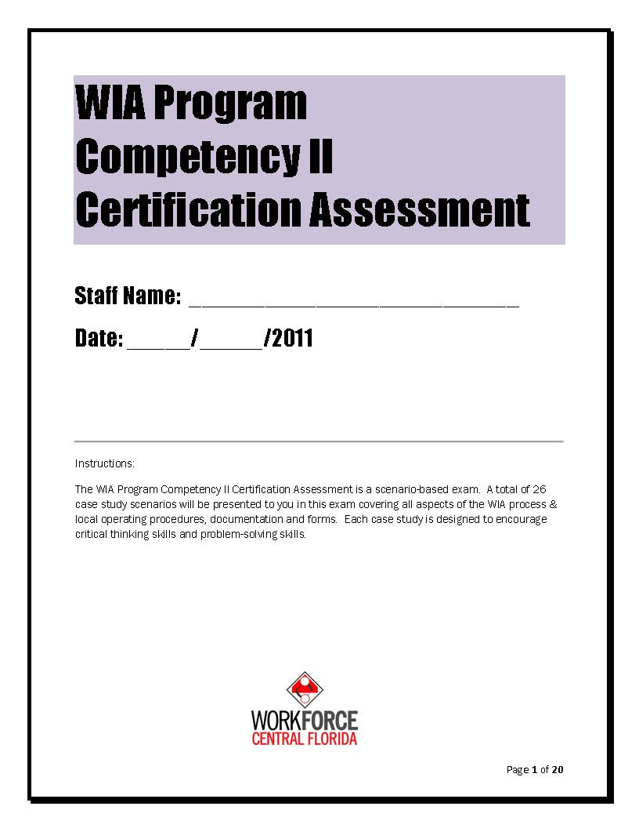
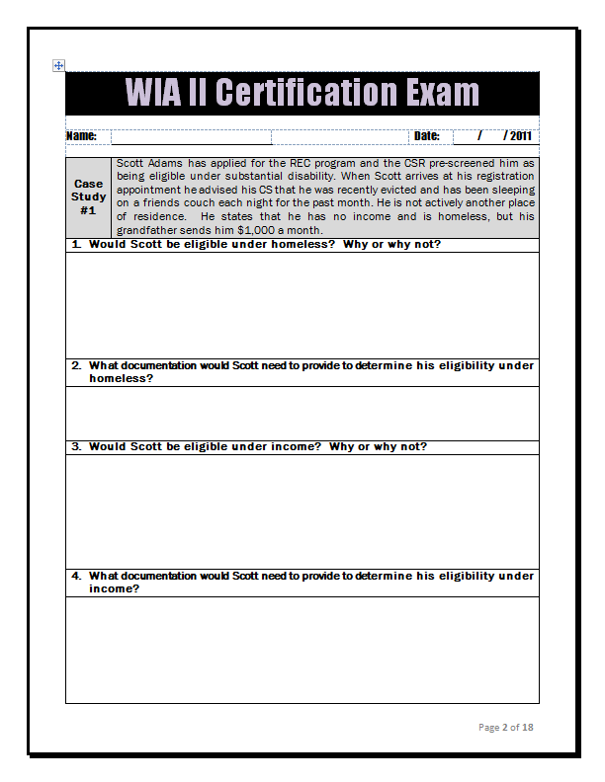
WIA Level 2 Competency Exam
26 case scenarios & 58 questions

Slide 34
Sample WIA Level 2 Questions
Scenario
Patricia Baker has been working as a cashier for the last 2 years. She earns $10.00 an hour and works 30 hours per week. Her husband, John, is unemployed and receiving SSI. Patricia is interested in training as a Medical Assistant and has come to her registration appointment with all the necessary documentation for eligibility. Patricia tells the CS that her hours have just been cut to 20 hours per week so work will not conflict with her attending training full time.
Questions
Is Patricia eligible? Explain in detail.
Can Patricia work and attend training under WIA policy?

Slide 35
Exam Testing Process
Centralized testing location
Exam is not open book
Staff are given 3 hours to complete exam
Performance standard -90%

Slide 36
Scoring Methodology
Management team reviews each completed competency exam.
Team approach
All questions are equally weighted.
Copy of scored test is given to staff person.

Slide 37
Exam Re-Testing
If staff do not pass the initial exam they are provided one re-test opportunity
Re-test date 30 days from initial exam date
Exam is not open book
Staff are given 3 hours to complete exam

Slide 38
PY 10-11 Exam Results
Program | # of staff tested | # of staff re-tested | Average Score
WIA Level 1 | 14 | 3 | 95.6%
REC Level 1 | 8 | 1 | 94.1%
SJC Level 1 | 14 | 9 | 95%
Totals | 36 | 13 | 94.9%

Slide 39
ROI
Increased employee productivity
Increased customer service/satisfaction ratings
Increased quality of product knowledge
Increased awareness of services
Validation of skills taught
Enhanced performance outcomes
Identifies promising practices

Slide 40
Questions
Jody A. Toner
WCF Vice President of Universal Services
407-531-1222 ext. 2029
jtoner@wcfla.com
www.WorkforceCentralFlorida.com

