Slide 1
Effective Strategies To Serve The Unemployed Hot Solutions for Cold Cases
by Corey J. McCaster
Notes:
Introduction
Background
Format

Slide 2
Objectives
Modify and Redirect the Cold Case File Dialogue
Explore Connections Between Dislocated Workers and Cold Cases
Analyze Cold Cases
Examine Cold Case Reporting Implications
Provide Overview of Possible Solutions to Cold Case Situations
Promote Rigorous Job Seeker Assessments
Heighten Intensive Services Prominence to That of Training Services
Discuss New Program Design

Slide 3
Audience Indicators

Slide 4
Cold
Dead Case Files

Slide 5
Cold Case
11,564
WIA Cases Open in Florida
Longer Than 2 Years

Slide 6
Cold Case
Case Review Result Categories:
Still Dislocated
Employed In Maintenance Jobs
Monthly Contact - No response

Slide 7
Cold Case – the99ers
Notes:
Key Focal Points:
99ers - more quickly re-attach them to the workforce
No –Tracers to reduce the number of WIA Adult and Dislocated Workers who fail to complete occupational skills training
Mission assist local boards in proactively lowering the number of cold cases.

Slide 8
Cold Case – the99ers
Who are the “99ers”?
Over the past year and half the number of Americans without work for 99 weeks reached an alarming, record-high 1.4 million, according to the Department of Labor.
Notes:
Key Focal Points:
99ers - more quickly re-attach them to the workforce
No –Tracers to reduce the number of WIA Adult and Dislocated Workers who fail to complete occupational skills training
Mission assist local boards in proactively lowering the number of cold cases.

Slide 9
Cold Case
A DISTINCT DIFFERENCE
Educated
Once Gainfully Employed
Skills – possibly obsolete
New Workers: ages 24 to 35
A.A. or Less
Loose Workforce Attachment
Few Job Skills
New Workers: ages 24 to 35
99ers

Slide 10
Cold Case – the99ers
The New Reality
The first question. What are the new realities or trends in the job market preventing the reemployment of the long term unemployed? We all know the media’s view of the job market. What are we witnessing in the One Stop Career Centers?
The second question. How can Workforce professionals tailor their programs and services to better meet the challenges created by the new realities of the Job Market?
The third question. Are 99ers aware of the changes they must make for reemployment? Are they willing to make them?
Notes:
Key Focal Points:
99ers - more quickly re-attach them to the workforce
No –Tracers to reduce the number of WIA Adult and Dislocated Workers who fail to complete occupational skills training
Mission assist local boards in proactively lowering the number of cold cases.

Slide 11
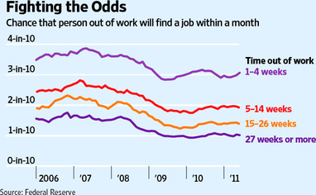

Slide 12
Cold Case – the99ers
The New Reality
“Average person today will have 10-14 careers.”
“Average job will last 3 – 5 years.”
“None of the top 10 jobs in 2020 exist today.”
Former Ed. Secretary Richard Riley

Slide 13
Cold Case – the99ers
The New Reality
Employment rates have been declining among men.
Since 2000, rates are down roughly 10 percentage points
among 20- to 34-year-olds — an enormous change.

Slide 14
Cold Case – the99ers
The New Reality
Immigration — and the flow of people and capital
across borders— is as great as at any time in recent
history, increasing competition, especially at the low
end.

Slide 15
Cold Case – the99ers
The New Reality
Reemployment: long term decision?
Short-term results = Long-term stability

Slide 16
Cold Case – the99ers
The New Reality
Average earnings have been stagnant or declining for more than 36 years

Slide 17
Cold Case – the99ers
The New Reality
Our labor market places a premium on higher education for better-paying jobs.
At the same time, nearly half of all jobs in 2016 will be low wage.

Slide 18
Unemployment Rates by Education Level
Education Level Achieved | October 2011 | Month/Month (Points) | Year/Year (Points)
Less than High School | 13.8% | -0.2 | -1.5
High School Grad No College | 9.6% | -0.1 | -0.5
Some College or Associate Degree | 8.3% | -0.1 | -0.2
Bachelor's Degree or Higher | 4.4% | +0.2 | -0.3

Slide 19
HOT SOLUTIONS

Slide 20
Cold Case
HOT SOLUTIONS
Community Partnerships and Referrals
Valuable and value-added assessments
Intensive Services – Educational & Life Skills
Implement proven programs; evaluate promising ones

Slide 21
Cold Case
HOT SOLUTIONS
Other States and the 99ers
Training Combos:
Short term training +Training for Long Term
Focus Short-term Training Resources On the 99ers
Customized Training
On-the-job Training

Slide 23
Cold Case
Good-Bye-Charlies
Untraceables
The Vanished
Goners

Slide 24
Cold Case: untraceables
Dislocated workers enrolled in training services but stopped participating for unknown reasons.

Slide 25
Cold Cases: untraceables

Slide 26
Cold Case: untraceables
11,564

Slide 27
Cold Case: untraceables
Similarities:
Training Types
Start Dates
Family Size
Other?

Slide 28
Cold Case: untraceables
HOT SOLUTIONS
Intensive Services:
2010 -2011 USDOL Monitoring Report
End Game
Better Fit For Dislocated Workers?

Slide 29
Cold Case: untraceables
HOT SOLUTIONS
Prevent Disappearances Before Registration

Slide 30
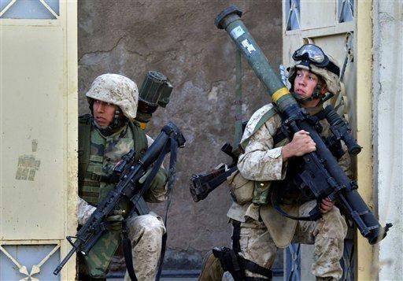
Cold Case: untraceables
HOT SOLUTIONS
How to Find Them

Slide 31
Cold Case: Performance
Implications:
Varies Reports
Gauging Impact
Annual Performance Drains

Slide 32
Cold Case: Other
Impacts:
Human Resources
Delay in EFM Follow-up auto population
Cross Matching

Slide 33
Cold Case: conclusions
HOT SOLUTIONS
Local Service Matrix
Service Combinations (blending and braiding of resources)
Short vs. Long Term Service Outlook
Assessments
Supports Services

Slide 34
Corey j. McCaster
Government Operations Consultant II
Please forward questions or comments about this training presentation, in part or whole, to the following email address or phone number:
E-Mail: Corey.McCaster@Deo.MyFlorida.com
Telephone : (850) 245-7402
Speakers Notes Are Available Upon Request

