Slide 1
Accountability and the sanction process Part 2
Notes:
Welcome to the Welfare Transition (WT) program’s training on Accountability and the Sanction Process: Part 2 offered by the Florida Department of Economic Opportunity. This training will review and emphasize correct implementation of the pre-penalty and sanction processes.

Slide 2
Pre-penalty and Sanction Process
Failure occurs
Mail AWI-WTP form 2290
Make an oral attempt
Oral attempt is successful
Does the customer have good cause or is good cause accepted?
YES!
End Pre-penalty with Good Cause
A sanction request is not necessary
Notes:
If the oral attempt is successful and the customer has good cause, we would end the pre-penalty on the alternative plan page. We would not request a sanction on the case. In the first example the oral attempt was not successful and the customer never contacted the case manager, thus resulting in a sanction request. In this example, the oral attempt was successful and the customer had good cause so a sanction was not warranted. If you are not sure what your region considers good cause, please speak with your supervisor and ask for your Good Cause Local Operating Procedure.

Slide 3
Failure-successful oral attempt without good cause
MONDAY | TUESDAY | WEDNESDAY | THURSDAY | FRIDAY | SATURDAY | SUNDAY
 |  |  | 1 Customer fails | 2 Notice of Failure (2290) mailed/oral attempt successful (customer has good cause) | 3 | 4
5 | 6 | 7 | 8 | 9 | 10 | 11
12 | 13 | 14 | 15 | 16 | 17 | 18
19 | 20 | 21 | 22 | 23 | 24 | 25
26 | 27 | 28 | 29 | 30 | 31
Notes:
Using the pre-penalty process described in the previous slide, the participant fails on the first day of the month. You mail the Notice of Failure (AWI form 2290) on the 2nd day of the month and make an oral attempt. The oral attempt is successful. The participant explains that she had to take her child to the emergency room because of an accident at the daycare. The daycare confirms the accident and the participant is willing to fax over the emergency room documentation. You accept this as good cause for missing the activity. What do you do in OSST?

Slide 4
Failure with successful oral attempt and Good Cause exists or is accepted
In OSST
End the pre-penalty with “Good Cause”
The pre-penalty end date would be the same as the failure date
Case note the event(s)
What if the participant fails again?
Follow the same pre-penalty process
Notes:
End the pre-penalty in OSST with good cause with the same date as the failure date. Case note the event(s). What happens if the participant has another failure? We would follow the same process as stated previously.

Slide 5
Notes:
Regardless of whether the oral attempt was successful or not, you will need to select the pre-penalty counseling hyperlink to either request a sanction or end the pre-penalty phase.

Slide 6
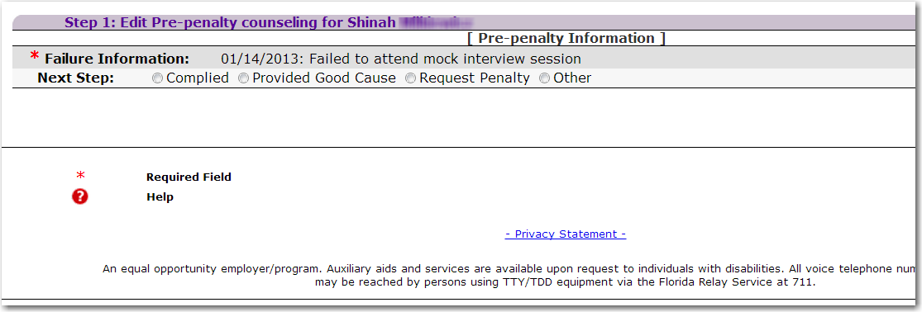
Notes:
Once you have selected the pre-penalty hyperlink, you will be asked to complete the approriate next step. For this process, the participant contacted the case manager regarding the failure and was determined to have good cause. In this example, you will select the “Provided Good Cause” radio button to end the pre-penalty.

Slide 7
Enter the pre-penalty end date and a brief description of the good cause.
Notes:
After you select the “Provided Good Cause” radio button, the next step would be to enter the end date and a description of why the failure was closed due to good cause. The failure date and the end date are should be the same. After all appropriate data is entered, select the “Save” button.

Slide 8
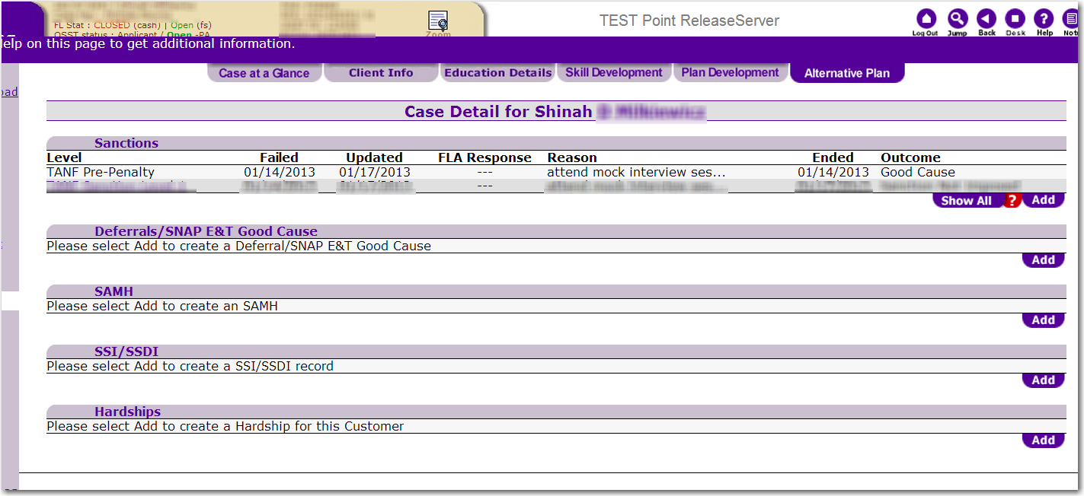
Notes:
After you select save, the outcome of the pre-penalty would display that the customer provided good cause for the failure. Note that the hyperlink has disappeared and you are no longer able to select the pre-penalty. What would we do if the customer does not provide good cause or the good cause provided is not accepted? Let’s take a look at another scenario.

Slide 9
Successful oral attempt and good cause does not exist or is not accepted
Failure occurs
Mail AWI-WTP form 2290
Make an oral attempt
Oral attempt is successful
Does the customer have good cause or is good cause accepted?
NO!
Counsel participant on noncompliance (offer services, if needed)
Establish compliance activity with a due date
Notes:
If the oral attempt is successful, but the customer does not have good cause or good cause is not accepted, we would let the participant know that the reason they provided is not good cause and counsel them on their noncompliance. We would offer services or referral for services if they are needed for the customer to participate and establish a compliance activity with a due date.

Slide 10
Failure occurred and 2290 mailed
Oral attempt successful?
Yes
Good Cause exists or accepted?
No
Counsel Participant on Noncompliance
Offer services, if needed. If the participant wants to comply, establish a compliance activity with a due date
Notes:
Assuming that the failure has occurred and you have mailed the 2290, you would make an oral attempt to contact the program participant. If the oral attempt is successful, you want to find out if good cause exists. If good cause does not exist or not accepted, you would counsel the participant regarding the noncompliance. Inform them that they do not have good cause or that the reason they have provided is not accepted as good cause. If the participant wishes to comply, you would establish a compliance activity and provide a due date. Encourage the participant to repeat what they are supposed to do and when they are supposed to do it. Case note the events of the participant’s noncompliance counseling.

Slide 11
Ten Day Contact Period
MONDAY | TUESDAY | WEDNESDAY | THURSDAY | FRIDAY | SATURDAY | SUNDAY
 |  |  | 1 Failure Occurs | 2 Notice of Failure (2290) mailed/oral attempt successful (customer agrees to comply on July 5th) | 3 | 4
5 | 6 | 7 | 8 | 9 | 10 | 11
12 | 13 | 14 | 15 | 16 | 17 | 18
19 | 20 | 21 | 22 | 23 | 24 | 25
26 | 27 | 28 | 29 | 30 | 31
Now that you have counseled the customer, what happens to the 10 day contact period?
Notes:
We have provided a calendar to discuss the ten day contact period. In this example, the participant fails on the first day of the month, which is a Thursday. You notice the failure and mail the Notice of Failure form (DEO WTP form 2290) to the program participant on the next day, Friday, the 2nd day of the month. You also make an oral attempt to counsel the participant on his/her failure. You are successful in reaching the participant and provided counseling. He/She agrees to a compliance activity. The oral attempt was successful. Now that you have spoken with the customer and he/she has agreed to comply, what happens to the 10 days?

Slide 12
Ten Day Contact Period
What are the ten days about?
Counseling
Pulling the customer back into program engagement
Providing services or referral to other services, if needed, to get back into compliance
Notes:
The 10 day contact period is set in place to help guide the participant back into program engagement. Counseling, offering services, and referring other forms of service to the customer are ways in which we, the career manager, attempt to guide the participant back into compliance.

Slide 13
Ten Day Contact Period
Oral Attempt is successful and customer agrees
The purpose of the 10 day contact period has been served
Notification of failure
Offering services, if needed to participate
Giving the participant the opportunity to reengage
Setting up a compliance activity
Notes:
If the oral attempt is successful and the customer agrees to comply and has been given a compliance activity, then the purpose of the 10 day contact period has been satisfied. The 10 day contact period will conclude once you have counseled the participant, regardless of when the contact was made during the 10 day period.

Slide 14
Compliance Activity Failure
MONDAY | TUESDAY | WEDNESDAY | THURSDAY | FRIDAY | SATURDAY | SUNDAY
 |  |  | 1 Failure Occurs | 2 Notice of Failure (2290) mailed/oral attempt successful (customer agrees to comply on July 5th) | 3 | 4
5 Customer didn’t show | 6 | 7 | 8 | 9 | 10 | 11
12 | 13 | 14 | 15 | 16 | 17 | 18
19 | 20 | 21 | 22 | 23 | 24 | 25
26 | 27 | 28 | 29 | 30 | 31
Notes:
Now, we will discuss what happens if the participant fails the compliance activity. Using this calendar, we know that the participant failed on the first day of the month, which was a Thursday. You mailed the notice of failure on the 2nd day of the month, mailed the Notice of Failure (form 2290) and called the participant. The oral attempt was successful. You counseled her and she agreed to show for a compliance activity on the fifth day of the month. You learned that the participant didn’t show on the 5th of the month. What should we do next?

Slide 15
Customer agrees to comply but doesn’t show
The customer agreed to attend a compliance activity, but didn’t show, what do I do in the system?
Note: this is a second failure
Notes:
In the previous example, the customer agreed to comply or show for his or her compliance appointment on the 5th day of the month; however, the customer didn’t show. This is where policy guides what happens in the system. In the example, the compliance activity was supposed to occur on the 5th day of the month. Because the customer failed to show, we would set an alert or use our outlook calendar to remind us of the three days that the customer has to contact us and provide good cause for why they failed. Using the 5th as the date, we would count out three days from that date.

Slide 16
Customer agrees to comply and doesn’t show for compliance activity
Set an alert or “to-do” for three days from the date of the failure of the compliance activity
Alternative: place it on your outlook calendar
DO NOT end the pre-penalty in the system
If the customer does not contact with Good Cause, request the penalty
Notes:
Set an alert for three days from the 2nd failure date to allow the participant to report good cause. It is important that you do not end the pre-penalty in the system. Because this is the 2nd failure, a 3 business day contact period is given to the customer to contact you with good cause. Let’s look at the calendar again.

Slide 17
Customer agrees to comply but doesn’t show
MONDAY | TUESDAY | WEDNESDAY | THURSDAY | FRIDAY | SATURDAY | SUNDAY
 |  |  | 1 Failure Occurs | 2 Notice of Failure (2290) mailed/oral attempt successful (customer agrees to comply on July 5th) | 3 | 4
5 What do you do if she doesn’t show? | 6 | 7 | 8 | 9 Request Penalty 9 | 10 | 11
12 | 13 | 14 | 15 | 16 | 17 | 18
19 | 20 | 21 | 22 | 23 | 24 | 25
26 | 27 | 28 | 29 | 30 | 31
Mail the Notice of Failure to Demonstrate Satisfactory Compliance. Form 2292.
Notes:
The 5th day of the month is a Monday. So, we will start counting from the 5th and the third day will be the 8th of the month. You will set your to-do or place the reminder on your outlook calendar for the 9th day of the month to notify you that you should request a sanction if the customer has not contacted you with good cause before this date. If you request a sanction, you would mail the Notice of Failure to Demonstrate Satisfactory Compliance Form 2292 on the 9th!

Slide 18
Question…
In the last slide it states that I need to request the penalty for the 2nd failure and mail the 2292. The letter doesn’t automatically generate. What do I do?
Notes:
The last slide states that I need to request the penalty for the 2nd failure and mail the 2292. The letter doesn’t automatically generate. What do I do? There are two possible ways to accomplish this.

Slide 19
Notes:
Once you have selected the pre-penalty hyperlink, you will be asked to record the next step. For this process, since the participant never contacted the case manager regarding the failure, you will select the “Request Penalty” radio button to sanction the customer.

Slide 20
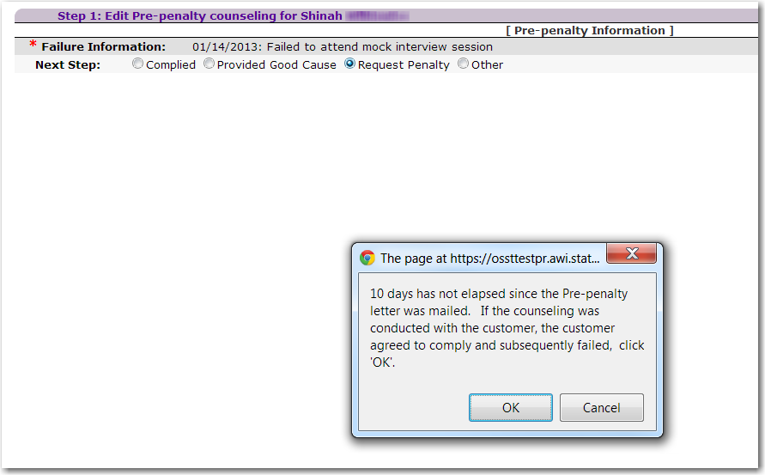
Notes:
Because 10 days have not elapsed in this instance, you will receive a notification that 10 days have not elapsed. It also states that if counseling was conducted and the customer agreed, but still failed, you should select “OK”

Slide 21
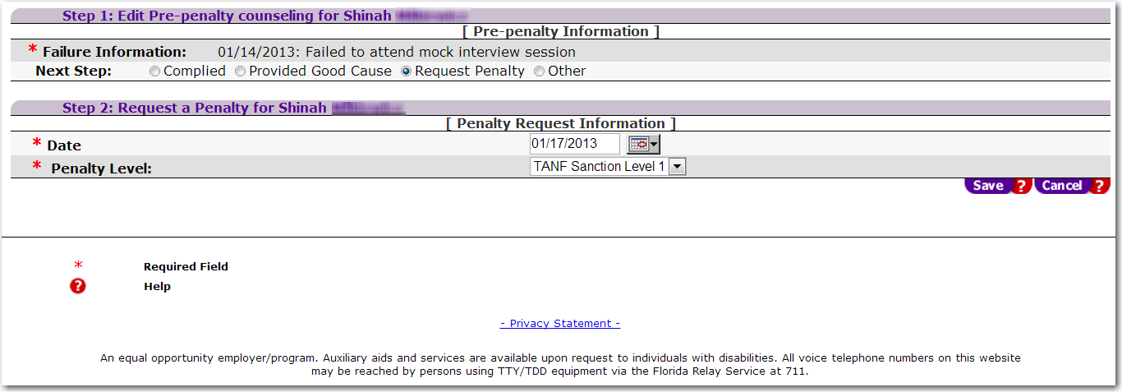
Enter the sanction request date and the sanction level
Notes:
We would complete the sanction request by entering the date and the sanction level. Select the “Save” button once you have entered in the correct information.

Slide 22
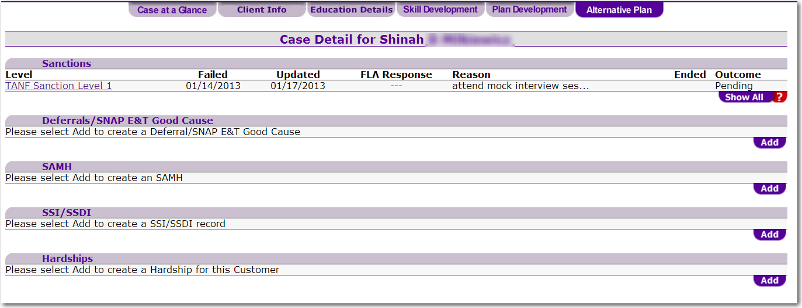
Notes:
After you select save, the sanction request is now in place and pending action from DCF. From here, you will have to send a 2292 because it is a 2nd failure.

Slide 23
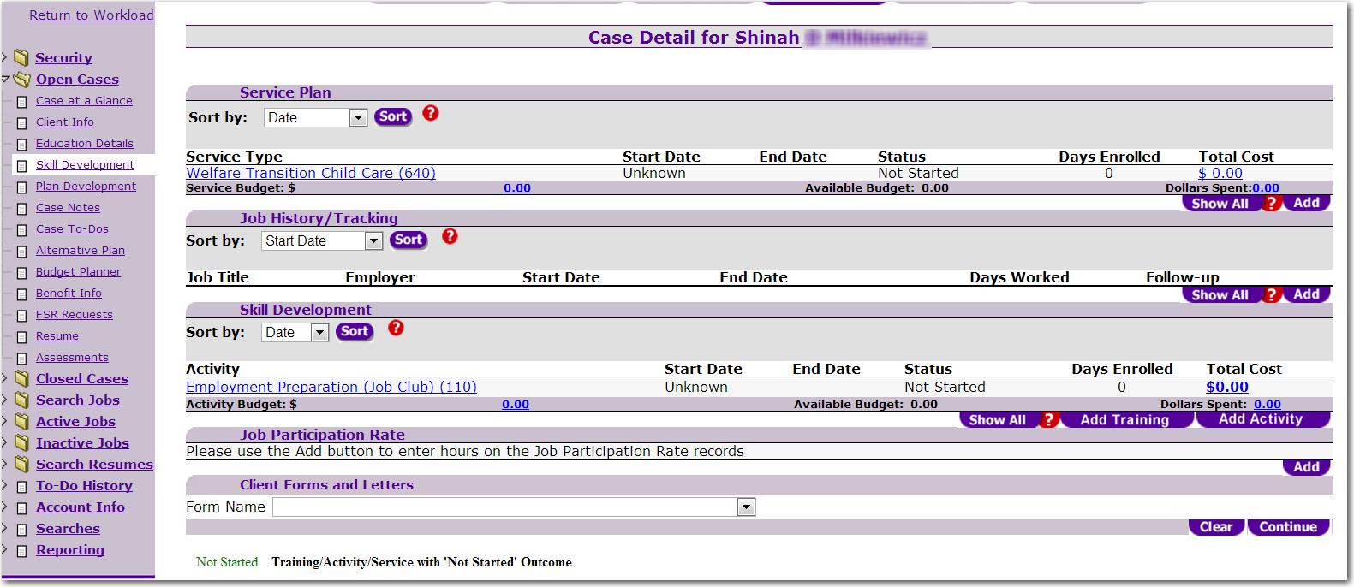
Notes:
The first way to print out the 2292 Form is to select the Skill Development tab on the left side of the screen. Under the Client Forms and Letters sub-section, you would select the dropdown arrow located at the end of the Form Name section.

Slide 24
Notes:
Here you will find a list of forms and letters that can be generated within the system. The title of the form we are in search of is “Notice of Failure to Demonstrate Satisfactory Compliance (CF-ES 2292).”

Slide 25
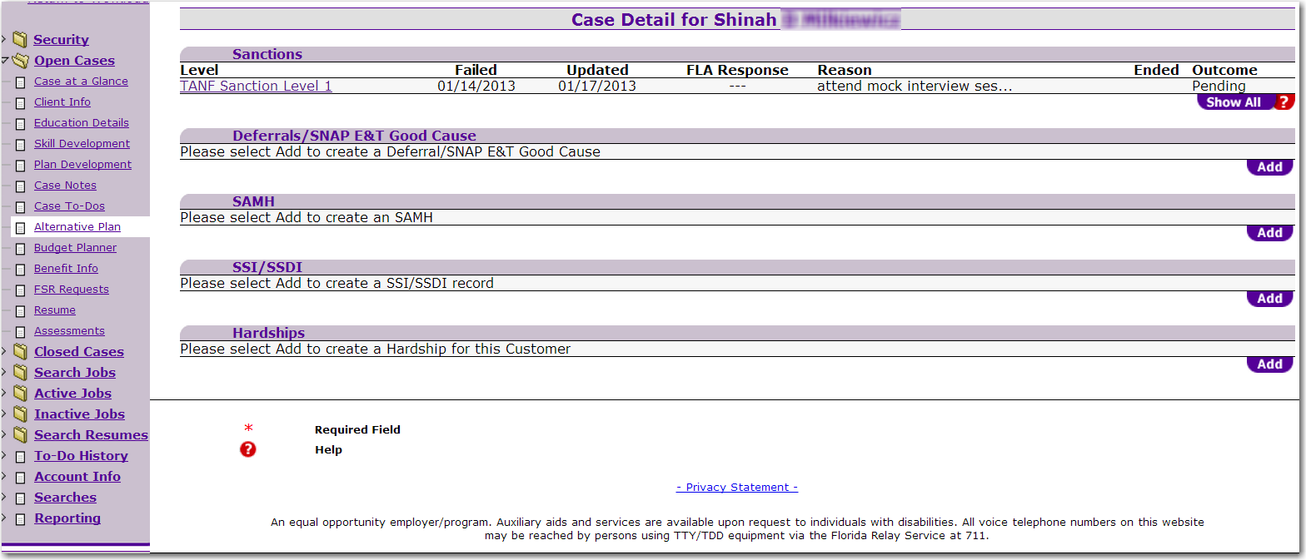
Notes:
Another method of locating the 2292 form is by selecting “Searches” from your left hand navigation menu.

Slide 26
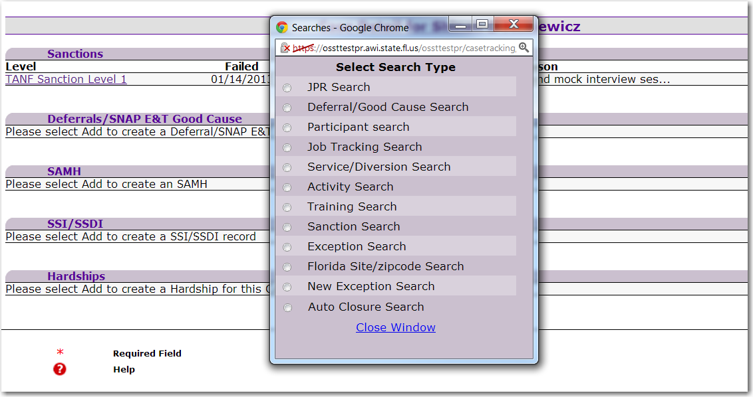
Notes:
Once you have done that, you will get a pop up box that displays all searches you can complete in the system. You will select “Participant Search.”

Slide 27
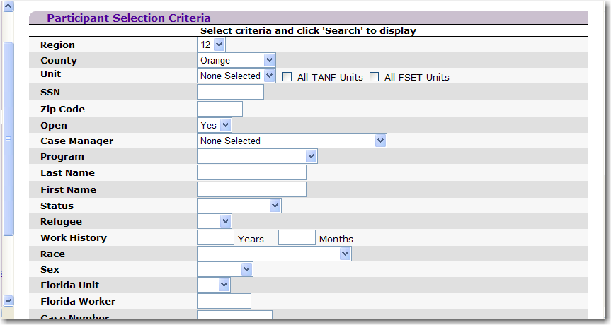
You may enter the SSN
You may enter the customer’s name
Notes:
Once you have selected participant search, you will be taken to the screen where you have to enter some parameters for your search. You will need to select a region and county. You can also enter the name of the person or his/her social security number. After you have selected your parameters, you will go to the bottom of the search screen and select search, which is illustrated in the next slide.

Slide 28
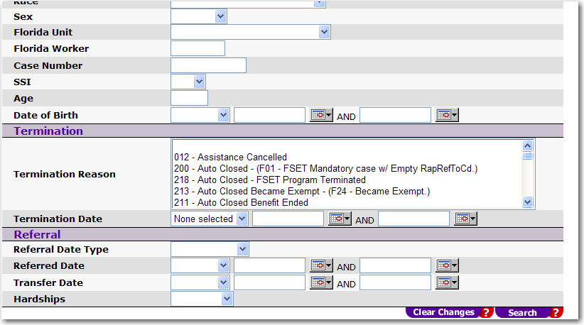
Notes:
Here you will select the Search button.

Slide 29
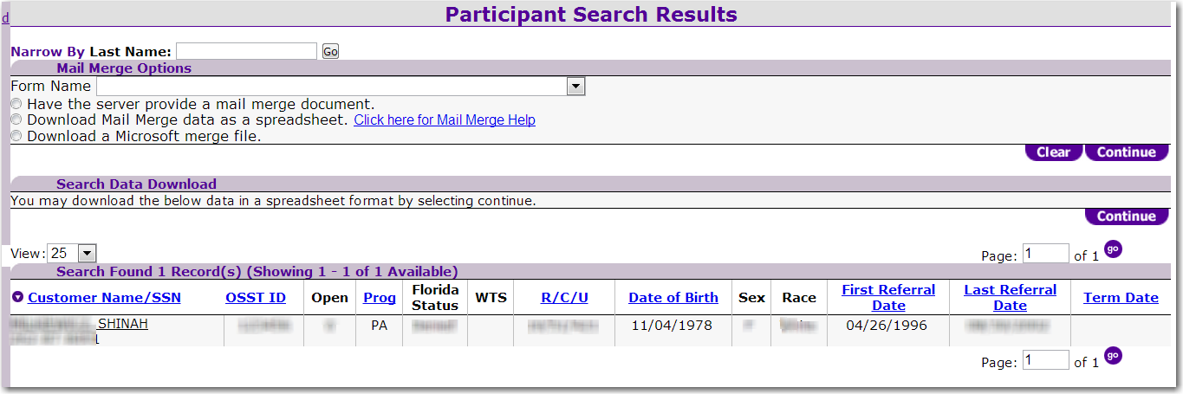
Notes:
If you chose to search by SSN, you should get only one record. If you search by name and the name is common, you will probably get more than one record. As a result, please ensure that you have selected the appropriate participant. Let’s take a look at the top of the screen for a moment. You should see a Mail Merge Options header and beneath that, you will see a drop down box with form name to the left of it. If you click on the dropdown, you will see all the forms you can print from the system.

Slide 30
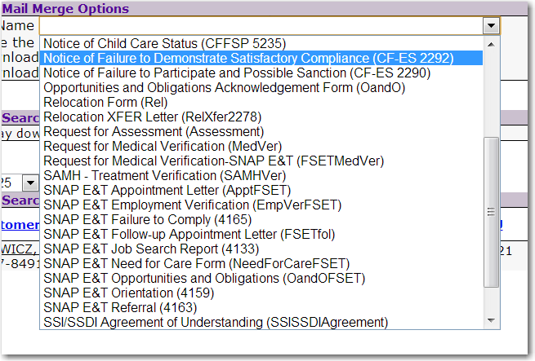
Notes:
We have highlighted the Notice of Failure to Demonstrate Satisfactory Compliance (form 2292) that appears in the dropdown box.

Slide 31
Notes:
After selecting the form, the system automatically populates the first radio button beneath the form name. This will generate the form you have selected from your dropdown. Select continue.

Slide 32
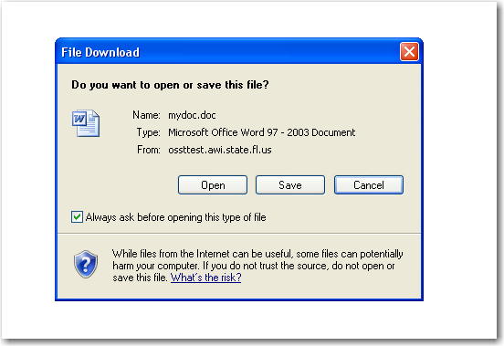
Notes:
You will get the pop up asking if you want to open the document, save it, or cancel it. You will select open to view/edit the document.

Slide 33
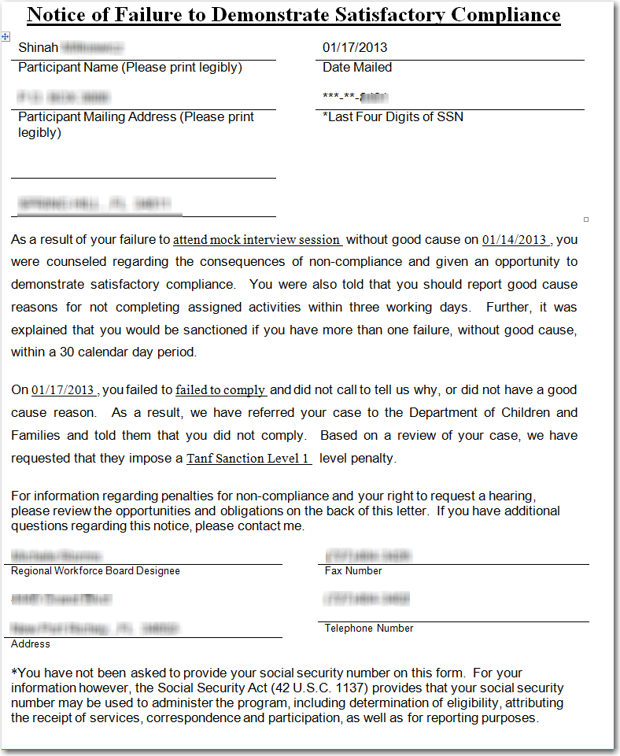
Notes:
You will print the letter, mail a copy to the customer, and keep a copy for your file. The system will generate a record that you have requested to print a form 2292, Notice of Failure to Demonstrate Satisfactory Compliance.

Slide 34
Notes:
The system generates a case note informing any system viewer that a 2292 was printed for this case. If you click on the hyperlinked Date, you will receive more details about the letter.

Slide 35
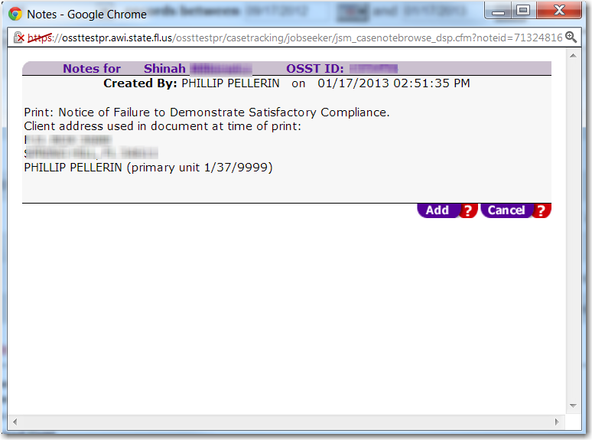
Notes:
Here is an example of how the case note will appear.

Slide 36
Accountability and the sanction process (Please Continue to part 3 of this training)
End of part 2
Notes:
This concludes part 2 of the Accountability and the sanction process training series. Please continue to part 3 of the training series.

