Slide 1



The Hidden Components of a Successful Job Search:
Getting Recognized
Notes:
Once job seeker customers have gotten organized, the next step in the job search process is to “get recognized.”

Slide 2
Objectives
During this lesson, we will focus on helping job seeker customers get recognized
  Discuss developing applications that are
    Concentrated
    Concise
    Complete
    Correct
    Conscientious
  Discuss developing a résumé employers will respond to
Notes:
The most common way for our job seekers to be recognized is through the application process. During this lesson, we will focus on helping job seeker customers get recognized by developing applications that are concentrated, concise, complete, correct, and conscientious (or the five “C”s of application writing). We will also discuss how to help our job seekers develop résumés that employers will respond to.
It is important to note that we will be discussing general concepts. Each Regional Workforce Board or RWB assists customers using innovative tools and unique activities designed to move job seeker customers towards employment based on state and local expertise. For example, we will review several types of résumés with a focus on a résumé type preferred in research conducted by the Society for Human Resource Management. Your RWB may prefer to use a different résumé format than the one described in this module. Please make sure that you learn more about the classes, workshops, online study tools and resources your RWB uses to assist job seekers with finding employment. If you find that local tools differ from anything seen in the Job Search Skills modules, follow your local operating procedures.

Slide 3




Getting Recognized
Applications are an important part of the job search process
  Employers use the application to get information that they cannot find on résumés
  Employers use information found in applications to weed through hundreds of candidates
Notes:
Filling out an application is an important part of the job search process. Most employers require job seekers to fill out an application at some point during the hiring process to collect information not found on the résumé. For example, many applications request information about felony convictions. Job applications serve a lot of purposes, but most importantly, job applications help employers screen out candidates quickly.
Once again, imagine you are the hiring manager at a large hospital. You post a position for a clerk in the newspaper and in the Employ Florida Marketplace or EFM system. At the end of the first week, you receive one-hundred applications. You only want to interview seven people. How do you narrow down 100 applications to less than ten possible candidates? Easy, you use the information found in the application to narrow down the possibilities.

Slide 4

The Five “C”s of Applications
oncentrated
oncise
omplete
orrect
onscientious
Notes:
We do not want our job seeker customers to be disregarded because their applications are not competitive. We must help our job seeker customers get noticed as potential job candidates. Our customers must ensure their applications are concentrated, concise, complete, correct, and conscientious.

Slide 5
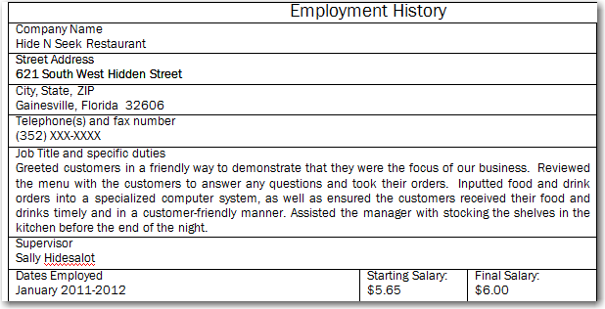

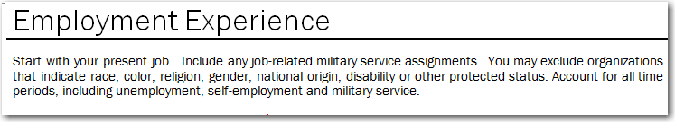
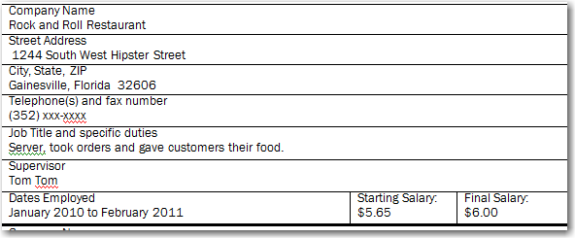
The Five “C”s of Applications
Applications must be concentrated
  Job seekers must focus follow employer directions
  Employers look to see if job candidates can fill out a simple form to specifications
Notes:
Job seekers must follow employer directions, which brings us to our first “C”. Job seekers must concentrate their efforts on filling out applications to employers’ specifications.
In this example, the job seeker candidate was asked to record his job history in reverse chronological order. The employer wanted to review the candidate’s most recent job information first. However, this customer entered his job history out of order. The first job entry on the application was from January 2010 to February 2011. The next job entry was from 2011 to 2012. This employer will simply think that the candidate cannot fill out the form correctly or does not pay attention to critical details. If the employer has 100 applications to look at, this application will simply be thrown out. During the application review process, employers look to see if job candidates can fill out simple forms to specifications.

Slide 6

The Five “C”s of Applications
Tip for a “concentrated” application
  Each application is different
  Job seekers should review the directions on applications first
    Fill out applications according to employer specifications
Notes:
To ensure applications concentrate on what employers want, job seekers must understand that every application is different. Therefore, job seekers must read the directions on the employer's application to fill out the form appropriately.

Slide 7

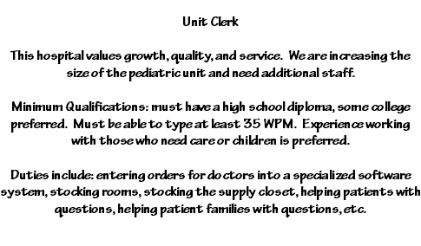
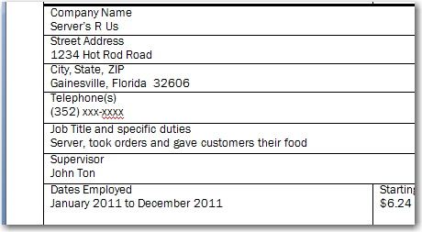
The Five “C”s of Applications
Applications must be filled out based on what employers are looking for
Notes:
Debra Auerbach of CareerBuilder.com states that many applicants use a “one-size fits all” job application, which is a major mistake. This brings us to our next “C”. Applications must be concise. While we encourage our customers to use an example application, applications and résumés actually submitted must be tailored to what employers are looking for. Details entered on applications must be based on what employers want.
You may be asking yourself, what does this mean? In previous examples, we stated that you are the hiring manager for a large hospital, and you are looking for a Unit Clerk who will enter orders in the computer for doctors, help patients, help patients’ families, and ensure supplies are stocked. The job advertisement includes these major job duties. So, you expect those responding to the advertisement to pay attention to these details. However, on Anny’s job application, you see that her last job only lists the duties: “took orders from customers and gave them their food.” In this example, Anny did not pay attention to the advertisement and focus on the transferrable and job specific skills that relate to the employer’s job posting. Essentially, Anny was not concise.

Slide 8


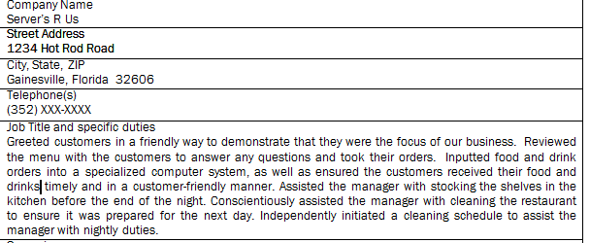


The Five “C”s of Applications
Job seekers must research
  Job postings
  Other related job postings
  Job descriptions in EFM
Using information found in these sources, job seekers must ensure applications respond to the employers’ needs in a concise manner
Applications must be concise by listing the transferrable and job specific skills job seekers have that will meet employer needs
Notes:
Applications must be concise by listing the transferrable and job specific skills job seekers have that will meet employer needs. Job postings are a great source of information. Essentially, employers tell job seekers exactly what they are looking for through written communication in either EFM or another job search system. Job seekers must read the information found in job postings and use this information to ensure their applications respond to employers’ needs.
Let’s return to our example and focus on helping Anny make her application concise. After talking with Anny, the workforce professional realizes Anny did more than just take orders and hand out food. She had to stock shelves in the kitchen; she took orders from customers and put them in a computer system; and, she assisted in cleaning the restaurant. Additionally, the workforce professional found out that Anny really enjoyed helping people. So, staff at the One-Stop Career Center helped Anny highlight these skills by outlining them in her example application. Anny then uses this information to fill out the application at the hospital. In this example, you read that Anny “greeted customers in a friendly way to demonstrate that they were the focus of the restaurant’s business." Anny also reviewed the menu with customers to answer any questions; she took orders; she entered their orders into a computer; and, Anny ensured customers received their food timely. Based on this information, you, the hiring manager, knows that Anny can greet customers, answer questions, take orders from a third party, learn and use specialized computer software, follow-up with her customers, stock shelves, work with a manager, identify a need and respond to that need, as well as work with others. This small bit of information really responds to the needs of the employer.

Slide 9
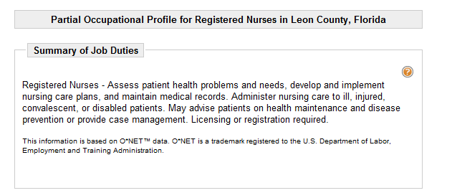
The Five “C”s of Applications
Job seekers
  Must review job postings
  Respond to what employers are looking for
  Research other sources if the job posting is limited
Notes:
Job seeker customers must review job postings and respond to what employers are looking for. If the employer’s job posting is limited, the job seeker can review the Occupational Profile in the EFM system, which will provide more details for the job seeker customer. How do we look up information in EFM associated with a specific occupational profile?

Slide 10

The Five “C”s of Applications
Notes:
This type of research like you just saw, helps job seekers fill out applications in a concise manner, which is a critical element of a successful job search.

Slide 11
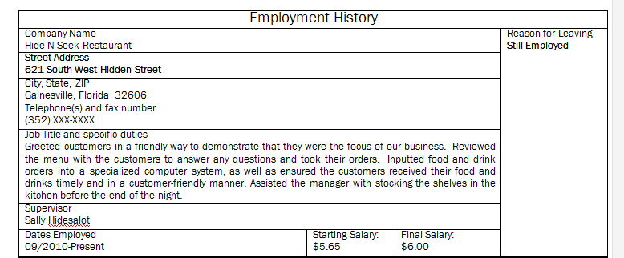
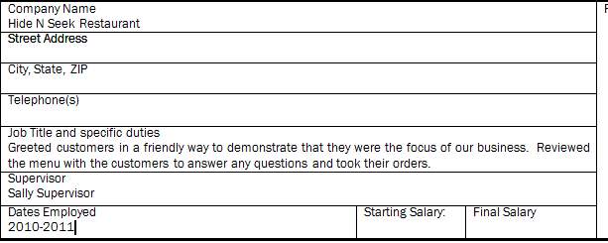

The Five “C”s of Applications
The application must be complete
Employment history
  Employer’s address
  Employer’s phone number
  Job title and specific duties
  Supervisor’s name
  Dates employed
  Salary
Education history
  High school information
  College information
  Certifications
Professional Skills
Notes:
Many job seekers are guilty of not filling out job applications completely. Applications should have every block filled in. This brings us to the third “C” of the application process; applications must be filled out completely. If an element on the specific application does not pertain to the customer, the job seeker customer should enter “N/A." Look at this example, will the employer guess the information or call the customer about the blanks; or, will the employer simply throw out the application?
In this job market, employers are getting dozens, if not hundreds, of applications to review. If applications are incomplete, employers will simply remove applications from consideration.
Job seekers are most likely to leave addresses, phone numbers, employment dates and salaries blank because they simply do not remember the details associated with past jobs. Job seekers should carry an example application in their document organizers. The example job application should include all pertinent information, and it should be used whenever the job seeker goes to fill out applications with employers. The example application should document critical information, such as the job seeker’s employment history; this must include each employer’s name, address, phone number and other critical data. The example application should also include the job seeker’s education history, including what schools the job seeker attended, the dates the job seeker was in school and the addresses of the schools. The example application should also include a list of professional skills that will help the job seeker respond to any specific informational requests. This example shows that the job seeker customer is still employed, and all of the information is complete. This application is neater and shows the job seeker is organized and ready to go to work.

Slide 12
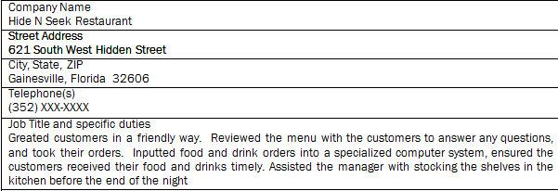
The Five “C”s of Applications
Applications must be correct
Notes:
The next “C” requires applications to be filled out correctly. Job seeker customers should not submit applications that have grammatical errors. Look at this example, can you find the grammatical errors? Employers will see this and assume that the job seeker cannot communicate using written forms. Grammatical errors on applications, cover letters and résumés are the quickest ways to be removed from consideration for a job. In a survey conducted by the Society for Human Resource Management, 99 percent of human resource professionals polled stated they have found grammatical errors on either the job seeker’s résumé or cover letter, and 87 percent stated they have thrown out an application due to such errors.

Slide 13
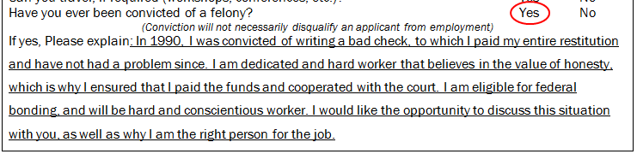

The Five “C”s of Applications
Prepare your customer by having him fill out a job application and explain any tough situations in a professional manner
Review the information with the customer in advance
Have your customer perfect the language and enter it on an example application
This example application should be maintained in the document organizer
  The customer can then use this language on future applications knowing it has been reviewed by a workforce professional
Job seekers must be conscientious when filling out job applications
Conscientious means to do something according to what is right
Notes:
Job seekers must also be conscientious when filling out job applications. What does this mean? This means that job seekers should fill out the job applications using correct information and according to their best judgments. The term “conscientious” actually means to do something according to what is right. Therefore, it is never appropriate to lie on an application. While information may be worded to demonstrate a positive perspective, it is never appropriate for job seekers to be dishonest. When job seekers are dishonest, they lose more than the opportunity to fill a position. In fact, many employers will remove dishonest job seekers from the list of potential candidates for future job openings.
So, what if the application element asks if the customer has ever been convicted of a felony, and the job seeker customer must answer “yes”? It is better to be honest on the application and to respond to the issue directly than to be dishonest. In this example, we see that the applicant has answered honestly and has asked for an opportunity to explain the situation. Additionally, the job seeker provided a cover letter addressing the issue, asking the employer to offer him the opportunity to be bonded using the Federal Bonding program. Prepare your customer in advance by having him fill out a job application and explain any tough situations in a professional manner. Review the language with the customer to ensure it is honest and professional. Next, have your customer write the information down on his example application, which he can take with him to future job sites.

Slide 14
Frequently Asked Questions
If the job seeker wants to be responsive to the advertisement, can he/she just make up job duties?
  No, this would not be “conscientious” or “right”
  Work with the job seeker to find those job duties that highlight transferrable and job specific skills
  Outline those skills in a positive manner, but never be dishonest
Notes:
What if the job seeker wants to impress the employer, but he or she cannot think of job duties that will highlight his or her skills? Can we simply make up job duties? No, this is not conscientious or “right." Your job as a workforce staff member is to work with the customer and ask probing questions that will help the job seeker outline his or her skills. Then, you can take this information and highlight transferrable or job specific skills in a positive manner. However, it is never appropriate to be dishonest on an application or on a résumé.

Slide 15
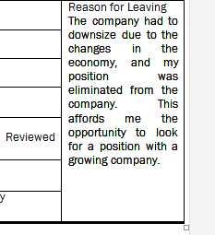
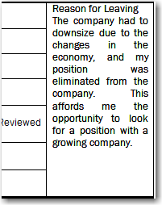
Frequently Asked Questions
What do we enter for “Reason for Leaving” if the individual quit or was fired?
  First, we review the information with the customer
  Next, we can re-state information in a positive manner without being dishonest
Notes:
There are instances when we have to restate information in a positive manner. For example, what do we enter if the customer was terminated from the job or the individual essentially quit? We do not want to enter “fired” or “quit” under “Reason for Leaving." First, we have to talk to the customer to find out what occurred. There are situations where it is not the customer’s fault, and we may be able to enter such information appropriately. In this example, the customer’s job was downsized due to the economy, and the application was updated to reflect this.

Slide 16
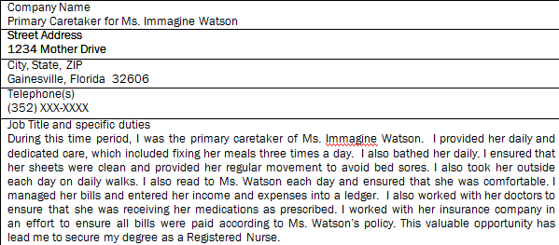
Frequently Asked Questions
What if the customer has a gap in employment?
  First, we have a duty to discuss the impact on the customer’s résumé
  Next, we can re-state information in a positive manner without being dishonest
Notes:
What if the customer has a gap in employment? Once again, we need to review the information with the customer. Let’s take Anny, our job seeker, as an example. Anny has a valid reason for having a gap in her work employment. She had to care for a sick family member, an issue that many employers can relate to. More than likely, Anny gained a host of transferrable skills during this period, but the employer will not see this unless it is provided in the application or cover letter. So, what should Anny do? She can address the gap in employment right in the work history section of the job application. In this example, Anny treated this time period as a job. Anny states that she was caring for her sick mother as a primary caretaker and lists her skills. She also stated that she is trying to become a nurse as a result of this experience.

Slide 17

Tips for Filling Out Job Applications
Job seekers should
  Be prepared through practice
  Have example applications
  Have a work experience and example cheat sheet
  Ensure that every application meets the five “C”s
Notes:
Here are some additional tips for job seekers who are either starting the job search process or are not having any luck during the job search process.
First, Job seekers should practice filling out job applications; and, workforce program staff should review those applications and provide ideas on how to improve the documents.
Job seekers should maintain an example application that documents all critical information.
Job seekers should have a detailed list of work experience and skills in the form of a cheat sheet, and, this should be kept in the document organizer. This information can be used to fill out applications with employers.
Finally, job seekers should ensure all completed applications meet the five “C”s.

Slide 18
Creating a Competitive Résumé
Employers expect job seekers to have résumés that highlight what the job seekers have to offer
Many job search methods require an Internet-based résumé
Notes:
Most employers require a résumé in addition to an application. In fact, most employers require job seekers to submit information by fax or by Internet. Job search systems, such as the EFM system and People First, afford employers the ability to secure information about job seekers directly through the system via submitted résumés. Additionally, job seekers should look for employment on the Internet; and, most Internet-based advertisements require the submission of an electronic résumé. A successful job search requires a strong and competitive résumé. Richard H. Beatty, the author of The Ultimate Job Search, states that to compete in this job market, the job seeker’s résumé has to stand out like a “snowflake in a snow storm."

Slide 19
Creating a Competitive Résumé
There are several different types of résumés
We are going to focus on three of the most common types of résumés
Chronological Résumé
Functional Résumé
Combination Résumé
Notes:
We are going to focus on three of the most common types of résumés. There is the chronological résumé, the functional résumé and the combination résumé.

Slide 20
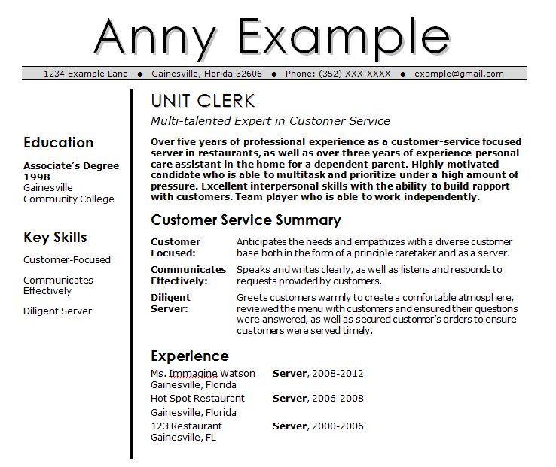
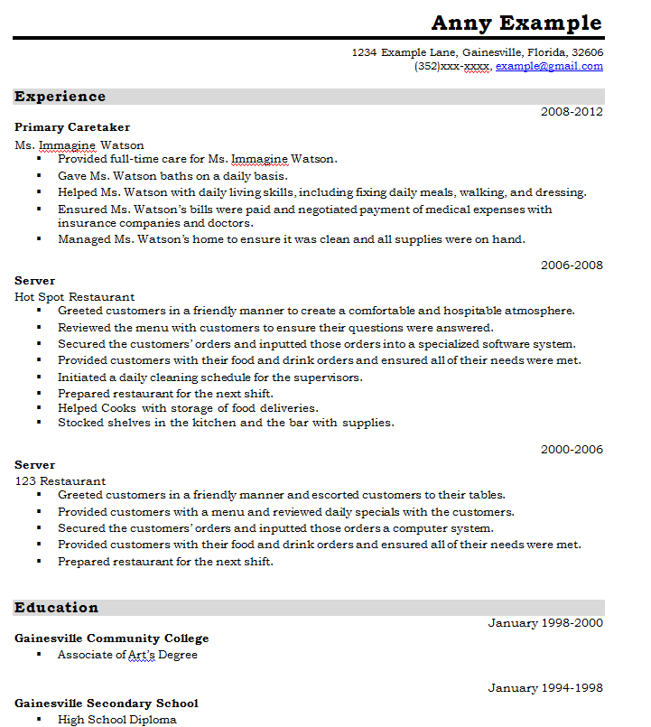
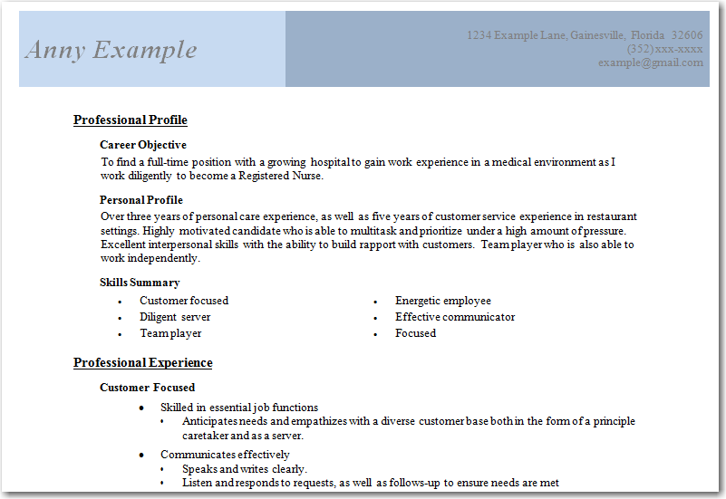
Combination Résumé
Functional Résumé
Chronological Résumé
Notes:
The chronological résumé focuses on offering information associated with the job seeker’s work experience over time. The chronological résumé provides the most recent job history first. Other job experiences are listed in reverse chronological order from most recent to the oldest. Functional or skills résumés focus on the skills that the customer has gained over time. Such résumés actually start with skills that are relevant to the job. Functional résumés can be very useful if the job seeker has extensive experience in a specific occupation or industry. Functional résumés are also very helpful if the job seeker has a gap in employment or other issues that would stand out in a chronological résumé. The job seeker’s most recent work experience is simply listed after the job seeker’s strengths and abilities have been highlighted in the document. The combination résumé mixes the chronological résumé and the functional résumé by highlighting the job seeker’s skills and abilities, as well as listing the job seeker’s employment history later in the document.

Slide 21
Frequently Asked Questions
So, which format should our job seeker customers use?
  74 percent of staffing professionals surveyed stated they preferred the chronological résumé
  99 percent of staffing professionals surveyed stated they consider a detailed job history a critical part of the résumé document
  Follow your local operating procedures
Notes:
So, which format should our job seeker customers use? According to the Society for Human Resource Management, 74 percent of staffing professionals surveyed prefer the chronological résumé over other formats. Additionally, 99 percent of those professionals surveyed consider a detailed job history a critical part of the résumé document.
You may be asking yourself, “What do I do if my region uses another résumé format?” This is not a problem. In fact, many times, our customers need to use other résumé formats because of a gap in work history, lack of work history, job jumping, and more. The information presented in this presentation was designed to help you understand what many employers are looking for when job seekers attempt to secure employment. Please follow your local operating procedures when working with your customers.

Slide 22
Creating a Competitive Résumé
Successful résumés follow three “C”s of the application process
  Correct
    In July 19, 2005’s online weekly survey, SHRM stated that 87 percent of respondents indicated that they had rejected a candidate due to grammatical errors on a résumé or cover letter
  Concise
    Respond to the employer’s needs based on the job advertisement or other research regarding the posted position
  Conscientious
    Ensure the information is true
Notes:
Successful résumés follow the three “C”s of the application process. Successful résumés are grammatically correct, concise and conscientious. In the July 19, 2005, weekly survey, the Society for Human Resource Management stated that 87 percent of respondents indicated they had rejected a candidate due to grammatical errors on a résumé or cover letter. This is why résumés must be grammatically correct. The résumé must also be concise and respond to the employer’s needs based on the job advertisement or other research regarding the posted position. The information on the résumé must also be true, meaning the job seeker must create the résumé conscientiously.

Slide 23
Creating a Competitive Résumé
Elements of a successful résumé
  Name
  Address
  Phone number
  Email address
  Skills
  Work history
  Education and training
  Accomplishments
Notes:
Additionally, successful résumés include the job seeker’s name, address, phone number, email address, skills, work experience and educational information. The information must be up-to-date and useful. For example, it does not help to post an invalid phone number. The phone number must be a working number that can be called by the employer, and the email must be checked on a regular basis.
Additionally, the job seeker must ensure that his or her résumé includes his or her accomplishments, not just what the customer did at the job. In other words, did the customer save the company money, design a new way of managing daily activities or implement a program to reward co-workers for their hard work? These accomplishments help employers identify achievements that have been attained for the employer’s benefit during the course of business. According to Richard Beatty, this translates to “tangible evidence” for the employer.

Slide 24
Creating a Competitive Résumé
Improved
Organized
Assisted
Facilitated
Produced
Executed
Balanced
Communicated
Compiled
Notes:
The final component of a competitive résumé is the use of action words. The use of a myriad of action words demonstrates a variety of skills. Action words show power, persuasion, and distinction. The Internet has a large number of action word lists the job seeker can use to power up his or her résumé; here are just a few that can be used.

Slide 25
Frequently Asked Questions
What if the job seeker has to submit a résumé electronically?
  The résumé should be converted to the appropriate file format
    Once again, job seekers must read the directions to ensure they upload or send the résumés in the correct format
  Type the information in Microsoft Word
    Check spelling and grammar
    Cut and paste into job search system
Notes:
What if the job seeker has to submit a résumé electronically? Job seekers should be prepared to create or enter a résumé into an Internet-based system. In fact, job seekers should place multiple résumés in the EFM system and in the State of Florida’s People First system. The résumé should be converted to the appropriate file format based on the system's directions. Before entering the résumé into a computer system, the job seeker should type the information into a Microsoft Word document to check the spelling and the grammar. The information should then be copied and pasted into the appropriate job bank system unless there is a résumé builder embedded in that job search system.

Slide 26
Frequently Asked Questions
You have helped the customer get organized
You have helped the customer prepare an application and a résumé
How does the customer get “recognized”?
  The job search process is critically important
  The job seeker customer must “get out there” to be recognized
Recognized
Prepared
Organized
Notes:
Let's recap for a moment. You have assisted the customer with organizing his or her space, time and efforts. You have helped the customer prepare an example application. You have also helped the customer prepare a résumé and references that can be passed out to employers. Now, how does the customer actually get recognized by employers? The job seeker must "get out there" to be seen by employers.

Slide 27
Frequently Asked Question
Job Fairs
Company Research
Direct Job Search
Notes:
We have discussed one process already, your job seeker customers need to put their résumés in job banks. Employers search for documents in job banks to find possible candidates. Next, your job seekers will need to search job banks, such as EFM or People First, and apply for specific jobs.
This may require responding with a system-based résumé or submitting a résumé or application according to directions that employers post in the system. Your job seekers should also research companies.
When job seekers find a company that they are interested in, the job seekers can go to company’s website to see if the company has any jobs posted. Job seekers can then follow the employer’s directions to apply directly with the company. Finally, job seekers can attend job fairs offered or facilitated by RWBs or community partners. Job Fairs afford job seekers the opportunity to meet directly with employers to express interest in job openings and employment opportunities.

Slide 28
Getting Recognized
All of these job search opportunities will lead your job seekers to apply for a lot of jobs
  Job seekers must stay organized to ensure they do not apply for the same job twice
  Job seekers must stay organized to ensure they have a copy of the résumés submitted to employers
  Job seekers must stay organized so they have copies of required documents to take to interviews
Notes:
All of these job search opportunities will lead your job seekers to apply for a lot of jobs; so remember, you have to help your job seekers stay organized. Encourage your job seekers to use a system of recording all actions taken with employers for each position. Encourage your job seekers to maintain copies of their résumés, as well as their references, which will be of critical importance when they go on interviews.

Slide 29
Conclusion
This concludes the third lesson in the Job Search Skills module
In the next lesson, we will discuss the interview process
Notes:
This concludes this lesson. In the next lesson, we will talk about getting heard or helping your job seekers master the art of a good interview.

