Slide 1
Employ Florida Marketplace
Lesson One: Introduction
Notes:
Welcome to the Employ Florida Marketplace module. This is lesson one, an introduction into EFM. It is important to note that you will only get credit for watching this module if you complete the entire session and select “Finish” on the last slide. Failure to take the quiz or select “Finish” on the last slide will result in a failure to complete the session.

Slide 2
Objectives
Introduction to the Employ Florida Marketplace (EFM) system
Review the EFM Home Page
Review common staff options
My Workspace
Services for Workforce Staff
Notes:
During this lesson, we introduce you to the Employ Florida Marketplace or EFM system. We will review the information available to all users through the EFM “Home Page”, as well as what workforce staff see when they log into the EFM system. This includes an overview of the most commonly used features associated with the “My Workspace” section of EFM and the “Services for Workforce Staff” section of EFM.

Slide 3
What is EFM?
State of Florida’s online job service website
Provides information and data exchange for job seekers and employers
Job seekers
Look for work using EFM
If registered, can create and post résumés directly in the system and apply for jobs through EFM
Notes:
EFM is the State of Florida’s online job service website, which provides information for both job seekers and employers in Florida. Job seekers can look for work using the EFM system. Those job seekers who are registered in the EFM system can create résumés and apply for job openings directly through the information exchange.

Slide 4
What is EFM?
Employers
Post job openings
Search for qualified job seekers
Both job seekers and employers
Access Labor Market Information
Other resources
Notes:
Employers can post job openings and find qualified job seekers through the EFM system. Both job seekers and employers can access Labor Market Information and other resources through the EFM system.

Slide 5
What is EFM?
Notes:
Think of it this way, EFM is the State of Florida’s online system for bringing job seekers and employers together. Employers enter job orders to show what they need. Job seekers create profiles and résumés to show what they can offer. And, the EFM system is designed to help regional staff bring them together.

Slide 6
Home Page
Notes:
This is the EFM home page. This page can be accessed through the Department of Economic Opportunity’s (DEO’s) website or by simply entering “Employ Florida Marketplace” in an Internet search engine. From this page, employers can search for a job seeker, register a job opening or access other services, such as Labor Market Information.

Slide 7
Home Page
Notes:
Job seekers may also access information from the home page. Under the Job Seekers section, individuals who are looking for work may select to look for work, create a résumé or access other resources. Job seekers who select to “Find a Job” do not have to register to use the system unless they want to apply directly online or submit a résumé to the registered employer. Job seekers who select “Create a Résumé” under the “Job Seekers” title will be prompted to register in EFM.

Slide 8
Home Page
Notes:
From the home page, workforce system customers have access to Labor Market Information, information about education and training services, access to research about specific occupations and access to information about youth and senior services. Additionally, job seeker customers, employers and workforce staff can log into the system by entering their user identification and password combination and selecting “Sign In”.

Slide 9
My Staff Workspace
Notes:
Staff who log into the EFM system will be directed to the “My Staff Workspace” page. Initially, staff will arrive at the “My Staff Dashboard” tab on this page, which displays staff resources such as messages, correspondence, the staff member’s calendar, latest news and announcements, and links to additional help and information if needed. Along with the “My Staff Dashboard” tab, staff can navigate to the other tabs to find additional staff resources, their individual staff account pages, and the “Directory of Services”. Under the “Directory of Services” tab, staff can find the “Services for Workforce Staff” page. Let’s take a look at that now.

Slide 10
Services for Workforce Staff
Central Page Navigation
Left Menu
Notes:
Under the “Directory of Services” tab, there are several expandable sections with tools, resources and information to assist staff members. Simply click on the title of a section to make it expand. This is the “Services for Workforce Staff” section. This is the hub of the staff member’s account, allowing the staff member to navigate to job seeker customers’ profiles, employers’ profiles, manage job orders, view résumés, and more. Navigation options are available in the middle of the page, as well as on the left side of the screen.

Slide 11
My Staff Workspace-My Staff Resources
Notes:
Under “My Staff Workspace”, workforce staff can access information about their preferences and profile. For example, by scrolling over “My Staff Resources”, the user has access to a host of short cuts to review messages, appointments, alerts, search lists, templates, case lists, reports preferences and upcoming events.

Slide 12
Element | Explanation
Correspondence | This page list all of your letters that you have currently saved in the system.
Messages | Individuals, employers and other staff may send you messages. By clicking on Messages, you can review all messages in your mailbox
Communication Templates | You can create and save templates for correspondence for later use.
My Alerts | EFM will alert you via a message when individuals in your caseload perform specific tasks or specific deadlines occur. The alerts that you receive are based on your alert settings.
Search Lists | If you save search results, you can look at those searches using this feature.
Assigned Cases | You can view a list of individuals of cases that have been assigned to you.
My Reports | You can maintain report filters that you have saved.
My Virtual Recruiter | Create Job Alerts or Resume Alerts to schedule recurring searches for jobs or candidates that match your requirements.
My Preferences | Set or change your user settings associated with system use.
My Appointments | You can manage your appointment calendar to meet with job seekers and employers
Upcoming Events | Access the event calendar to view or create events associated with your regional offices.
Notes:
Each of the options under My Staff Resources is listed here with the explanation of the option.

Slide 13
Services for Workforce Staff
Notes:
Under “Services for Workforce Staff” there are options that allow staff to review information associated with customers or take action within the EFM system. We will review some of the most common links now. The first link on the left menu is “Manage Individuals”.

Slide 14
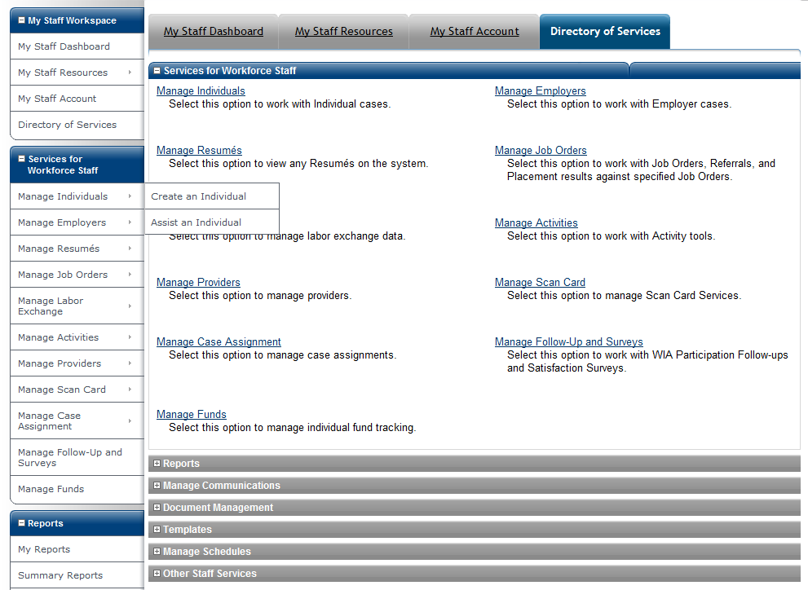
Manage Individuals
Notes:
From this link, staff can create a job seeker profile through registration or assist an individual already registered in the system. When creating an individual profile, staff enter basic information. The customer will still need to complete the Background Wizard, provide a valid e-mail address, and post a résumé to be fully registered in EFM. To find an individual in the system and record information associated with their services, activities or case, staff can select “Assist an Individual”. Let’s look at the individual search process now.

Slide 15
Register an Individual
What does it look like when a staff member registers a job seeker in the EFM system?
Basic registration includes
Creation of a user name and password
Selection of a security question
Entry of the customer’s social security number
Entry of basic demographic information
Notes:
When a job seeker is registered in the system, basic information must be entered. In addition to the staff member creating a user name and password for the customer, the staff member also establishes a security question that if answered will help the job seeker access the system if he or she forgets his or her password. The staff member enters either the customer’s real social security number or a pseudo social security number based on guidelines established. The staff member also enters basic demographic information. Let’s take a look at this basic process now.

Slide 16
Manage Employers
Notes:
Staff may also register an employer in the EFM system or look up an employer to take action or manage their account. Simply click on “Create an Employer” to create an employer account or “Assist an Employer” to look up an employer account.

Slide 17
Manage Résumés
Notes:
Staff may create a résumé for a registered job seeker, search for résumés and match résumés to a job order that is posted in the EFM system.

Slide 18
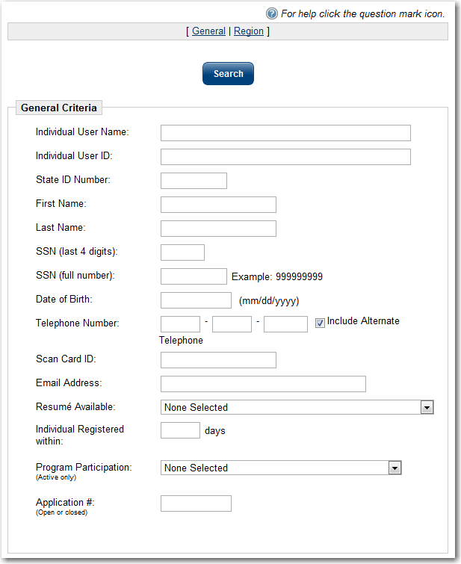
Create a Résumé
Résumés are associated with a specific job seeker
An individual must be registered in EFM to have a résumé created or loaded into the system
Notes:
Résumés can only be created on a job seeker who is registered in EFM. Therefore, the workforce staff member must look up the job seeker’s profile to create a résumé for or with that job seeker. The staff member must enter the search criteria, such as the job seeker’s name or social security number and select “Search”.

Slide 19
Create a Résumé
Résumés are associated with a specific job seeker
An individual must be registered in EFM to create a résumé or load a résumé in the system
Notes:
The results will display. The results include the job seeker’s user identification, first name and last name, as well as last four digits of the job seeker’s social security number. The user identification in the first column is actually a hyperlink to the customer’s case. Simply click on the job seeker’s user identification to navigate to his or her case.

Slide 20
Create a Résumé
From this page, the staff member can
View active résumés
View expired résumés
Create a new résumé
And more
Notes:
This actually navigates the staff member to the job seeker customer’s case. The staff member can then view active résumés, view old or expired résumés, create a new résumé and much more. Now, let’s return back to the staff member’s main page.

Slide 21
Manage Résumés
Notes:
Many job seekers already have one or more résumés in the EFM system. From this screen, the workforce staff member can search for a résumé to connect job seekers who meet required qualifications to employers who have job openings in the EFM system. To search for a résumé, click “Search for Résumés” on the left menu. Let’s take a look at that process now.

Slide 22
Services for Workforce Staff
Other common features associated with the Services for Workforce Staff menu
Manage Job Orders
Manage Labor Exchange
Manage Activities
Manage Providers
Notes:
Other common features associated with the “Services for Workforce Staff” menu include “Manage Job Orders”, “Manage Labor Exchange”, “Manage Activities” and “Manage Providers”.

Slide 23
Manage Job Orders
Create an Internal Job
Create job orders for registered employers
Manage Internal Jobs
View, edit, delete and print existing internal job orders
Search for Jobs
Allows staff to search for internal and external jobs
Notes:
The “Manage Job Orders” option on the navigation menu is a commonly used point of access, allowing workforce staff members to create job orders for registered employers; view, edit, delete and print existing internal job orders; and allows staff to search for internal and external jobs.

Slide 24
Manage Labor Exchange
This option allows staff to choose jobs and refer job seekers to those jobs.
Mass Job Referrals
Mass Candidate Referrals
Enter Referral Results
Referrals Pending Review
Job Candidate Follow Up
Job Skill Sets
External Job Options
This option allows staff to choose job seekers and refer jobs to those job seekers.
This option allows staff to record the outcome of an internal job referral.
This option allows staff to see all of the referrals that require approval.
This option allows staff to see the list of job seekers who require follow up.
This option allows staff to manage what external or “spidered” jobs appear in the EFM system.
This option allows staff to create or modify a detailed skills set that help staff find qualified job seekers to fill job openings.
Notes:
Under the “Manage Labor Exchange” menu, there are a host of options for workforce staff. Mouse over each one to learn more about the option.

Slide 25
Manage Activities
Individual Services
Find a job seeker and enter engagement or activities associated with that job seeker
Employer Services
Find an employer and record services given to the employer
Scheduled Services
View services scheduled in offices based on the date and location of the services
Events
View a schedule of events, as well as add new events by region, office location and event category
Event Rosters
Manage rosters of job seekers attending events
Notes:
Commonly used elements associated with the Manage Activities section of EFM are listed here. Under Individual Services, staff can find a job seeker registered in EFM and enter information about the job seeker’s engagement in activities or services received. Under “Employer Services”, the staff member can find an employer and record services given to that specific employer. Under “Scheduled Services”, staff can view services scheduled in offices based on the date and location of the services. Under “Manage Events”, staff can view a schedule of events, as well as add new events by region, office location and event category. Finally, staff can manage rosters of job seekers attending events under Manage Event Rosters.

Slide 26
Conclusion
Notes:
This concludes Lesson One in the EFM module. In the next two lessons, we will discuss how to help job seekers look for work using the EFM system, as well as how to create résumés within EFM.

