Slide 2
Evolution
Originally known as the Summer Career Institute, the program has evolved into STEM TEC: Summer Career Institute which now concentrates on career exploration in STEM occupations
Served over 1,800 youth ages 14-16 since 2002
What began as a 4 week full-time career exploration program that also focused on workplace readiness and leadership has developed into a year round program that offers internship and job shadowing opportunities for new and past graduates
Started as a full-contract; now managed by WorkNet and facilitated by contractor

Slide 3
Program Basics
WHO
14-16 year olds
At-risk youth; economically disadvantaged (eligibility depends on funder)
GPA 2.5 or higher
WHAT
Career exploration training in STEM occupations; Microsoft Office; work readiness; entrepreneurial planning; leadership skills
Hands on STEM projects
Field based learning experiences – business and environmental sites
Career blueprints & assessments
Performance incentives based
WHEN
4 weeks-5 days a week: June-July after school year
Year round for internships/job shadowing/select Saturday events
WHERE
St. Petersburg College campuses around the county
Various business & environmental site locations
HOW MUCH
Average cost per participant: $1,666

Slide 4
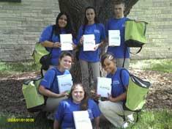
Best Practices
Established relationships:
Public school system
Youth provider
Post-secondary school(s)
Education foundation
Business
Community organizations/government
Top instructors:
Recruitment of STEM teachers through the school system
Teachers propose curriculum & hands on projects in STEM
Engaged students:
Recruitment of students through school counselors; intensive enrollment process; communicated expectations
Recruitment of college students as mentors
Incentives for positive performance & attendance

Slide 5
Best Practices
Employer “buy in”:
Menu of options for involvement – sponsorship, site visit, internship/job shadow offering, in-kind
STEM interest continuum:
Connecting middle school students to high school
Connecting high school students to post-secondary
Year round activities
Sponsorship fundraising campaign:
Establishing independent funding stream
Spin off programs:
IT Summer Camp
Pinellas Hope

Slide 6
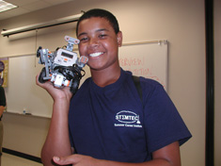
Proven Results
More than 1,800 served since 2002
In 2010:
Trained 180 WIA youth in STEM (120% of goal set at 150)
Of the 180 students trained:
228 credentials were earned (1 GED, 39 occupational certificates & 188 work readiness certificates)
47 students achieved grade level gains in reading & math
27 students gained employment
Raised scholarships for 6 students who didn’t meet WIA eligibility
Established new partnerships with 40 high school and middle schools in Pinellas County
Established new business partnerships for the future

Slide 7
Success Stories
“Through STEM TEC I have been able to learn very important skills. From building solar powered cars, learning how to design websites, understanding the American banking system, to learning the importance of business ethics, I have gained invaluable knowledge and skills…I plan on studying engineering and technology when I go to college and having this hands-on experience has really opened my eyes to the possibilities in my future.”
– Allijah G.
“All of the students who participated (in STEM TEC) impressed me greatly with their preparation, focus and good ideas. They demonstrated a real entrepreneurial spirit. It’s always fun to watch young people meet and exceed our expectations.”
– Dr. Bill Law, President
St. Petersburg College

Slide 8
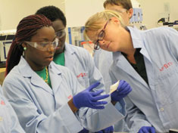
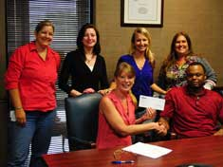
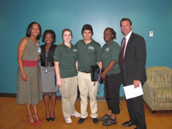
Replication
Partnerships
Partnerships
Partnerships
Partnerships

Slide 9
Questions?
Contact :
Jacqueline Skryd
Project Director
WorkNet Pinellas, Inc.
jskryd@worknetpinellas.org
(727) 608-2451

