Slide 1
House Community & Military Affairs Subcommittee Presented by: Mike McDaniel, Chief of Comprehensive Planning, Division of Community Development Tuesday, September 20, 2011

Slide 2
Implementation of the Community Planning Act (HB 7207) Effective June 2, 2011

Slide 3
Highlights of New Legislation
Streamlining/Incentivizing Sector Plans
Simplifying Evaluation & Appraisal Process for Updating Comprehensive Plans
Streamlining the Comprehensive Plan Amendment Process
Focusing State Review Role on Protecting Important State Resources & Facilities
Developers No Longer Required to Pay for Deficient Roads

Slide 4
Highlights of New Legislation
Allowing Local Government Option to Maintain Concurrency Program for Transportation, Schools & Parks & Recreation
Eliminated 3 Development Categories from DRI Review Requirements
Eliminated Maximum Land Use Need Requirement
Repealed Rule 9J-5 & Incorporated Portions into Statutes

Slide 5
Updated Department’s Website to Reflect HB7207
Legislative Summaries
Technical Assistance Papers
Frequently Asked Questions
Flowcharts of New Plan Amendment Process

Slide 6
Regional Workshops on HB 7207
Held 6 Workshops
Sponsored by Regional Planning Councils
Invited Local Governments, General Public & Practitioners
Approximately 1,500 Persons Attended
Presented Key Elements of HB 7207
Audience Question and Answer Period

Slide 7
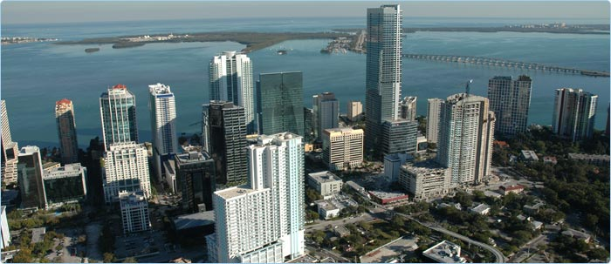
Workshops with State and Regional Review Agencies
Brief on New Legislation
Discussed Their Role in Reviewing Plan Amendments

Slide 8
Sector Planning
Discussing Submittal of 3 New Sector Plans with Landowners
Completed Conversion of 2 Approved Large Scale Plan Amendments to Sector Plans in Osceola & Nassau Counties
Currently Reviewing 2 More Conversions to Sector Plans in Highlands & Hendry Counties

Slide 9
Option to Maintain Concurrency
Local Governments Deciding to Keep Concurrency
Only 1 Local Government, City of St. Augustine, Eliminated Transportation Concurrency

Slide 10
Comprehensive Plan Amendment Process
Most Amendments Processed Under New Expedited State Review Process
No Adverse Impacts to Important State & Regional Resources & Facilities Identified by Reviewing Agencies
No Challenges to Plan Amendments Filed by the Department
Approximately 50% Time Savings in Number of Days an Amendment is Reviewed by the State

Slide 11
Comprehensive Plan Amendment Process
Some Amendments Processed Under More Conventional State Coordinated Review Process
Related to Evaluation & Approval Process or Areas of Critical State Concern
4 ORC Reports Filed with Objections by the Department since June 2, 2011
No Amendments Found Not In Compliance

Slide 12
Transportation Concurrency
Many Questions Have Been Raised by Local Governments & Practitioners Regarding New Proportionate Share Contribution Requirements, Including Not Requiring Developers to Pay for Deficient Roads
Coordinating with FDOT on Answering Questions & Posting Responses on Website

Slide 13
Transportation Concurrency
As Required by HB 7207, FDOT is Interviewing Developers & Local Governments Regarding the New Proportionate Share Requirements in Preparation for Submittal of Report due to the Legislature by December 15, 2011

Slide 14
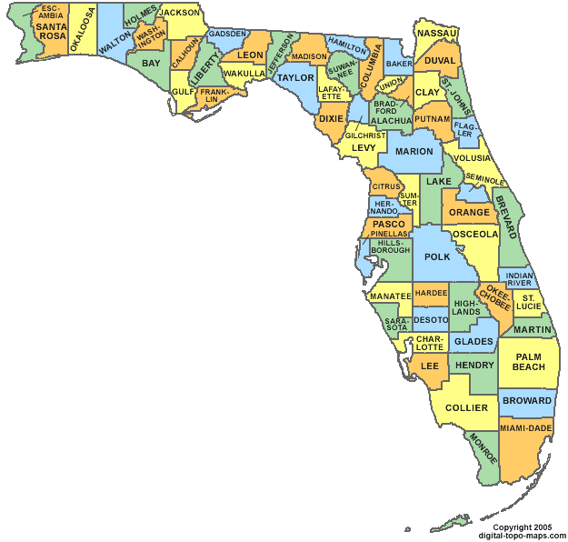
Evaluation & Appraisal Process
Posted a Draft Schedule for Local Governments to Submit Letters to Department on Decision to Update Comprehensive Plan on the Department’s Website
Will Undertake Rulemaking to Adopt Schedule

Slide 15
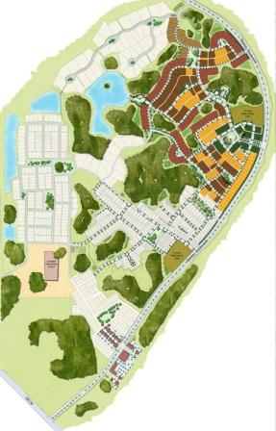
Not In Compliance Administrative Proceedings
Settled All 20 Cases based on HB 7207 Provisions
Met Requirements in HB 7207 to Review Administrative Proceedings Within 60 Days of Effective Date & Dismiss or Amend Petition if Not Consistent with New Statutory Provisions

Slide 16
Economic Development/Jobs
Meeting with Local Governments to Assist with Community Needs/Economic Development Opportunities & Land Use Technical Assistance
Evaluating How Existing Grant Programs Can Be More Focused on Promoting Economic Development/Jobs
Coordinating with Enterprise Florida and Division of Strategic Business Development to Promote Development in Designated Catalyst Sites in Rural Areas of Critical Economic Concern

Slide 17
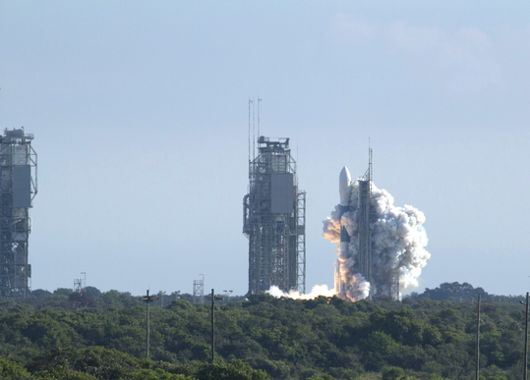
Economic Development/Jobs
Working with NASA, Space Florida, and FDOT to Create Future Development Concepts for the Kennedy Space Center & Promote Future Public/Private Partnerships in Use of Launch Sites & Development of Space Related Industrial Sites

Slide 18
Questions?
Mike McDaniel
Chief of Comprehensive Planning,
Division of Community Development
Florida Department of Economic Opportunity
107 East Madison Street
Tallahassee, FL 32399-4135
floridajobs.org

