Slide 1
Limited English
& Program Assistance Training

Slide 2
Limited English Proficiency & Program Assistance Training
Thank you for attending the LEP and PA Training! Please watch the training video on the next page, answer a few questions about LEP and PA and enter your name on the certificate and submit to your supervisor showing that you have completed the training. Please click on the icon to move forward with the presentation and
to go back in the presentation.
3

Slide 3
Limited English Proficiency & Program Assistance Training
4

Slide 4
LEP & PA Training Quiz
Directions
Read each of the following questions carefully
Click on the correct answer
If you don’t get it right the first time try again by selecting the icon
If you answer the question correctly select to move on to the next question
5

Slide 5
Question 1
What does LEP stand for?
Lime Expensive Program.
Limited Exception Program.
Limited English Proficiency.
5

Slide 6
You’re Right
6

Slide 7
Sorry. Try again.
6

Slide 8
Question 2
What would be considered a barrier to disabled individuals?
1. Little to no delays
2. Full participation in programs
3. Inaccessible facility
5

Slide 9
You’re Right
6

Slide 10
Sorry. Try again.
6

Slide 11
Question 3
An example of an LEP individual served by the Department of Economic Opportunity would be:
A fully-employed individual who speaks primarily Spanish
A migrant worker seeking job placement
An unemployed individual speaking fluent English
6

Slide 12
You’re Right
6

Slide 13
Sorry. Try again.
6

Slide 14
Training Completed
You have completed the Limited English Proficiency Training! On the next slide enter your name and date you completed the training and submit to your supervisor.

Slide 15
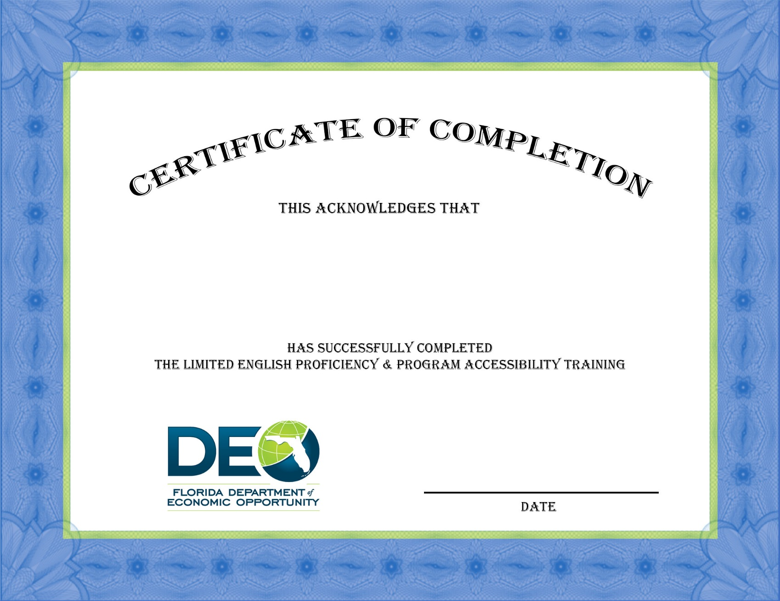
Certificate of Completion

