Slide 1
FL TAA Training: Reports Management

Slide 2
Reports Overview

Slide 3
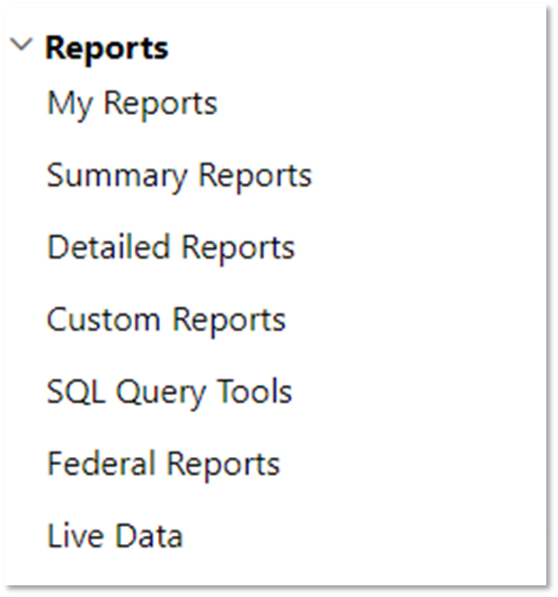
VOS Reports Overview
Manage Reports includes more than 500 standard reports
Reports organized into specific categories
Dedicated reports server ensures operational performance
Some data backed up on reports servers overnight

Slide 4
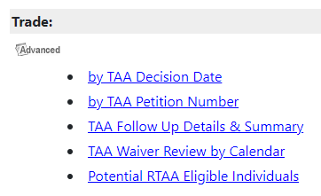
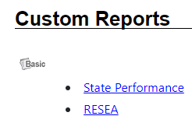
VOS Reports Overview (Cont.)
Two categories of reports
Basic reports – SQL queries and standard HTML web pages; usually simple listings of information. Generally can’t be scheduled.
Advanced reports – Microsoft SQL Server Reporting Services (SSRS); more complex formatting requirements. Can be scheduled.
Staff privileges control access to reports

Slide 5
Report Generation
Select report category/report title from menu
‘Actual’ report titles – present specific information
‘List’ reports – just the facts (for the related sub-category)
‘By’ reports – a derivation of ‘List’ reports
Choose filter display options
Save to My Reports
Saved reports can be shared!
Click Run Report

Slide 6
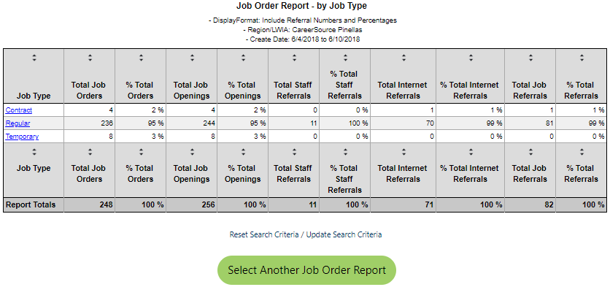
Report Features
Click on links to dig deeper
Notes:
Displays report title and the selected data filters (top center)
Displays total record counts and total percentages (summary reports)
Sortable column headings (ascending / descending) displayed top and bottom
Built-in hyperlinks (many, not all reports)
Links to reset/update search criteria

Slide 7
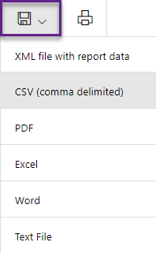
Report Features (Cont.)
Page navigation controls
First, previous, next, last page
Manual page entry (page X of Y)
Initial (not actual) page count to decrease load time
Parent/child report access
Page zoom
Standard export options
Print capability

Slide 8
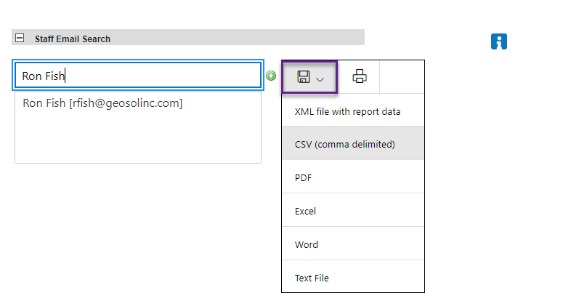
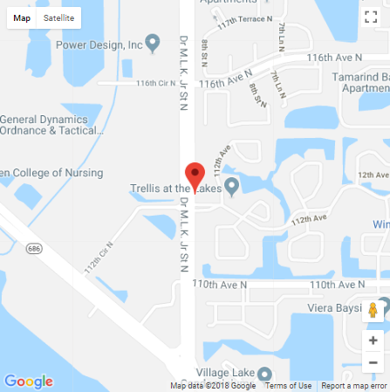
Report Export Options
Email
Google Maps

Slide 9
Saving, Sharing and Scheduling Reports

Slide 10
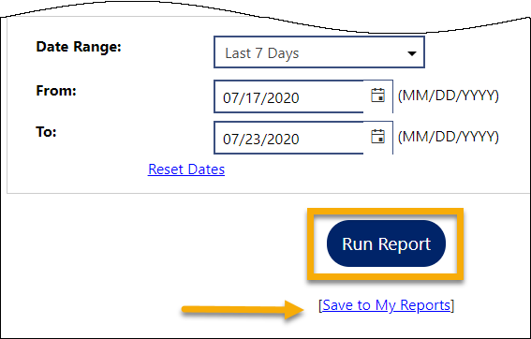
Saving Reports
Before clicking Run Report, users click Save to My Reports from the Report Filter screen.
In the window that displays:
Enter a report description
Choose share option
Click Save
Access My Reports to retrieve saved reports
Be careful about pop-up blocker!!

Slide 11
Sharing Reports
Send the report to a colleague via email; choose desired file type
Share saved reports

Slide 12
Scheduling Reports
Staff must first save a report to schedule it!
From My Reports:
Locate desired report
Click Schedule

Slide 13
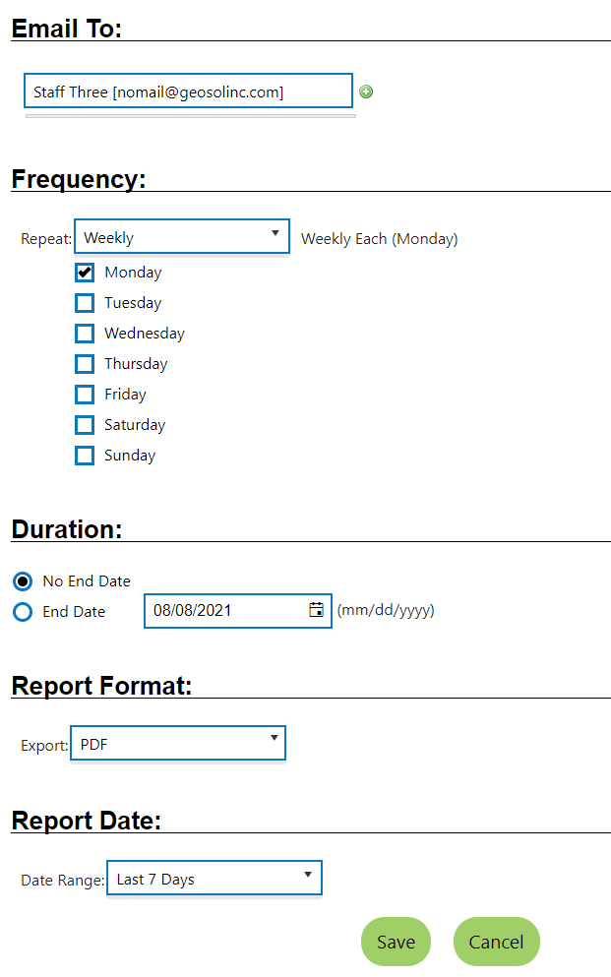
Scheduling Reports
Select the following:
Email recipient(s), if desired
Frequency
One Time (today)
Weekly [check day(s) of week]
Monthly (click calendar date)
Duration (endless or fixed)
Format (PDF or Excel)
Date Range (last X days)
Click Save

Slide 14
Demonstration

Slide 15
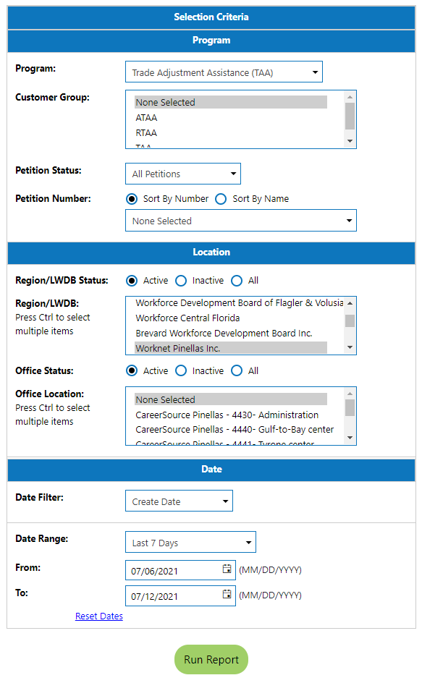
Reports Filters
In most instances, staff will select from three filter areas to generate TAA program reports:
Program = TAA
Location = your LWDB/Region
Date = your choice

Slide 16
Reports Request 1
Which report shows TAA participants currently in training in my region (training is approved, and it is an open/active activity)?

Slide 17
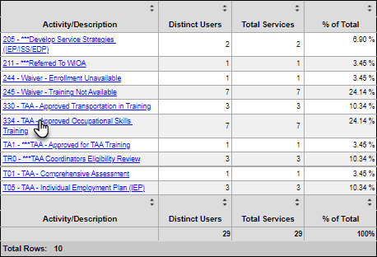
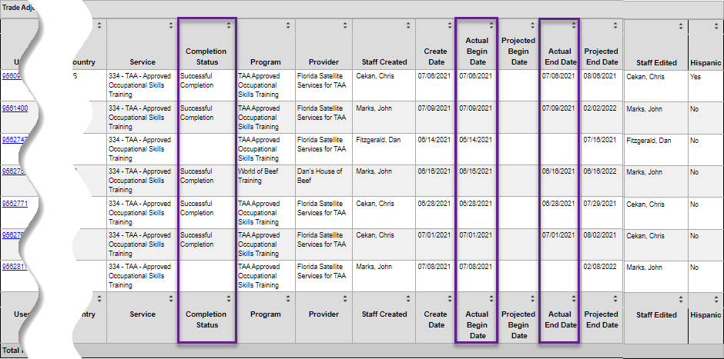
Reports Request 1 Answer
[Detailed Reports > Services Reports > Services Provided Individuals > by Services report]

Slide 18
Reports Request 2
Which report shows TAA participants previously in training in their region (completion was entered)?

Slide 19
Reports Request 2 Answer
[Detailed Reports > Services Reports > Services Provided Individuals > by Services report]

Slide 20
Reports Request 3
Which report shows TAA participants receiving RTAA in my region?

Slide 21
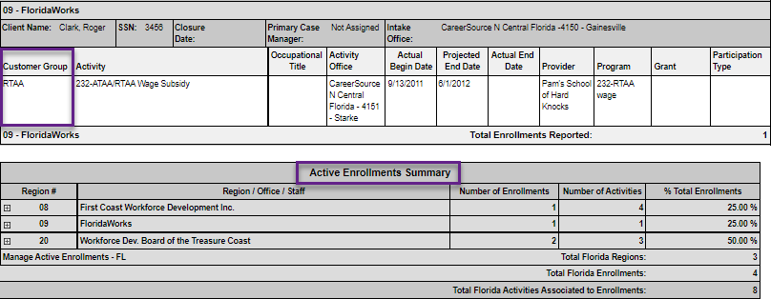
Reports Request 3 Answer
[Detailed Reports > Case Management Reports > Case Load Reports > Active Enrollment report]

Slide 22
Reports Request 4
Which report shows all TAA participants in my region on the same petition (search by petition number)?

Slide 23
Reports Request 4 Answer
[Detailed Reports > Case Management Reports > Case Load - Non - WIOA > Trade section > by TAA Petition Number report]

Slide 24
Reports Request 5
Which report shows all TAA participants in my region on the same petition (search by petition number) and the status (active or exited with an exit date)?

Slide 25
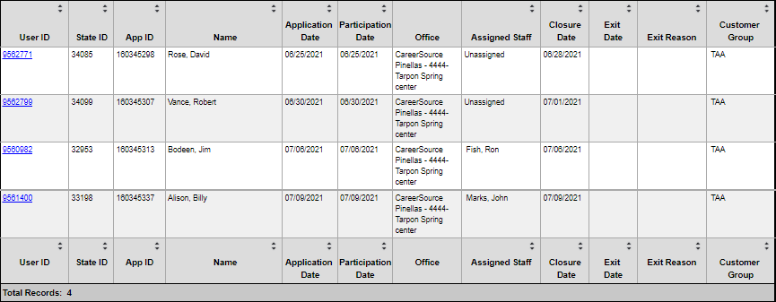
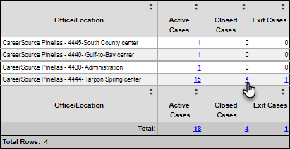
Reports Request 5 Answer
NOTE: There is no such data currently available within the “by TAA Petition Number” report. Option:
[Detailed Reports > Case Management Reports > Case Load > Active Cases report]

Slide 26
Reports Request 6
How can I pull my assigned case load?

Slide 27
Reports Request 6 Answer
NOTE: Report output is read-only; no dynamic linking to cases.
[Detailed Reports > Case Management Reports > Case Load > Active Cases report]

Slide 28
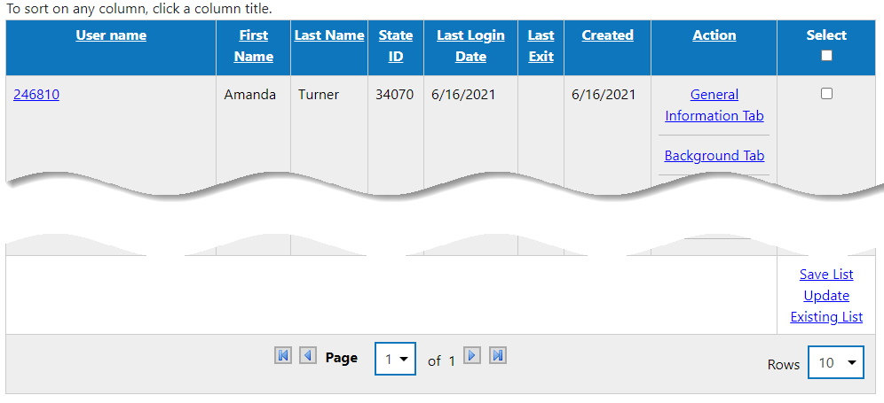
Reports Request 6 Answer (Option 2)
NOTE: For staff who cannot generate this report, they can search for an individual to see their assigned cases!
[Manage Individuals > Assist an Individual > Click More Search Options > Click Staff jump link > in Case Management Criteria section, click Select Me > Click Search]

Slide 29
Reports Request 7
How can I see when a [TAA] case will exit?

Slide 30
Reports Request 7 Answer
[Detailed Reports > Case Management Reports > Case Load > Soon to Exit Cases report]

Slide 31
Reports Request 8
Which report will show when the last [TAA] service was provided?

Slide 32
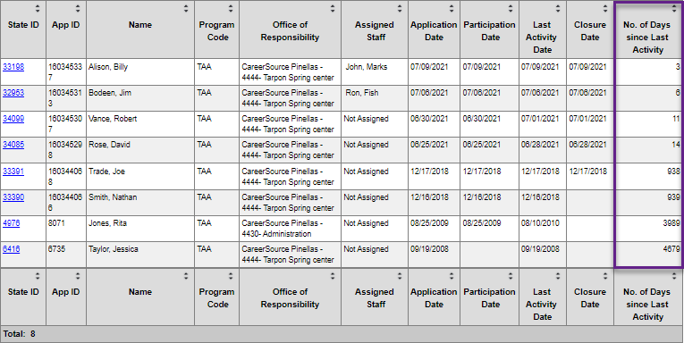
Reports Request 8 Answer
[Detailed Reports > Case Management Reports > Case Load > Days since Last Service report]

Slide 33
Ending
Building Integrated Workforce Development Systems

