Slide 1
Accountability and the Sanction Process
Part 1
Notes:
Welcome to the Welfare Transition (WT) program’s training on Accountability and the Sanction Process: Part 1 offered by the Florida Department of Commerce. This training will review how accountability and the sanction process go hand-in-hand.

Slide 2
Successful Engagement
Proper and In-depth Assessment
Defined Goals
Clear Plan
Accountability
Notes:
The key to successful engagement is based on four elements:
Proper and in-depth assessment;
Defined Goals;
A clear plan; and
Accountability.
Information from the assessment and the participant’s stated goal will be the basis of the Individual Responsibility Plan (IRP). In developing a clear plan, you need to outline the specific steps that the participant needs to take to get to the next level. When you create the plan with the participant, you set a standard of accountability.
Accountability not only refers to the program participant, it also refers to you as his or her career advisor. The program participant is looking to you to help them reach their goal. While you can’t do everything for them, you can help them make decisions and provide resources to help them reach those goals

Slide 3
Proper and In-depth Assessment
Test of Adult Basic Education
Skills Assessment/Interest Inventory
Needs Assessment/Hidden Disabilities
Notes:
Each region has its own assessment process and assessment tool or combination of tools. Assessments are not just pieces of paper or information about a program participant. Assessment data is a glimpse into the participant’s ability to perform certain tasks, duties and an indication of his or her educational capabilities. The most common assessments are the Test of Adult Basic Education (TABE), a skills inventory and/or interest inventory, and a needs assessment (including a hidden disabilities screening).
The assessment should be used in conjunction with a participant’s defined or stated goals.

Slide 4
Defining Goals
Goal
Wants to be a Dentist
Current Situation
No High School Diploma or GED
First Step
Educational Assessment
Notes:
It’s important to understand how a participant’s assessment results play a key role in helping participants achieve their goals. An individual who does not have a high school diploma and wants to be a Dentist, cannot realistically jump from having no high school diploma to an advanced degree overnight. Additionally, that person probably could not secure a job in the related field overnight. The participant needs to be assessed. A good way to assess his or her educational capabilities would be the TABE Test. This will give you and the participant an indication of his or her current educational level. Possessing this information provides a foundation for a Clear Plan.

Slide 5
Clear Plan?
Goal: Start Working
Objective: find a job
Steps
Participate 40 hours per week
Complete job applications
Call me if you need a gas card
Turn in job search log
Turn in proof of employment
Notes:
What’s wrong with this picture? Sometimes what makes logical sense to us doesn’t make sense to someone else. While some people may understand what is being presented in the slide, others may experience difficulty. What are the issues?
Has a goal really been defined?
Not really. Start working where? What is the job or career goal?
Has an objective really been defined?
No. The objective should be to get a job. The objective should also be specific to the type of job wanted.
Are the steps clear?
While they are complete thoughts, they are not clear.
Participate 40 hours in what?
Complete job applications when and where? Am I going out, applying online, is sending a resume the same as a job application?
When should the participant contact for a gas card? Is it dependent on the activity, distance, actual participation? If it is dependent on actual participation, what is the activity?
Turn in job search logs when and to whom?
Turn in proof of employment when and to whom?
These things can determine the customer’s success or failure in the program.

Slide 6
Clear Plan
Goal: Get my GED
Objective: Take the TABE Test
Steps
Show up to the Career Center located at 123 Main Street, room A, on January 7, 2013 at 9:40am
Bring a copy of your appointment card and give it to the test administrator
Attend a follow up appointment with your career advisor on January 11, 2013 at 10:30am to discuss test results and next steps.
Notes:
Creating a clear plan means understanding where the customer should begin. In a previous slide, we learned that the customer wants to become a Dentist but does not have a high school diploma. Before we can help the customer experience some success, we need to know more about them. An educational assessment is the best option as a starting point. The customer’s short term goal could be to attain a GED, but we need to know his or her educational level before making the appropriate educational referral. Depending on the participant’s educational level, you will either inform him or her to sign up for a GED course or, based on the participant’s TABE scores, he or she already may be ready to take the GED test. In developing a clear plan, you will outline the specific steps that participants need to take to obtain the educational level where he or she can move forward to becoming a Dentist. Using information from the previous slide, we would request that the participant take the TABE test. This will become a part of his or her IRP. Creating this level of detail in the plan will lay the groundwork for a level of accountability with the participant.

Slide 7
You may ask…
Why are we talking about assessments, goals and IRPs during a pre-penalty and sanctions presentation?
Notes:
You may ask, “Why we are discussing assessments, goals and IRPs during a pre-penalty and sanction training?” The reality is, failures occur long before a participant actively fails in the program. A failure may occur for many reasons such as:
The instructions may not have been clear
The participant did not understand the instructions
The participant wasn’t sure what to do first
The career advisor wasn’t clear in his or her instructions
The participant just didn’t want to do it
Unaddressed barriers
Undefined goals
Whatever the reason for the failure, we want to ensure that we have provided the participant with the details and guidance necessary to effectively make an informed decision. If the participants chooses not to participate because they lack the desire, that is something we cannot realistically change, especially if we have done everything as a career advisor to motivate them. However, we want to make sure that we give them the resources to participate, the guidance to move forward, and hold them accountable for their actions.

Slide 8
Accountability
What is accountability?
Accountability is:
Responsibility to someone or some activity or
The active acceptance of responsibility
Notes:
Accountability is defined as responsibility to someone or some activity or the active acceptance of responsibility. This is important because “responsibility” is one of the core elements we are trying to impart on our program participants. Keeping in mind that we, too, must be responsible. How are we responsible? We are responsible if we fail to provide the necessary resources the participants needed or if we have failed to complete a proper assessment. It is our responsibility to help move our participants in the direction to self-sufficiency, ensuring that their limited time is not wasted.

Slide 9
Why are customers failing?
Notes:
Why are our customers failing? As previously stated, there are many reasons why customers fail to engage in the program. Sometimes the instructions we provide are not clear and may confuse our participants. This, often times, leads to program failures that result in pre-penalties and sanctions.

Slide 10
Pre-Penalty and Sanction Process
Notes:
Now that we have briefly defined accountability and presented examples of clear guidance and unclear guidance, let’s talk about the pre-penalty process.

Slide 11
Why do we sanction?
45 CFR 261.16
The State must penalize someone who refuses to engage in the work program, or the State will be subject to penalties
(45 CFR 261.16)
Notes:
The main reason is because it’s the law and if we don’t, we as a State could be subject to penalties for failing to do so. 45 CFR, (Code of Federal Regulations) at 261.16 requires the State to penalize someone who refuses to engage in the work program. We have provided you with a link to this information at the bottom of the slide.

Slide 12
Why do we sanction? (cont’d)
Florida Statute 414.065
The State must establish procedures for administering penalties for nonparticipation in work requirements and failure to comply with alternative plan requirements
(TANF State Plan-Page 33)
Notes:
Florida Statute 414.065 states that we must establish procedures for administering penalties for non-participation in work requirements and failure to comply with alternative plan requirements. Florida’s penalty guidelines can be found in multiple places: 414.065 : Florida Administrative Code 65A-4.205, The TANF State Plan, and Work Penalty and Pre-penalty Counseling Guidance. We have provided you with a link to this information at the bottom of the slide.

Slide 13
Pre-Penalty and Sanction Process
Failure occurs
Mail DEO-WTP form 2290
Make an oral attempt
Oral attempt is not successful
Wait 10 days from the 2290 mail date
Is there contact from the customer before the 10 days are over?
NO!
Request the sanction on the alternative plan screen
Notes:
Here is a basic pre-penalty and sanction timeline for a customer who fails, but you are not successful in contacting them during the 10 day response period. In this illustration, because you are not successful in speaking with the customer during the oral attempt AND the customer does not call you during the 10 day response period, you would request the penalty on the 11th day or the next work day.

Slide 14
Failure – Unsuccessful Oral Attempt
MONDAY | TUESDAY | WEDNESDAY | THURSDAY | FRIDAY | SATURDAY | SUNDAY
 |  |  | 1 Customer fails | 2 Notice of Failure (2290) mailed/oral attempt unsuccessful | 3 | 4
5 | 6 | 7 | 8 | 9 | 10 | 11
12 | Request Penalty 13 | 14 | 15 | 16 | 17 | 18
19 | 20 | 21 | 22 | 23 | 24 | 25
26 | 27 | 28 | 29 | 30 | 31
Notes:
Using the process stated previously, if the customer fails on the first day of the month and you mail the Notice of Failure (form 2290) on the 2nd day of the month. You would, also, make an oral attempt to contact the participant on the 2nd day of the month. You need to allow the participant 10 calendar days to contact you. If the customer does not contact you within 10 full calendar days from the date you mailed the pre-penalty letter, you will request a sanction on the 11th day. If the 11th day is on a weekend or a holiday, you will request it the next business day.

Slide 15
Notes:
To enter a pre-penalty, you will need to log on to OSST and locate the participant’s case. On the Alternative plan screen, you will see a section titled “Sanctions.” Click on the “Add” button located under the Sanctions header.

Slide 16
Notes:
Once you have selected Add from the alternative plan page, you will be able to enter the pre-penalty information for the participant’s failure. You need to enter a description of the exact failure (or what the participant failed to do) and the failure date. Once you are done, select save.

Slide 17
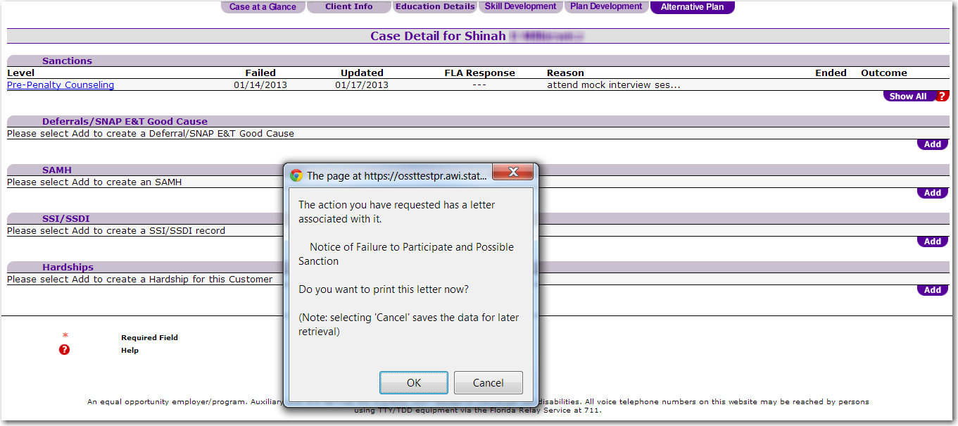
Notes:
Once you have selected “Save”, you will be taken back to the “Alternative Plan” screen. You will see an active hyperlink that says “Pre-penalty” counseling. You will also see a pop-up box informing you that “The action you have requested has a letter associated with it.” You will click “OK” to print this letter to mail to the participant. You will also keep a copy of the letter, using your locally determined method, for the participant’s case file.

Slide 18
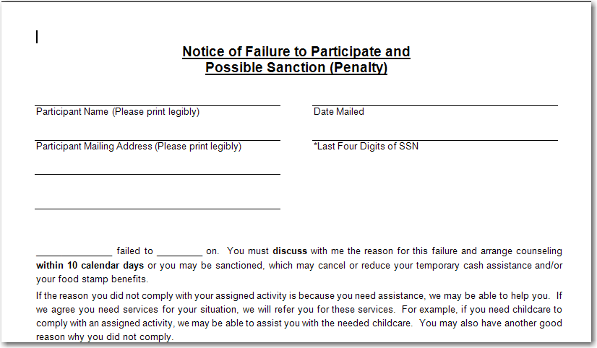
Notes:
Now, let’s look at the Notice of Failure letter or the 2290. In the highlighted area it states “You must discuss with me the reason for this failure and arrange counseling within 10 calendar days…”
The letter informs the participant that they have failed to complete an activity or action and that the participant must discuss with the case manager the reason for the failure, within 10 calendar days. Further down on the letter, it reminds the participant that they must personally discuss the reason for the failure with the case manager.

Slide 19
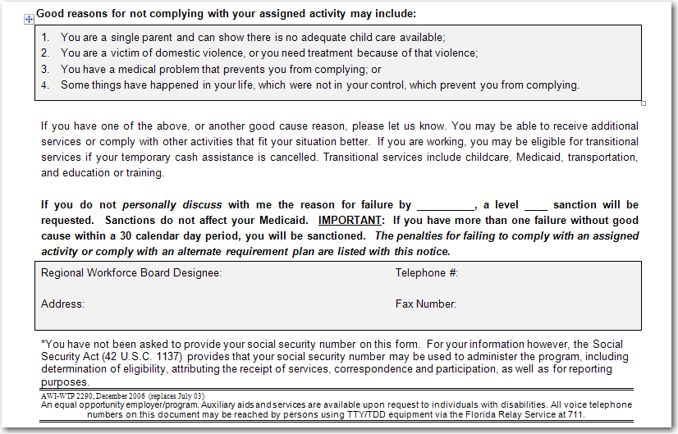
Notes:
The language states, “if you do not personally discuss with me the reason for the failure by….” The reason for this is for case managers to provide counseling to prevent the customer from being sanctioned. Your counseling should tell the customer what he/she needs to do to keep from being penalized.

Slide 20
Notes:
Once the ten days are over and the customer has not contacted you, you will select the pre-penalty counseling hyperlink to request the sanction.

Slide 21
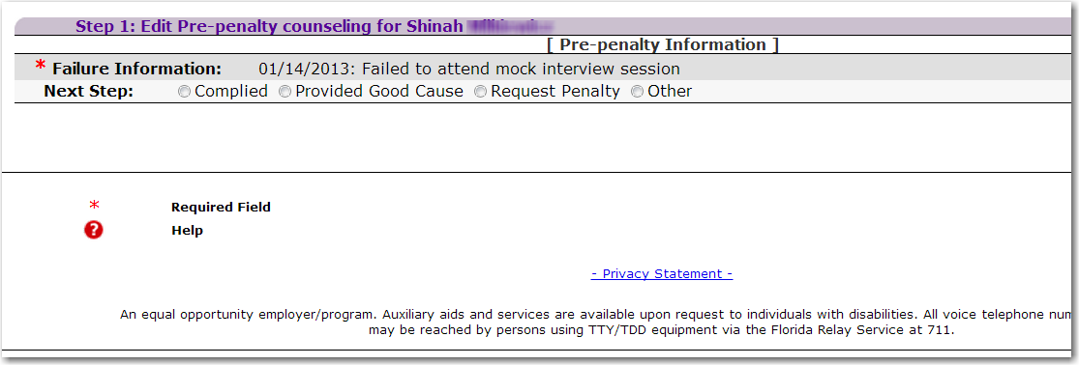
Notes:
After you have selected the pre-penalty hyperlink, you will be asked to make the next step. Since the participant never contacted the case manager regarding the failure; you would select the “Request Penalty” radio button to sanction the customer.

Slide 22
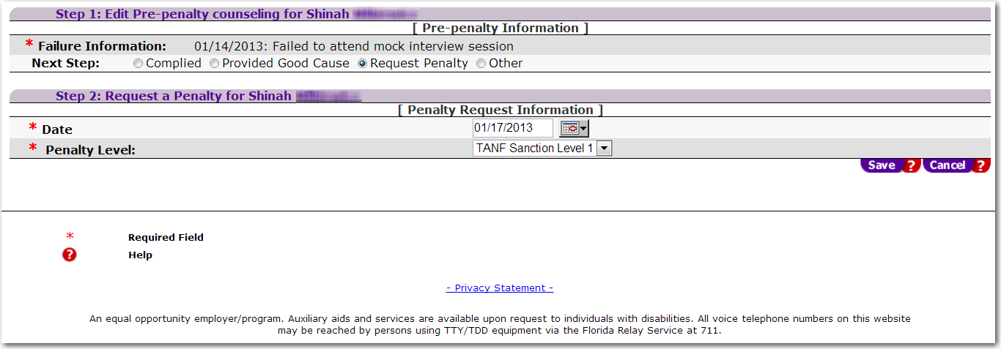
Enter the sanction request date and the sanction level
Notes:
We complete the sanction request by entering the date and the sanction level. Select the “Save” button once you have entered in the correct information.

Slide 23
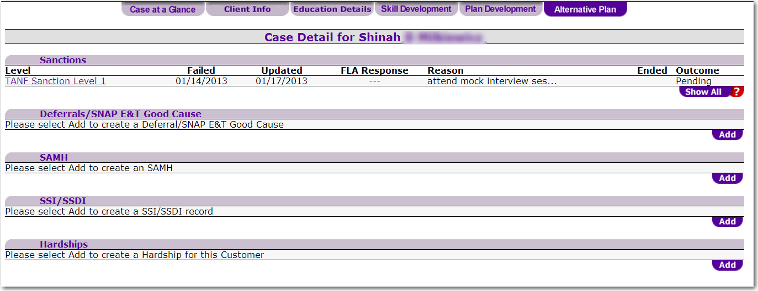
Notes:
After you select save, the sanction request is now in place and pending action from DCF. From here, you will have to send a form 2292 because it is a 2nd failure.

Slide 24
End of Part 1 Accountability and the Sanction Process (Please continue to Part 2 of this training)
Notes:
This concludes part 1 of the Accountability and the sanction process training series. Please continue to part 2 of the training series.

